Slide 1
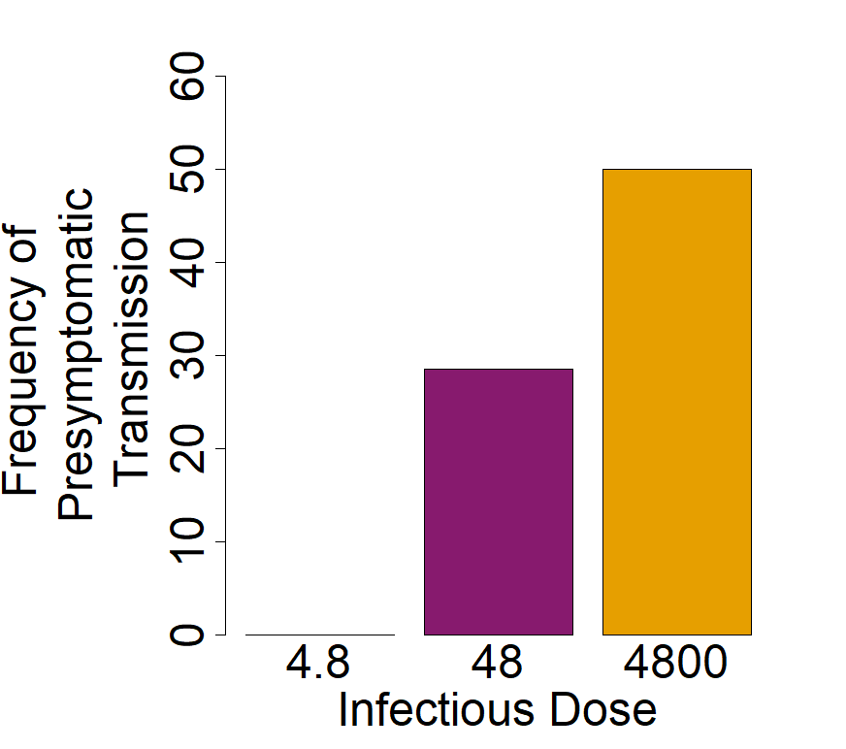
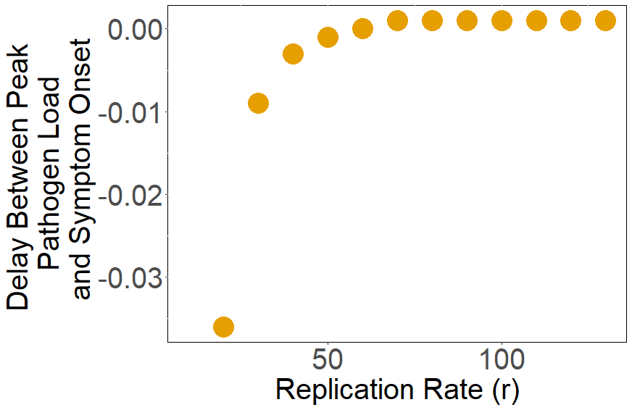
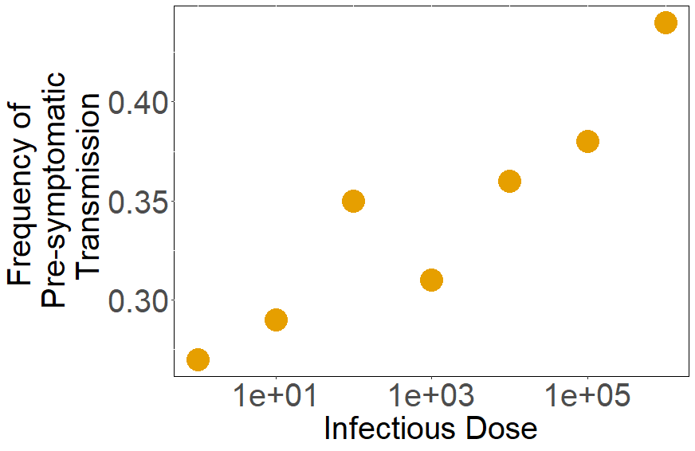
What causes
pre-symptomatic transmission??
Kayla Zhang, Damie Pak, and Megan Greischar
Assumptions
Transmission potential is proportional to pathogen load
Symptoms are determined by immune response, which is increased by pathogen load
By analyzing a controlled human infection trial of norovirus, I found that pre-symptomatic transmission rates increased with infectious dose (Atmar et al., 2008).
Model
Pathogen
Immune clearance
Replication
P
Immune recruitment
Baseline
production
I
Baseline death
Pre-symptomatic transmission occurs at low pathogen replication rates.
These results can be recreated through modeling if symptoms are determined by an immune response threshold.
Immune
Response
(King et al., 2009)
If symptoms are caused by immune response, pathogen replication rate decreases pre-symptomatic transmission rates and infectious dose increases them.

