Slide 1
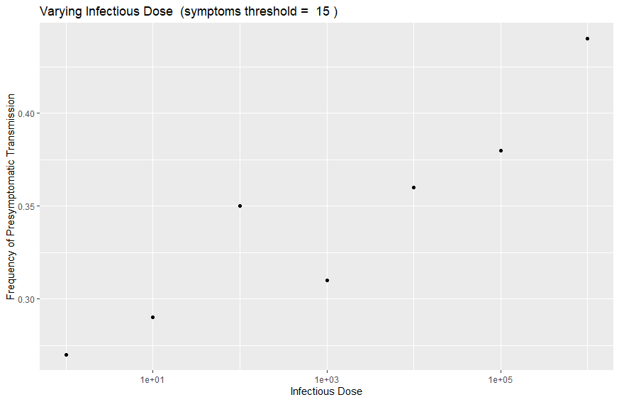
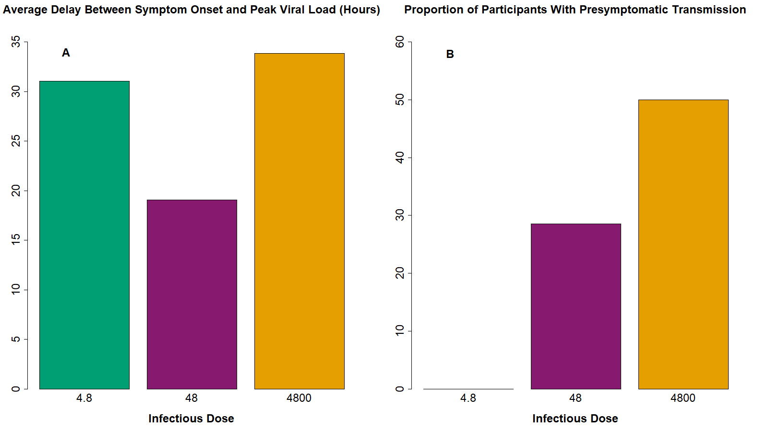
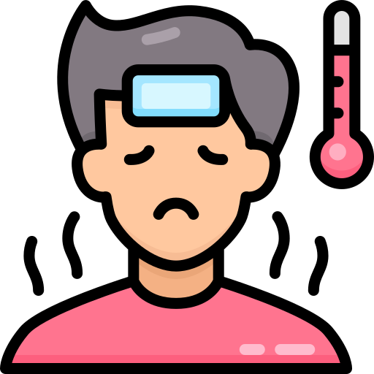
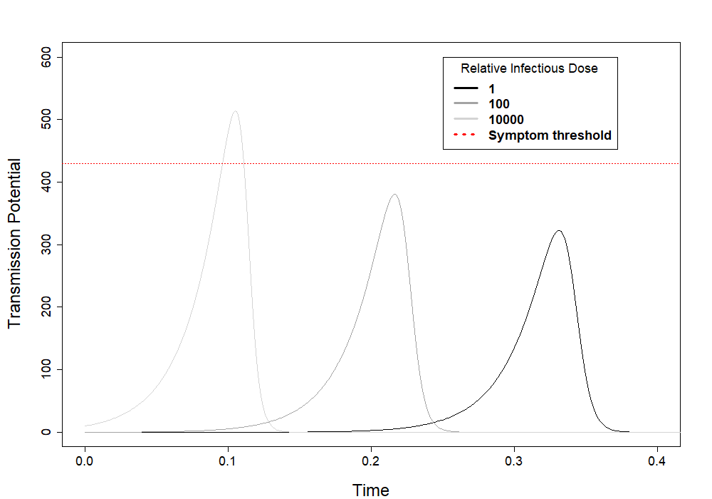
What causes pre-symptomatic transmission?
These results can be recreated through computer modeling.
Pre-symptomatic transmission rates increase with infectious dose.
Some models do not fit the data.

