Slide 1
Material Process-Property Data Warehouse
2022-12-09

Slide 2
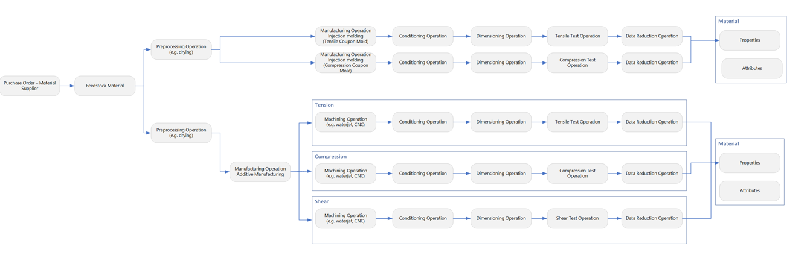
Process-Property Data Warehouse

Slide 3
Process-Property Data Warehouse
0101
0110
ΔMat
Design
+Geo
ΔMat
ΔGeo
ΔMat
0101
0110
0101
0110
Mmt(s)
Mmt(s)
0101
0110
Part(s)
Part(s)
+Mat
Batch
(same as above)
Mmt(s)
Batch
ΔGeo
ΔMat
ΔGeo
ΔMat
0101
0110
0101
0110
ΔMat
Mmt(s)
Mmt(s)
Part
Part(s)
Part(s)
Batch
+Geo
0101
0110
Part
(same as above)
0101
0110
Mmt(s)
Design
Part
(same as above)
Artifacts
Operations
Material
Provenance
+Mat
Geometric
Provenance
+Geo
Digital
0101
0110
0101
0110
ΔMat
ΔGeo
Mmt
Design
Operation
Material
ΔMat
ΔGeo
Part
Batch

Slide 4
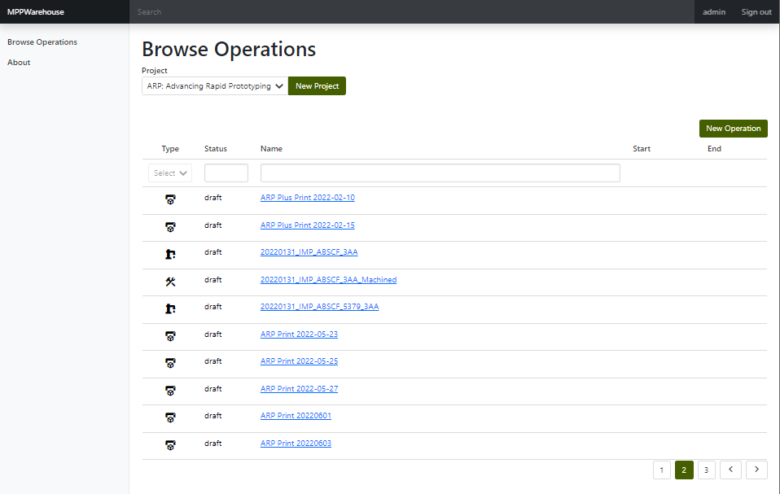
Project View
Notes:
Every project has a number of operations, which can be created, browsed and searched

Slide 5
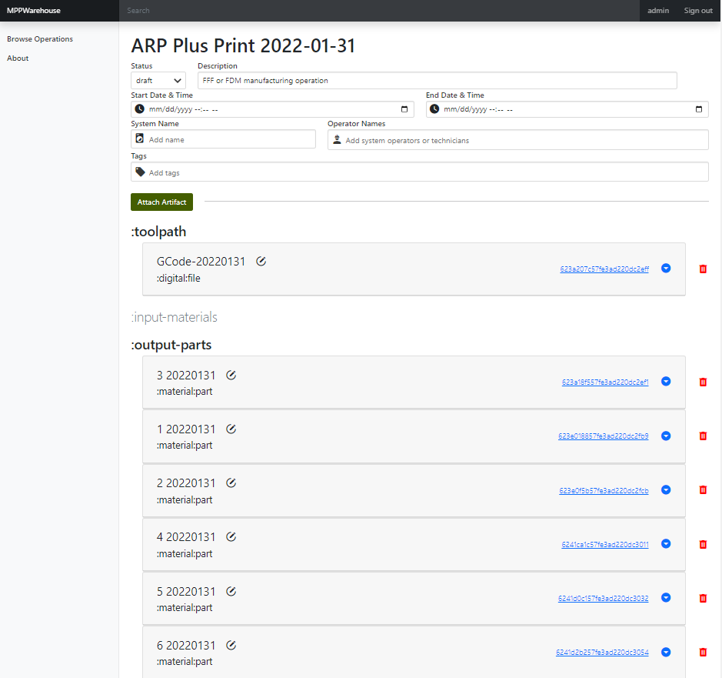
Manufacturing Operation

Slide 6
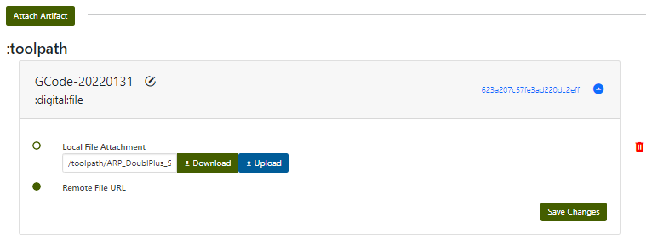
Material and Digital Artifacts

Slide 7
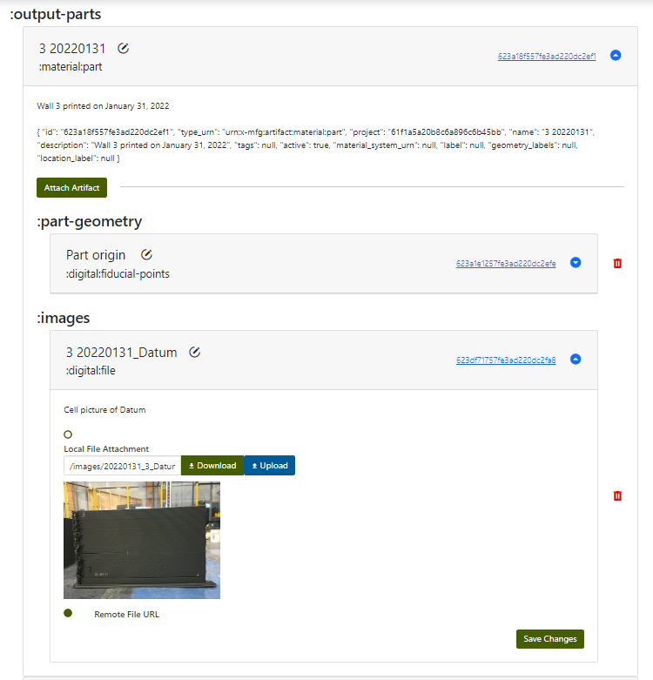
Material and Digital Artifacts

Slide 8
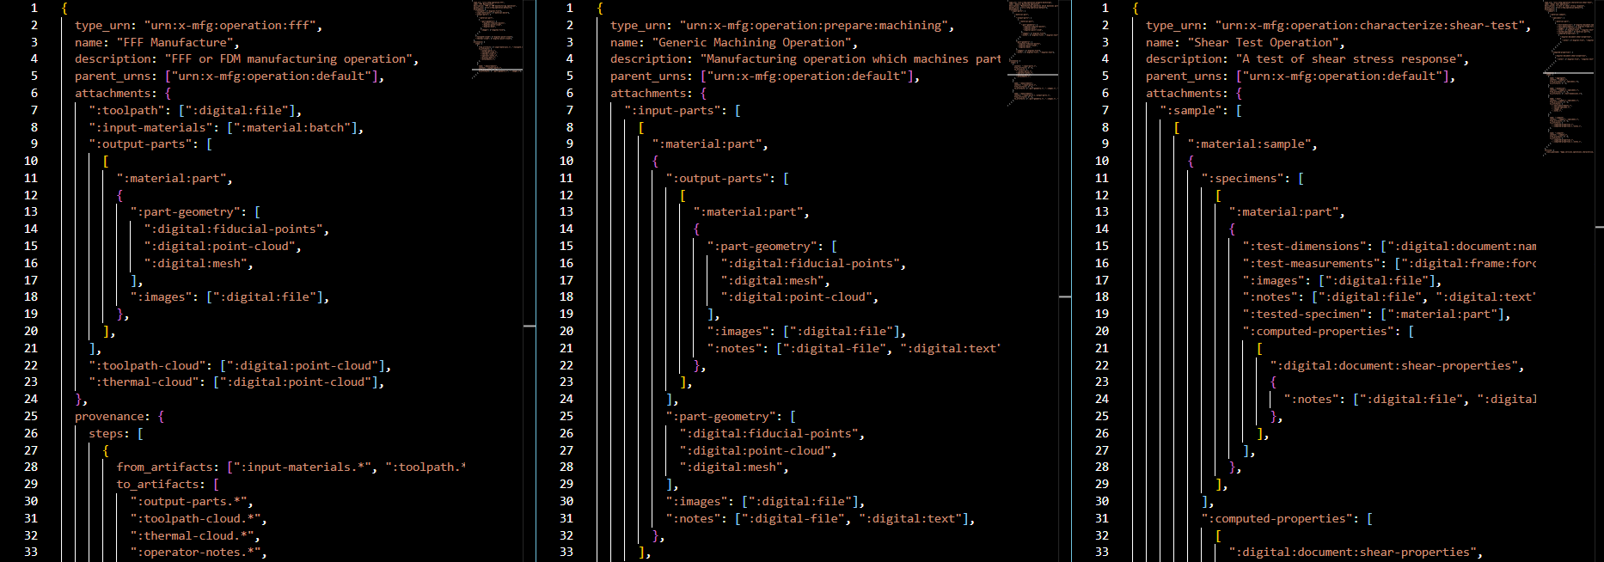
Manufacturing Operation Schemas
Define “standard” attachment structure

Slide 9
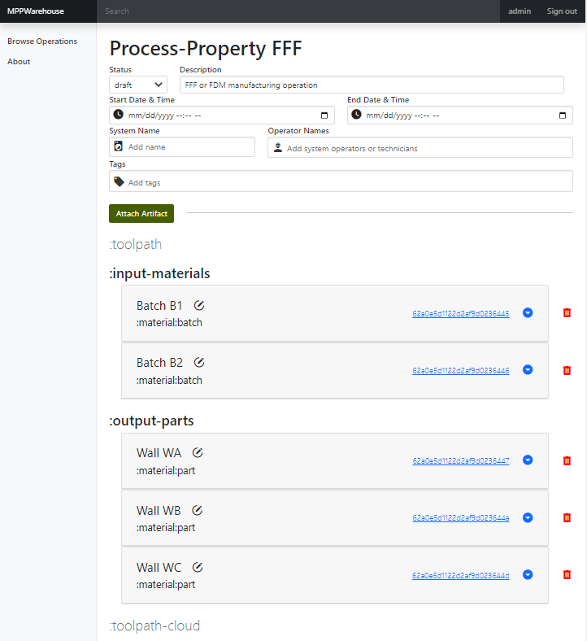
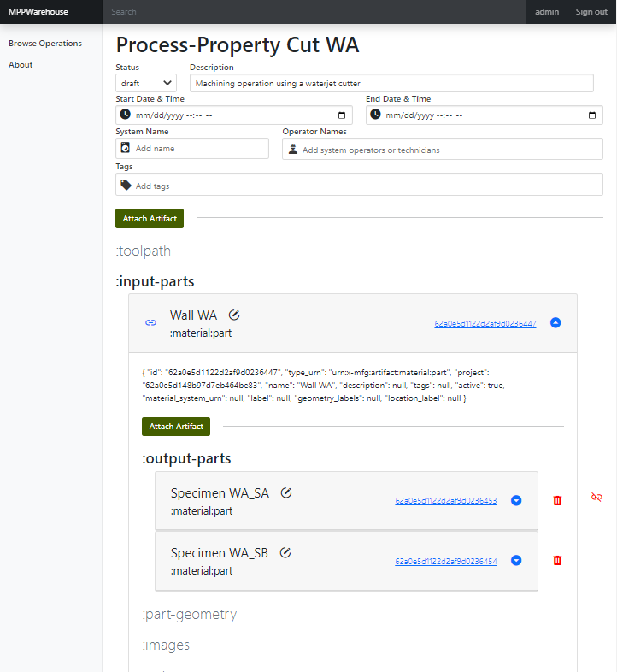
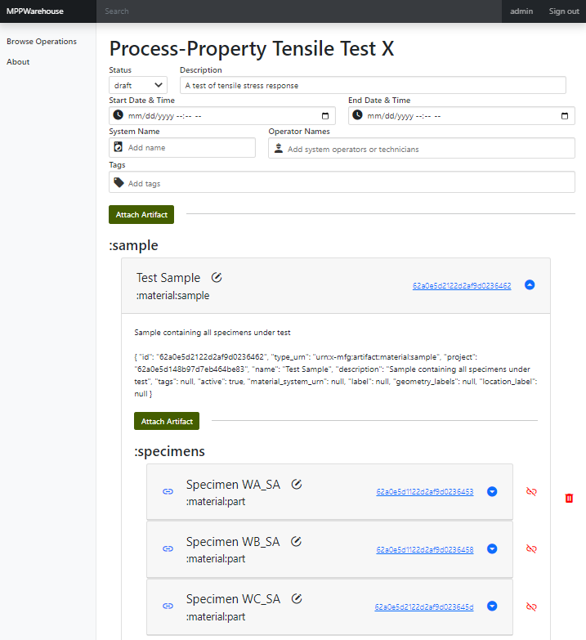
Manufacturing Operation Schemas
Rendered as custom API / UI

Slide 10
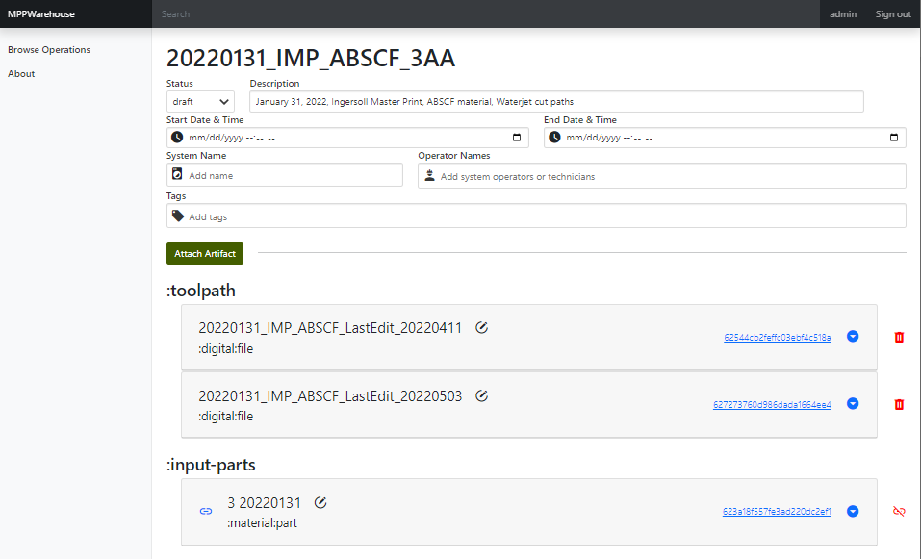
Linked Artifacts

Slide 11
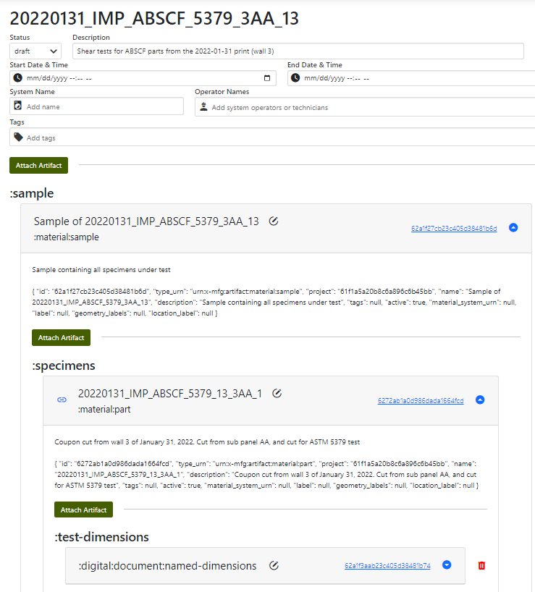
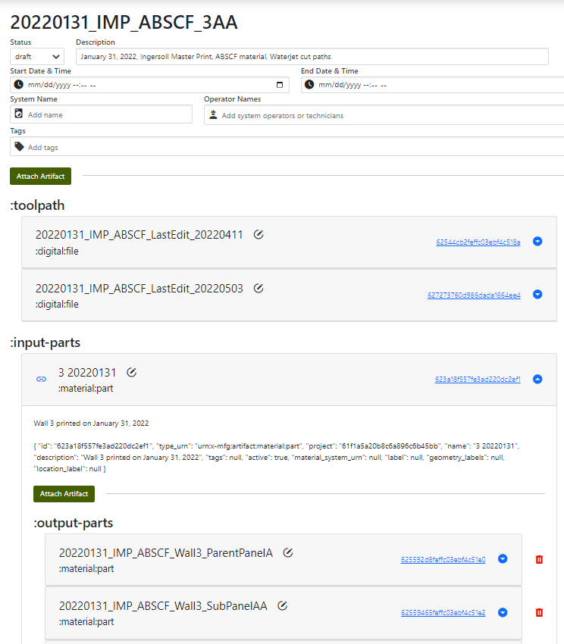
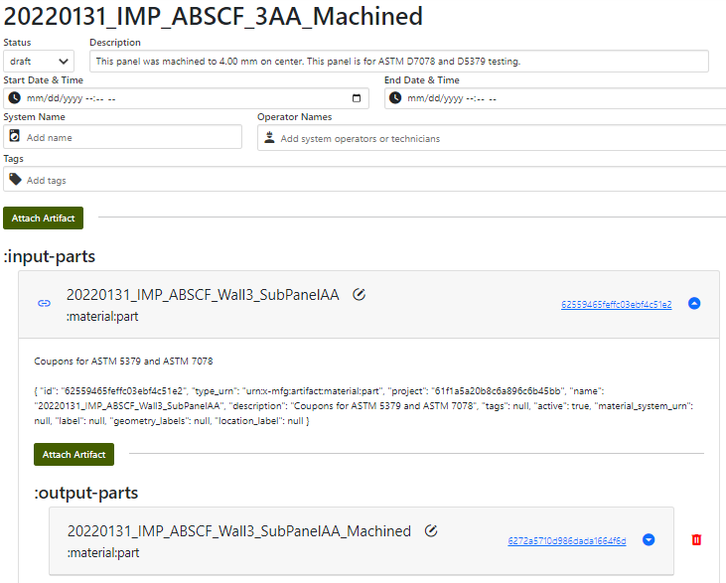
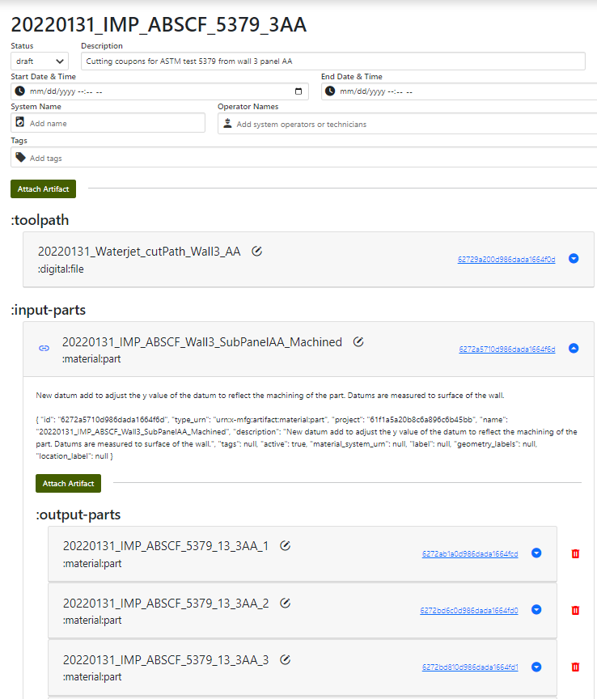
Linked Artifacts

Slide 12
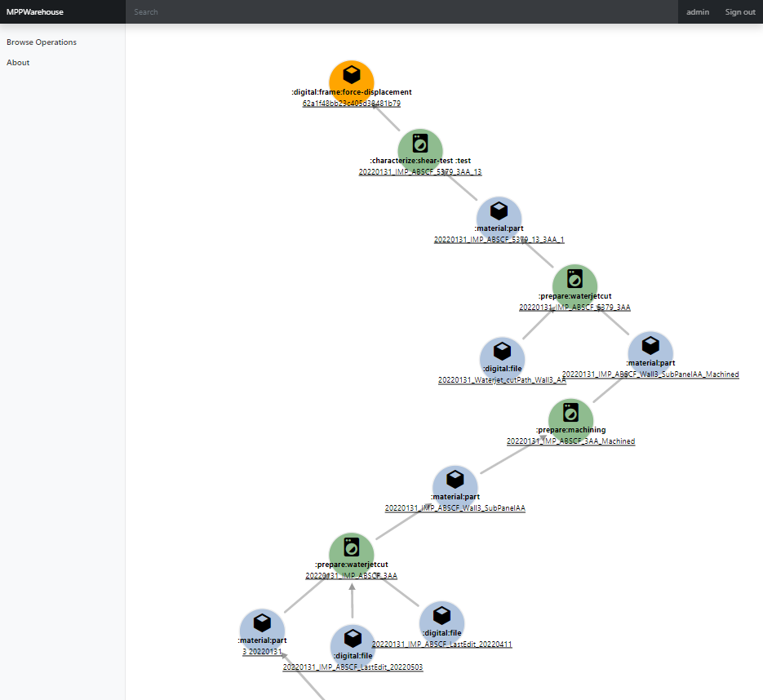
Artifact Provenance

