Slide 1
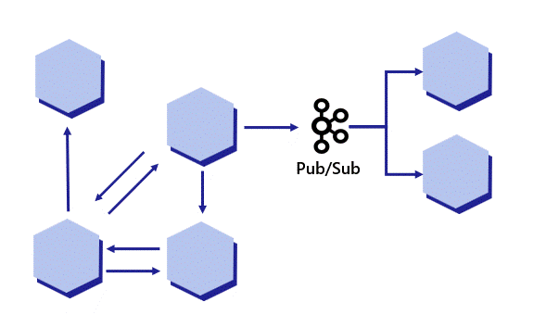
dapr.io Pub/Sub demo

Slide 2
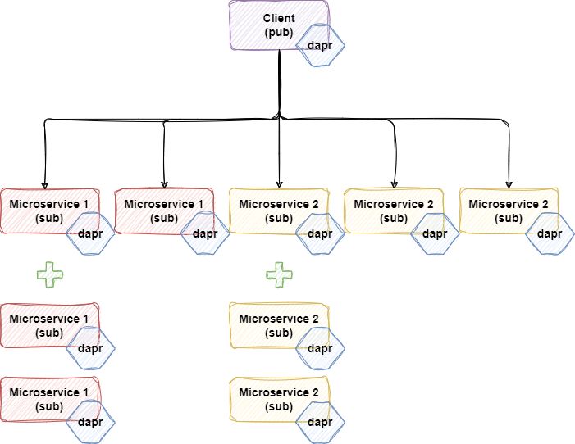
The problem
Multiple instances of microservices integrated as pub/sub, using Dapr

Slide 3
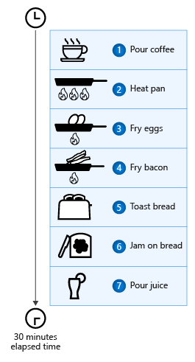
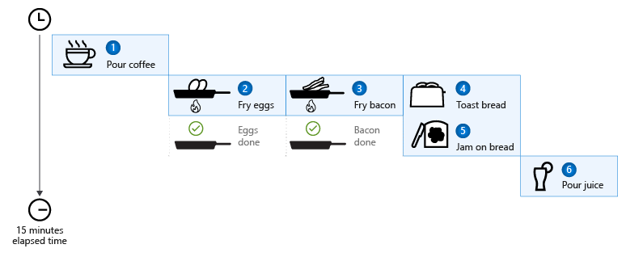
Example
https://learn.microsoft.com/en-us/dotnet/csharp/asynchronous-programming/
x N

Slide 4
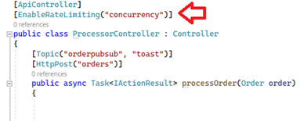
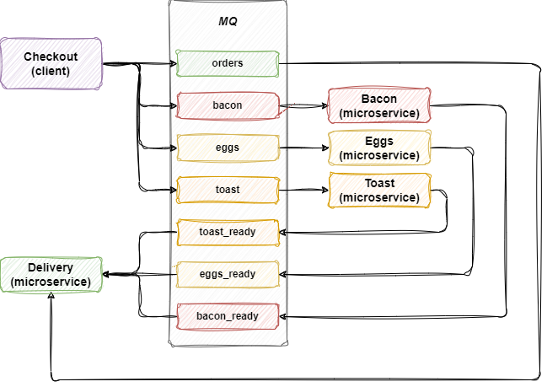
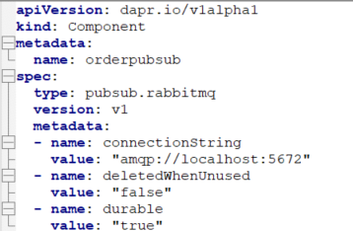
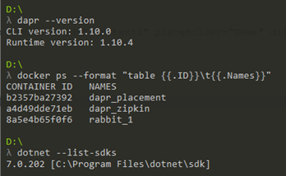
Architecture
https://github.com/dapr/quickstarts/tree/master/pub_sub/csharp/sdk

Slide 5
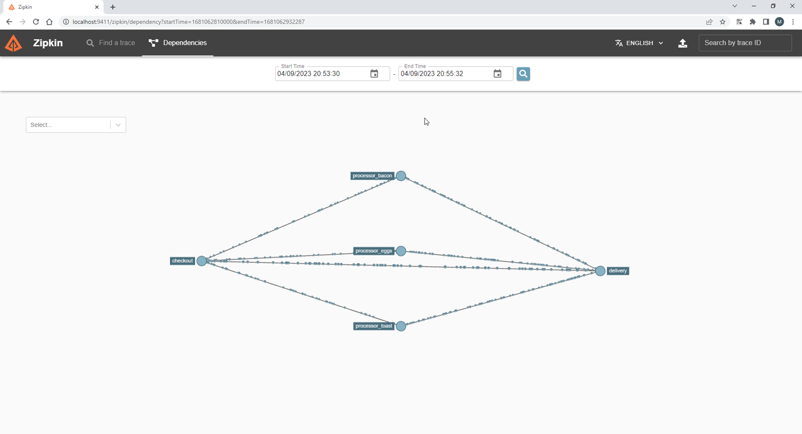
Monitoring

Slide 6
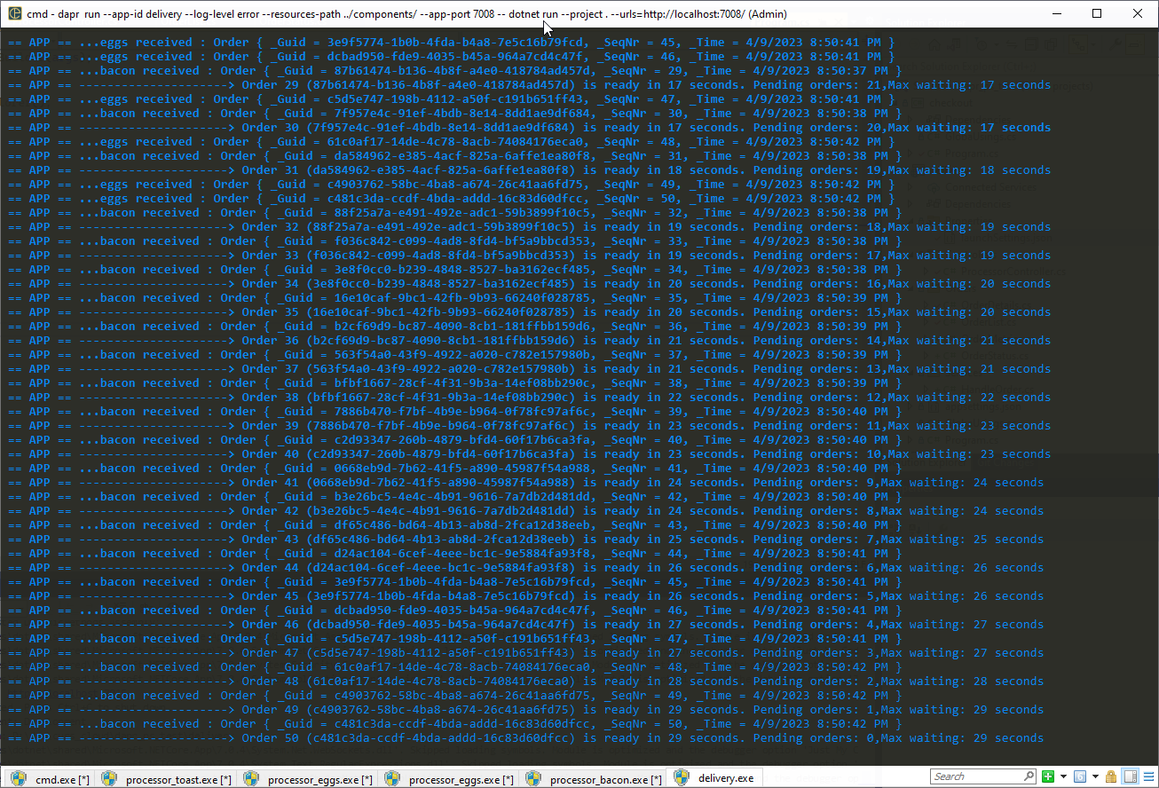
Simulation 1
1 bacon processor
1 toast processor
2 eggs processors
Max waiting: 29 sec
Bacon arrives too late

Slide 7
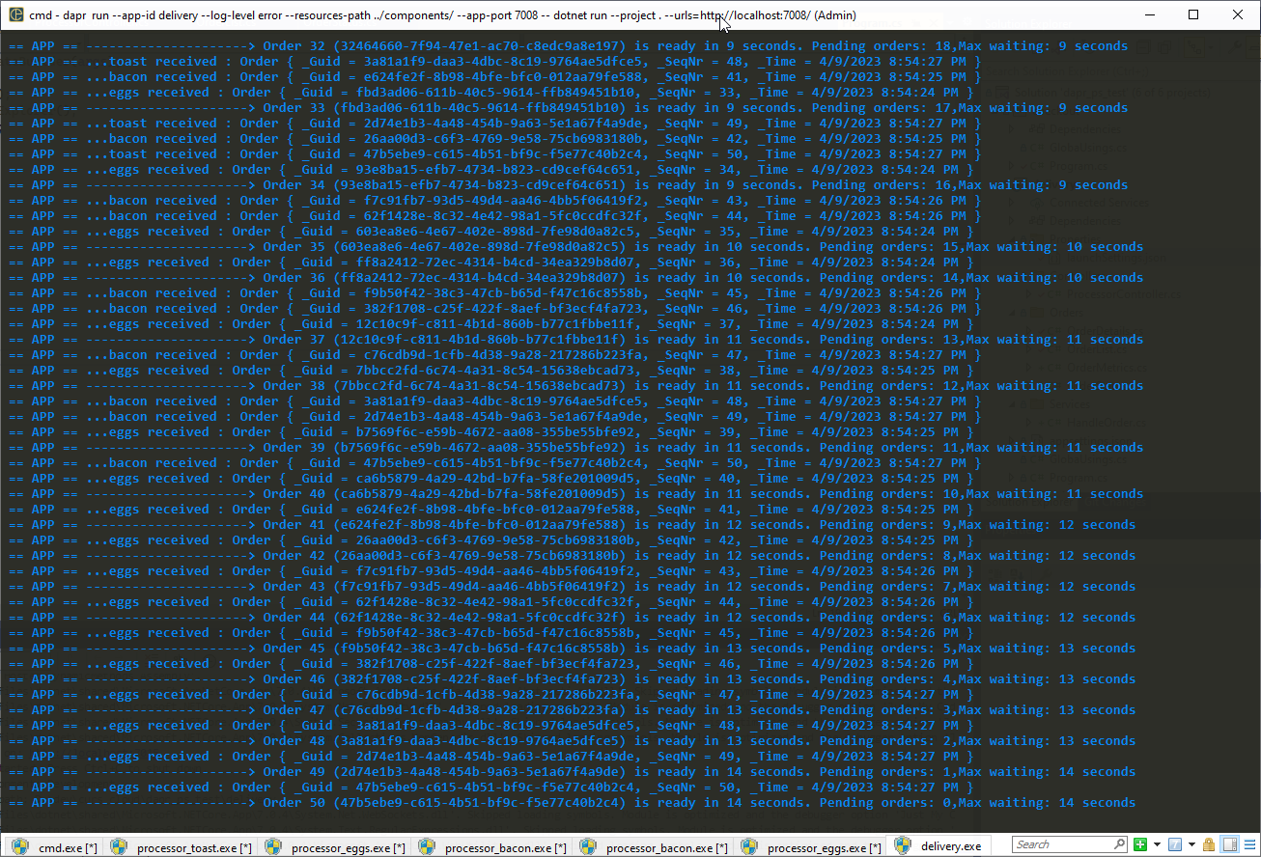
Simulation 2
2 bacon processors
1 toast processor
2 eggs processors
Max waiting: 14 sec

Slide 8
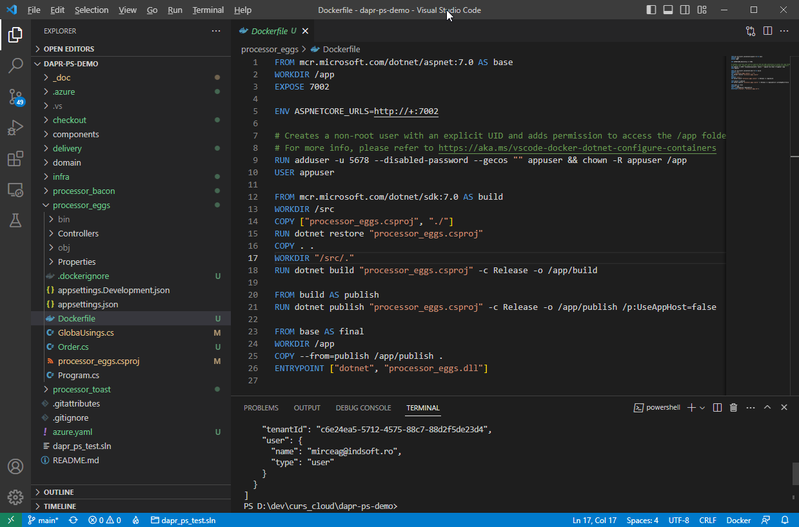
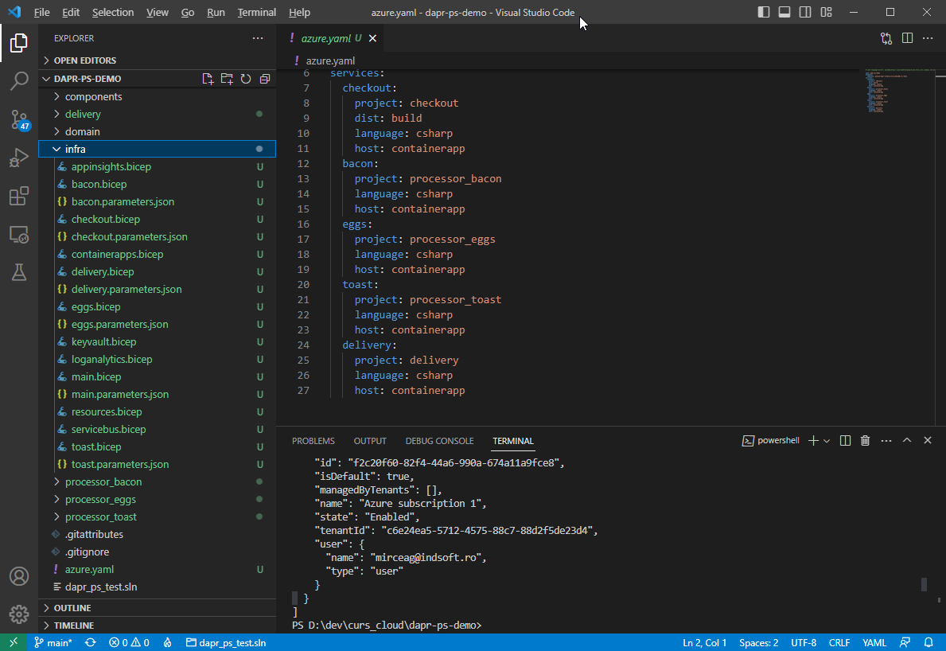
Azure deployment
https://learn.microsoft.com/en-us/azure/container-apps/microservices-dapr-pubsub?pivots=csharp

Slide 9
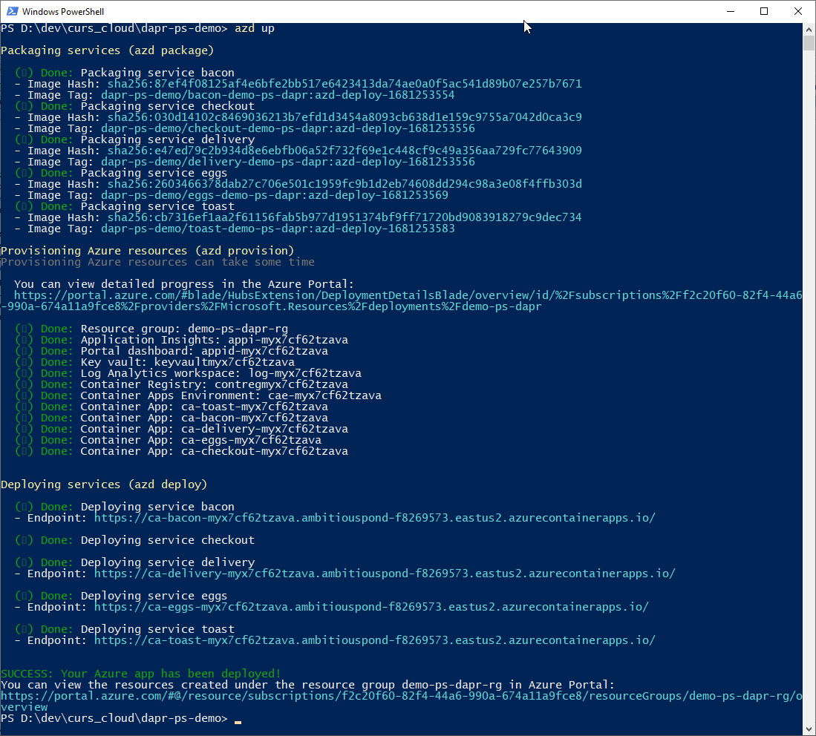
…done

Slide 10
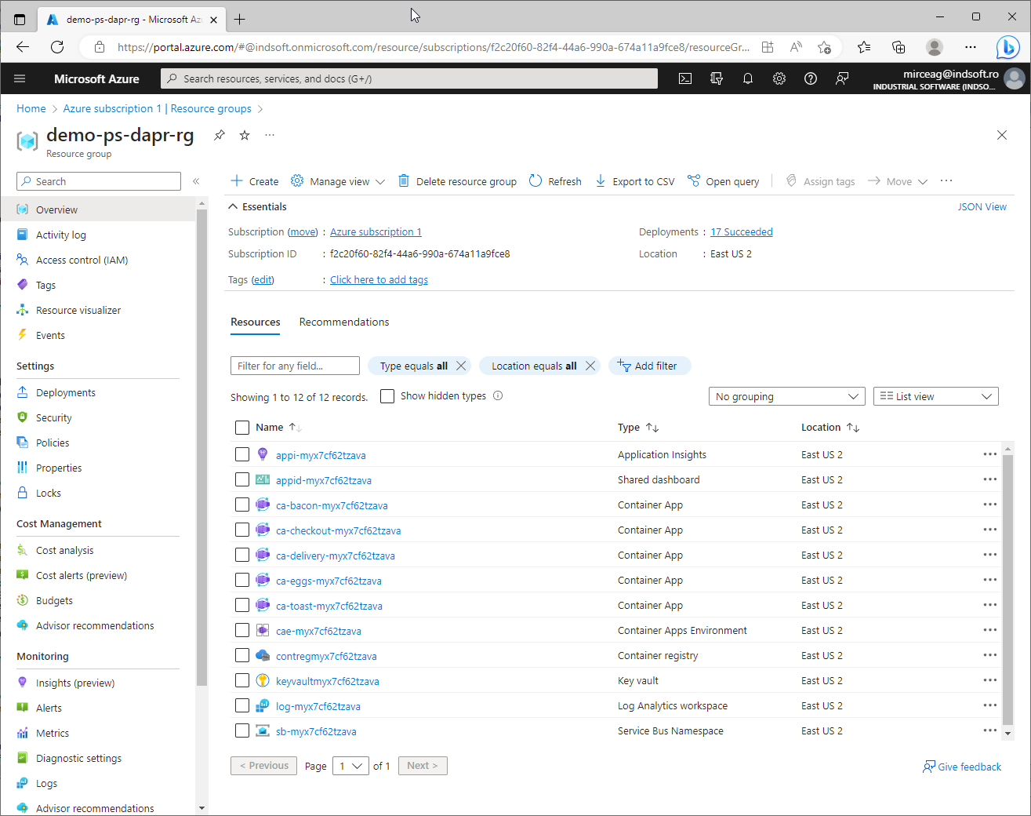
Resource group

Slide 11
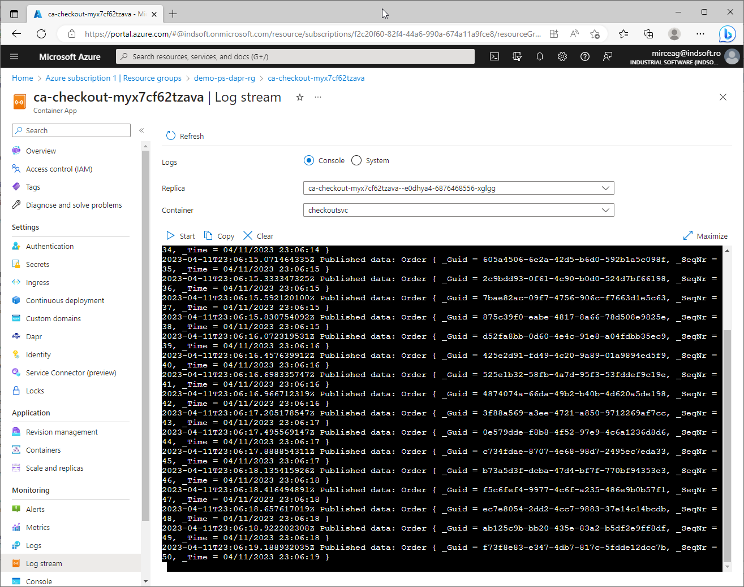
Checkout (pub) output

Slide 12
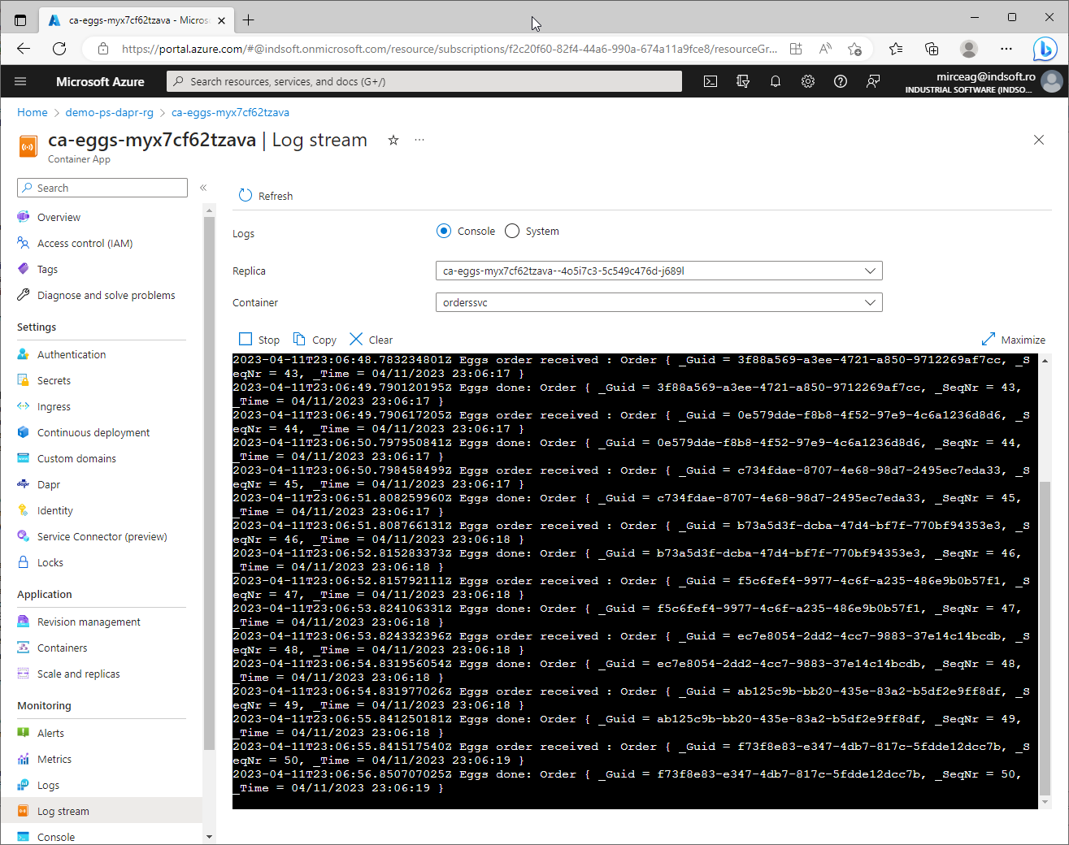
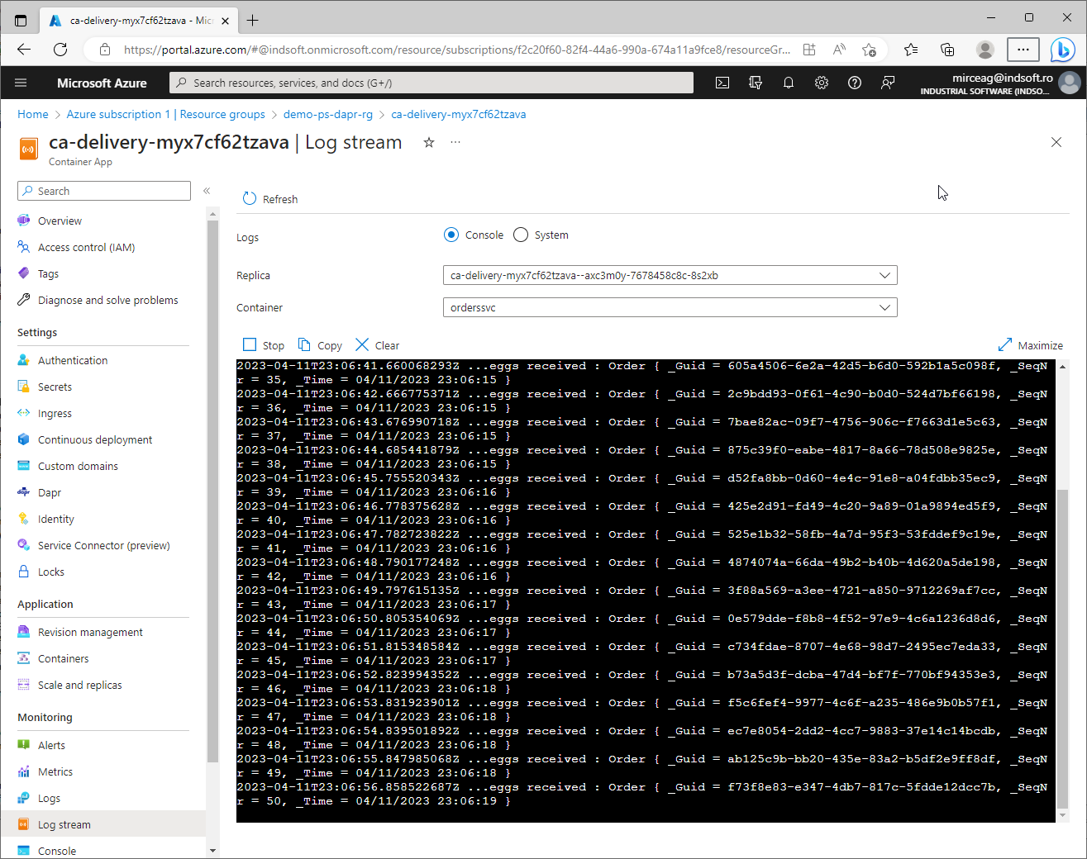
Eggs & Delivery (sub) output

Slide 13
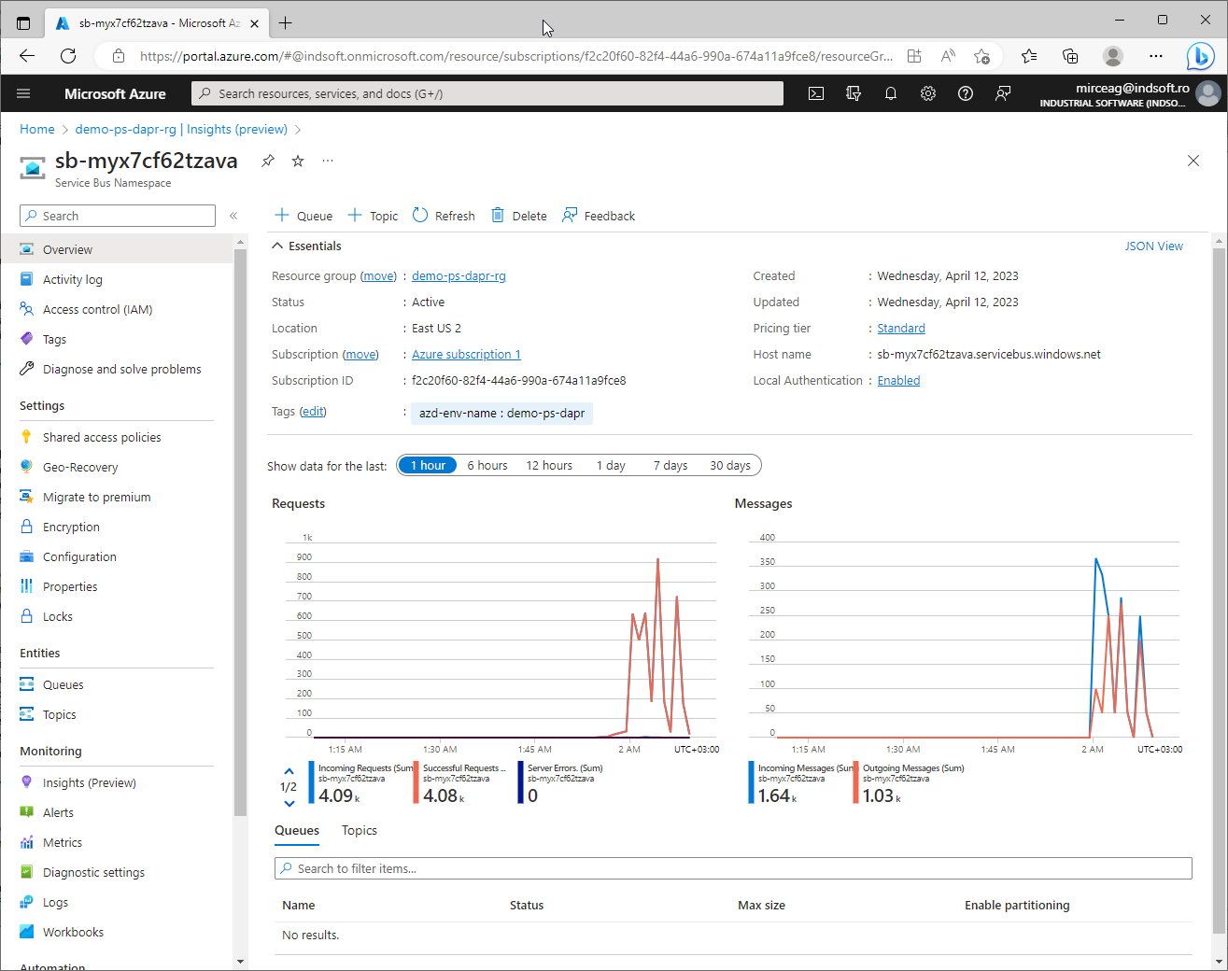
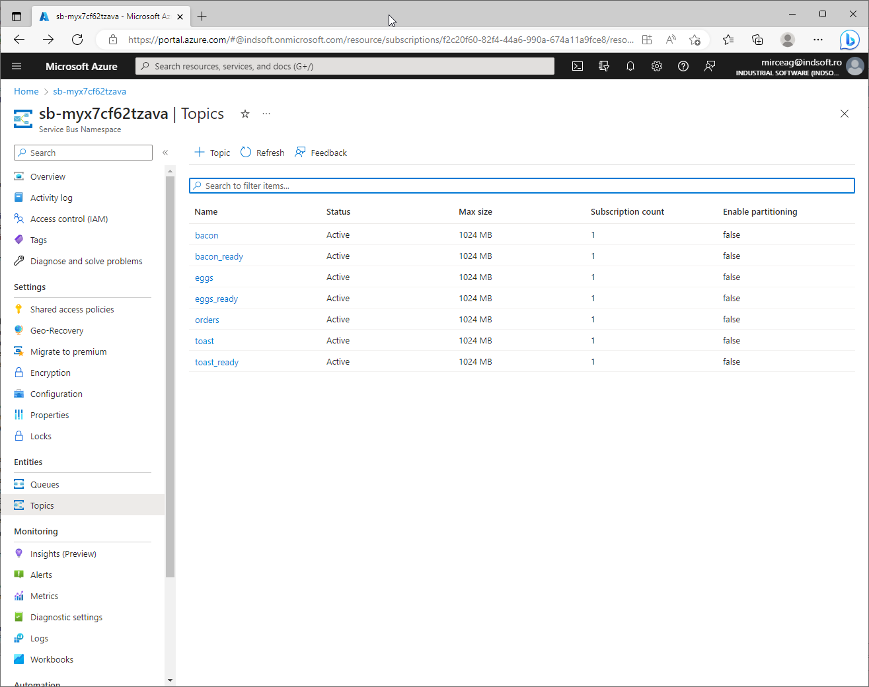
Service bus

Slide 14
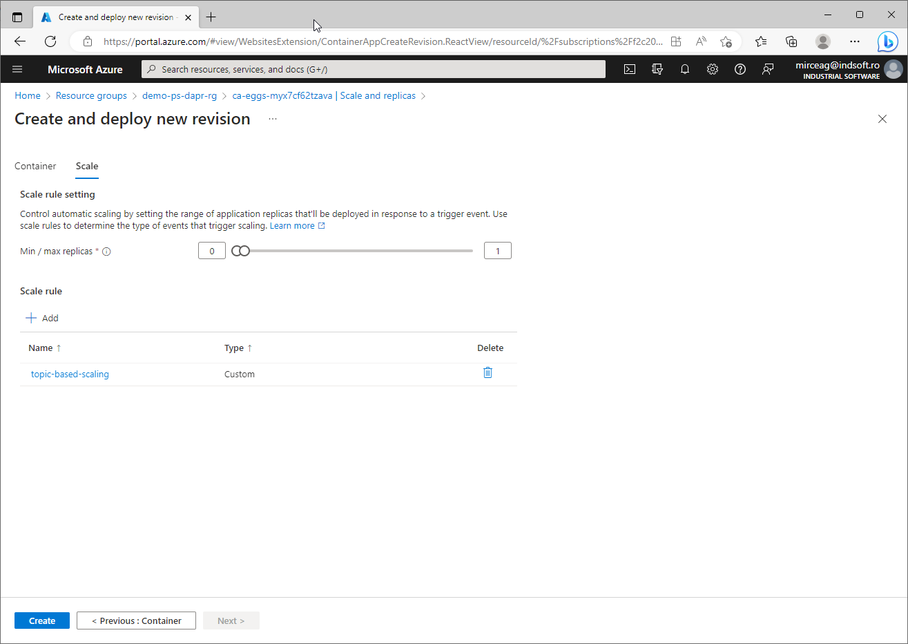
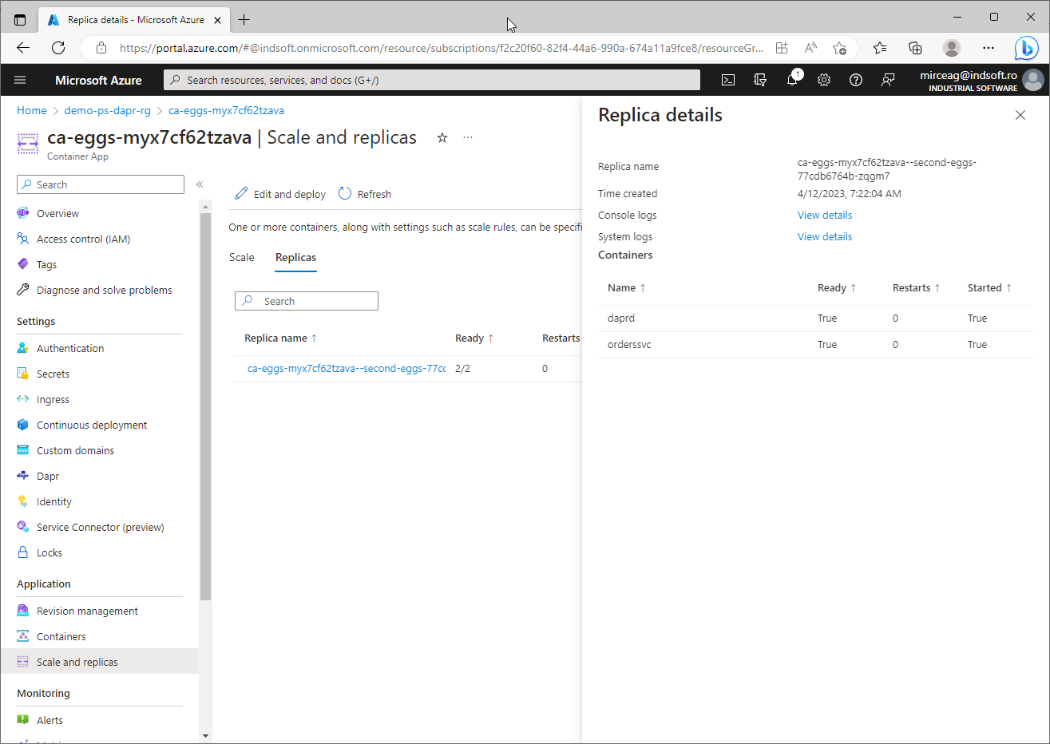
Scaling microservices (???)

Slide 15
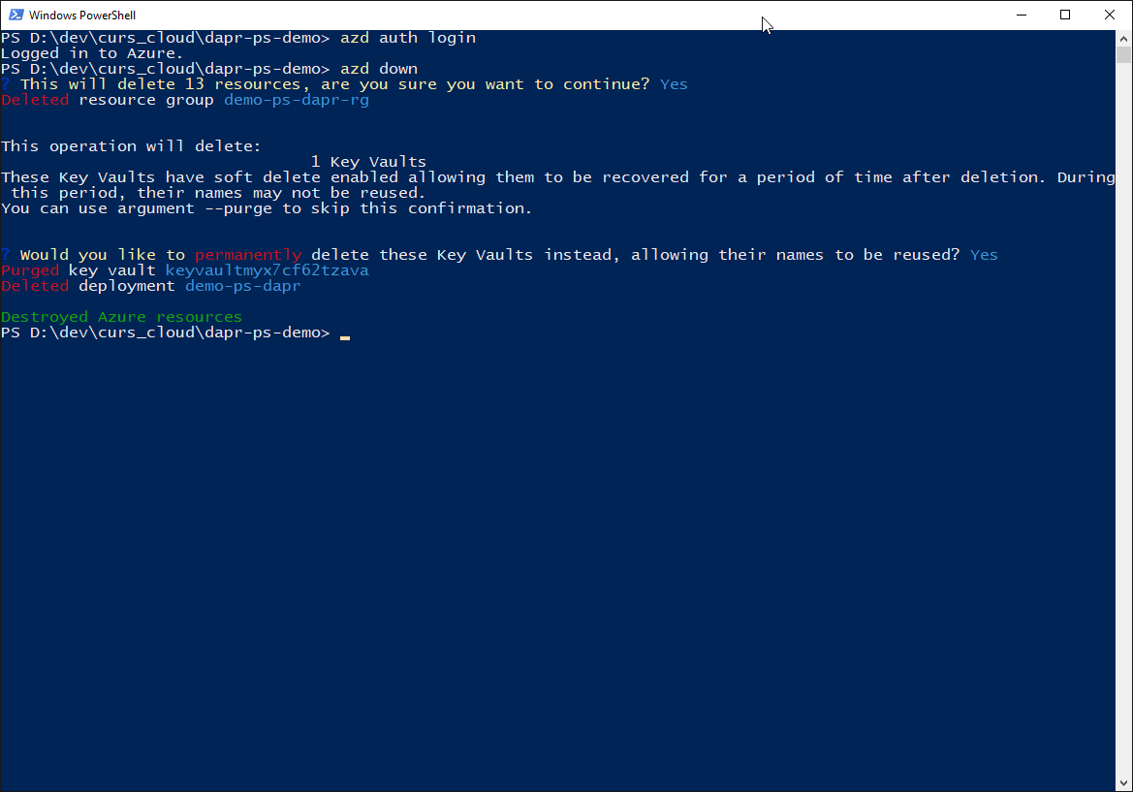
Undeploy

