Slide 1
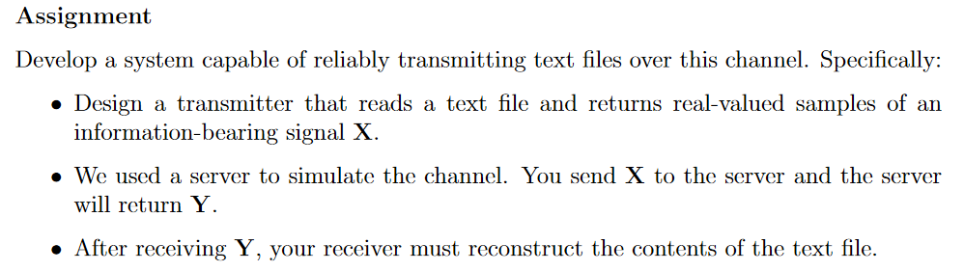

Principles of Digital Communications
Project presentation
Gaiëtan RENAULT Sophia ARTIOLI Alexandre SANTANGELO

Slide 2

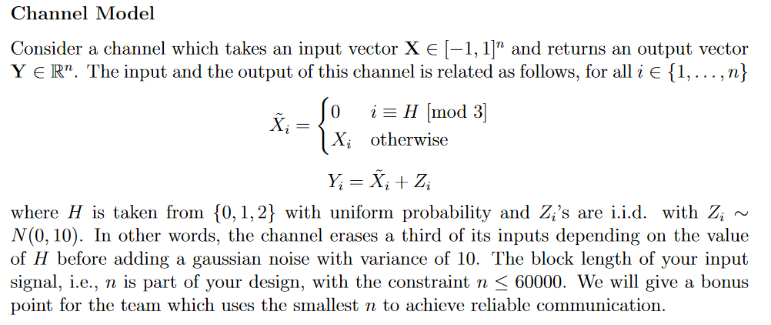
Overall
msg-to-send.txt
msg-received.txt
input.txt
output.txt
EPFL Server
X
Y
Transmitter
Channel
Receiver
UTF-8, XOR, Hadamard encoding
Hadamard , XOR, UTF-8 decoding

Slide 3

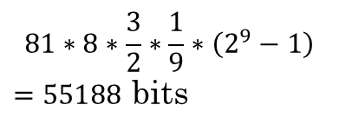

Transmitter
Chars to bytes
(UTF8)
Hadamard encoding with order $2^{9}$
Pad entering sequ. with 0x0 (null char) so that we can map every $9$ bits sequences to $2^{9}−1$ bits sequence using Hadamard encoding.
Reshape
$b_{0}^{\left(0, H\right)},b_{0}^{\left(\frac{640}{2},H\right)},b_{0}^{\left(0,H\right)}⊗b_{0}^{\left(\frac{640}{2},H\right)},…$
$b_{j}^{\left(i,H\right)},b_{j}^{\left(i+\frac{640}{2}\right)}{,b_{j}^{\left(i, H\right)}⊗b}_{j}^{\left(i+\frac{640}{2},H\right)},…$
Map bits
Map 0 to -1 and 1 to 1
msg-to-send.txt
input.txt
960 bits
~80 chars
640 bits
Control bit encoding
Split sequence in two and apply XOR
$b_{0}^{\left(0\right)}…b_{j}^{\left(i\right)}…$
$b_{0}^{\left(\frac{640}{2}\right)}…b_{j}^{\left(i+\frac{640}{2}\right)}…$
---------------------------------------
$b_{0}^{\left(0\right)}⊗b_{0}^{\left(\frac{640}{2}\right)}…{b_{j}^{\left(i\right)}⊗b}_{j}^{\left(i+\frac{640}{2}\right)}…$
$$81∗8∗\frac{3}{2}∗\frac{1}{9}∗\left(2^{9}−1\right)$$
$=55188$ bits

Slide 4




AWGN Channel
Server
Erease (periodically) one third of input, by mapping bit to 0. Then apply i.i.d Gaussian noise.
$b_{0}^{\left(0, H\right)},b_{0}^{\left(\frac{640}{2},H\right)},b_{0}^{\left(0,H\right)}⊗b_{0}^{\left(\frac{640}{2},H\right)},…$
$b_{j}^{\left(i,H\right)},b_{j}^{\left(i+\frac{640}{2}\right)}{,b_{j}^{\left(i, H\right)}⊗b}_{j}^{\left(i+\frac{640}{2},H\right)},…$
input.txt
output.txt
$$0$$
$$Y=ℝ^{55188}$$
$$X={\left\{−1,1\right\}}^{55188}$$
$$0$$

Slide 5





Receiver
MAP estimation of J
Computing minimum argument above sum of absolute 3-period values. Then delete corresponding 3-period values.
Reshape
$b_{0}^{\left(0, H\right)},…,b_{j}^{\left(i,H\right)},…,b_{0}^{\left(\frac{640}{2},H\right)},…,b_{j}^{\left(i+\frac{640}{2}\right)},…$
$b_{0}^{\left(0,H\right)}⊗b_{0}^{\left(\frac{640}{2},H\right)}, …,b_{j}^{\left(i, H\right)}⊗$ $b_{j}^{\left(i+\frac{640}{2}\right)}$,…
Hadamard decoding with order $2^{9}$
Map $2^{9}−1$ reals nbrs sequences to $9$ bits sequence using maximum argument inner product rule (decoded is closest one).
Control bit decoding
If necessary (J is 0 or 1) recover ereased 3-period values.
$b_{0}^{\left(0\right)}…b_{j}^{\left(i\right)}…$
$$b_{0}^{\left(0\right)}⊗b_{0}^{\left(\frac{640}{2}\right)}…{b_{j}^{\left(i\right)}⊗b}_{j}^{\left(i+\frac{640}{2}\right)}…$$
---------------------------------------
$b_{0}^{\left(\frac{640}{2}\right)}…b_{j}^{\left(i+\frac{640}{2}\right)}…$
640 bits
msg-received.txt
output.txt
$$0$$
$$0$$
640 bits
Bytes to chars
(UTF8)
~80 chars
$55188$ nbrs

Slide 6
To finish
Works for all UTF-8 characters.
Hadamard coding ~ Orthogonal coding (problem 2 of GHW2) in fact.
8 bits order Hadamard was not sufficiently reliable, that’s why we’ve implemented 9 bits order Hadamard
Ideas to reduce total block length n < 60000 (channel parameter) :
As encoded length sequence exponentially increasing with order in Hadamard coding, one way to deal with it is to remove random bits of encoded sequence known to receiver after Hadamard coding (Heuristic way)
Implement other coding scheme (convolutional ? Too complex). We decided to also implement Random code (also in main.py), with it we can freely play with the block length. Using empirical method it seems that random code works fine with N = 370 and so a total block length of n = 44400 (better than Hadamard which has n = 55188)

Slide 7
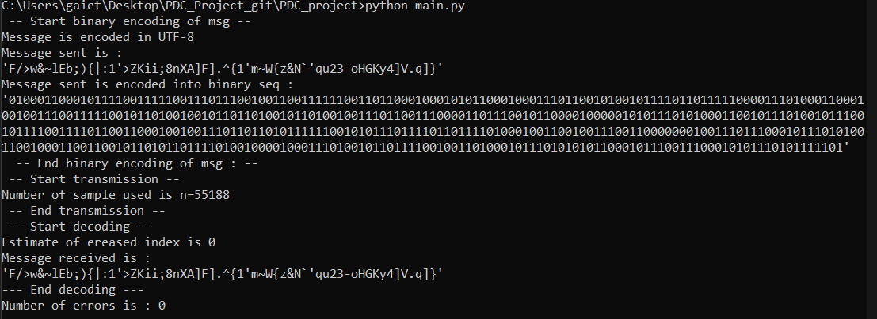
To finish
Test
Bibliography :
We based our thinking on Hadamard’s Coding Matrix and Some Decoding Methods paper.

