Slide 2
Autonomous Driving
Pics of faluts, car crashes

Slide 3
People trying to fix
FI
Adhoc technique

Slide 4
Our goal

Slide 5
Structure of ADS
High level diagram of components and feedback loop.

Slide 6
Talk about sensors
Four type of sensors

Slide 7
Camera
First LIDAR but due to issues

Slide 8

CARLA (Car learning to act)
An open source urban environment simulator
Developed by Intel and Toyota research

Slide 9
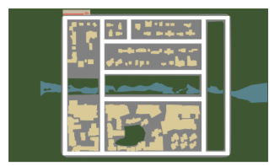
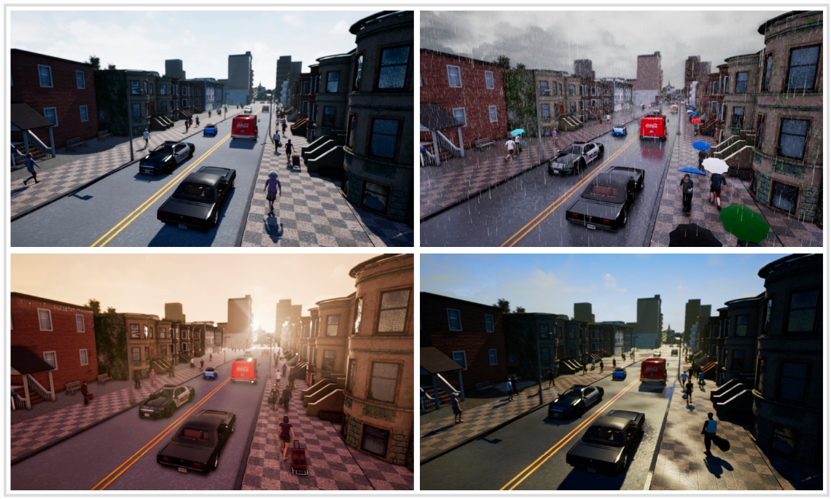
CARLA – Capabilities
Urban Layout
Weather Control
NPC characters

Slide 10
CARLA – Structure
Commands
Server
Client
Driving agent
Sensor Data
Environment
AV
Sensors
Notes:
Also mention the configuration we have chosen and its over all success rate (~85%)

Slide 11
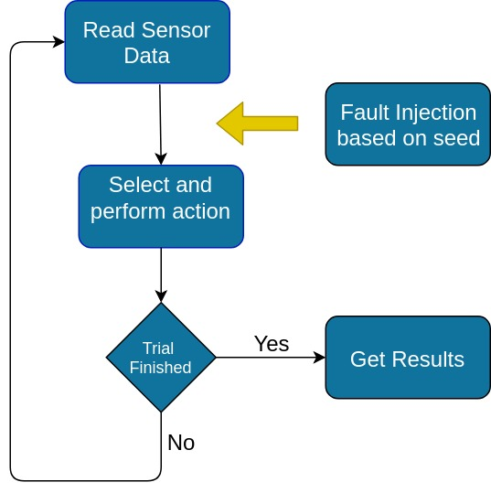
Fault injection
Golden Run
Compare results to get matrices
Notes:
Golden Run, filter out environmental conditions, routs etc. to avoid inherent machine learning errors.
Mentions the trials, with different weathers, routes etc.

Slide 12
Fault model – Metrics
Goals achieved percentage
Goals achieved without traffic violations

Slide 13
Results

Slide 14
Optimize FI
Huge overhead of exhaustive Fault injection.
Graph showing overhead
We have filtered out the most critical faults.
Can we do better for more exhaustive search?

Slide 15
Fault Injection at Critical locations
Profile commands from golden run.
Recognize critical moments in the path using a threshold.
Inject fault only at these moments.
Steering angle, Throttle, Break
Server
Client

Slide 16
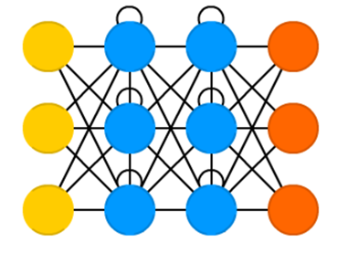
Fault Injection at Critical locations
Fails to induce failure <Graph here>
Recurrent neural networks used.
Fault not always at critical location.

Slide 17
Fault Injection at Critical locations

Slide 18
Why noises are considered?
Even in expensive equipment.
Arti will add article

