Slide 2
Project Title
Scaling of Web Application hosted on Containers with an automated build tool
Project Guide
Dr. Monit Kapoor
Associate Professor & Head
Dept. of Cybernetics, School of Computer Science

Slide 3
Team Members & Role
Members | Role
Harsh Gupta | Coding and Implementation
Kunal Visoulia | Coding and Implementation
Vibhor Jain | Coding and Implementation

Slide 4
Introduction
Today, the cloud industry is adopting the container technology both for internal usage and as commercial offering. The use of containers as base technology for large-scale systems opens many challenges in the area of management of these containers at run-time.
Here the challenge is to scale up and down the containers at run time. A container can also fail to run due to many reasons but that doesn't mean that a client's work should come at halt. A system is needed which can automatically detect a failure and run another hosting platform and resume the services.

Slide 5
Problem Statement
Businesses today need to be agile and need the ability to scale resources easily and quickly based on rapidly changing market needs. Because an enterprise’s demand for computing resources can vary dramatically from one period of time to another, maintaining sufficient resources to meet peak requirements can be costly.
With a system which can detect the failures and achieve fault tolerance by running up another application hosting platform can cut costs by maintaining minimal computing resources until they run into the need to increase them meanwhile only paying for what they use.

Slide 6
Motivation
Motivating Example-Kubernetes:
Kubernetes is an open-source container-orchestration system for automating deployment, scaling and management of containerized applications. It was originally designed by Google and is now maintained by the Cloud Native Computing Foundation. It aims to provide a platform for automating deployment, scaling, and operations of application containers across clusters of hosts. It works with a range of container tools, including Docker

Slide 7
Objectives
To demonstrate a system which can horizontally scale a web application hosted on containers and deploying those containers with multilevel queue scheduling algorithm
Sub-objectives:
Making a 3 tier web application
Creating a container environment for the required web application.
Commiting a full fledged container image for a web application.
Using multilevel queue scheduling algorithm to orchestrate and deploy the container environment.
Knitting of different services together as a stable automation using Make utility as a build tool.
Extracting the state of the subsystems, so that while restarting,the image of the process can be reconstructed.

Slide 8
Software/ Hardware Requirement
Hardware Requirements:
x86_64/amd64 architecture
4.00 GB of RAM
30.00 GB of Disk Storage
An Ethernet type Network Adapter
Software Requirements:
Ubuntu (LTS 14.04 and above with Linux kernel version 3.10 or latest)
Docker (10.0 and above)
Container images of web server and web application
GCC compiler

Slide 9
Literature Review

Slide 10
WORKFLOW DESIGN
Client
Client
Client
CLUSTER SERVER
Application Hosting Container
Application Hosting Container
Application Hosting Container

Slide 11
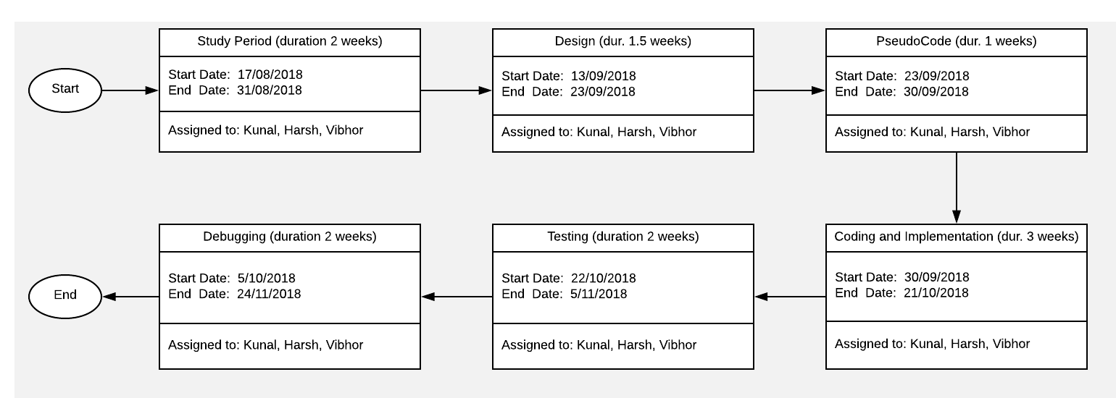
PERT Chart

Slide 12
References
Docker Documentation
Available: https://www.docker.com/resources/what-container.
Martin Flower, “Article on Microservices Architecture and Characteristics of microservices”, 25th March 2014
make (1) - Linux Man Pages
make: GNU make utility to maintain groups of programs
Docker Official Resources
Available: https://www.docker.com/resources
MatthewRevell,”Introduction to Container Orchestration-Docker, Kubernetes,and Mesos” a guide to compare strengths of orchestration tools available, Aug. 01, 16 · Cloud Zone · Opinion
Kubernetes Documentation
Available: https://kubernetes.io/docs/concepts/overview/what-is-kubernetes/
Wes Felter, Alexandre Ferreira, Ram Rajamony, Juan Rubio, IBM Research Report, An Updated Performance Comparison of Virtual Machines and Linux Containers.
Pahl, Claus & Brogi, Antonio & Soldani, Jacopo & Jamshidi, Pooyan. (2017). Cloud Container Technologies: a State-of-the-Art Review. IEEE Transactions on Cloud Computing. PP. 1-1. 10.1109/TCC.2017.2702586.
Brendan Burns,David Oppenheimer..Google..Design patterns for container based distributed systems.
Chao Zheng and Douglas Thain ,Department of Computer Science and Engineering,University of Notre Dame. Integrating Containers into Workflows: A Case Study using Makeflow, Work Queue, and Docker

