Slide 1
K-means Clustering in R
KSEA US-Korea Conference
Data Science Workshop
August 3–4, 2018
Notes:
The following tutorial was excerpted by S.Y. Park from ‘R for Everyone: Advanced Analytics and Graphics,’ by J.P. Lander (2014).
Clustering is the partitioning of data into groups, and plays a big role in modern machine learning. Along with hierarchical clustering, K-means clustering is a popular method of clustering. In terms of a data.frame, a clustering algorithm finds out which rows are similar to each other. Rows that are grouped together are supposed to have high similarity to each other and low similarity with rows outside the grouping.
K-means clustering divides the observations into discrete groups based on some distance metric. The dataset for this example is the wine dataset from the UC-Irvine Machine Learning Repository (http://archive.ics.uci.edu/ml/datasets/Wine)

Slide 2
kmeans(x, centers, iter.max = 10, nstart = 1, algorithm = c("Hartigan-Wong", "Lloyd", "Forgy", "MacQueen"), trace=FALSE)
x numeric matrix of data
centers number of clusters
iter.max maximum number of iterations allowed
nstart number of random sets to be chosen
> wine <- read.table(”~/wine.csv", header = TRUE, sep = ",")
> set.seed(278613)
> wineK3 <- kmeans(x = wine, centers = 3)
> plot(wineK3, data = wine)
Notes:
In R, K-means is done with the aptly named kmeans function. Its first two arguments are the data to be clustered, which must be all numeric (K-means does not work with categorical data), and the number of centers (clusters). Because there is a random component to the clustering, we set the seed to generate reproducible results.
Printing the K-means objects displays the size of the clusters, the cluster mean for each column, the cluster membership for each row and similarity measures.

Slide 3
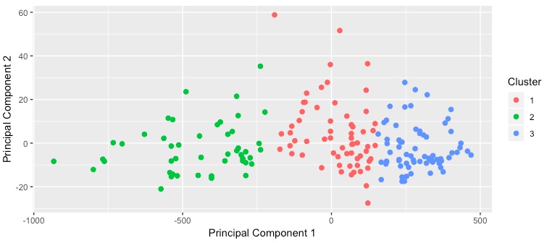
Results of K-means clustering
Notes:
Plotting the result of K-means clustering can be difficult because of the high dimensional nature of the data. To overcome this, the plot.kmeans function in useful performs multidimensional scaling to project the data into two dimensions, and then color codes the points according to cluster membership.

Slide 4
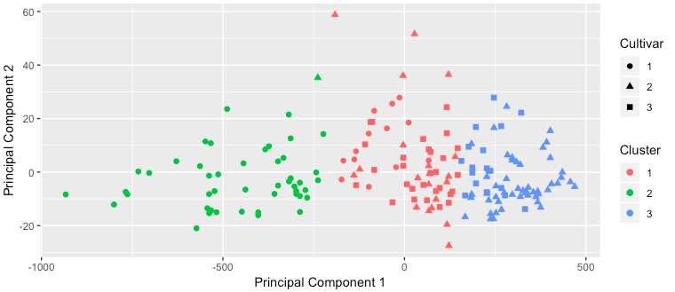
Comparison of cultivar designations and K-means clustering results
Notes:
If we pass the original wine data and specify that Cultivar is the true membership column, the shape of the points will be coded by Cultivar, so we can see how that compares to the colors. A strong correlation between the color and shape would indicate a good clustering.

Slide 5
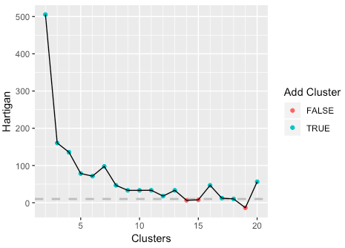
Choosing the right number of clusters: Hartigan’s Rule
> wineBest <- FitKMeans(wine, max.clusters=20, nstart=25, seed=278613)
> PlotHartigan(wineBest)
Notes:
Choosing the right number of clusters is important in getting a good partitioning of the data. According to David Madigan, the chair of the Department of Statistics, Columbia University, a good metric for determining the optimal number of clusters is Hartigan’s Rule ( J. A. Hartigan is one of the authors of the most popular K-means algorithm). It essentially compares the ratio of the within-cluster sum of squares for a clustering with k clusters and one with k + 1 clusters, accounting for the number of rows and clusters.
If that number is greater than 10, then it is worth using k + 1 clusters. Fitting this repeatedly can be a chore and computationally inefficient if not done right. The useful package has the FitKMeans function for doing just that.
According to this metric we should use 13 clusters. Again, this is just a rule of thumb and should not be strictly adhered to. Because we know there are three cultivars it would seem natural to choose three clusters. Then again, the results of the clustering with three clusters did only a fairly good job of aligning the clusters with the cultivars, so it might not be that good of a fit.

Slide 6
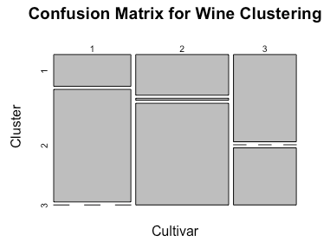

Fit assessment of K-means clustering
> table(wine$Cultivar, wineK3N25$cluster)
> plot(table(wine$Cultivar, wineK3N25$cluster), main="Confusion Matrix for Wine Clustering", xlab="Cultivar", ylab="Cluster")
Notes:
The following figure shows the cluster assignment going down the left side and the cultivar across the top. Cultivar 1 is mostly alone in its own cluster, and cultivar 2 is just a little worse, while cultivar 3 is not clustered well at all. If this were truly a good fit, the diagonals would be the largest segments.

Slide 7
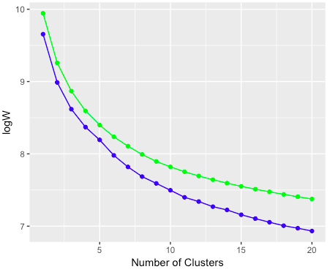
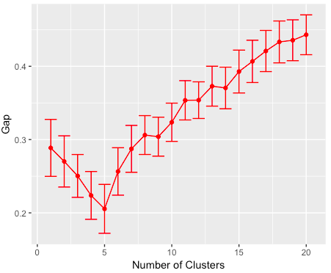
Choosing the right number of clusters: the Gap statistic
> theGap <- clusGap(wine, FUNcluster = pam, K.max = 20)
> gapDF <- as.data.frame(theGap$Tab)
Notes:
An alternative to Hartigan’s Rule is the Gap statistic, which compares the within-cluster dissimilarity for a clustering of the data with that of a bootstrapped sample of data. It is measuring the gap between reality and expectation. This can be calculated (for numeric data only) using clusGap in cluster. It takes a bit of time to run because it is doing a lot of simulations.
The blue curve is the observed within-cluster dissimilarity, and the green curve is the expected within-cluster dissimilarity. The red curve represents the Gap statistic (expected-observed) and the error bars are the standard deviation of the gap.

