Slide 1
Tools Introduction
Dominik Gresch

Slide 2
Overview
symmetry-representation
Z2Pack
TBmodels
kdotp-symmetry
bands-inspect
PhaseMap
AiiDA plugins
NodeFinder

Slide 3
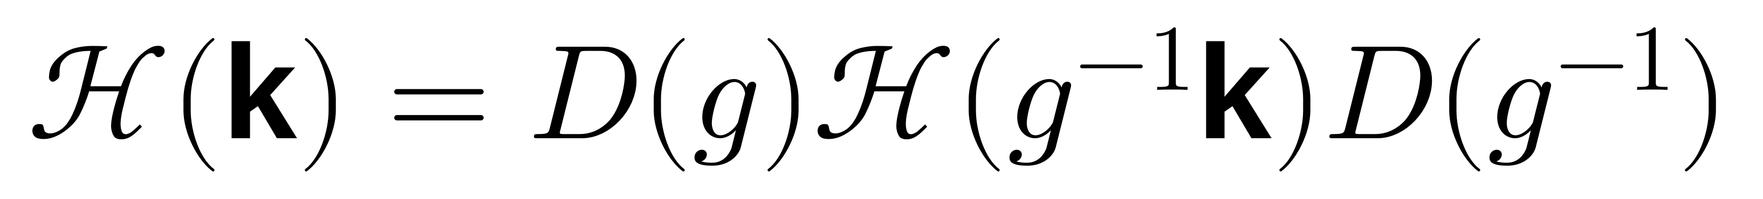
symmetry-representation
Goal:
  Describe symmetry operations, create representation matrix
needs: representation matrix real-space matrix

Slide 4
TBmodels
Goal:
  Evaluate and modify tight-binding models
Features:
  Efficient evaluation
  Parse to / from different formats
  (e.g. Wannier90 output)
  Symmetrization

Slide 5
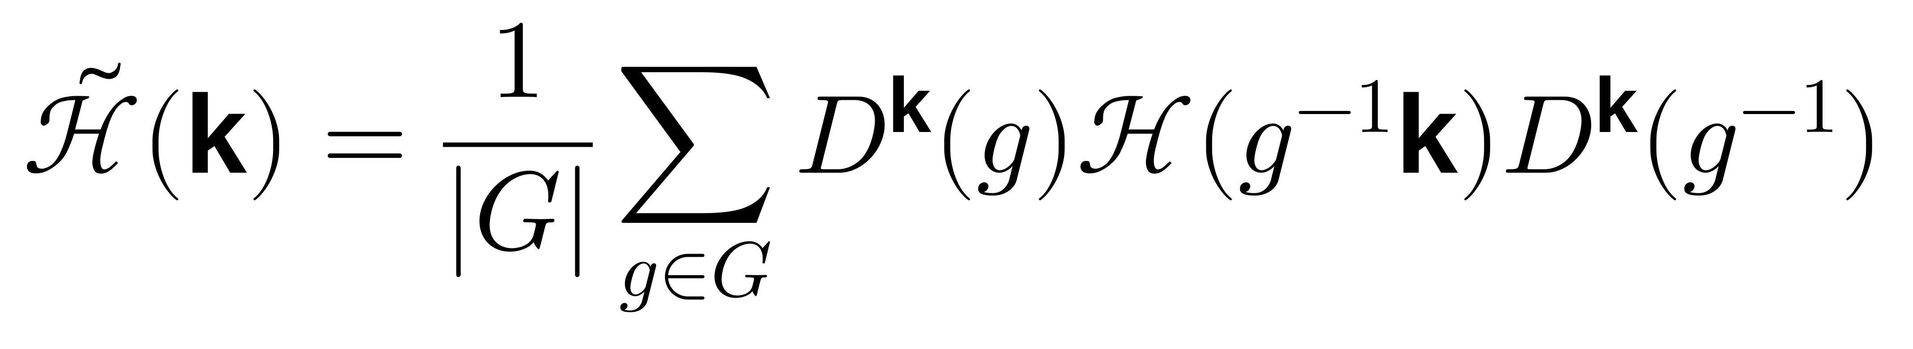
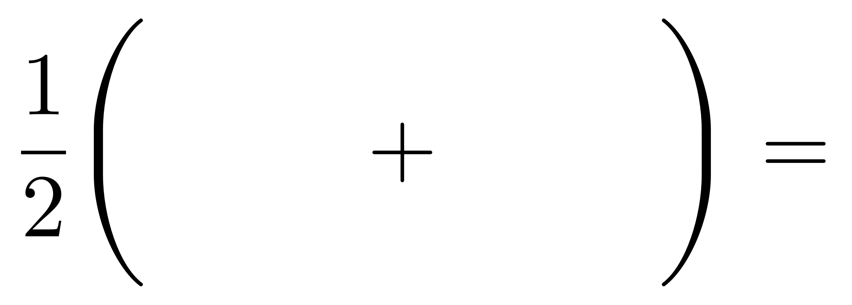
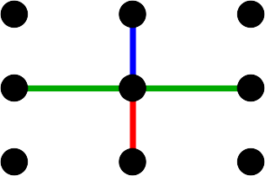
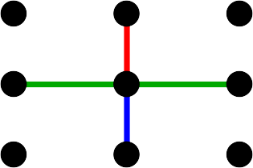
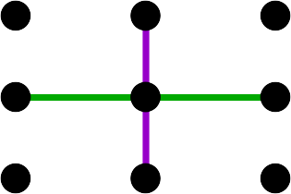
TBmodels: Symmetrization
Calculates group average:
Condition: Tight-binding basis must be complete under symmetry
Gresch et al., Phys. Rev. Materials 2, 103805 (2018)

Slide 6
kdotp-symmetry
Goal:
  Create k·p basis which respects given symmetries

Slide 7
Z2Pack
Goal:
  Calculate topological invariants (Chern number, Z2 invariant)
  Tracks Wannier charge center / Wilson loop eigenvalue evolution across a surface

Slide 8
PhaseMap
Goal:
  Calculate a phase diagram with minimal number of phase evaluations
  Requires a function to evaluate the phase at a given point

Slide 9
NodeFinder
Goal:
  Find and classify all nodal features in a potential landscape (use case: band gap closures)

Slide 10
AiiDA plugins
What is AiiDA?
  Workflow / automation framework
Pro:
  Allows for high-throughput calculations
  Creates “provenance graph” of calculations
Con:
  Significant learning curve
  Overhead of creating plugins
  Additional complexity: non-zero chance of bugs

Slide 11
AiiDA plugins
Is it for me?
  For things which could also be done (reasonably) by hand: no
  Larger / more complex runs: yes

Slide 12
AiiDA plugins
aiida-tbextraction:
  plugin for calculating tight-binding models from first-principles calculations
  optimize Wannier90 energy window
  includes symmetrization procedure
Modular workflow design: Link

Slide 13
Documentation: Links
Z2Pack: http://z2pack.ethz.ch/doc
Other Tools: http://z2pack.ethz.ch/projects.html
AiiDA plugins:
  aiida-optimize.readthedocs.io
  aiida-strain.readthedocs.io
  aiida-bands-inspect.readthedocs.io
  aiida-symmetry-representation.readthedocs.io
  aiida-tbmodels.readthedocs.io
  aiida-tbextraction.readthedocs.io

Slide 14
Theory Explanation
kdotp-symmetry, PhaseMap, NodeFinder: https://doi.org/10.3929/ethz-b-000308602
Z2Pack: paper, book chapter
TBmodels symmetrization, AiiDA plugins: https://dx.doi.org/10.1103/PhysRevMaterials.2.103805

Slide 15
Coding Guidelines
Scientific code is a mess – and that’s fine
Code to solve problems, refactor to create tools

Slide 16
Coding Guidelines
“Unix philosophy”: small tools which do one thing well
  In hindsight, maybe fewer separate repositories would be simpler
Design from the user perspective
  think about how to use the code first
  write extensive sufficient documentation

Slide 17
Coding Guidelines
Checkpoints: invaluable for longer-running calculations
  include them in your design from the start
  no, pickle is not a long-term storage format
Use unit-testing, static code analyzer, code formatter, …
  can be a pain to use, but worth it in the long run

