Slide 1

Seek
The Digital Hide and Seek Game
By Rob Gresham, Matt Dear, Dave Hill, Eva czako, ducky (he’s Quakers)

Slide 2
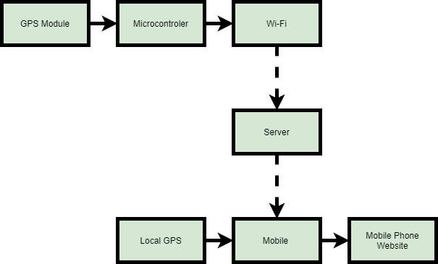
The System

Slide 3

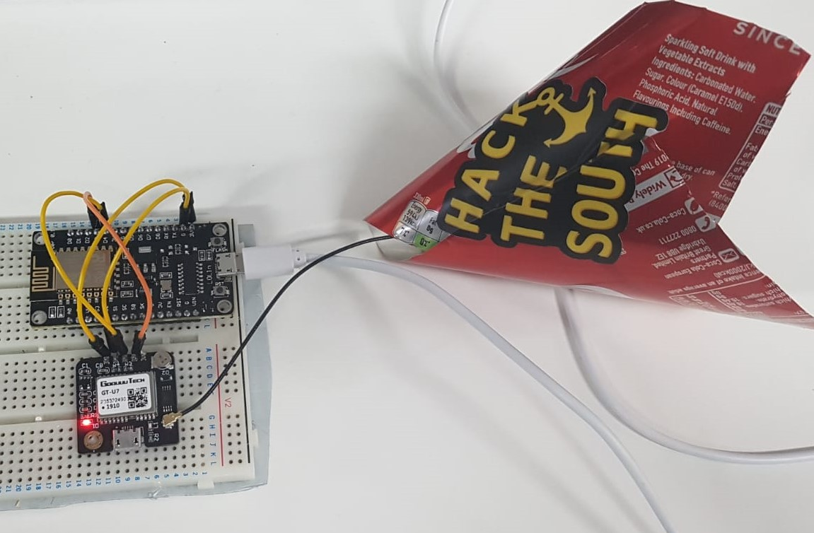
HIDER
The microcontroller that was used was a ESP8266
The GPS module connected to the microcontroller via a serial interface.
The coordinates captures were then send over the built in Wi-Fi to the server
Coke can was to make the GPS work better

Slide 4


SEEKER
The website has a login page to keep track of progress of the seeker
Once logged in the device’s coordinates are then compared with the seeker’s current coordinates
Both coordinates are compared and calculated and a compass bearing is displayed
http://m7d4.com/

Slide 5

Future improvements
N
Creating a mobile app
Adding distance to Seeker display
Keeping a record of achievements
iBeacon and Eddystone integration to remove reliance on WiFi
Using batteries to power Hider device
Navigation around buildings e.g. (Conferences Halls and Hospitals)
W
E
S

