Slide 1
Team Project: FCC-ee, the CLD detector
FCC-ee with the CLD Detector
FCC-ee CLD Collaboration
Saurav Bania, Greta Brianti, Jurjan Bootsma, Vincenzo Del Piano, Kobe Degeetere, Andrea Maria, Sergei Solokhin
Notes:
Whole team: welcome the audience, introduce the two-task structure (Task A = SM identification, Task B = BSM validation) and the speaker line-up.

Slide 2
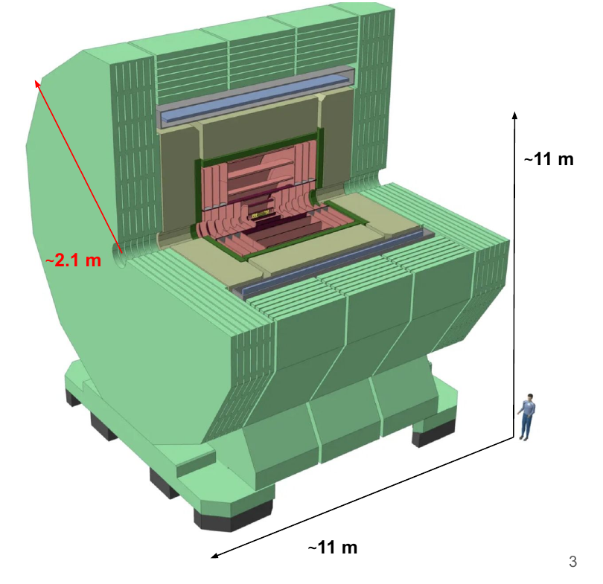
FCC-ee and the CLD detector
INTRODUCTION
FCC-ee: a 100 km e+e− collider. Four energies: 91 (Z pole), 160 (WW), 240 (ZH), 365 GeV (t̅t).
CLD gives us tracking, calorimetry and a 2 T field — enough to reconstruct jets, leptons and missing energy.
Each energy hands us several anonymised samples. We don't know what they are yet.
Code and analysis pipeline: github.com/gretabrianti/fcc-ee-cld-bnd-school
CLD detector — original FCC-ee CLD collaboration deck
FCC-ee CLD Collaboration
Vincenzo Del Piano
Slide 2
Notes:
State FCC-ee basics: 100 km ring, four run energies.
Emphasize what CLD gives us: tracking, calorimetry, 2T field.
Set up the framing for the whole talk: every sample is anonymised -- the audience (and we) don't know what they are yet.
Point out the GitHub repo link for anyone who wants to follow along with the code.

Slide 3
Method & Task Split
INTRODUCTION
Agreed with the IDEA collaboration: Task A — the CLD detector studies center-of-mass energies of 160 GeV and 365 GeV. Task B — both collaborations present the found excesses.
1
Define the SM
2
Find an excess
3
Interpret it
4
Validate it
→
→
→
At 91 and 365 GeV we found an excess — all four steps apply. At 160 and 240 GeV, no excess was found. We stop after step 1.
FCC-ee CLD Collaboration
Vincenzo Del Piano
Slide 3
Notes:
Explain the IDEA-collaboration agreement up front: Task A is the CLD detector's own analysis at 160 and 365 GeV; Task B is both collaborations independently presenting whatever excesses they found.
Walk through the four-step method.
Flag immediately: at 160/240 GeV we stop after step 1 -- no excess there, so don't over-promise for that part of the talk.

Slide 4
SM process identification at 160 GeV
Reconstructing the known processes before studying the excess
Next: Kobe Degeetere
Notes:
Quick hand-off: Kobe covers the 160 GeV SM identification (Task A, step 1 only).

Slide 5
Task A: identifying the samples
SM · 160 GEV · STEP 1 ONLY
Task A: match each anonymous sample to a known process, using cuts on jets, leptons, b-tagging and MET. Two of four samples are identified this way. No excess is searched for at this energy — step 1 of the method is all we need here.
Process | Key cuts | Efficiency
Higgs (ννH, H→bb̅) | 2 jets b-tag>0.7, 0 leptons, MET cut | 32.7%*
WW (semileptonic) | 2 jets, 1 lepton, MET pT>5 GeV | 43.2%*
* assumed (toy), not measured — the talk gives cuts, not absolute yields.
FCC-ee CLD Collaboration
Kobe Degeetere
Slide 5
Notes:
Explain the cut-based matching: jets, leptons, b-tagging, MET.
Stress the efficiencies are toy assumptions (*), not measured.
Reiterate: no excess search happens at 160 GeV.

Slide 6
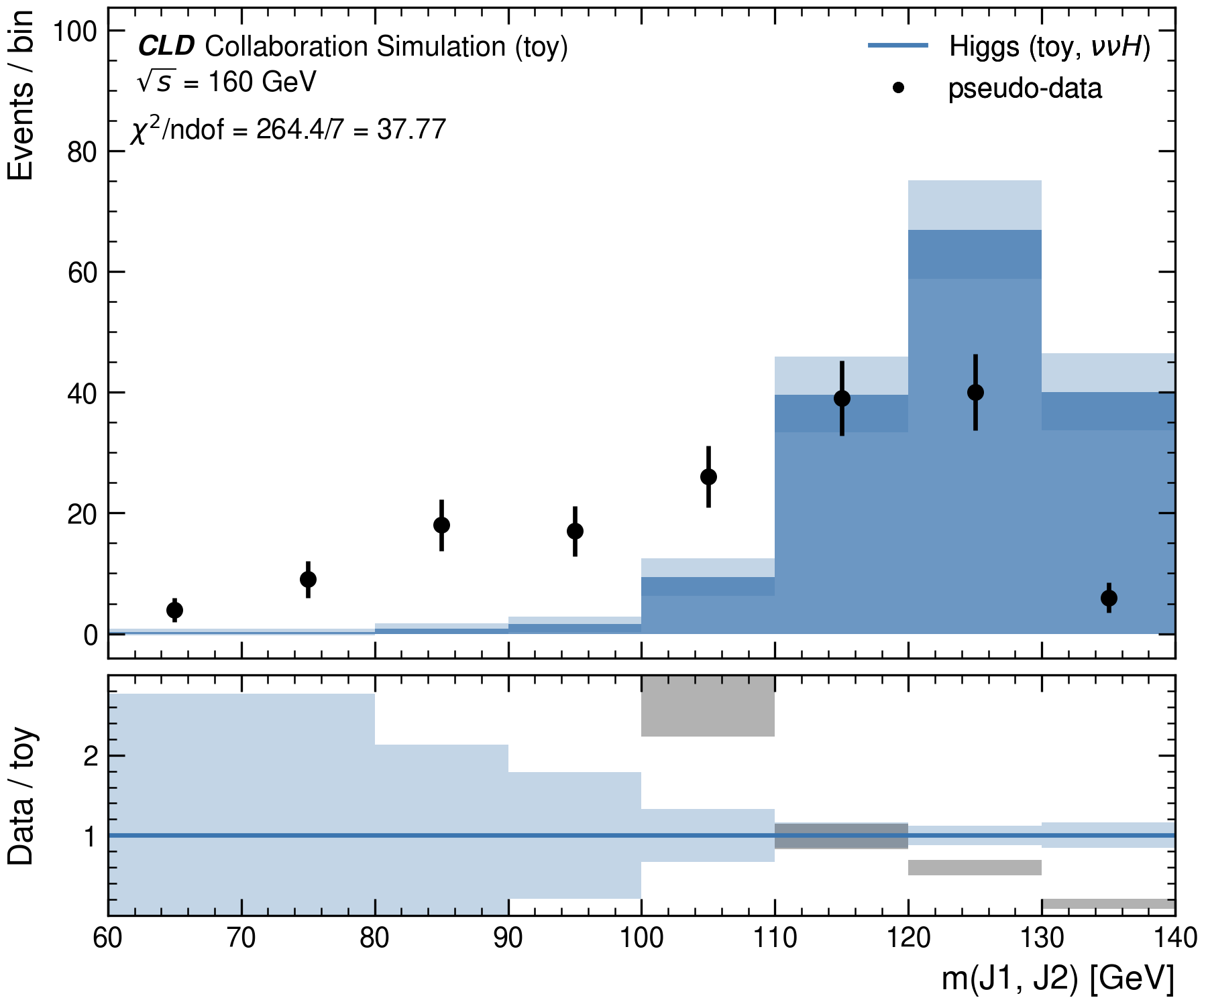
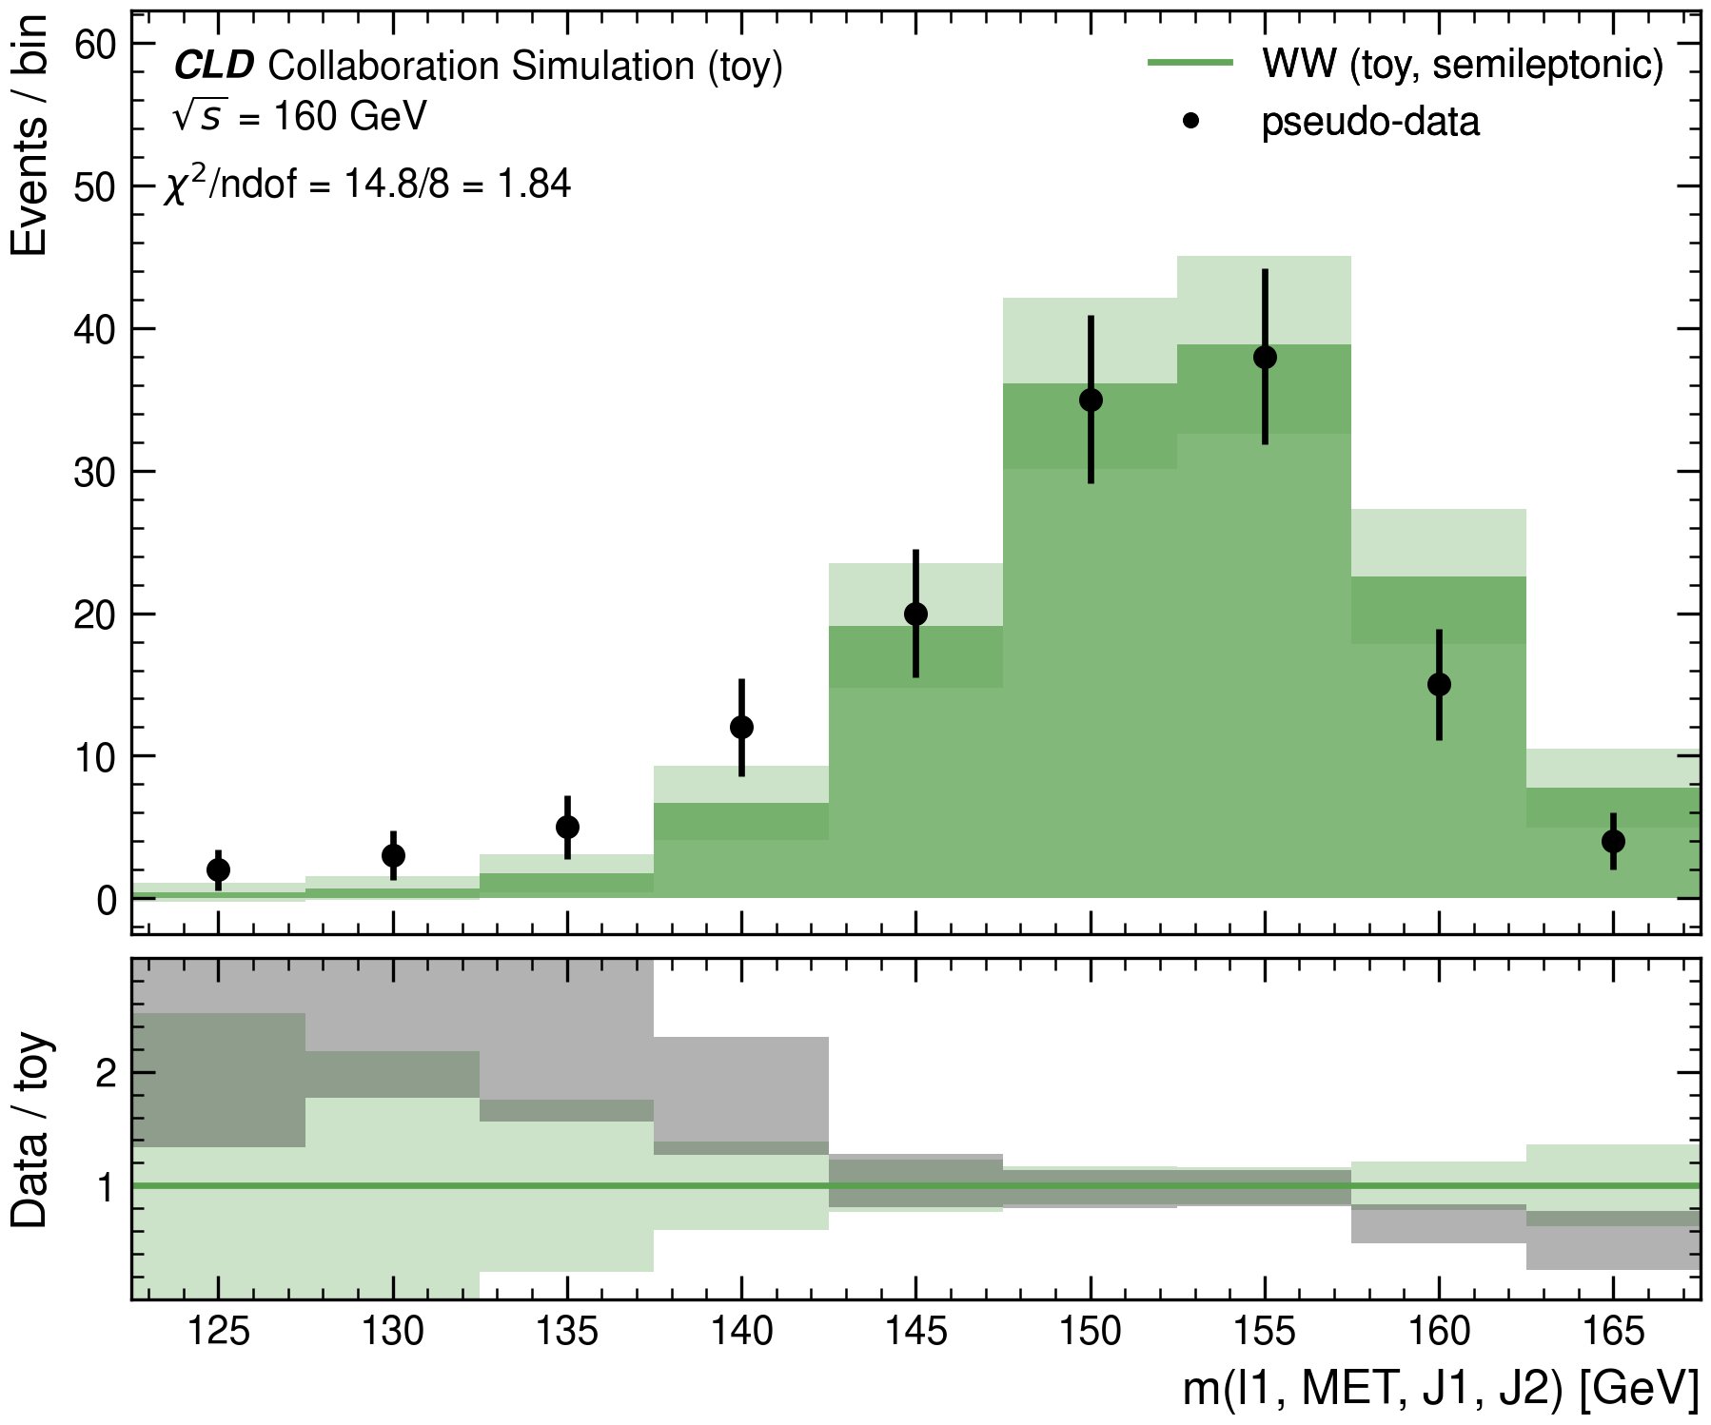
Higgs and WW mass peaks
SM · 160 GEV
Higgs: the dijet mass peaks at ~125 GeV. WW: the effective mass recovers close to √s = 160 GeV, as expected for a semileptonic decay. Both agree with the reported points at the peak.
FCC-ee CLD Collaboration
Kobe Degeetere
Slide 6
Notes:
Walk through both mass plots side by side.
Point out where each peak lands vs. expectation (125 GeV Higgs, sqrt(s)=160 GeV WW).
Note both agree with the reported points -- nothing unusual here yet.

Slide 7
SM process identification at 365 GeV
Five anonymous samples, five SM assignments
Next: Saurav Bania
Notes:
Hand off to Saurav for the 365 GeV SM identification (all five samples).

Slide 8
All five samples identified
SM · 365 GEV · STEP 1 ONLY
365 GeV is the most complete working point: all five samples get an assignment — t̅t, e⁺e⁻→ff̅, ZZ, ZH, WW. More jets are available here than at 160 GeV, so b-tagging separates these final states well.
Process | Efficiency
t̅t | 10.7%*
e⁺e⁻ → ff̅ | 10.2%*
ZZ → ℓℓqq̅ (X5) | 8.7%*
ZH | 5.4%*
WW | 52.0%*
* assumed (toy), not measured.
FCC-ee CLD Collaboration
Saurav Bania
Slide 8
Notes:
365 GeV is the richest working point -- all five processes get assigned.
Briefly mention more jets + b-tagging separates the final states well.
Keep it quick, this sets up the two 365 GeV highlight plots next.

Slide 9
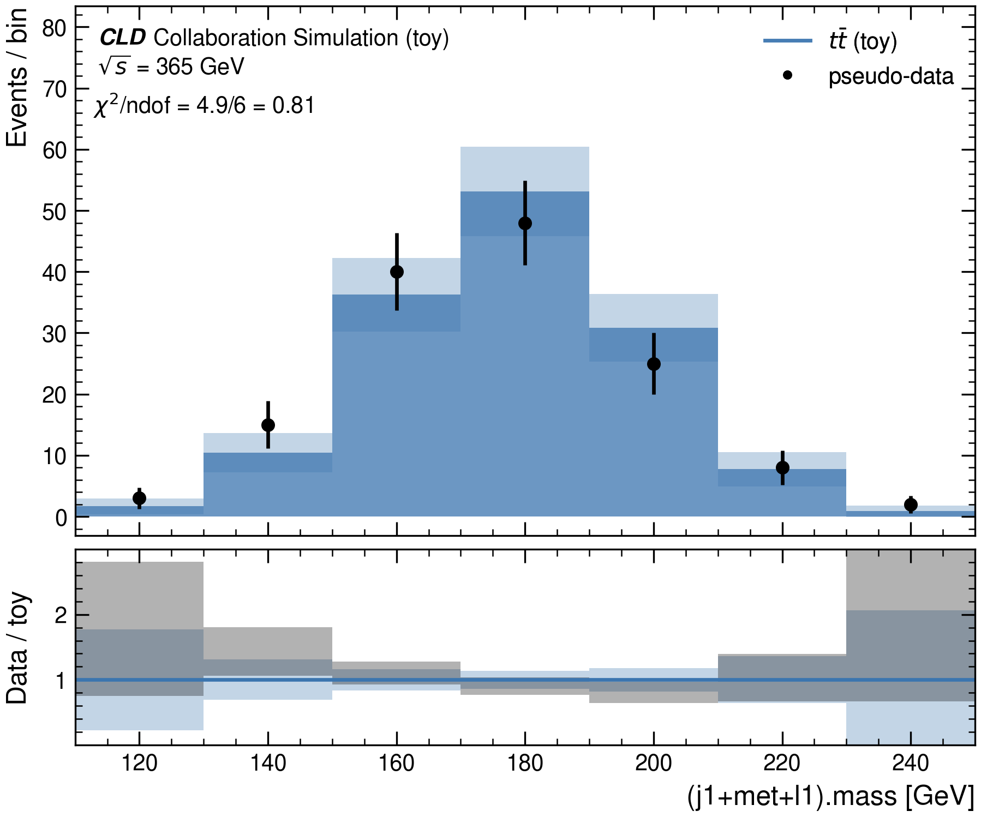
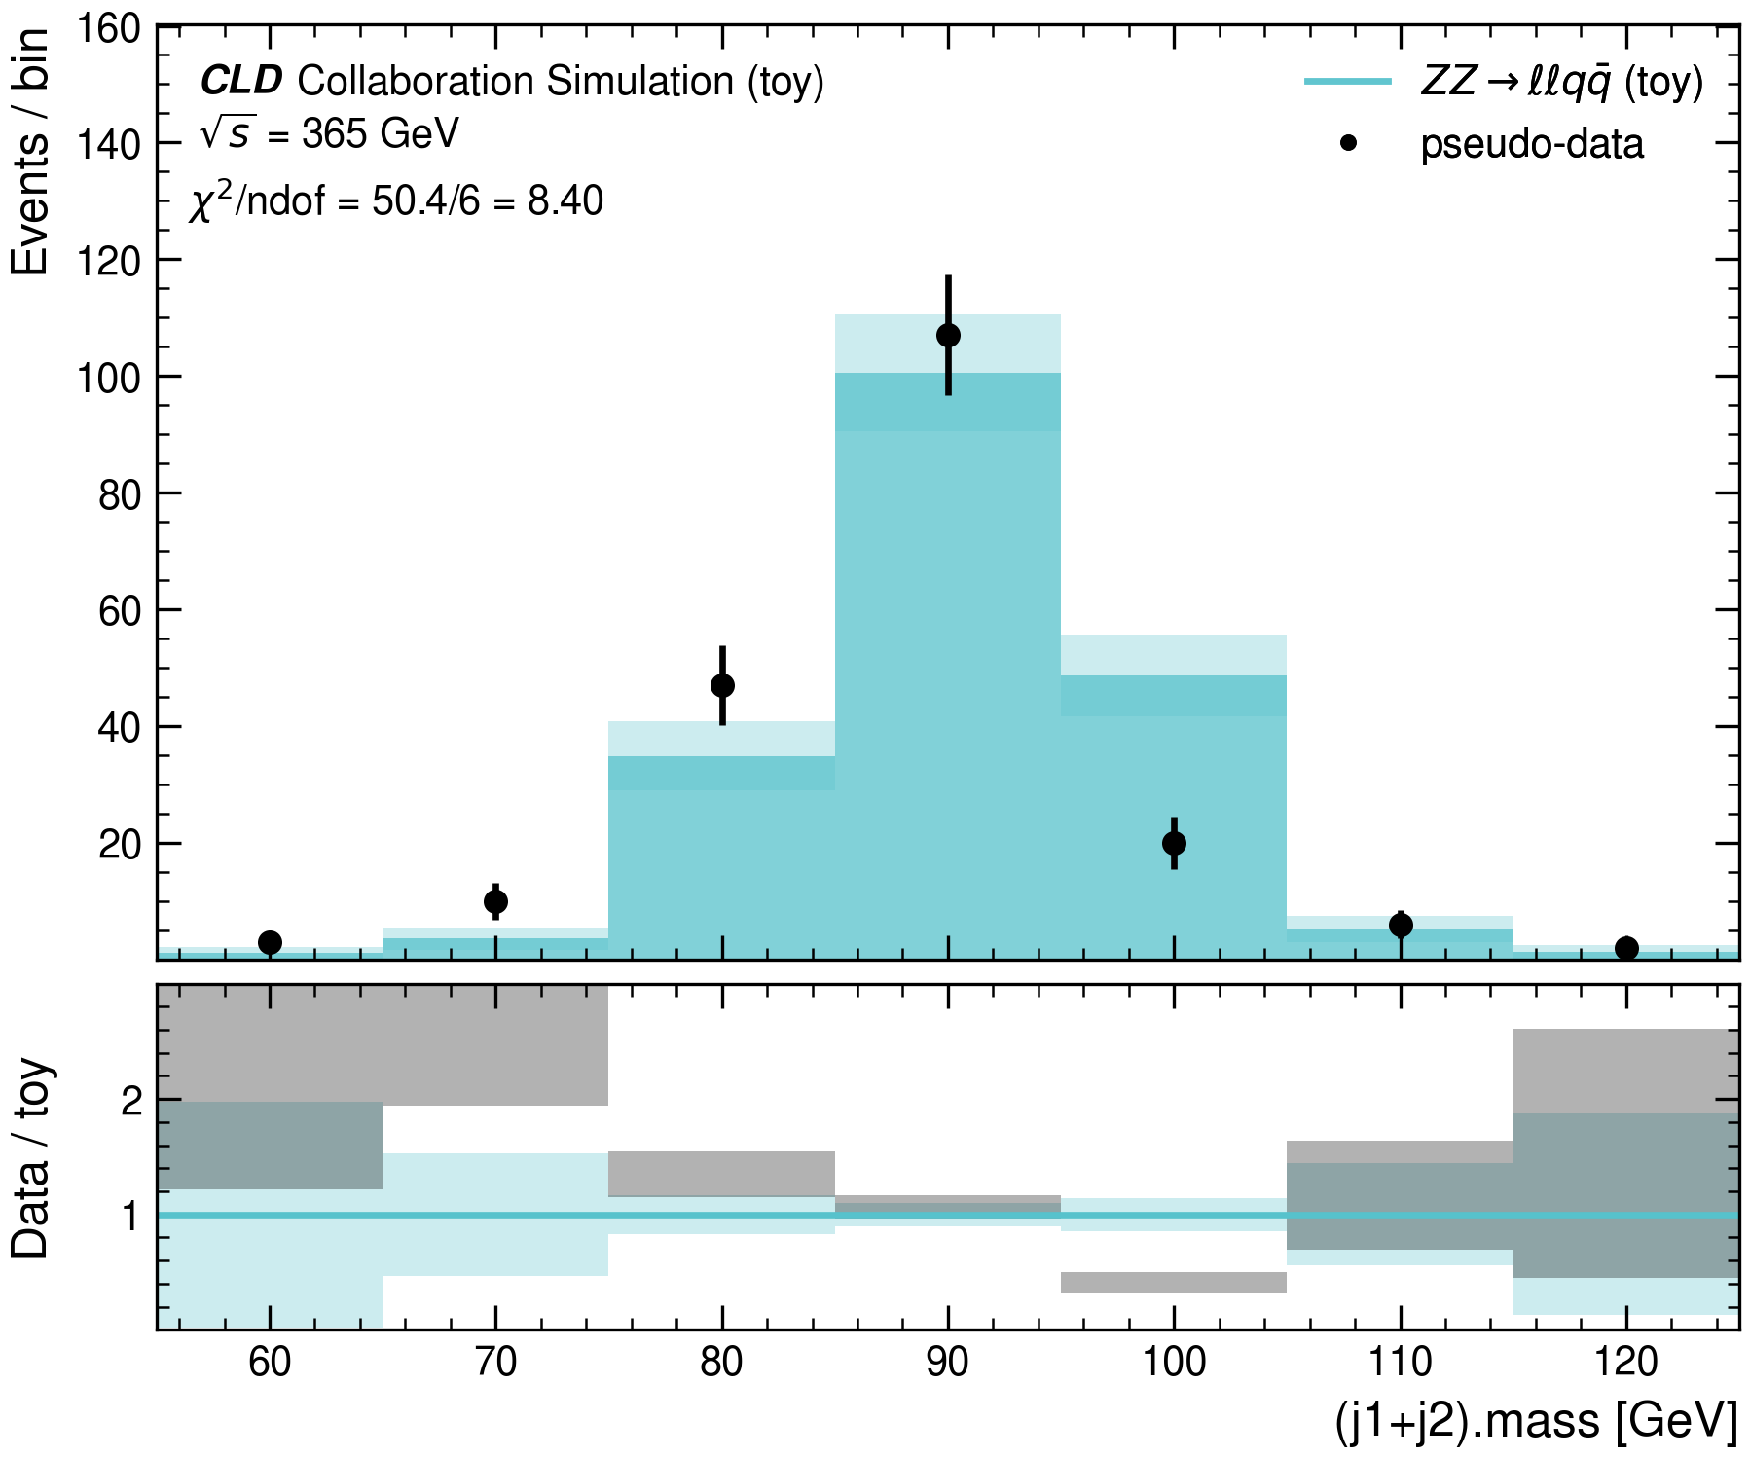
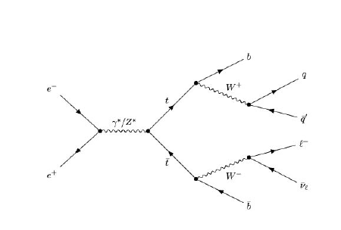
Strongest evidence: t̅t and ZZ
SM · 365 GEV
t̅t: reconstructed mass sits at the top scale, χ²/ndof = 0.81 — the best agreement in this study. ZZ: dijet mass peaks cleanly at mZ = 91 GeV.
t̅t production
FCC-ee CLD Collaboration
Saurav Bania
Slide 9
Notes:
Point at the ttbar Feynman diagram briefly to orient the audience.
Highlight this is the best chi2/ndof in the whole study (0.81).
ZZ peaks cleanly at mZ -- another clean SM identification.

Slide 10
From SM identification to the excess
Once the samples are identified, can the SM explain the observed structure?
Next: Andrea Maria
Notes:
Hand off to Andrea -- pivot from SM identification into the excess/BSM section.

Slide 11
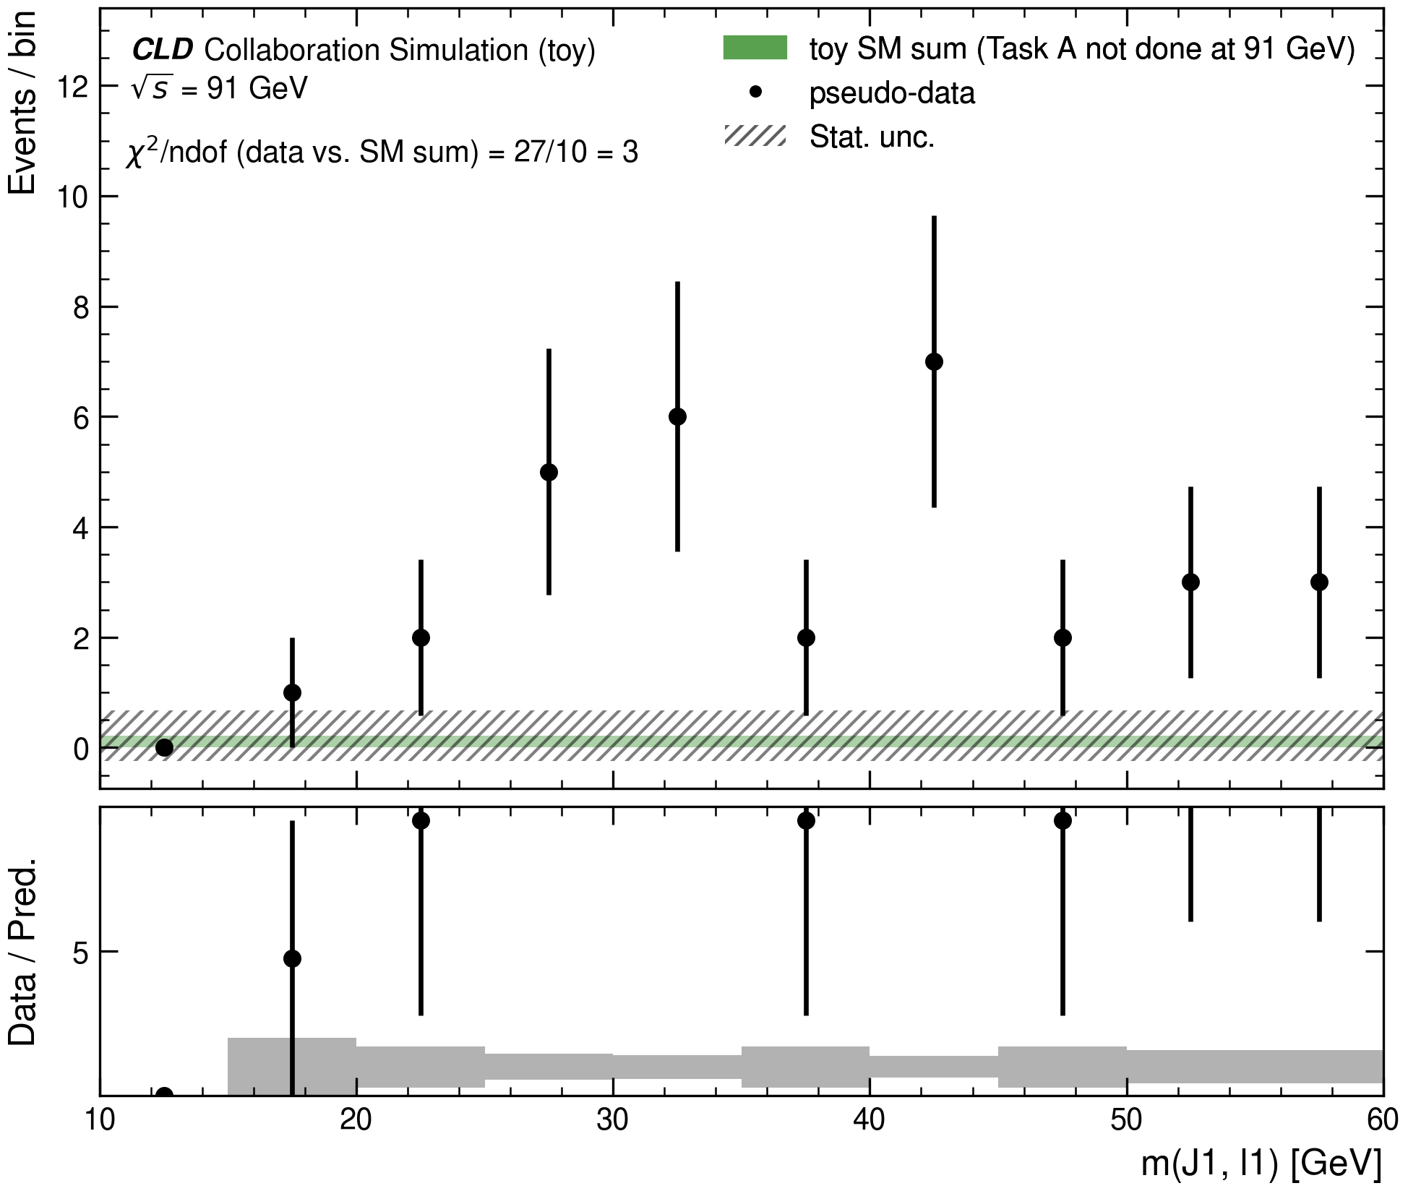
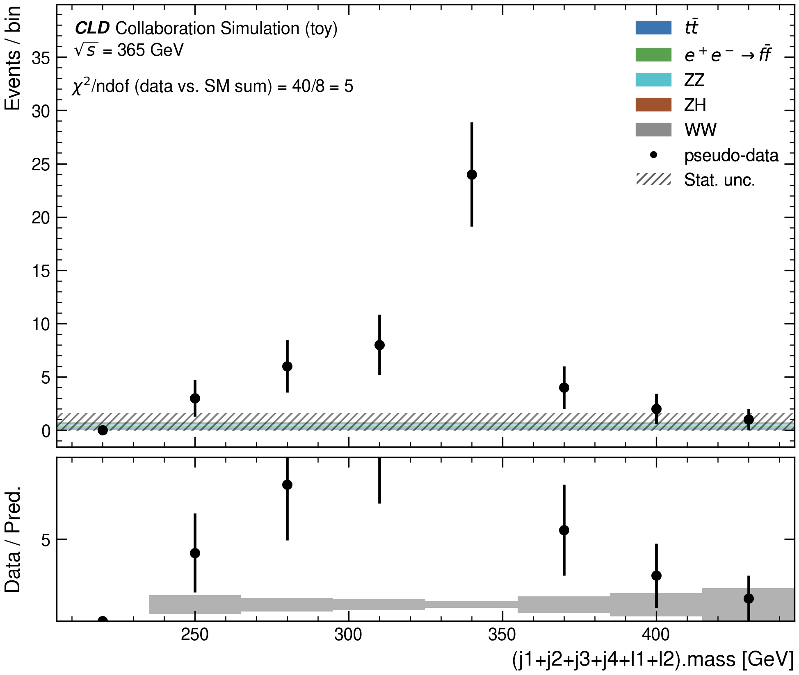
The SM alone doesn't explain it
EVIDENCE · BOTH ENERGIES
Sum every identified SM process and compare to the reported points. At both 91 and 365 GeV the excess sits far above that sum. This is why an interpretation is needed — step 2 becomes step 3.
91 GeV
365 GeV
FCC-ee CLD Collaboration
Andrea Maria
Slide 11
Notes:
This is the pivot slide of the whole talk.
Show clearly: summed SM does not cover the excess at either energy.
Say explicitly: this is why we move from evidence to interpretation (method step 2 to step 3).

Slide 12
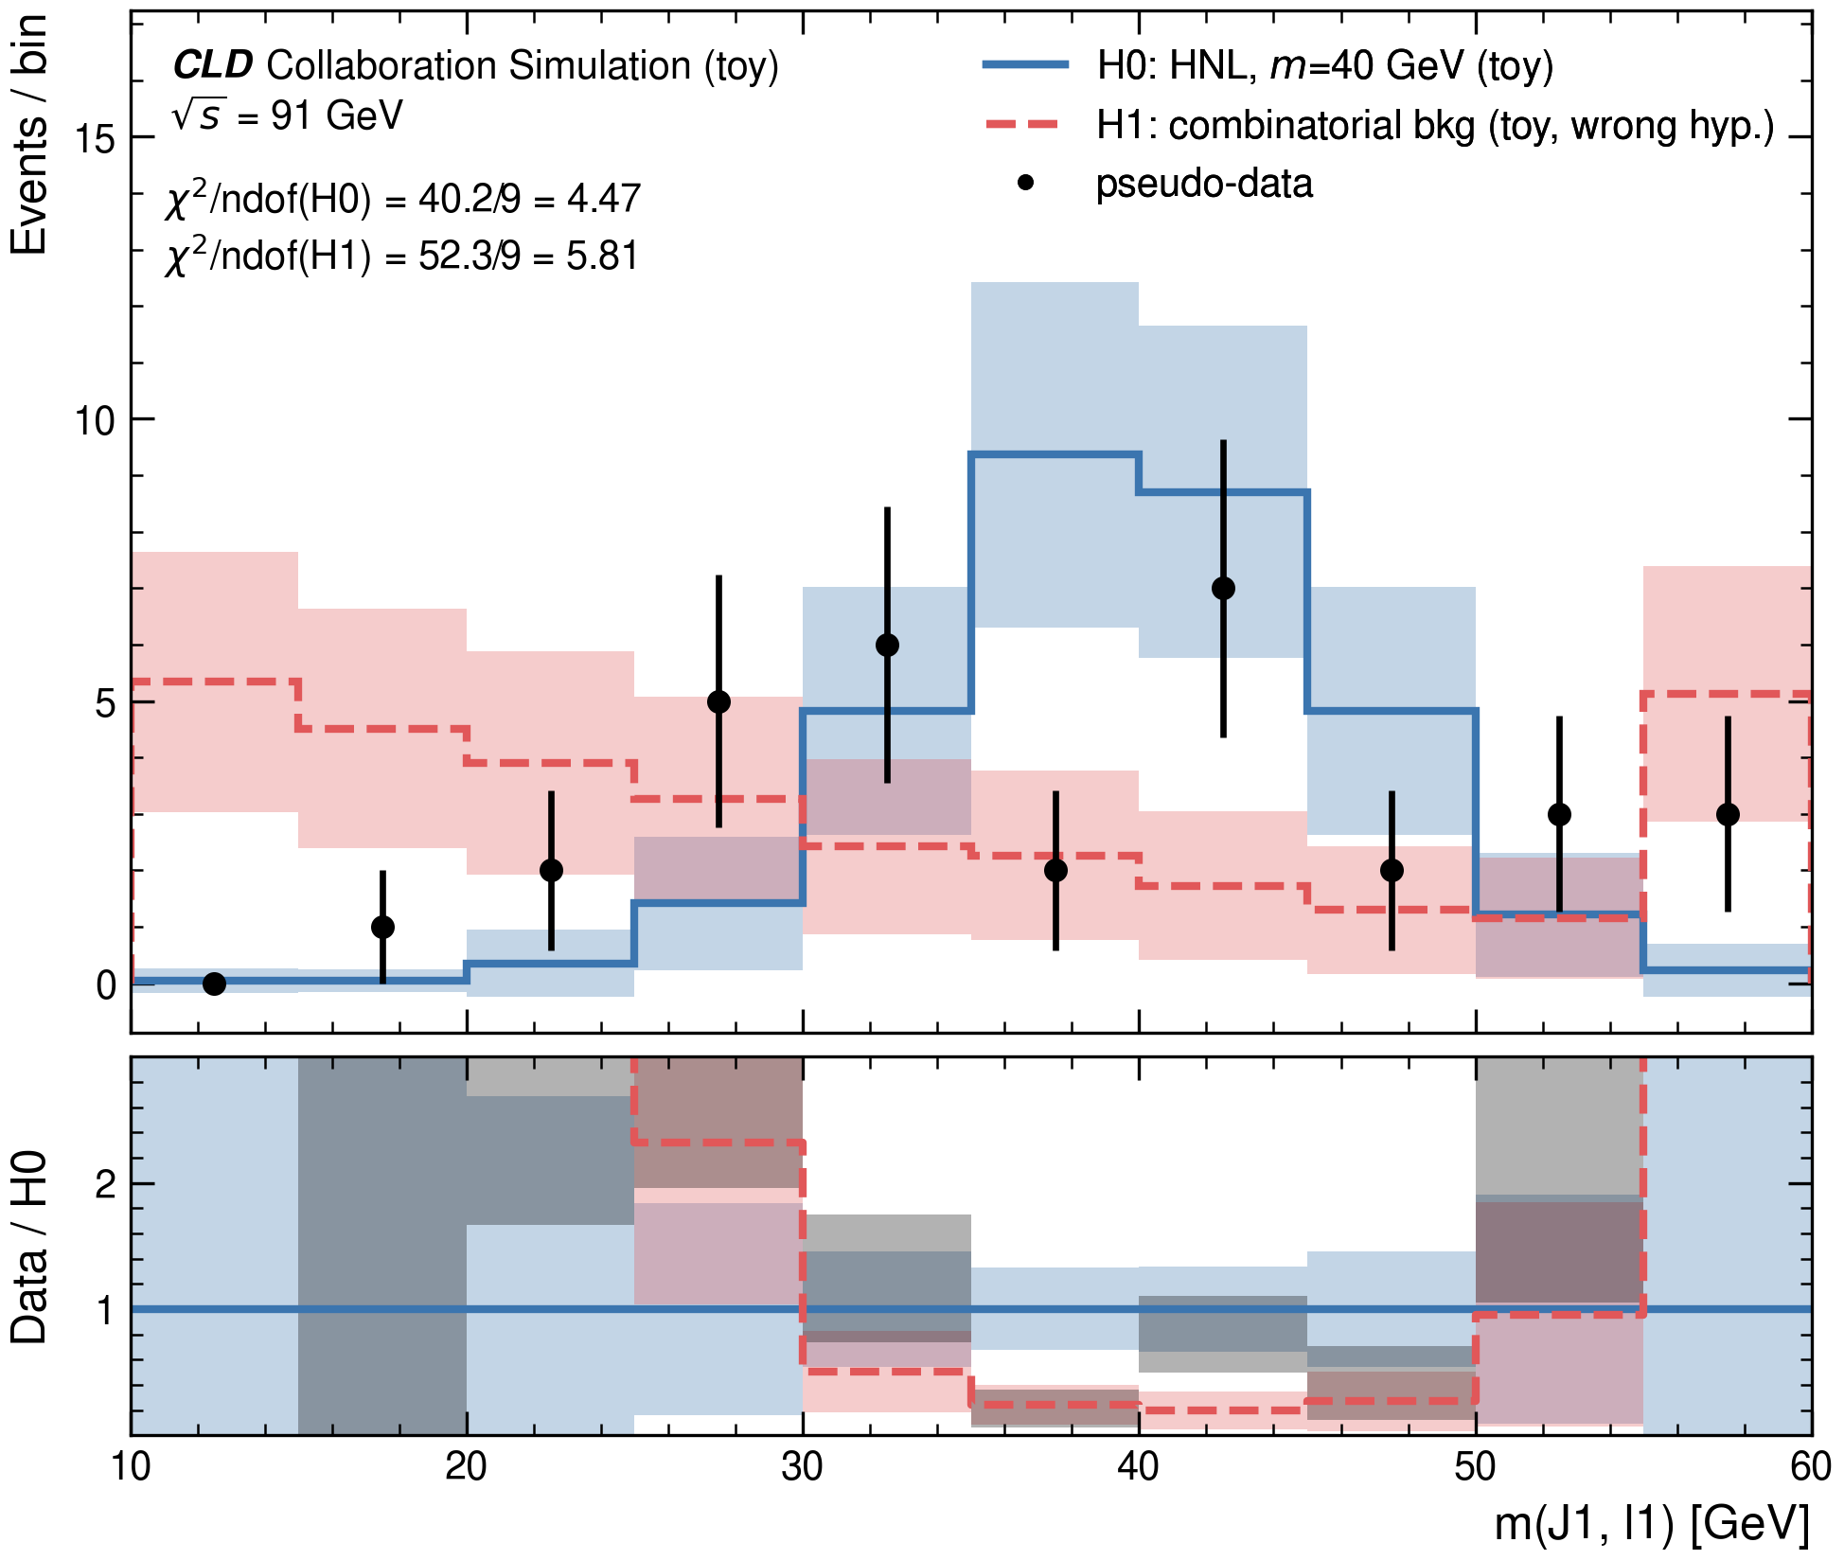
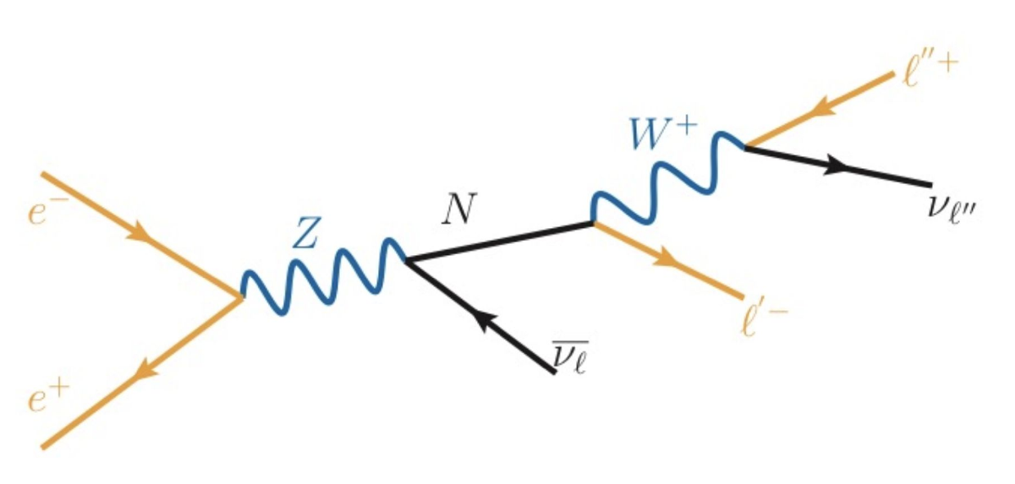
An excess, not an SM sample
BSM · 91 GEV
Excess → Reconstruction → H1: flat bkg → H0: HNL, m≈40 → Test
Tight selection: MET pT>3 GeV, ≥1 lepton, small impact parameter. A lepton+jet excess appears. Proposed: a Heavy Neutral Lepton, mass ≈40 GeV. The resonance hypothesis fits better than a flat background: χ²/ndof 4.47 vs. 5.81.
HNL at a Z-factory
FCC-ee CLD Collaboration
Andrea Maria
Slide 12
Notes:
Describe the tight selection that isolates the excess.
Introduce the HNL hypothesis, mass ~40 GeV.
Resonance fit beats flat background (4.47 vs 5.81) -- but this alone doesn't prove HNL, just that a bump fits better than no bump.

Slide 13
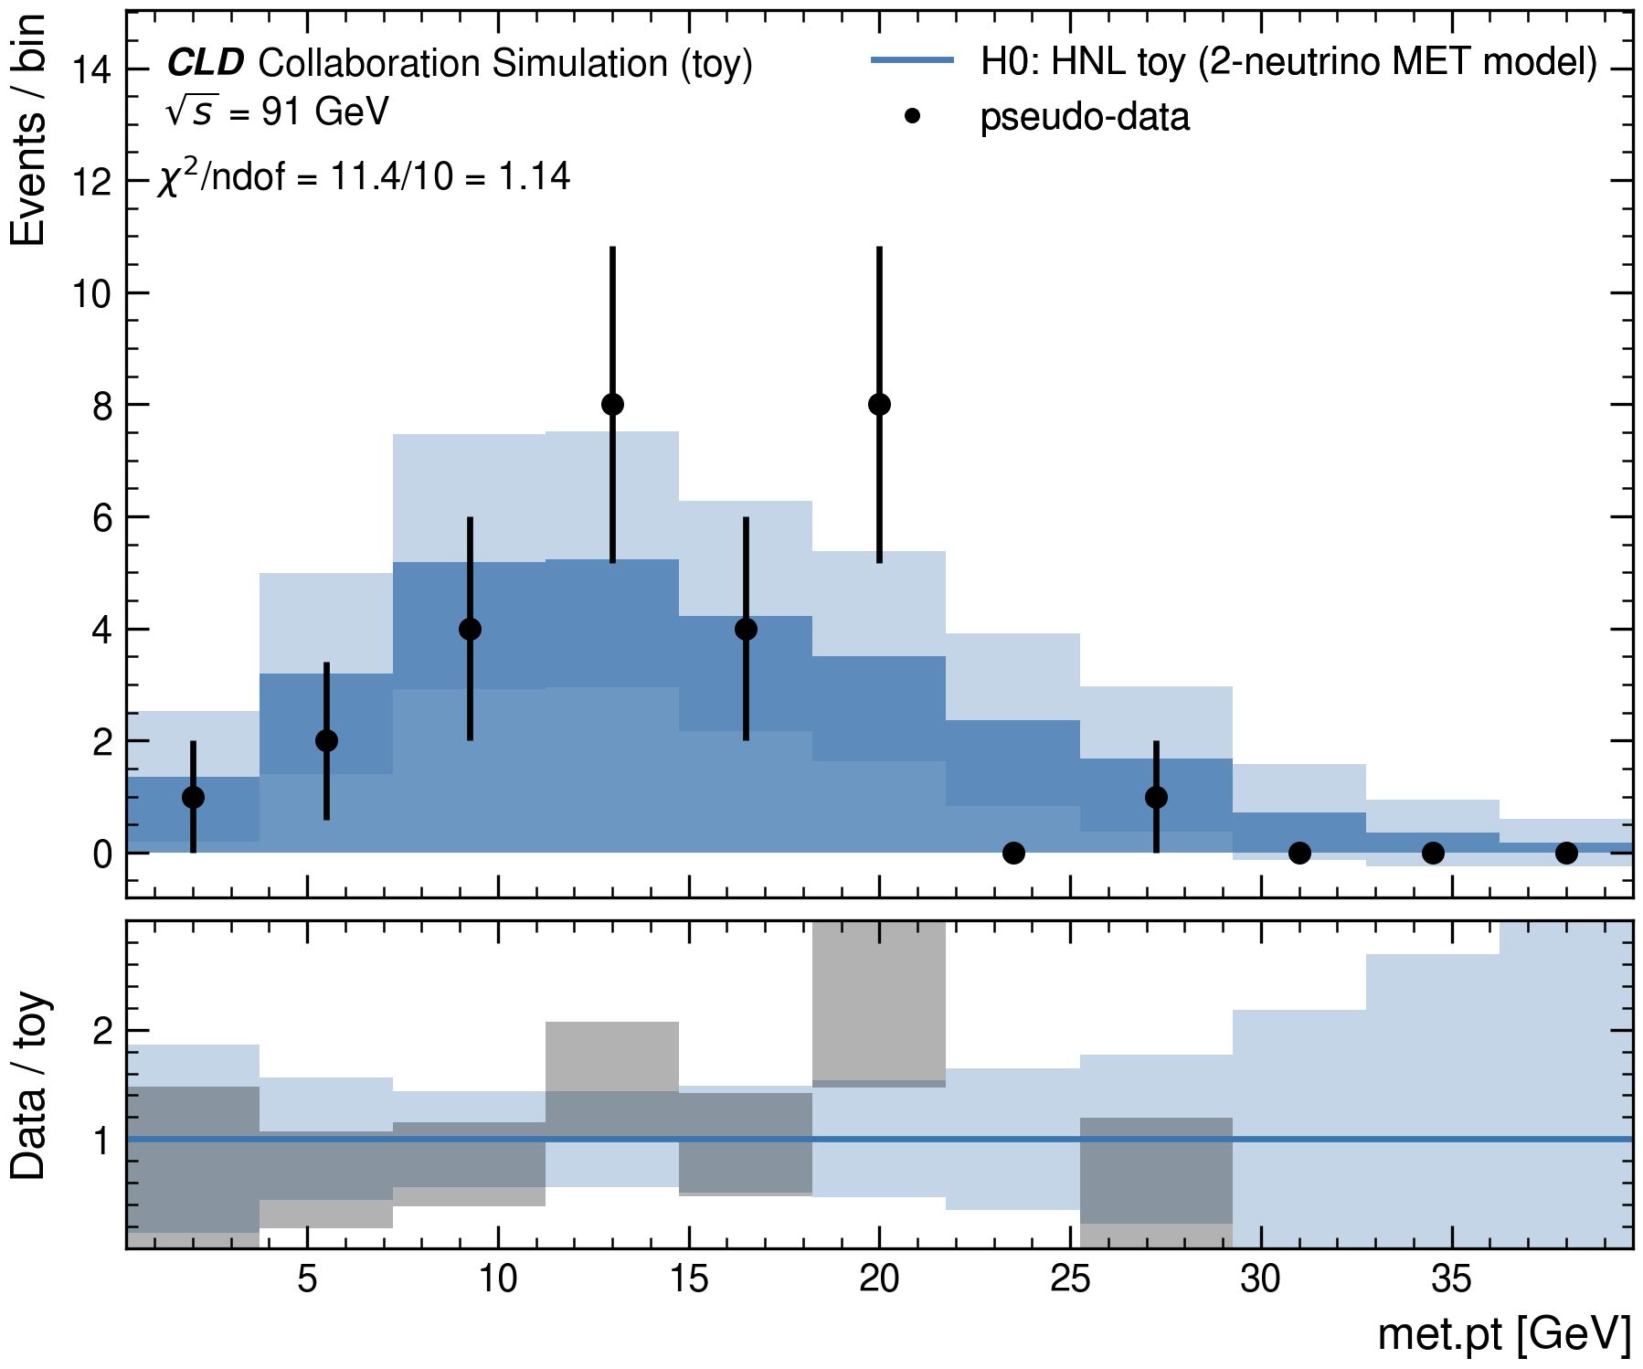
An independent cross-check
BSM · 91 GEV
A second, independent variable — missing energy itself — agrees with the same hypothesis: χ²/ndof = 1.14. This isn't the same test twice.
FCC-ee CLD Collaboration
Andrea Maria
Slide 13
Notes:
Stress independence: MET is a different observable, not a re-test of the same variable.
chi2/ndof = 1.14 is a strong agreement -- use this to build confidence before the significance slide.

Slide 14
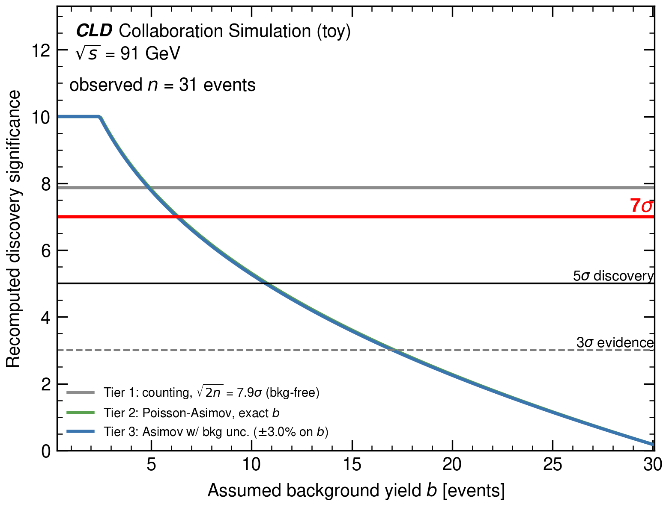
Significance of the excess
BSM · 91 GEV
The source quotes 7σ as the headline significance for the 91 GeV excess. Our recomputation, shown below, converges toward the same value. No look-elsewhere correction is applied — we don't have a real trials count.
FCC-ee CLD Collaboration
Andrea Maria
Slide 14
Notes:
State only the 7 sigma headline number -- don't cite the other tiers from the source, we're not confident they're the same definition.
Caveat clearly: no look-elsewhere correction. Don't over-claim discovery.

Slide 15
The excess at 365 GeV
Testing reconstruction and background hypotheses
Next: Jurjan Bootsma
Notes:
Hand off to Jurjan for the 365 GeV excess and pairing/reconstruction study.

Slide 16
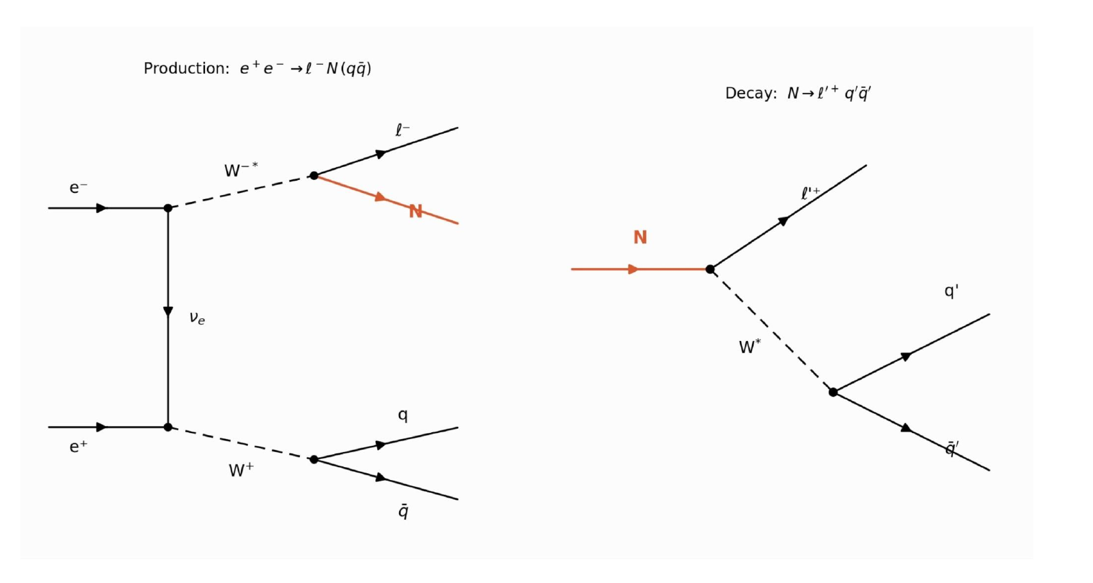
The excess, and the original method
BSM · 365 GEV
Tighter selection again: low MET, ≥2 jets, ≥2 leptons, Z-veto, b-veto. Original method: hadronic-W channel, one jet assumed, a fixed pairing m(j₂,j₃). The source itself flags this: “sub-optimal pairing might lead to large spread.”
Production and decay, slide 18
FCC-ee CLD Collaboration
Jurjan Bootsma
Slide 16
Notes:
Describe the tighter 365 GeV selection.
Explain the original method's fixed jet pairing and its acknowledged weakness (quote the source's own caveat).

Slide 17
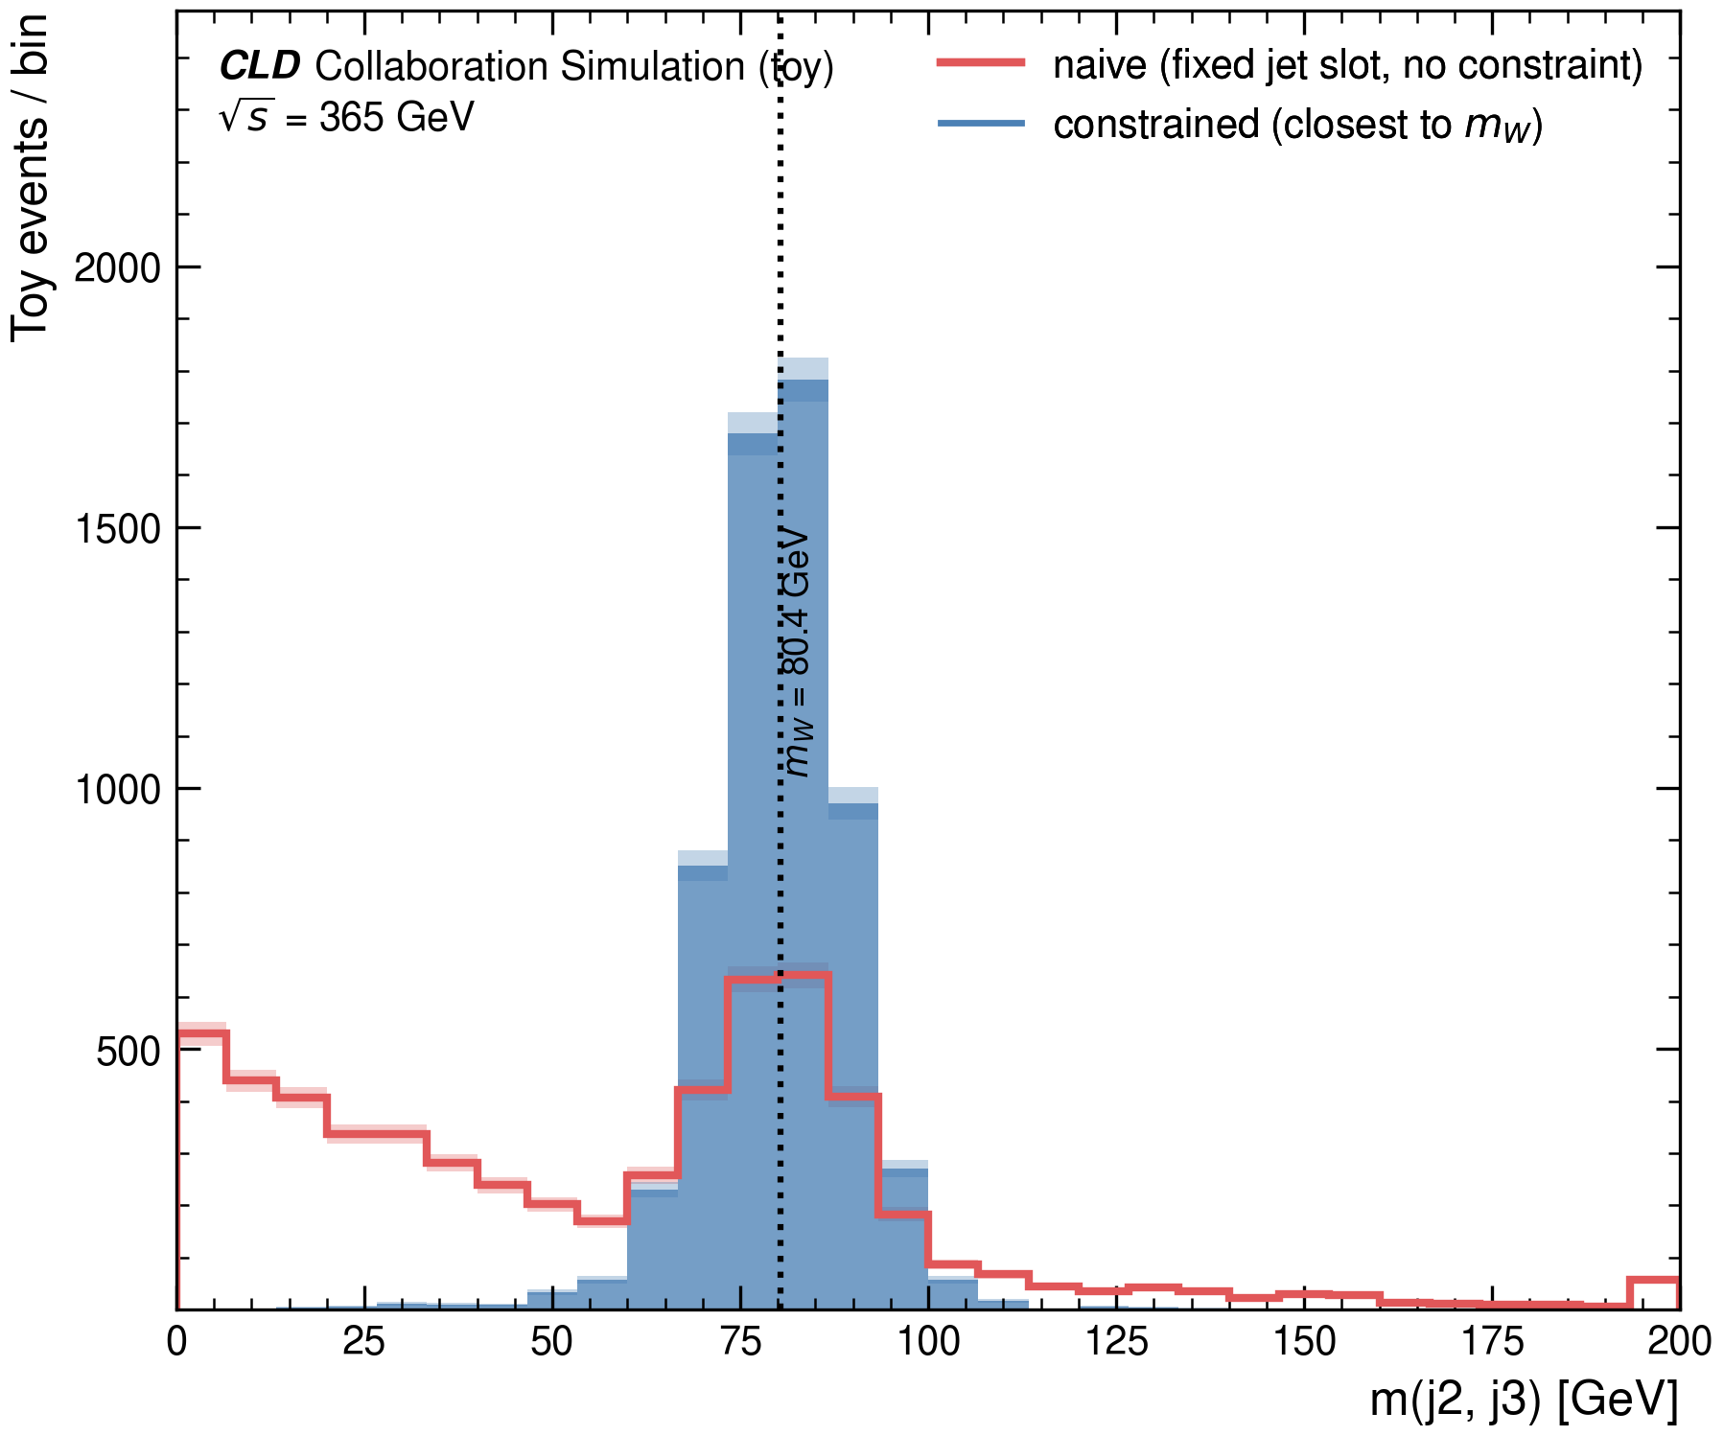
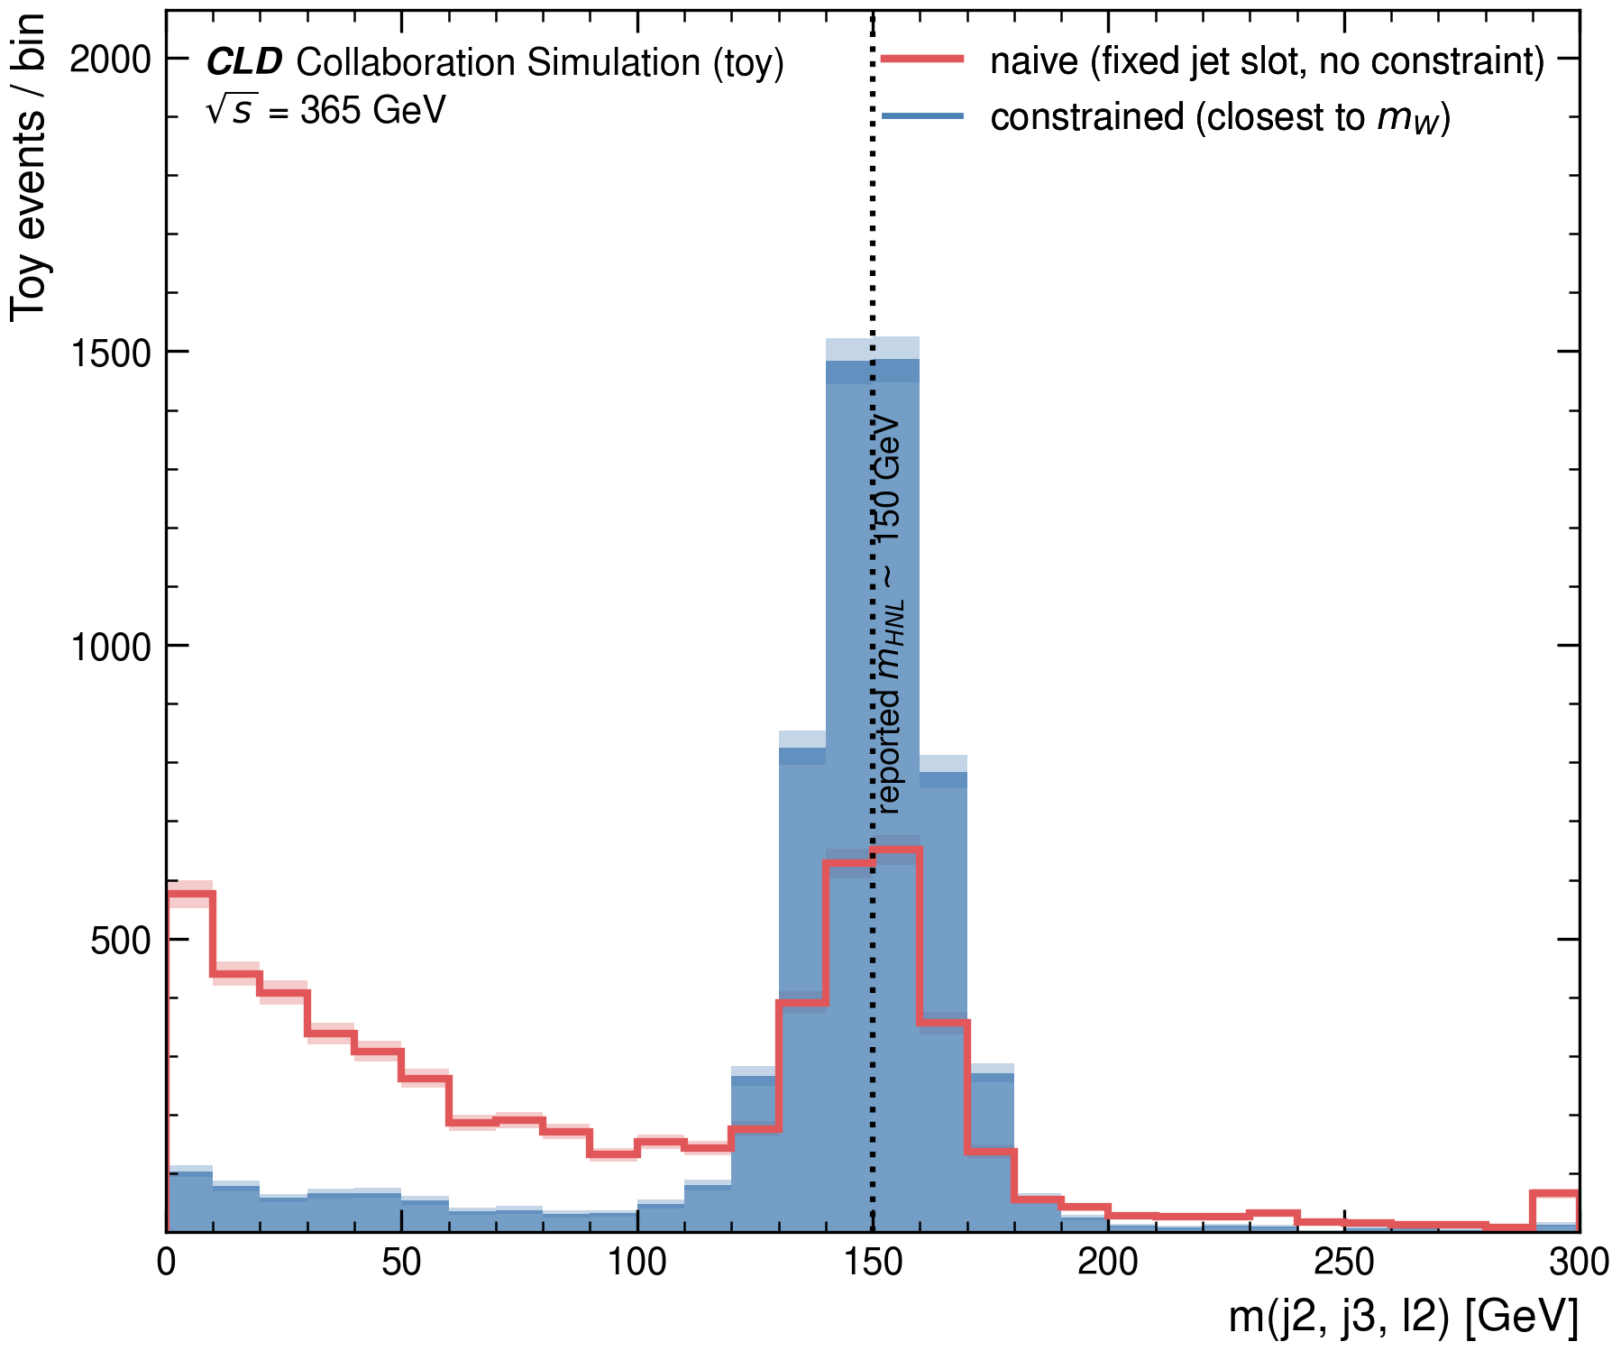
[CURRENT ANALYSIS] Testing the pairing
BSM · 365 GEV
Four jets give three candidate pairings. The fixed original pairing is correct only 33% of the time by construction. Picking the pairing closest to mW instead gets it right 88% of the time, and both peaks narrow sharply. This is evidence the original pairing can mis-associate jets — it supports better reconstruction, not an HNL by itself.
Naive = original · Constrained = current analysis
FCC-ee CLD Collaboration
Jurjan Bootsma
Slide 17
Notes:
Explain why the original pairing is only right 1/3 of the time, by construction.
Constrained (closest to mW) pairing: 88%, peaks narrow sharply.
Be careful with the conclusion: this supports better reconstruction, it is not by itself evidence for an HNL.

Slide 18
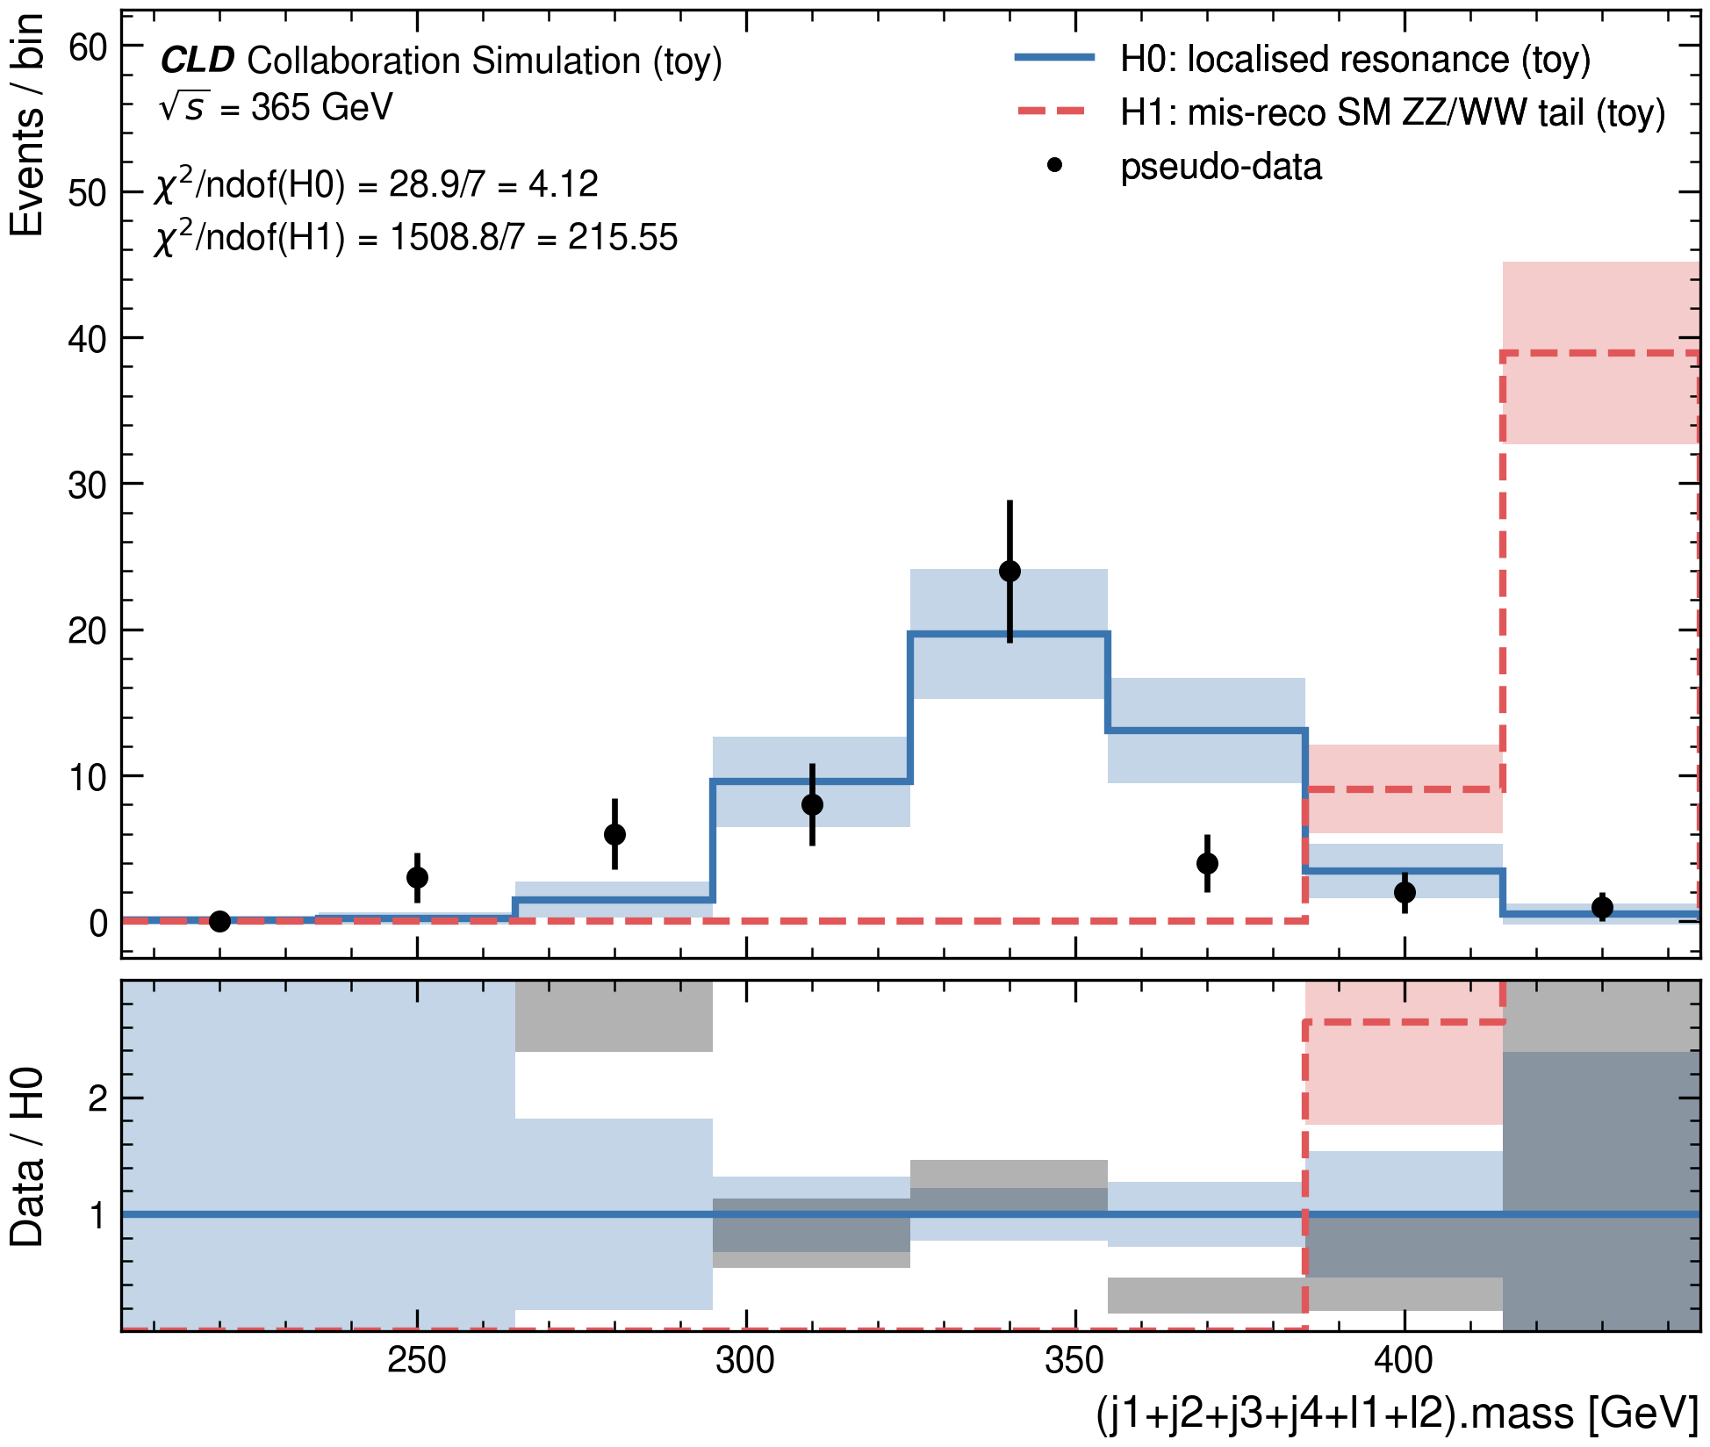
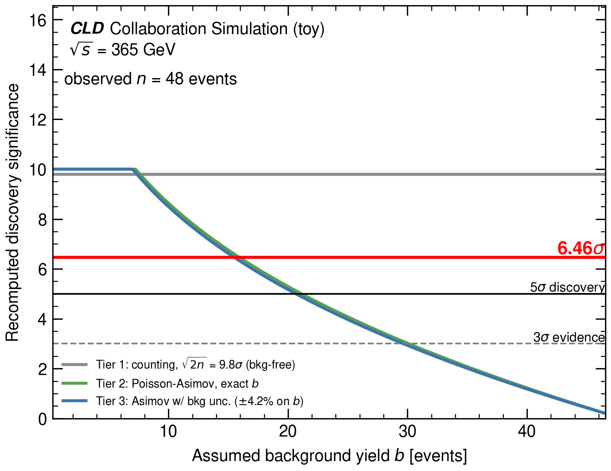
Resonance vs. SM-tail, and significance
BSM · 365 GEV
Resonance vs. a mis-measured ZZ/WW tail: χ²/ndof 4.12 vs. 215.55 — this specific SM-tail model is disfavoured. Quoted significance: 6.46σ. The background behind that number isn't established in the source.
FCC-ee CLD Collaboration
Jurjan Bootsma
Slide 18
Notes:
Chi2 comparison strongly disfavors the SM-tail alternative (4.12 vs 215.55).
Cite 6.46 sigma but flag clearly: the background behind that number is not established in the source -- treat it as quoted, not verified.

Slide 19
What has been established -- and what remains open?
Consistency, caveats, and conclusions
Next: Jurjan Bootsma
Notes:
Jurjan bridges into the closing section: consistency recap, then open questions.

Slide 20
Open questions
CONSISTENCY
40 GeV vs. 150 GeV: two HNL masses. One particle has one mass. This is open, not explained away.
365 GeV background normalisation: not established.
No look-elsewhere trial count is available, so none is applied.
Every cut efficiency shown is a toy assumption.
Rejecting one background model is not proof of an HNL.
FCC-ee CLD Collaboration
Jurjan Bootsma
Slide 20
Notes:
Walk through each open question in turn:
- 40 vs 150 GeV mass tension -- flag it, don't explain it away.
- 365 GeV background normalisation not established.
- No real trials count, so no look-elsewhere correction applied.
- All cut efficiencies are toy assumptions.
Land on: rejecting one background model is not proof of an HNL.

Slide 21
χ² per SM process
CONCLUSIONS
All five 365 GeV processes and both 160 GeV processes now have a toy-vs-pseudo-data comparison — every value traceable to this repo's code.
Process (365 GeV) | χ²/ndof
t̅t | 0.81
ZZ → ℓℓqq̅ | 8.40
e⁺e⁻ → ff̅ | 5.17†
ZH | 3.89†
WW | 26.22†
Process (160 GeV) | χ²/ndof
Higgs | 37.77
WW | 1.84
† second-pass digitisation, lower precision than the other rows (see PROVENANCE_AUDIT.md).
FCC-ee CLD Collaboration
Andrea Maria
Slide 21
Notes:
Point to the full table -- every SM process now has a chi2 comparison.
Flag the dagger-marked rows explicitly as lower-precision, second-pass digitisation -- don't present them with the same confidence as the rest.

Slide 22
Flat vs. resonant hypothesis
CONCLUSIONS
At both energies the resonance hypothesis fits better than the flat/SM-tail alternative tested. That supports the interpretation. It doesn't prove it.
 | 91 GeV | 365 GeV
Resonance (H0) χ²/ndof | 4.47 | 4.12
Flat / SM-tail (H1) χ²/ndof | 5.81 | 215.55
Reconstructed mass | ≈40 GeV | ≈150 GeV
Quoted significance | 7σ | 6.46σ
Jet mis-association (365 only) | — | 33% → 88%
FCC-ee CLD Collaboration
Andrea Maria
Slide 22
Notes:
Recap the table: resonance wins at both energies.
Significance: 7 sigma at 91 GeV, 6.46 sigma at 365 GeV -- quoted numbers only.
Reiterate the caveat: this supports the interpretation, it does not prove it.

Slide 23
Where this leaves us
CONCLUSIONS
Five SM processes at 365 GeV, two at 160 GeV, each traceable. Two excesses, both consistent with a resonance hypothesis, both with open caveats. FCC-ee's precision lets small, careful excesses be taken seriously — if every claim stays traceable. So: what do you think is really in there?
FCC-ee CLD Collaboration
Jurjan Bootsma
Slide 23
Notes:
Closing summary: seven SM processes traced, two excesses found, both open.
End on the open question to the audience: "what do you think is really in there?" -- invite discussion.

