Slide 1
TRIMNET:
A NEW DEEP LEARNING METHOD FOR MOLECULAR REPRESENTATION FROM TRIPLET MESSAGES
Machine Learning exam, Prof. Asperti

Slide 2
PRESENTATION SECTIONS
SECTION I
SECTION II
SECTION III
SECTION IV
TrimNet architecture
and dataset
Code organisation
Running the code
New implementations
Input feed forward
Message phase
Readout phase
Output feed forward
Loss function
Depth (N)
Number of attention mechanisms (K)

Slide 3
I.
TRIMNET ARCHITECTURE AND DATASET

Slide 4
MOLECULAR PROPERTY PREDICTION
GRAPH NN
MACHINE LEARNING
Operates on the graph structure with an information diffusion mechanism
TRIMNET
Requires expert knowledge and is labor-intensive
CONVOLUTIONAL NN
GCN and MPNN
Only data with a “regular data structure” (like images)
Many parameters and insufficient bond information extraction

Slide 5
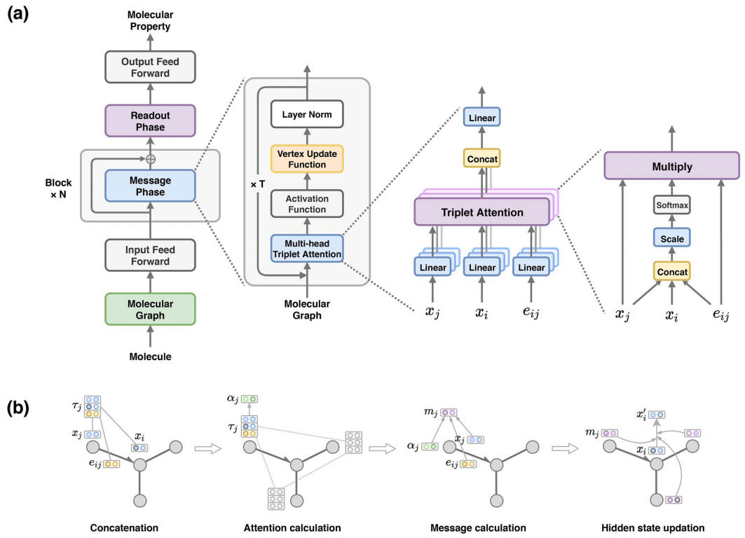
TRIMNET ARCHITECTURE
The triplet message mechanism calculates the message from atom-bond-atom information and updates the hidden states of the NN.
Drops the matrix mapping of the edges
Clear interpretation of the prediction task

Slide 6
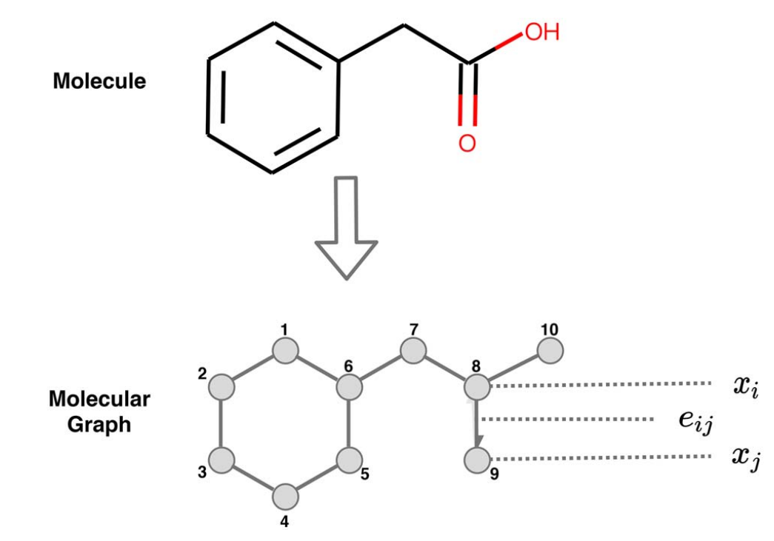
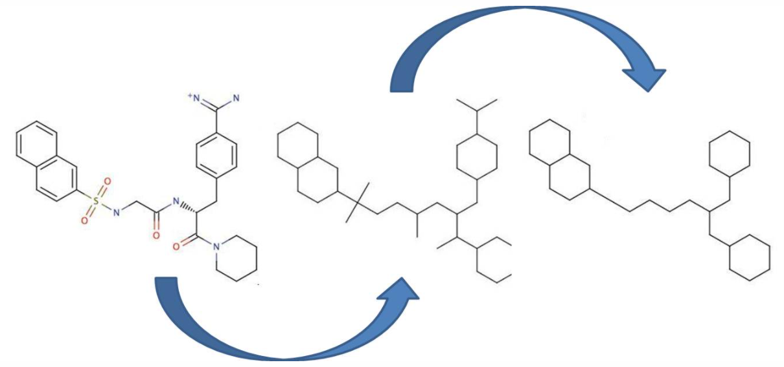
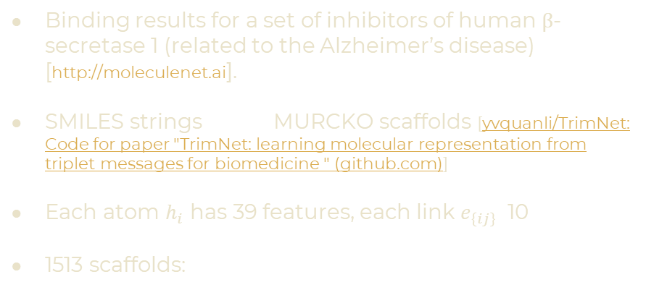
DATASET: THE BACE BENCHMARK DATASET
Binding results for a set of inhibitors of human β-secretase 1 (related to the Alzheimer’s disease) [http://moleculenet.ai].
SMILES strings MURCKO scaffolds [yvquanli/TrimNet: Code for paper "TrimNet: learning molecular representation from triplet messages for biomedicine " (github.com)]
Each atom $h_{i}$ has 39 features, each link $e_{\left\{ij\right\}}$ 10
1513 scaffolds:
RDKIT
1216 for the training
143 for the validation
154 for the testing
TASK: BINARY CLASSIFICATION
BEMIS-MURCKO FRAMEWORK GENERATION

Slide 7
II.
CODE ORGANISATION

Slide 8
(lin0): Linear(in_features=39, out_features=32, bias=True) (convs): ModuleList( (0): Block( (conv): MultiHeadTripletAttention(32, 32, heads=4) (gru): GRU(32, 32) (ln): LayerNorm((32,), eps=1e-05, elementwise_affine=True) ) (1): Block( (conv): MultiHeadTripletAttention(32, 32, heads=4) (gru): GRU(32, 32) (ln): LayerNorm((32,), eps=1e-05, elementwise_affine=True) ) (2): Block( (conv): MultiHeadTripletAttention(32, 32, heads=4) (gru): GRU(32, 32) (ln): LayerNorm((32,), eps=1e-05, elementwise_affine=True) ) ) (set2set): Set2Set(32, 64) (out): Sequential( (0): Linear(in_features=64, out_features=512, bias=True) (1): LayerNorm((512,), eps=1e-05, elementwise_affine=True) (2): ReLU(inplace=True) (3): Dropout(p=0.2, inplace=False) (4): Linear(in_features=512, out_features=2, bias=True)
[2.A]
MULTI-HEAD TRIPLET ATTENTION
1.
INPUT FEED FORWARD
[2.B]
VERTEX UPDATE FUNCTION
2.
MESSAGE PHASE (N=3)
[2.C]
LAYER NORMALIZATION
3.
READOUT PHASE
4.
OUTPUT FEED FORWARD

Slide 9
1.
INPUT FEED FORWARD

Slide 10
INPUT FEED FORWARD CODE
1.
2.
CELU(x)=max(0,x)+min(0,α*(exp(x/α)−1))
CELU(x)=max(0,x)+min(0,α*(exp(x/α)−1))
CELU(x)=max(0,x)+min(0,α*(exp(x/α)−1))
CELU(x)=max(0,x)+min(0,α*(exp(x/α)−1))
LINEAR LAYER
A linear transformation is applied to the content of the considered batch [# atoms, #atoms’ features]. The output tensor has shape [# atoms, # node_channels].
CONTINUOUSLY DIFFERENTIABLE EXPONENTIAL LINEAR UNIT
$$CELU\left(x\right)=\max\left(0,x\right)+min⁡(0,α\left(e^{\frac{x}{α}}−1\right))$$

Slide 11
2.
MESSAGE PHASE

Slide 12
MESSAGE PHASE CODE
LOOP ON THE DEPTH (NUMBER OF BLOCKS)
The tensor with all the current integrated features is taken as input.
LOOP ON THE T TIME STEPS
This tensor with all the atoms in the batch is processed by the MULTI-HEAD TRIPLET ATTENTION [2.A].
A CELU function is applied.
These extracted messages are fused with the current integrated features by a GATED RECURRENT UNIT [2.B], which acts as vertex update function.
A LAYER NORMALIZATION [2.C] is applied.
The DROPOUT stochastic regularization technique is applied.
The resulting tensor is added to the original one with the current integrated features. This is the new features’ tensor.

Slide 13
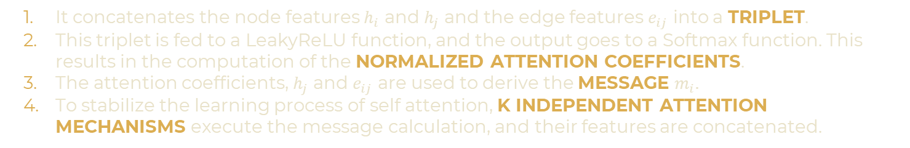
[2.A] MESSAGE CALCULATION: MULTI-HEAD TRIPLET ATTENTION
Computes the attention score and aggregates the neighboring nodes’ and edges’ information according to the ATTENTION.
Decreases the number of parameter by employing the triplet attention instead of the edges’ features matrix.
It concatenates the node features $h_{i}$ and $h_{j}$ and the edge features $e_{ij}$ into a TRIPLET.
This triplet is fed to a LeakyReLU function, and the output goes to a Softmax function. This results in the computation of the NORMALIZED ATTENTION COEFFICIENTS.
The attention coefficients, $h_{j}$ and $e_{ij}$ are used to derive the MESSAGE $m_{i}.$
To stabilize the learning process of self attention, K INDEPENDENT ATTENTION MECHANISMS execute the message calculation, and their features are concatenated.

Slide 14
MULTI-HEAD TRIPLET ATTENTION CODE (I)
1.
2.
3.
WEIGHTS INITIALIZATION
KAIMING INITIALIZATION: avoids both the vanishing and exploding gradient problem
FORWARD CALL
Multiplies the tensor with all the atoms in the batch with the weight tensor [node_channels, K*node_channels]. Same for the edges.
Defines the MESSAGE PROPAGATION by multiplying the adjacency matrix (given by the edge index and attributes tensors) and the weighted nodes’ tensor.
MESSAGE
Concatenates in a TRIPLET, for each possible edge, the values related to the corresponding edge and two atoms (for all K mechanism).

Slide 15
MULTI-HEAD TRIPLET ATTENTION CODE (II)
4.
Multiplies this tensor of triplet for the triplet_attention weight and makes a sum, so that each atom connected to an edge has only K values.
This is then fed to a LeakyReLU: the output are the ATTENTION COEFFICIENTS.
To facilitate the comparison of coefficient across different nodes, the attention coefficient are normalized with a Softmax function.
For each atom connected to an edge, the normalized attention coefficient (with its corresponding K values) is multiplied with the tensor related to that edge and the other atom. This is the FINAL MESSAGE.
UPDATE
The nodes embeddings (node_channels values for each mechanism, for each node) are updated by multiplying them with a weight tensor and adding a vector of bias.

Slide 16
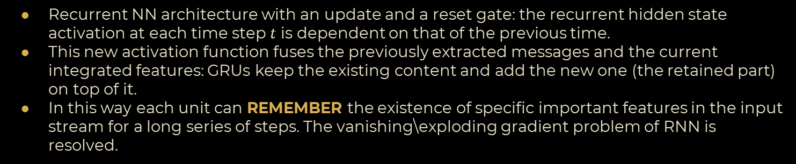
[2.B] VERTEX UPDATE: GATED RECURRENT UNIT
Recurrent NN architecture with an update and a reset gate: the recurrent hidden state activation at each time step $t$ is dependent on that of the previous time.
This new activation function fuses the previously extracted messages and the current integrated features: GRUs keep the existing content and add the new one (the retained part) on top of it.
In this way each unit can REMEMBER the existence of specific important features in the input stream for a long series of steps. The vanishing\exploding gradient problem of RNN is resolved.
Takes as input: - the final message computed by the multi-head triplet attention mechanism
- the tensor containing the current integrated features as the initial hidden state for each element in the batch at the beginning of the Block (at the first time step) or as the tensor containing the hidden state of the GRU unit.
Gives as output: - the tensor containing the output features from the last layer of the GRU.
- the tensor containing the final hidden state.

Slide 17
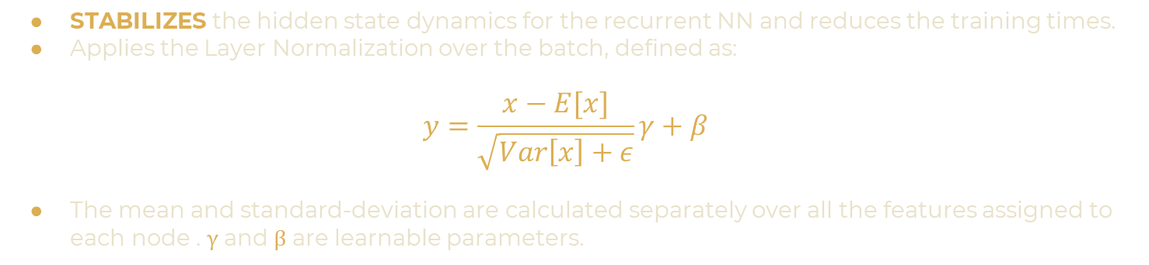
[2.C] LAYER NORMALIZATION
STABILIZES the hidden state dynamics for the recurrent NN and reduces the training times.
Applies the Layer Normalization over the batch, defined as:
$$y=\frac{x−E[x]}{\sqrt{Var\left[x\right]+ε}}γ+β$$
The mean and standard-deviation are calculated separately over all the features assigned to each node . γ and β are learnable parameters.

Slide 18
3.
READOUT PHASE

Slide 19
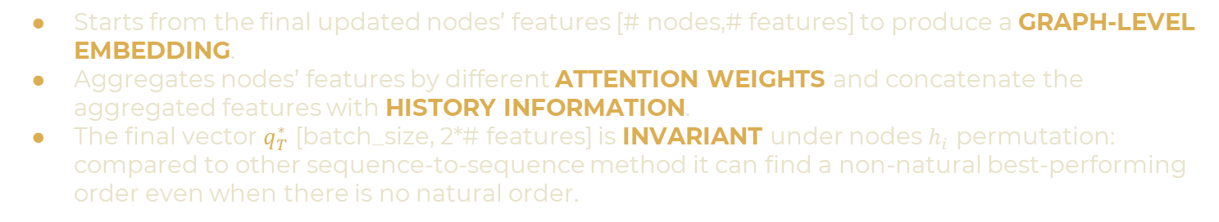
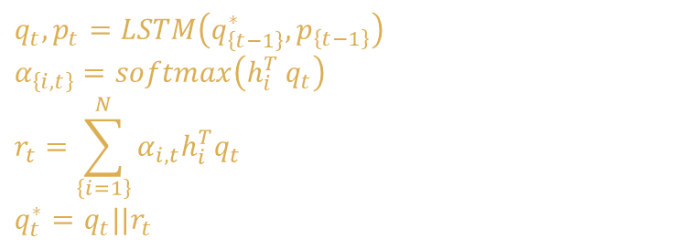
READOUT PHASE: SET2SET
Starts from the final updated nodes’ features [# nodes,# features] to produce a GRAPH-LEVEL EMBEDDING.
Aggregates nodes’ features by different ATTENTION WEIGHTS and concatenate the aggregated features with HISTORY INFORMATION.
The final vector $q_{T}^{∗}$ [batch_size, 2*# features] is INVARIANT under nodes $h_{i}$ permutation: compared to other sequence-to-sequence method it can find a non-natural best-performing order even when there is no natural order.
Initializes two null tensors: $p \{\left[layers,batch size,input channels\right],[layers,batch size,input channels]$} and $q^{∗} [batch size,output channels]$.
For t in range (0,processing_steps=T’) it performs:
$$q_{t},p_{t}=LSTM\left(q_{\left\{t−1\right\}}^{∗},p_{\left\{t−1\right\}}\right)$$
$$α_{\left\{i,t\right\}}=softmax\left(h_{i}^{T }q_{t}\right)$$
$$r_{t}=\sum_{\left\{i=1\right\}}^{N}{α_{i,t}h_{i}^{T}q_{t}}$$
$$q_{t}^{∗}=q_{t}||r_{t}$$
By extracting the atomic attention weights in Set2Set, we can visualize the atomic groups that determines the molecule’s properties.

Slide 20

LONG SHORT TERM MEMORY UNIT
RNN architecture that can deal with the vanishing\exploding gradient problem.
Uses gating mechanisms to control the flow of long-term and short-term dependencies.
Takes three information: the current input data, the short-term memory from the previous cell and the long-term memory.
Then uses gates to regulate the information to be kept or discarded at each time step
Input gate.
Forget gate
Output gate
$$q^{∗}$$
$$p\left[0\right]$$
$$p[1]$$
Current input data
Short-term memory
Long-term memory

Slide 21
4.
OUTPUT FEED FORWARD

Slide 22
OUTPUT FEED FORWARD CODE
1.
2.
3.
4.
5.
CELU(x)=max(0,x)+min(0,α*(exp(x/α)−1))
LINEAR LAYER
A linear transformation is applied to the content of the output
[batch_size, 2*# features] of Set2Set, after a DROPOUT. The output tensor has shape [batch_size, 512].
LAYER NORMALIZATION
Over the 512 features of each of the batch_size examples in the batch.
RELU FUNCTION
Default activation function for many types of neural networks because a model that uses it is easier to train and often achieves better performance.
DROPOUT
During training, randomly zeroes some of the elements of the input tensor with probability p using samples from a Bernoulli distribution. Effective stochastic regularization technique for preventing the co-adaptation of units.
LINEAR LAYER
A linear transformation is applied to the tensor [batch_size, 512]. The output tensor has shape [batch_size, 2]. This is the FINAL PREDICITION $\hat{y}$.

Slide 23
III.
RUNNING THE CODE

Slide 24
RUNNING THE CODE
1.
2.
3.
INITIALIZATION
Hyper-parameter definition. Definition of the model and the dataset
LOOP ON THE EPOCHS
TRAINING: LOOP ON THE BATCHES
Model’s prediction and computation of the LOSS. BACKPROPAGATION and ADAM OPTIMIZATION (with the saved learning rate) of the parameters
VALIDATION AND TESTING: LOOP ON THE BATCHES
Model’s prediction and computation of the LOSS.
Computation of the MEAN OF THE LOSSES of all batches (for training, validation and testing). Computation of the new learning rate with a LEARNING RATE SCHEDULER.
RESULTS
Selection and testing of the best model.

Slide 25
TRAINING AND HYPERPARAMETERS
TrimNet is trained via the standard batch gradient descent method with the error back-propagation algorithm.
To update the parameters the optimization algorithm ADAM is used
Gets gradient.
Compute the first and second moment estimates.
Updates the parameters.
To reduce overfitting the WEIGHT DECAY regularization technique is added to ADAM
To find the optimal hyperparameters a grid search procedure was applied in the original article.

Slide 26
IV.
NEW IMPLEMENTATIONS

Slide 27
NEW LOSS FUNCTION: FOCAL LOSS
Differentiate betweeen positive and negative examples
Differentiate between easy and hard examples too
CROSS ENTROPY
FOCAL LOSS
 | LOSS | AREA UNDER THE ROC CURVE | PRECISION
TESTING OF THE BEST ORIGINAL MODEL | 0.765 | 0.744 | 0.665
TESTING OF THE BEST FOCAL LOSS MODEL | 0.112 | 0.538 | 0.489

Slide 28
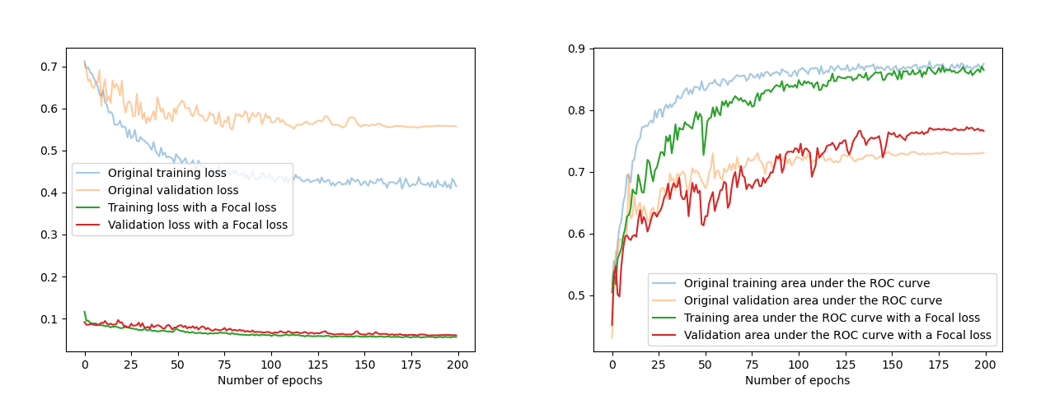
COMPARISON BETWEEN ORIGINAL MODEL AND MODEL WITH A FOCAL LOSS

Slide 29
NEW NUMBER OF BLOCKS: CHANGING N
 |  | N=2 | ORIGINAL MODEL (N=3) | N=6 | N=9
PRECISION OF THE BEST MODEL |  | 0.531 | 0.665 | 0.568 | 0.531
ELAPSED TIME FOR 200 EPOCHS |  | 30.0 min | 44.8 min | 83.2 min | 113.8

Slide 30
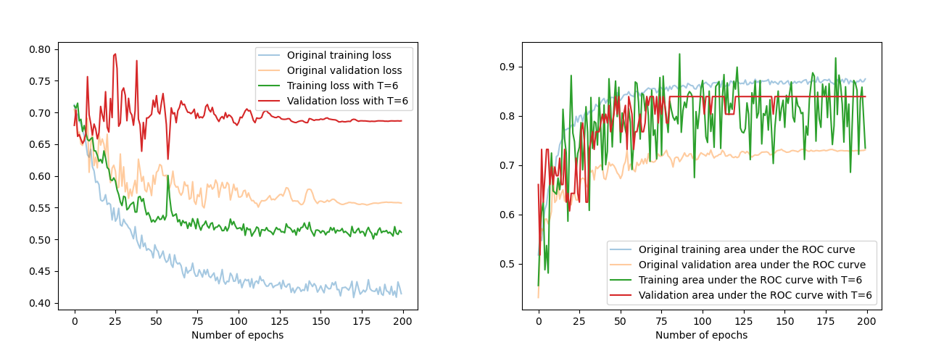
COMPARISON BETWEEN ORIGINAL MODEL AND MODEL WITH N=6

Slide 31
NEW NUMBER OF ATTENTION MECHANISMS: CHANGING K
 | K=2 | ORIGINAL MODEL (K=4) | K=8
PRECISION OF THE BEST MODEL | 0.622 | 0.665 | 0.538
ELAPSED TIME FOR 200 EPOCHS | 25.6 min | 44.8 min | 67.7 min

Slide 32
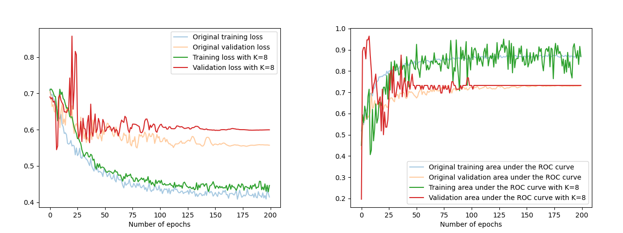
COMPARISON BETWEEN ORIGINAL MODEL AND MODEL WITH K=8

Slide 33
RESOURCES
BIBLIOGRAPHY
Pengyong Li, Yuquan Li, Chang-Yu Hsieh, Shengyu Zhang, Xianggen Liu, Huanxiang Liu, Sen Song,Xiaojun Yao.TrimNet: learning molecular representation from triplet messages for biomedicine.Briefings in Bioinformatics, bbaa266
Chung J, Gulcehre C, Cho KH et al.Empirical evaluation of gated recurrent neural networks onsequence modeling.In: arXiv preprint, arXiv:1412.3555, 2014
Jimmy Lei Ba, Jamie Ryan Kiros and Geoffrey E. Hinton.Layer Normalization.ArXiv 1607.06450.2016
Vinyals O, Bengio S, Kudlur M et al.Order matters: sequence to sequence for sets.In: InternationalConference on Learning Representations, San Juan, Puerto Rico, 2016. ICLR Press.
Tsubaki M, Tomii K, Sese J.Compound-protein interaction prediction with end-to-end learning ofneural networks for graphs and sequences.Bioinformatics 2019; 35(2): 309–18.
RDKIT: Open-source cheminformatics. In 2006. rdkit.org
K. He, X. Zhang, S. Ren and J. Sun.Delving Deep into Rectifiers: Surpassing Human-LevelPerformance on ImageNet Classification.2015 IEEE International Conference on Computer Vision(ICCV), Santiago, 2015, pp. 1026-1034, doi: 10.1109/ICCV.2015.123.
Kingma DP, Ba JL.Adam: a method for stochastic optimization.In: International Conference onLearning Representations, San Diego, CA, 2015. ICLR Press
Govindan Subramanian, Bharath Ramsundar, Vijay Pande, and Rajiah Aldrin Denny.ComputationalModeling ofβ−Secretase 1 (BACE-1) Inhibitors Using Ligand Based Approaches.. Chem. Inf. Model.2016, 56, 10, 1936–1949.
Xiong, Zhaoping and Wang, Dingyan and Liu, Xiaohong and Zhong, Feisheng and Wan, Xiaozhe andLi, Xutong and Li, Zhaojun and Luo, Xiaomin and Chen, Kaixian and Jiang, H. and Zheng, Mingyue.(2019).Pushing the boundaries of molecular representation for drug discovery with graph attentionmechanism.Journal of Medicinal Chemistry. 63. 10.1021/acs.jmedchem.9b00959.
ORIGINAL CODE AND DATA
MODIFIED CODE AND PROCESSED DATA
https://github.com/yvquanli/TrimNet
gretagrassmann/Machine-Learning-Exam: Exam with Prof. Asperti (github.com)

Slide 34
Please keep this slide for attribution.

