Slide 1
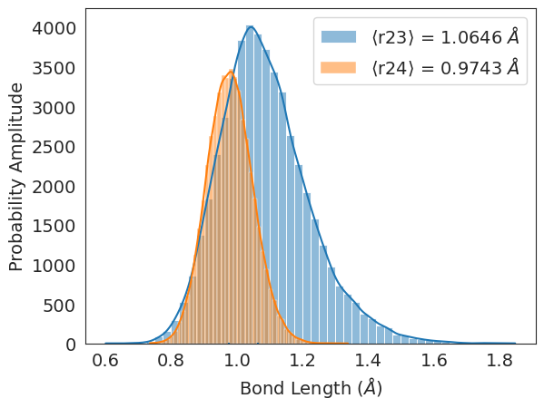
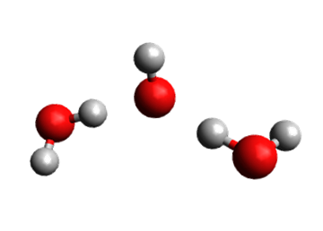
PyVisDMC
A Visualization tool for Diffusion Monte Carlo simulations
Team Members
Greta Jacobson
Lauren Dressler
Ramses Llobet

Slide 2
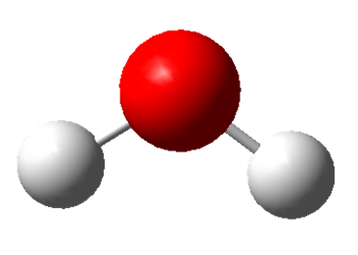
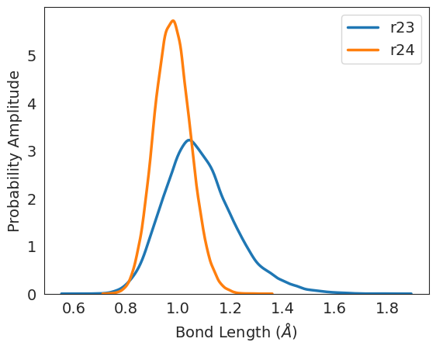
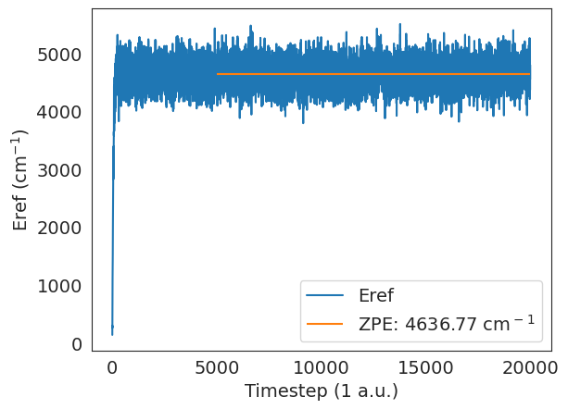
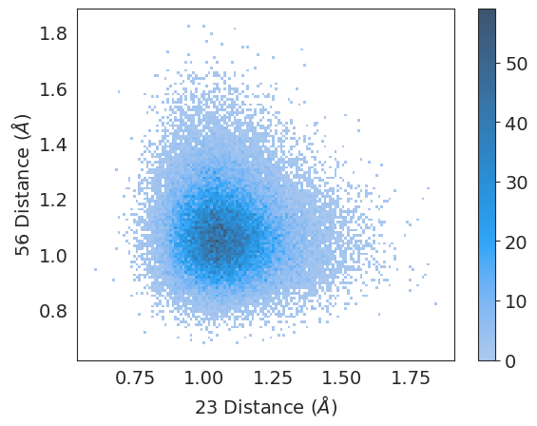
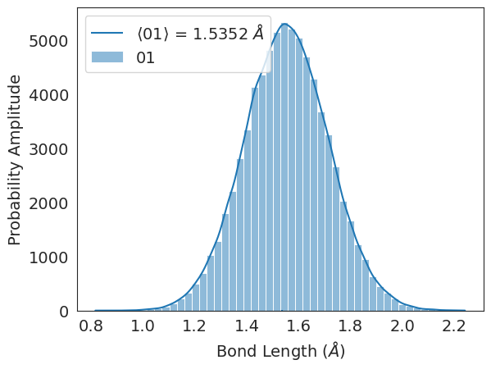
Problem Statement/Description
Problem
PyVibDMC is an existing software package for simulating molecular vibrations
Very little built-in analysis tools
Solution
Develop partner package PyVisDMC to streamline initial data analysis
Intentional default settings for quick analysis, and for users who are new to Python
Further customization through matplotlib’s functionality
Modular Design
Data loader for a given simulation output from PyVibDMC
Separate visualization tasks:
Single distribution (one_dist)
Multiple distributions (mult_dist)
Energy reference analysis (plot_eref)
2D distribution analysis (two_d_dist)

Slide 3
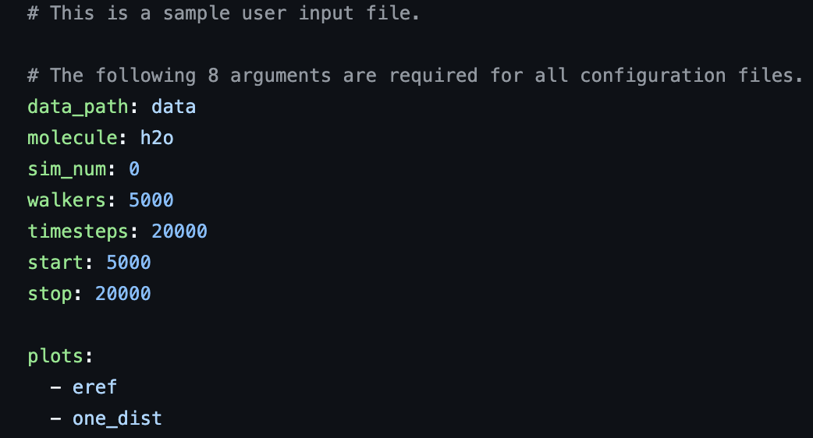
Human Centered Design
Our users are…
Grad students, postdocs, faculty, researchers–all people who are
already using PyVibDMC
They want to use PyVisDMC as…
A teaching tool
Usage must be simple
A way to explore big sets of DMC simulation data
Enough sophistication to make useful plots, extensible
How to achieve both?
User inputs a single configuration file (.yaml)
with simple format
Lots of documentation makes it easy for users to add custom plotting functions

Slide 4


Technologies Used
Matplotlib
Provided low-level control for figure customization and fine-tuning.
Enabled publication-quality visualizations tailored to exact specifications.
Ideal for experienced users needing advanced figure adjustments.
Integration of Scientific Libraries
NumPy: Efficient numerical operations, enabling rapid data manipulation.
PyVibDMC: Domain-specific library for extracting and analyzing simulation data.
Pandas (optional): Useful for structured data processing if needed in the pipeline.
Seaborn
Enhanced default visualization aesthetics (e.g., set_style() for cleaner visuals).
Simplified multi-dimensional data exploration.
Suitable for initial data insights and quick statistical visualizations.
User-friendly for researchers with less coding experience.
PEP 8 Compliance
Code adheres to Python’s style guide for consistency and readability.
pylint score > 8 achieved after optimizations.

Slide 5
Challenges
What type of interface to use
How to test our package when the data sets it takes in are huge
Lauren and Ramses: chemistry-speak vs. seeing the big picture
Generalizing the code for different molecular systems, size of ensemble, length of simulation, etc.
Config file with a limited number of user inputs
Create small subsets of simulation data that are pre-processed
Redefined our individual roles
Identifying all underlying assumptions about simulation data
Unified folder structure and naming scheme for all simulation data

Slide 6
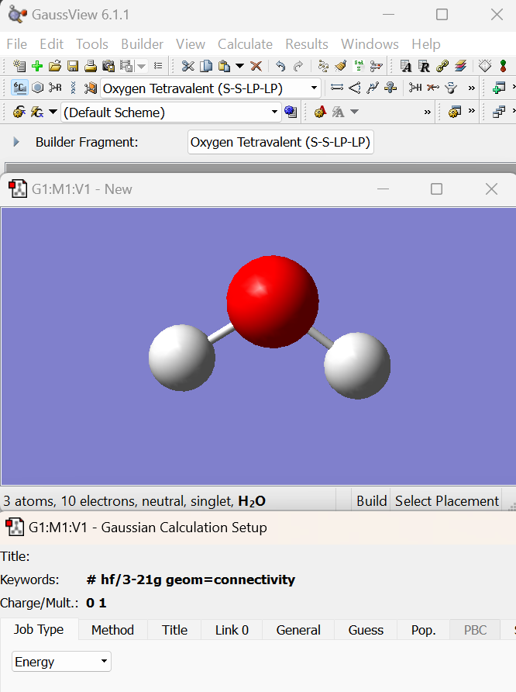
Future Steps
Short Term:
Additional plotting functions
Comparing distributions/energies between different molecules
Additional data analysis functionality
Calculate statistics between multiple simulations
Streamlined identification of atoms
Ex. “plot all O-H bonds” instead of “plot atom indices [[0,1], [0,2]]”
Long Term:
Use this project as basis for MolSSI fellowship proposal
Develop a full GUI for PyVibDMC simulation set up and data analysis
Analogous to Gaussian/GaussView software

