Slide 1

Symbolic Characterization of Heap Abstractions
www.math.tau.ac.il/~gretay
Greta Yorsh
Joint work with
Thomas Reps
Mooly Sagiv
Reinhard Wilhelm

Slide 2

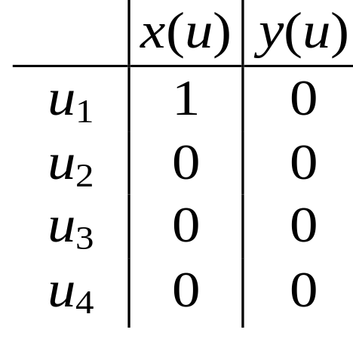
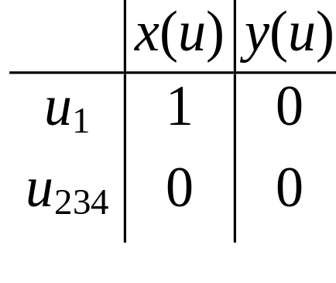
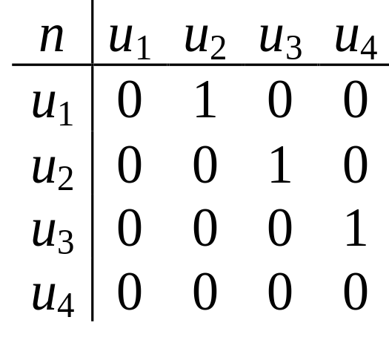
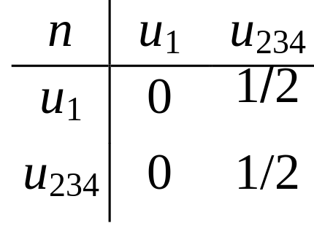
Canonical Abstraction:
An embedding whose result is of bounded size
x
x
u₁
u₂
u₃
u₄
u₁
u₂₃₄

Slide 3
Motivation
Automatically generate loop invariants in some logic
  First order logic
  Separation logic (BI)
  …

Slide 4
Generating Loop Invariants
List reverse (List x) {
List y, t;
y = NULL;
while (x != NULL) {
t = y;
y = x;
x = x → next;
y → next = t;
}
return y;
}
S₁
S₂
S₃
t
y
t
y
t
y
NULL
NULL
NULL
x
x
x
(S₁)
−
(S₂)
−
(S₃) …
Notes:
There are 12 structures at this node.

Slide 5
Motivation
Automatically generate loop invariants in some logic
  First order logic
  Separation logic (BI)
  …
Employ decision procedures
  Extract information in the most precise way
    More precise than the compositional way

Slide 6
Motivation – Extracting Information
Does program condition x == NULL evaluate to TRUE in all stores that arise at program point p ?
YES
p: if (x == null) then S; else P;
p: S;

Slide 7
Is there a heap sharing?
x
u₁
u₂
r_{x}
r_{x}
is
is
⬥ = ∃v₁,v₂,v: n(v₁,v) ∧ n(v₂,v) ∧ v₁ ≠ v₂
1/2
∧
1/2
∧
1
compositional:
1/2
supervaluational:
0

Slide 8
Computing Most Precise Value
if (S) ⇒  is valid return 1
if (S) ⇒ ¬ is valid return 0
otherwise return ½

Slide 9
Why should you be interested ?
Automatically generate loop invariants in some logic
  First order logic
  Separation logic (BI)
  …
Employ decision procedures
  Extract information from in the most precise way
    More precise than the compositional way
  Compute the best (induced) transformer

Slide 10
Symbolic Operations: Three Value-Spaces
α
T#
T
γ
Concrete
Values
Formulas
Abstract
Values

Slide 11
Why should you be interested ?
Automatically generate loop invariants in some logic
  First order logic
  Separation logic (BI)
  …
Employ decision procedures
  Extract information from in the most precise way
    More precise than the compositional way
  Compute the best (induced) transformer
  Assume-guarantee reasoning

Slide 12
Why should you be interested ?
Automatically generate loop invariants in some logic
  First order logic
  Separation logic (BI)
  …
Employ decision procedures
  Extract information from in the most precise way
    More precise than the compositional way
  Compute the best (induced) transformer
  Assume-guarantee reasoning
Expressive power of 3-valued abstraction

Slide 13
Expressive Power
SO formulas
NP formulas
3-valued structures
FO+TC formulas
Canonical abstraction
Quantifier free formulas
Predicate abstraction

Slide 14
Outline
The problem
  Characterizing concretization with a FO formula
Negative result
Simplifying assumptions
Generating FO+TC formula
Loop invariants
Supervaluation
NP formula
Conclusion

Slide 15
Characterizing Concretizations
Concrete Domain
Formulas
Abstract Domain

Slide 16
Characterizing Concretizations
(S₁)
(S₁)
S₁
S₂
Concrete Domain
Formulas
Abstract Domain
store  (S₁)
store  (S₁)
Notes:
iff important
extracting info
loss of info from concrete to abstract but no loss from abstract to formula

Slide 17
Quiz
u₁
u₂
u₃
Notes:
Explain the edges from concrete to abstract: given a concrete store, let me should why this concrete store embeds into the
3 valued structure, because I can pick a mapping, such that…
What concrete structures does it represent ?
3-Col of undirected graphs is NP complete
NP computation cannot be expressed by FO even with TC !
Therefore, there is no FO-formula that characterizes all concrete structures embedded into this structure
This shows that there exists a 3-valued structure that cannot be characterised with first order formula

Slide 18
Negative Result
u₁
u₂
u₃
3-colorable graphs with at least 3 nodes
3-colorability is NP-complete
NP computation can not be expressed with first order formula [Courcelle]
There exists a 3-valued structure that can NOT be characterized with
first-order formula
Notes:
What concrete structures does it represent ?
3-Col of undirected graphs is NP complete
NP computation cannot be expressed by FO even with TC !
Therefore, there is no FO-formula that characterizes all concrete structures embedded into this structure
This shows that there exists a 3-valued structure that cannot be characterised with first order formula

Slide 19
FO Identifiable Nodes
u₁
u₂
u₃
Notes:
What concrete structures does it represent ?
3-Col of undirected graphs is NP complete
NP computation cannot be expressed by FO even with TC !
Therefore, there is no FO-formula that characterizes all concrete structures embedded into this structure
This shows that there exists a 3-valued structure that cannot be characterised with first order formula

Slide 20
FO Identifiable Nodes
u₁
u₂
u₃
Notes:
What concrete structures does it represent ?
3-Col of undirected graphs is NP complete
NP computation cannot be expressed by FO even with TC !
Therefore, there is no FO-formula that characterizes all concrete structures embedded into this structure
This shows that there exists a 3-valued structure that cannot be characterised with first order formula

Slide 21
FO Identifiable Nodes
x
x
l₁
l₂
l₃
l₄
u₁
u₂
r_{x}
r_{x}
r_{x}
r_{x}
r_{x}
r_{x}
node_{u1}^{s}(w)
node_{u2}^{s}(w)
node_{u2}^{s}(w)
node_{u2}^{s}(w)
node_{u1}^{s}(w)
node_{u2}^{s}(w)
Notes:
node formula for u1 is satisfied by some concrete node iff the concrete node corresponds to the abstract node u1.

Slide 22
Generating node_{u}(w) formula
x
x
l₁
l₂
l₃
l₄
u₁
u₂
r_{x}
r_{x}
r_{x}
r_{x}
r_{x}
r_{x}
node_{u1}^{s}(w) = x(w)  r_{x}(w)  ¬y(w)  ¬r_{y}(w)
node_{u2}^{s}(w) = ¬x(w)  r_{x}(w)  ¬y(w)  ¬r_{y}(w)

Slide 23
Generating FO formula
x
u₁
u₂
r_{x}
r_{x}
(S) = “onto”
 “total”
 “predicate embedding”
 “integrity rules”

Slide 24
“onto” formula
x
x
l₁
l₂
l₃
l₄
u₁
u₂
r_{x}
r_{x}
r_{x}
r_{x}
r_{x}
r_{x}
v₁,v₂ : node_{u1}(v₁) ∧ node_{u2} (v₂) ∧ v₁ ≠ v₂

Slide 25
“total” formula
x
x
l₁
l₂
l₃
l₄
u₁
u₂
r_{x}
r_{x}
r_{x}
r_{x}
r_{x}
r_{x}
v : node_{u1}(v)  node_{u2} (v)

Slide 26
“predicate embedding” formula
x
x
l₁
l₂
l₃
l₄
u₁
u₂
r_{x}
r_{x}
r_{x}
r_{x}
r_{x}
r_{x}
 w : node_{u1}(w) ⇒ x(w) ∧ r_{x}(w) ∧ ¬y(w) ∧ ¬r_{y}(w)
 w : node_{u2}(w) ⇒ ¬x(w) ∧ r_{x}(w) ∧ ¬y(w) ∧ ¬r_{y}(w)

Slide 27
“predicate embedding” formula
x
x
l₁
l₂
l₃
l₄
u₁
u₂
r_{x}
r_{x}
r_{x}
r_{x}
r_{x}
r_{x}
 w₁,w₂ : node_{u1}(w₁) ∧ node_{u2} (w₂) ⇒ ¬n(w₂, w₁)
 w₁,w₂ : node_{u1}(w₁) ∧ node_{u1} (w₂) ⇒ ¬n(w₁, w₂)

Slide 28
Integrity Rules
Exclude structures that do not represent valid stores
Example – linked list
  unique ∀ v₁,v₂: x(v₁)  x(v₂) ⇒ (v₁ = v₂)
  function ∀ v,v₁,v₂: n(v, v₁)  p(v, v₂) ⇒ (v₁ = v₂)
  reachability ∀ v: r_{x}(v) ⇔ ∃ v₁: x(v₁)  n*(v₁,v)

Slide 29

Supervaluation

Slide 30
Supervaluational Semantics
Related work
[B. van Fraassen66][Blamey02]
[Bruns,Godefroid00][Reps, Loginov, Sagiv 02]
value of  on S is summary of values of  on store  (S)
TRUE
⬥ is true for all store  (S)
FALSE
⬥ is false for all stores  (S)
⬥ is true for some store  (S) and false for others
UNKNOWN
Notes:
Difference between compositional and this is that here we have iff and there only ….

Slide 31
Supervaluation Semantics
1 if store for all store ∈ (S)
0 if store for all store ∈ (S)
½ otherwise
NOT
Constructive
Notes:
<< phi >> (S) is join of values of phi obtainted from each of the concrete structures that S represents.
It does NOT provide a constructive way to compute, because gamma(S) is infinite set.

Slide 32
Generating Loop Invariants
List reverse (List x) {
List y, t;
y = NULL;
while (x != NULL) {
t = y;
y = x;
x = x → next;
y → next = t;
}
return y;
}
S₁
S₂
S₃
t
y
t
y
t
y
NULL
NULL
NULL
x
x
x
⬥ 
−
−
(S₁)
(S₂)
(S₃) …
⬥ ⇒ “x and y point to disjoint lists”
Notes:
There are 12 structures at this node.

Slide 33
Missing …
Prototype implementation using
  TVLA
  SPASS
NP – formula
Best transformer for canonical abstraction

Slide 34
Conclusions
First order logic provides a way to express concretization in interesting domains
  linear size
Theorem provers can be integrated with program analyzers
  enables flexible abstractions
  no loss of information beyond the abstraction

Slide 35
The End
www.math.tau.ac.il/~gretay

