Slide 1
Shape Analysis Overview
presented by Greta Yorsh
Notes:
Main topics and challenges in shape analysis
Shape analysis is a broad topic.
TVLA-centric view

Slide 2
Shape Analysis [Jones and Muchnick 1981]
Program analysis to determine all possible shapes of the heap at every program point
Applications
Compiler optimizations
Automatic verification
Notes:
Compile-time garbage collection
Parallelization

Slide 3
Programs and Properties
Dynamically allocated memory (heap)
Destructive updates
Recursive data structures
Recursive procedures
Concurrency
Memory safety
Preservation of data structure invariants
Partial correctness
Linearizability
Termination

Slide 4
Mark and Sweep
void Mark(Node root) {
if (root != null) {
pending = ∅
pending = pending ∪ {root}
marked = ∅
while (pending ≠ ∅) {
x = SelectAndRemove(pending)
marked = marked ∪ {x}
t = x.left
if (t ≠ NULL) and (t ∉ marked)
pending = pending ∪ {t}
t = x.right
if (t ≠ NULL) and (t ∉ marked)
pending = pending ∪ {t}
}
}
assert marked = = Reachset(root)
}
void Sweep() {
unexplored = Universe
collected = ∅
while (unexplored ≠ ∅) {
x = SelectAndRemove(unexplored)
if (x ∉ marked)
collected = collected ∪ {x}
}
}
assert collected == all – Reachset(root)
∀v: marked(v)  successor*(root,v)
∃r . root(r) ∧(p(r)∨m(r)) ∀v . (m(v) ∨ p(v)) → successor*(root,v) ∀v . ¬(p(v) ∧ m(v)) ∀v, w . (m(v) ∧ ¬m(w) ∧ ¬p(w) → ¬successor(v, w))

Slide 5
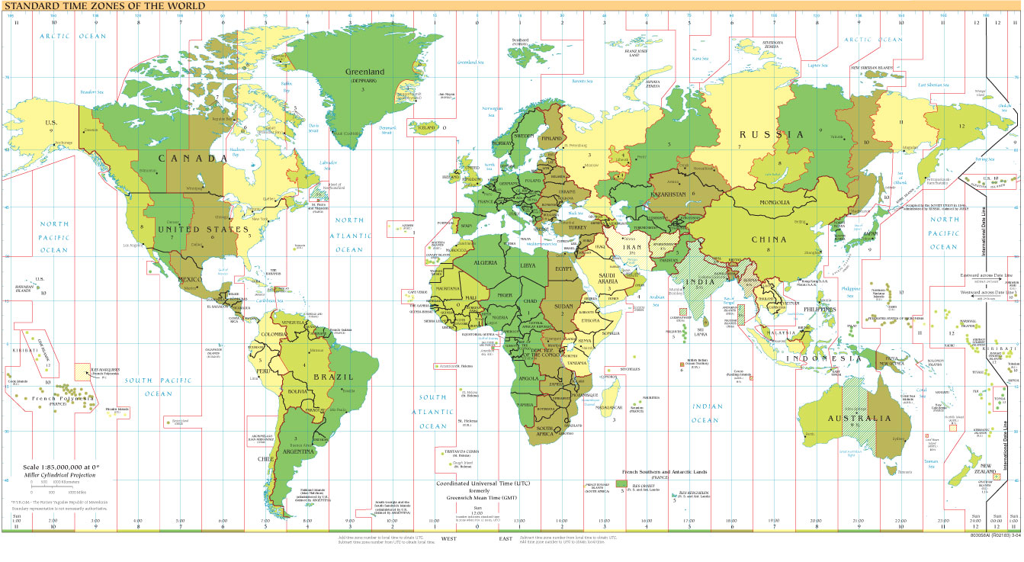
Parametric Shape Analysis via 3-valued Logic
LIAFA
Universität des Saarlandes
(Wilhelm)
Inria
MSR
Queen Mary
Berkeley
MSRC
MSRI
IBM
Tel Aviv University
(Sagiv)
University of Wisconsin
(Reps)
... and others ...

Slide 6
Timeline: Shape Analysis
Parametric Shape Analysis via 3-valued Logic
[Sagiv, Reps, Wilhelm POPL’99 ,TOPLAS’02]
A Local Shape Analysis
Based on Separation Logic
[Distefano et al, TACAS’06]
Flow analysis and
optimization of
Lisp-like structures [Jones and Muchnick 1981]
Verifying Concurrent Heap Manipulating Programs
[Yahav et al, POPL’01]
Verifying Linearizability
with Heap Decomposition
[Manevich, Lev Ami et al, SAS’08, CAV’08]
Numerical Abstractions
[Gopan et al, TACAS’04]
Analysis of pointers
and structures
TVLA
[Lev Ami et al, SAS‘00]
Verifying
Linearizability
[Amit et al, CAV’07]
Logical Characterization of Heap Abstractions
Thread Modular Shape Analysis
[Gotsman et al, PLDI 07]
Procedure
Local Heaps
and cutpoints
[Rinetzky et al, POPL’05]
Interprocedural and Recursive Programs
[Rinetzky et al, CC‘01]
1981
1990
1999
2000
2001
2003
2004
2005
2006
2007
2008
2009
Notes:
Shape Analysis [Jones and Muchnick 1981]
Determine the possible shapes of a dynamically allocated data structure at a given program point
Motivation: More efficient compilation (Compile-time garbage collection, Parallelization), Verification

Slide 7
Applications
Memory safety & preservation of data structure invariants [Dor SAS’00, Loginov ISSTA’08]
Compile-time garbage collection [Shaham et al, SAS’03]
Correct API usage [Ramalingam at al PLDI’02, Yahav et al PLDI’04]
Typestate verification [Yahav et al, ISSTA’06]
Sorting implementations [Lev-Ami ISTTA’00, Rinetzky SAS’05]
Deutsch-Shorr-Waite [Loginov et al, SAS’06]
Linearizability [Amit et al, CAV’07, Manevich at al, SAS’08,CAV’08]
Device drivers [ Yang et al, CAV’08]
Notes:
7

Slide 8
Outline
Shape abstractions in a nutshell
Computing transformers
Challenges in shape analysis

Slide 9
Concrete Stores as Logical Structures
stack
heap
x
24
7
26
3
44
2
64
5
80
1
80
7
0
p
64
24
26
44
64
64
80
n
n
n
n
n
x
p

Slide 10
Concrete Stores as Logical Structures
Locations ≈ Individuals
Program variables ≈ Unary relations
Fields ≈ Binary relations
Instrumentation predicates defined in FOTC  v . r_{p} (v)   w. p(w) ∧ n*(w,v)
n
n
n
r_{p}
n
n
x
r_{p}
r_{p}
p

Slide 11
Canonical Abstraction
n
n
n
r_{p}
n
n
r_{p}
x
r_{p}
p

Slide 12
Canonical Abstraction
n
n
n
n
n
n
n
n
n
x
r_{p}
r_{p}
n
r_{p}
x
p
p
n
n
n
n
n
r_{p}
r_{p}
Abstract stores are 3-valued logical structures
{0, 1, ½} values for relations with 0  1 = 1/2

Slide 13
Canonical Abstraction with Reachability
n
n
n
r_{p}
n
n
r_{p}
x
r_{p}
p
n
n
n
n
r_{p}
x
r_{p}
p

Slide 14
Canonical Abstraction without Reachability
n
n
n
n
n
n
n
n
n
x
n
x
p
p
n
n
n
x
p

Slide 15
Logical Characterization in FOTC [Yorsh’03] [Kuncak’04] [Wies’07 ]
n
n
n
n
x
r_{x}
r_{x}
r_{x},r_{p}
r_{x},r_{p}, shared
p
∀v: ( x(v) ∧ ¬p(v)∧¬r_{p}(v)) ∨ (¬x(v) ∧ ¬p(x)∧¬r_{p}(v)) ∨ (¬x(v) ∧ p(v)∧ r_{p}(v)) ∨ (¬x(v) ∧ ¬p(v)∧ r_{p}(v)))
∀v, w. ¬x(v) ∧ ¬p(v)∧r_{p}(v) ∧ x(w)∧¬p(w)∧¬r_{p}(w) → ¬n(v, w)
...
∀v . r_{p}(v)  ∃w . p(w) ∧ n*(w, v)
...
∀v . shared (v)  ∃v₁,v₂. n(v₁,v) ∧ n(v₂,v) → v₁=v₂

Slide 16
Logical Characterization in Separation Logic
n
n
n
n
x
r_{x}
r_{x}
r_{x},r_{p}
r_{x},r_{p}, shared
p
 v, w . x  v  lseg(v,p)  p  w  lseg(w,null)
lseg(x,y) =  v . x  v  (y = v  emp  lseg(v,y) )

Slide 17
Canonical Abstraction
Limited form of quantified invariants
quantifier alternation only in instrumentation
Not a static memory partition
The same memory location can be represented by different abstract nodes in different shape graphs

Slide 18
Non-Static Partition
x
x
y
y
x = x→n
x
x
y
y

Slide 19
Outline
Shape Abstractions in the nutshell
Computing abstract transformers
Challenges in shape analysis

Slide 20
Best Transformer
x
x
x = x→n
y
y
x
x
y
concrete
semantics
y
.
.
.
.
.
.
concretization
canonical abstraction
x
y
x
x
y
y

Slide 21
Transformer using Partial Concretization
x
x
x = x→n
y
y
x
x
concrete
semantics
y
y
.
.
.
partial
concretization
canonical abstraction
x
y
x
x
y
y

Slide 22
Symbolic Transformer
foo()

  τ_{foo}
concrete
semantics
symbolic
concretization
decision procedure
x
y
x
x
y
y

Slide 23
Partial Concretization
Temporarily refine the abstract domain per statement
Employed in other shape analysis algorithms [Distefano, TACAS’06, Evan, SAS’07, POPL’08]
Soundness is immediate
Precision depends on the heap mutation
Locality
Uniformity
Can even guarantee precision under certain conditions [Lev-Ami, VMCAI’07]

Slide 24
Challenges in shape analysis
Programming language features
Procedures
Modularity and encapsulation
Concurrency
Properties
Complex data structures
Hierarchy
Mixture of data and heap
Array of heaps
Scaling to larger programs

Slide 25
Handling Procedures
Complicated sharing patterns [Rinetzky, CC’01]
Relational shape analysis [Jeannet, SAS’04]
New semantics for procedures (Cutpoints) [Rinetzky, POPL’05]
Tabulation for cutpoint free programs [Rinetzky, SAS’05]
Handling cutpoints [Gotsman, SAS’06]

Slide 26
Concurrency
Models threads as ordinary objects [Yahav, POPL’01]
Thread-modular shape analysis [Gotsman, PLDI’07]
Heap decomposition and thread quantification [Manevich et al SAS’08, CAV’08]
Enforcing a locking regime [Rinetzky]

Slide 27
Handling Larger Programs ?
Staged analysis
Specialized abstractions
Counterexample guided refinement
Coercer abstractions
Weaker summary nodes [Arnold, SAS’06]
Special join operator [Manevich, SAS’04, TACAS’07, Yang’08]
Heterogeneous abstractions [Yahav, PLDI’04]
Implementation techniques
Optimizing transformers [Bogodlov, CAV’07]
Optimizing GC
Reducing static size
Partial evaluation
Persistent data structures [Manevich, SAS’04]
…

Slide 28

Conclusion
Limited forms of quantified invariants can prove interesting properties
Partial concretization is useful for transformers
Scaling shape analysis is still an open problem
Like a Swiss army knife or a Unix utility
Only for experts
... but at least it’s very useful to them

