Slide 1
Abstraction-Guided Synthesis of Synchronization
Martin Vechev
Eran Yahav
Greta Yorsh
IBM Research

Slide 2
Challenge: Correct and Efficient Synchronization
T1()
T2()
T3()
{
……………………………
…………………….
…
}
{
………………
……
………………….
…………………….
…………………………
}
{
…………………..
……
…………………….
………………
……………………
}
atomic
atomic
atomic
Assist the programmer by automatically inferring correct and efficient synchronization

Slide 3
Challenge: Correct and Efficient Synchronization
T1()
T2()
T3()
{
……………………………
…………………….
…
}
{
………………
……
………………….
…………………….
…………………………
}
{
…………………..
……
…………………….
………………
……………………
}
Assist the programmer by automatically inferring correct and efficient synchronization

Slide 4
Challenge
Find minimal synchronization that makes the program satisfy the specification
Avoid all bad interleaving while permitting as many good interleavings as possible
Handle infinite-state programs
Notes:
Assumption: we can prove that serial executions satisfy the specification

Slide 5
A Standard Approach: Abstraction Refinement
program

specification
Abstract
counter example
Verify

abstraction

Refine
Change the abstraction to match the program

Slide 6
A Standard Approach: Abstraction Refinement
concurrent program
ϕ
Restrict
synchronized program

safety specification
Abstract
counter example
Verify

state abstraction

Refine
Change the program to match the abstraction

Slide 7
Our Approach
Synthesis of synchronization via abstract interpretation
Compute over-approximation of all possible program executions
Add minimal atomics to avoid (over-approximation of) bad interleavings
Interplay between abstraction and synchronization
Finer abstraction may enable finer synchronization
Coarse synchronization may enable coarser abstraction

Slide 8
AGS Algorithm – High Level
Input: Program P, Specification S, Abstraction 
Output: Program P’ satisfying S under 
ϕ = true
while(true) {
Traces = {π | π ∈ (←P→ ∩ ←ϕ→) and π  S }
if (Traces is empty) return implement(P,ϕ)
select π ∈ Traces
if (?) {
ϕ’ = avoid(π)
if (ϕ’ is false) abort else ϕ = ϕ ∧ ϕ’
} else {
’ = refine(, π)
if ( = ‘) abort else  = ‘
}
}

Slide 9
Avoiding an interleaving
By adding atomicity constraints
Atomicity predicate [l1,l2] – no context switch allowed between execution of statements at l1 and l2
avoid(π)
A disjunction of all possible atomicity predicates that would prevent π
Example
π = A₁ B₁ A₂ B₂
avoid(π) = [A₁,A₂]  [B₁,B₂]
(abuse of notation)

Slide 10
Example
T1
1: x += z
2: x += z
T2
1: z++
2: z++
T3
1: y1 = f(x)
2: y2 = x
3: assert(y1 != y2)
f(x) {
if (x == 1) return 3
else if (x == 2) return 6
else return 5
}

Slide 11
Example: Parity Abstraction
y1
y1
6
6
5
5
4
4
3
3
2
2
1
1
0
1
2
3
4
y2
0
1
2
3
4
y2
Concrete values
Parity abstraction (even/odd)

Slide 12
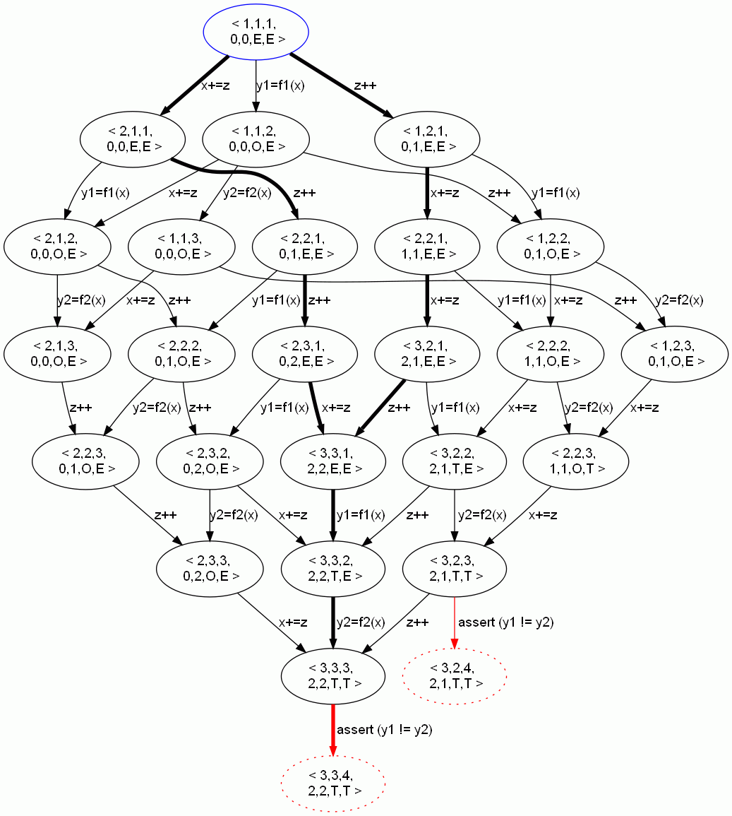
Example: Avoiding Bad Interleavings
ϕ = true
while(true) {
Traces={π|π∈(←P→ ∩ ←ϕ→) and
π  S }
if (Traces is empty)
return implement(P,ϕ)
select π ∈ Traces
if (?) {
ϕ = ϕ ∧ avoid(π)
} else {
 = refine(, π)
}
}
avoid(π₁) = [z++,z++]
ϕ = [z++,z++]
ϕ = true

Slide 13
Example: Avoiding Bad Interleavings
ϕ = true
while(true) {
Traces={π|π∈(←P→ ∩ ←ϕ→) and
π  S }
if (Traces is empty)
return implement(P,ϕ)
select π ∈ Traces
if (?) {
ϕ = ϕ ∧ avoid(π)
} else {
 = refine(, π)
}
}
avoid(π₂) =[x+=z,x+=z]
ϕ = [z++,z++]
ϕ = [z++,z++]∧[x+=z,x+=z]

Slide 14
Example: Avoiding Bad Interleavings
T1
1: x += z
2: x += z
ϕ = true
while(true) {
Traces={π|π∈(←P→ ∩ ←ϕ→) and
π  S }
if (Traces is empty)
return implement(P,ϕ)
select π ∈ Traces
if (?) {
ϕ = ϕ ∧ avoid(π)
} else {
 = refine(, π)
}
}
T2
1: z++
2: z++
T3
1: y1 = f(x)
2: y2 = x
3: assert(y1 != y2)
ϕ = [z++,z++]∧[x+=z,x+=z]

Slide 15
Example: Avoiding Bad Interleavings
parity
y1

parity

parity

T1
x+=z; x+=z
6
T1
x+=z; x+=z
6
T1
x+=z; x+=z
6
5
5
5
T2
z++;
z++;
4
T2
z++;
z++;
4
T2
z++;
z++;
4
3
3
3
T3
y1=f(x)
y2=x
assert
y1!= y2
T3
y1=f(x)
y2=x
assert
y1!= y2
T3
y1=f(x)
y2=x
assert
y1!= y2
2
2
2
1
1
1
0
1
2
3
4
y2
0
1
2
3
4
0
1
2
3
4
But we can also refine the abstraction…

Slide 16
parity
y1
✗
parity
✗
parity
✓
T1
x+=z; x+=z
6
T1
x+=z; x+=z
6
T1
x+=z; x+=z
6
5
5
5
T2
z++;
z++;
4
T2
z++;
z++;
4
T2
z++;
z++;
4
3
3
3
T3
y1=f(x)
y2=x
assert
y1!= y2
T3
y1=f(x)
y2=x
assert
y1!= y2
T3
y1=f(x)
y2=x
assert
y1!= y2
2
2
2
1
1
1
(a)
0
1
2
3
4
y2
(b)
0
1
2
3
4
(c)
0
1
2
3
4
interval
✗
interval
✓
T1
x+=z; x+=z
6
T1
x+=z; x+=z
6
5
5
T2
z++;
z++;
4
T2
z++;
z++;
4
3
3
T3
y1=f(x)
y2=x
assert
y1!= y2
2
T3
y1=f(x)
y2=x
assert
y1!= y2
2
1
1
(d)
0
1
2
3
4
(e)
0
1
2
3
4
octagon
✗
octagon
✓
T1
x+=z; x+=z
6
T1
x+=z; x+=z
6
5
5
T2
z++;
z++;
4
T2
z++;
z++;
4
3
3
T3
y1=f(x)
y2=x
assert
y1!= y2
2
T3
y1=f(x)
y2=x
assert
y1!= y2
2
1
1
(f)
0
1
2
3
4
(g)
0
1
2
3
4

Slide 17
Quantitative Synthesis
Performance: smallest atomic sections
Interval abstraction for our example produces the atomicity constraint: ([x+=z,x+=z] ∨ [z++,z++]) ∧ ([y1=f(x),y2=x] ∨ [x+=z,x+=z] ∨ [z++,z++])
Minimal satisfying assignments
₁ = [z++,z++]
₂ = [x+=z,x+=z]

Slide 18
AGS Algorithm – More Details
Forward Abstract Interpretation, taking ϕ into account for pruning infeasible interleavings
Input: Program P, Specification S, Abstraction 
Output: Program P’ satisfying S under 
ϕ = true
while(true) {
Traces = {π | π ∈ (←P→ ∩ ←ϕ→) and π  S }
if (Traces is empty) return implement(P,ϕ)
select π ∈ Traces
if (?) {
ϕ = ϕ ∧ avoid(π)
} else {
 = refine(, π)
}
}
Order of selection matters
Choosing between abstraction refinement and program restriction
not always possible to refine/avoid
may try and backtrack
Backward exploration of invalid Interleavings using ϕ to prune infeasible interleavings.
Up to this point did not commit to a synchronization mechanism
Notes:
Notes:
In general, both “avoid” and “implement” are pluggable procedures
Language of constraints may need to be adapted though

Slide 19
Implementability
Separation between schedule constraints and how they are realized
Can realize in program: atomic sections, locks,…
Can realize in scheduler: benevolent scheduler
T1
1: while(*) {
2: x++
3: x++
4: }
T2
1: assert (x != 1)
No program transformations (e.g., loop unrolling)
Memoryless strategy

Slide 20
Choosing a trace to avoid
y=2
0,0 0,0
if (y==0)
T1
0: if (y==0) goto L
1: x++
2: L:
T2
0: y=2
1: x+=1
2: assert x !=y
0,1 0,2
2,0 0,0
if (y==0)
y=2
1,1 0,2
2,1 0,2
x++
x+=1
2,1 1,2
2,2 1,2
x+=1
3,2 2,2

Slide 21
Examples Intuition
If we can show disjoint access we can avoid synchronization
Requires abstractions rich enough to capture access pattern to shared data
Parity
Intervals

Slide 22
Example: “Double Buffering”
Render
Fill
fill() {
L1:if (i < N) {
L2:Im[Fill][i] = read();
L3: i += 1;
L4: goto L1;
}
L5: Fill ˆ= 1;
L6: Render ˆ= 1;
L7: i = 0;
L8: goto L1;
}
render() {
L1:if (j < N) {
L2: write(Im[Render][j]);
L3: j += 1;
L4: goto L1;
}
L5: j = 0;
L6: goto 1;
}
int Fill = 1;
int Render = 0;
int i = j = 0;
main() {
fill() || render();
}

Slide 23
Examples
Program | Refine Steps | Avoid Steps
Double buffering | 1 | 2
Defragmentation | 1 | 8
3D array update | 2 | 23
Array Removal | 1 | 17
Array Init | 1 | 56

Slide 24
Summary
An algorithm for Abstraction-Guided Synthesis
Synthesize efficient and correct synchronization
Handles infinite-state systems based on abstract interpretation
Refine the abstraction and/or restrict program behavior
Interplay between abstraction and synchronization
Quantitative Synthesis
Separate characterization of solution from choosing optimal solutions (e.g., smallest atomic sections)

