Slide 1
Generating Precise and Concise
Procedure Summaries
Greta Yorsh
Eran Yahav
Satish Chandra

Slide 2
Procedure Summaries
A procedure summary conservatively represents the effect of calling a procedure
  relation between input and output states
Use summary of a procedure instead of re-analyzing it (if possible)
Notes:
what is a summary

Slide 3
Properties of Summaries
Precise: result of applying the summary is the same as the result of re-analyzing the procedure
Efficient: applying the summary is more efficient than re-analyzing the procedure
Concise
  exploit the commonalities in procedure’s behavior
  no superfluous context information
Notes:
summaries wish list

Slide 4
Motivation
Modular verification
  concise summary can capture infinitely-many contexts in a finite way
  reuse summary of a library with different clients
  summarize libraries before the client code is written
Interprocedural analysis
  concise summary ignores irrelevant context information
  potentially more compact representation than an explicit summary table or BDDs
Notes:
why is it useful ?
Modular
Interprocedural
In particular, for complex for abstractions with composite dataflow facts.
Exploit commonalities in the way abstract values are transformed.
Modular analyses – parts of the program are summarized separately (e.g., summarize libraries)
Non-modular analyses – compactly represent summary tables

Slide 5
Main Challenge
Restrict the representation of abstract transformers to permit automatic composition while maintaining precise summaries
Composition is difficult
  express intermediate states in terms of initial and final states
  corresponds to quantifier elimination
Notes:
what do we technically do

Slide 6
Composition
(A1)
The result of composing the transformers tr¹² and tr²³ is transformer tr¹³ that relates the initial states A1 to the final states A3 without using the intermediate states A2
tr¹²
tr¹³
(A2)
tr²³
(A3)

Slide 7
Structured Transformers
Key to finding efficient representation
  expose underlying uniformity and dependencies
Decompose the values into finite number of classes with uniform behavior
  transform each class of values separately
  share representation within the same class

Slide 8
Efficient Representations
Existing methods
  IFDS transforms each dataflow fact separately
  IDE transforms values of each variable independently
Our method - breaks into as many levels as needed to get something uniform

Slide 9
Our Contributions
Framework for generating precise, efficient and concise summaries
  class of abstract domains and transformers
  composition algorithm
Instances of the framework include
  known classes: IFDS, IDE
  modular constant propagation with aliasing
  modular typestate verification with aliasing
Prototype implementation and evaluation for typestate

Slide 10
Framework
Input
  a procedure
  abstract domain defined using certain domain constructors
  abstract transformers expressed in a certain restricted language
Output
  precise efficient and concise summary of the procedure
Notes:
derives procedure-level transformers by symbolic composition of statement-level
transformers, and represents the result of composition in the
same form as a statement-level transformer.

Slide 11
Domain Constructors
Powerset
Product
  certain reduced products can be using integrity rules
Binary relation
  with properties such as deterministic, reflexive, symmetric, transitive
Atomic values
  such as states of a finite-state automaton, integer numbers
Domain parameter
  a placeholder for program-specific entities such as names of program variables and fields, allocation sites

Slide 12
Example: Nullness of References
Abstract value is a set M of access paths that must be null at runtime
  M ∈ P(AP) where
  AP is the set of access paths of length at most 1:
    AP(Vars, Fields) = P(Vars  (Fields  ε))
    Vars are program variables
    Fields are fields of structures
Notes:
M ⊆ AP(Var, Fields) where
AP(Var, Fields) = P(Var  (Fields  ε))
Program-independent description of abstract values
parametric in domain parameters Vars and Fields
Instantiate for a given program by binding the domain parameters to specific program variables and fields
if Vars = {x,y} and Fields = {f} then AP = {x.ε, y.ε, x.f, y.f }

Slide 13
Example: Nullness of References
Abstract transformer tr for a set M operates pointwise on the elements of M
  tr(M) = _{d ∈M} tr_{AP}(d)
Micro-transformer tr_{AP} maps an access path d to a set of access paths
  if d is null before the statement then every access path in tr_{AP}(d) is null after the statement
  tr_{AP} is conditional micro-transformer
Notes:
Abstract transformer is hierarchical
following the structure of the abstract value

Slide 14
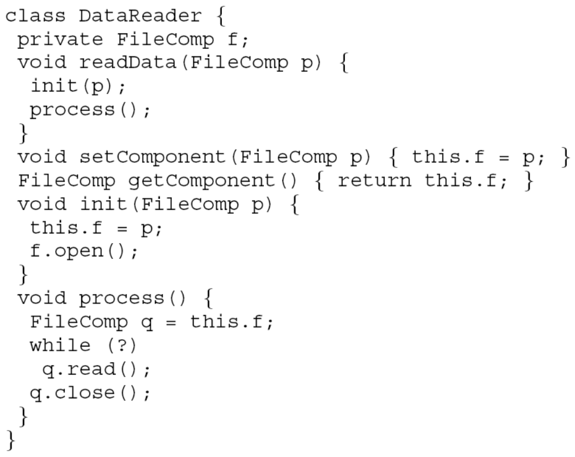
Example
Notes:
Our running example

Slide 15
Conditional Micro-Transformers
tr_{AP}(d) ≡
d
d≠t ∧
d≠this.f
d=this.f
if d = this.f return { this.f, t }
else if d = t return { }
else return { }
d=this.f
d
t
this.f
t = getComponent()
tr_{AP}(d) ≡
d
if d = p return { this.f, p }
else if d = this.f return { }
else return { d }
d≠this.f
∧ d≠p
d=p
d=p
d
p
this.f
setComponent(FileComp p)
preconditions (under certain restrictions)
Notes:
Abstract transformer refers to
parameters
values st

Slide 16
Example: Composition Algorithm
t = getComponent(); setComponent(t)
d
d≠t ∧
d≠this.f
d=this.f
t = getComponent()
d=this.f
d
t
this.f
substitution
d := d
d := t
d:=this.f
d
d
d
d≠this.f
∧ d≠t
d≠this.f
∧ d≠t
d≠this.f
∧ d≠t
d=t
d=t
d=t
setComponent(t)
d=t
d=t
d=t
d
d
d
t
t
t
this.f
this.f
this.f

Slide 17
Example: Composition Algorithm
t = getComponent(); setComponent(t)
d
d≠t ∧
d≠this.f
d=this.f
d=this.f
d:=d
d:=t
d:=this.f
d≠this.f
∧ d≠t
d=t
t≠this.f
∧ t≠t
t=t
this.f≠this.f
∧ this.f ≠t
this.f=t
d=t
t=t
this.f=t
d
t
this.f
t
t
this.f
this.f
t
this.f









t≠this.f
t≠this.f

Slide 18
Example: Composition Algorithm
t = getComponent(); setComponent(t)
d
d≠t ∧
d≠this.f
d
d=this.f
d≠t ∧
d≠this.f
d=this.f
d=this.f
d≠this.f
∧ d≠t
t=t
d
this.f
t
t = getComponent();
setComponent(t)
t=t
d
t
this.f




Slide 19
Example: Typestate Verification
Typestate properties
  describe the sequences of operations that are permitted on an object of a certain type
  temporal safety properties
  can be encoded as DFA
  <Σ, Q,init,F,δ>
  “Don’t read from a closed file”
Goal: Statically ensure that no execution of a Java program can transition to err
  non-trivial aliasing
  flow-sensitivity
  context-sensitivity
read()
open()
close()
init
open
closed
read()
open()
err
close()
Notes:
Prove that no object reaches err state

Slide 20
Typestate Abstract Domain
Abstract value is a set of dataflow facts
Dataflow fact is <a, s, M, pts, alias>
  allocation site a∈AS of the tracked object
  type state s∈Q of the tracked object
  M⊆AP set of access-paths that must point to the tracked object
  pts is a global pointers-to information
    (p,a)∈pts when access path p may point to an object allocated at a
  alias is a global aliasing information
    (p,q)∈alias when access paths p and q may be aliased (may point to the object)

Slide 21
Typestate Abstract Transformers
Abstract transformers operate pointwise on dataflow facts
  tr(X) = _{x∈X} tr₁(x)
Micro-transformer tr₁ operates separately on the type-state part and on the must-set:
  tr₁(<a,s,M,pts,alias>)=tr_{TS}(<a,s>)tr_{MS}(M){pts}{alias}
  pts and alias remain unchanged
tr_{TS} is a conditional micro-transformer
tr_{MS} operates pointwise on the access paths in M
  tr(M) = _{d ∈M} tr_{AP}(d)
tr_{AP} is a conditional micro-transformer

Slide 22
Example
Notes:
Our running example

Slide 23
Conditional Micro-Transformers
init(p)
Typestate tr_{TS}(<a,s>) | Must Access Path
if p∈M return { <a,_{open}(s)> } else if p∉M ∧ (p,a)∈pts return {<a,s>, <a,_{open}(s)>} else return {<a,s>} | if d = p return { p, this.f } else if d=v.f ∧ (v, this)∉alias return {d} else if d=v.g ∧ f≠g ∧ v.g≠p return {d} else return { }
tr_{AP}(d)
process()
Typestate | Must Access Path
if this.f ∈ M return {<a, _{close}(s’)>} else … | identity

Slide 24
Composition Algorithm for
Conditional Micro-Transformers
Preconditions may refer to parameters of the micro-transformer and to additional context
  Nullness of reference: preconditions refer to the parameter d only
  Typestate with aliasing: preconditions refer to the parameter r and to set M
Handle context using a generalized version of weakest precondition
Leverage the structure of the micro-transformers
  preconditions are disjoint and total

Slide 25
Composition Algorithm for
Conditional Micro-Transformers
pre_{A}
(A1)
tr¹² = if pre_{A}(d) then { f_{A}(d), g_{A}(d) }
else ….
f_{A}
g_{A}
g_{A}
f_{A}
tr²³ = if pre_{B}(d) then { f_{B}(d), g_{B}(d) }
else ….
pre_{B}
(A2)
f_{B}
g_{B}
(A3)

Slide 26
Composition Algorithm for
Conditional Micro-Transformers
pre_{A}
wp(pre_{A}, d:= f_{A}(d))pre_{B}
(A1)
tr¹² = if pre_{A}(d) then { f_{A}(d), g_{A}(d) }
else ….
wp
f_{A}
tr²³ = if pre_{B}(d) then { f_{B}(d), g_{B}(d) }
else ….
pre_{B}
(A2)
substitution
f_{B}
g_{B}
tr¹³ = if wp(pre_{A}, d:=f_{A} (d))  pre_{B}
then { f_{B}(f_{A}(d)), g_{B}(f_{A}(d)) }
else ….
(A3)

Slide 27
Typestate Example: Composition
init(p)
Typestate tr_{TS}(<a,s>) | Must Access Path
if p∈M return { <a,_{open}(s)> } else if p∉M ∧ (p,a)∈pts return {<a,s>, <a,_{open}(s)>} else if (p,a)∉pts return {<a,s>}
tr_{AP} (d)
tr_{AP}
if d = p return { p, this.f }
else if d=v.f ∧ (v, this)∉alias return {d}
else if d=v.g ∧ f≠g ∧ v.g≠p return {d}
else return { }
if d = p return { p, this.f }
else if d=v.f ∧ (v, this)∉alias return {d}
else if d=v.g ∧ f≠g ∧ v.g≠p return {d}
else return { }
process()
Typestate | Must Access Path
if this.f ∈ M return {<a, _{close}(s)>} else … | …
init(p); process(p)
wp(this.f∈M, init(p) ) = ?
p∈M
If tr_{AP} is invertible then we can automatically compute wp
The precondition on d for which tr_{AP}(d) = this.f is
d=p ∨
d=this.f ∧ (this,this) ∉alias



Slide 28
Typestate Example: Composition
init(p)
Typestate tr_{TS}(<a,s>) | Must Access Path
if p∈M return { <a,_{open}(s)> } else if p∉M ∧ (p,a)∈pts return {<a,s>, <a,_{open}(s)>} else if (p,a)∉pts return {<a,s>}
tr_{AP} (d)
tr_{AP}
if d = p return { p, this.f }
else if d=v.f ∧ (v, this)∉alias return {d}
else if d=v.g ∧ f≠g ∧ v.g≠p return {d}
else return { }
if d = p return { p, this.f }
else if d=v.f ∧ (v, this)∉alias return {d}
else if d=v.g ∧ f≠g ∧ v.g≠p return {d}
else return { }
process()
Typestate | Must Access Path
if this.f ∈ M return {<a, _{close}(s)>} else … | …
init(p); process(p)
wp(this.f∈M, init(p) ) = ?
p∈M

if p∈M  p∈M return { <a,_{open}(_{close}(s))> }
else if p∈M  p∉M ∧ (p,a)∈pts return ….
else if p∈M  (p,a)∉pts return ….



Slide 29
Principles
Capture infinitely-many calling contexts in a finite way
Ignore context information that is irrelevant under abstraction
Identify constraints on the parameters of the abstraction and on their correlations
Describe how each parameter is updated
possibly using
  its previous value and
  values of other parameters
Delay decisions to time of transformer evaluation
Notes:
what is our solution? what helps us, what do we rely on?
Parametric abstract domain and its transformers can only make finitely-many distinctions regarding the parameters
It’s not the amount of existing information (infinite), it’s the amount of information you query (finite! small!) that matters

Slide 30
Laziness has a price
Conditions are accumulated as transformers are composed
Why does it work?
  some combined conditions are non-satisfiable
  number of distinctions relevant to typestate are relatively small
Can be still costly…

Slide 31
Prototype Implementation
Heart of the implementation: substitution-based composition
Requires non-trivial consistency checking and simplification of formulas
  Theory of lists for access paths
  Additional theories (e.g., for simplifying composed automata transitions)
even non-optimized summaries (maintaining precision) are of moderate sizes
Interesting tradeoffs between cost of simplification and the size of summaries
In practice, need to trade precision for scalability (e.g., impose hard size limits on summaries)
Future work: investigate ways in which precision can be lost in a controlled manner

Slide 32
Summary
Identified a class of (parametric) abstract domains and transformers
  conditional micro-transformers
Defined efficient composition algorithm
  case-splitting and substitutions
Generalized IFDS, IDE to modular setting
Applied to typestate verification in the presence of aliasing
  the language of summaries is closed under composition and finite

