Slide 1

Early-stage commercial validation for Chleo
Kinder Signs
Trusted early communication across school and home
Big idea
KinderFlow sells Kinder Signs to early-years centers like Chleo's, where baby sign is already taught and families already trust the school. The same pipeline becomes a KinderFlow asset for other clients and markets.
KinderFlow - Early-stage commercial validation

Slide 2
A baby can sign for milk months before saying the word. What is missing is a shared way to understand it.
KinderFlow - Early-stage commercial validation

Slide 3
Chleo starts with a trust advantage most parenting apps do not have
Chleo and her husband own an early-years center in Madrid that already teaches baby sign. Her school is the trusted channel to families, and KinderFlow's first B2B customer.
Trust
Families already know the school. Early-childhood guidance is easier to test when the channel is already trusted.
Access
Parents and educators are already connected through school routines and communication.
Real routines
Signs, meals and daily updates happen in moments that cross school and home.
The opportunity is turning that trusted relationship into a scalable digital service. An advantage, not yet proof of adoption.
KinderFlow - Early-stage commercial validation

Slide 4
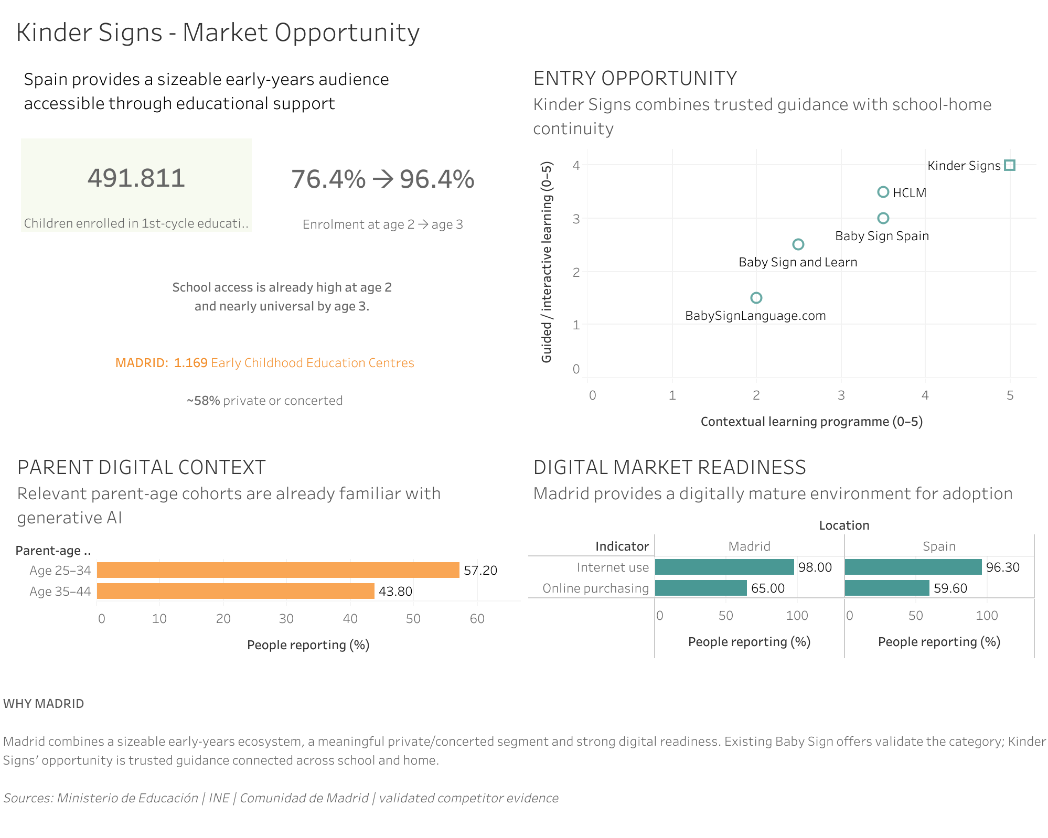
The dashboard supports commercial validation, not a scale decision
1
3
Children enrolled in 1st-cycle education
1
Market access
Spain has a sizeable early-years education audience.
2
Madrid entry point
2
Madrid offers a relevant education ecosystem and digital readiness.
3
Positioning gap
The opportunity is trusted school-home continuity, not Spanish content alone.
The dashboard supports access and positioning. It does not yet prove demand, willingness to pay or product-market fit.
Sources: Spanish Ministry of Education; Comunidad de Madrid; INE ICT Survey.

Slide 5
Each stakeholder question maps to a metric
Stakeholder metrics for a validation decision. Not a revenue forecast.
Educators
Can it fit the weekly classroom routine without adding production work?
Families
Will the guidance be clear, useful and easy to repeat at home?
KinderFlow
Can one approved library serve multiple schools, groups and children?
Decision owner: Chleo
Is Kinder Signs worth an 8–9 week commercial validation phase before scaling?
491,811 children in 1st-cycle education
REACH · market access
76.4% enrolled at age 2
REACH · routine starts early
96.4% enrolled at age 3
REACH · continuity signal
1,169 centers in Madrid
REACH · entry ecosystem
~58% private or concerted
READINESS · commercial channel
98% internet use in Madrid
READINESS · family access
57.2% of parents aged 25-34 use GenAI
READINESS · AI-service readiness
The audience is reachable and the channel already exists. Demand and willingness to pay are the only unknowns left, and that is exactly what the 8-9 weeks test.
So, what
Sources used in dashboard: Spanish Ministry of Education, Comunidad de Madrid and INE public datasets.
KinderFlow - Early-stage commercial validation
5

Slide 6
THE MARKET IS ALREADY THERE
96%
The classroom is already full.
What we still do not know is whether anyone pays for the routine.
of children in Madrid are already in a
classroom at age 3.
That gap is what the 8–9 week validation phase is built to close.
Source: Spanish Ministry of Education and INE public datasets. Full metric set in appendix.
KinderFlow - Early-stage commercial validation
6

Slide 7
The strongest first use case to validate
Kinder Signs
Kinder Daily
School-family information turned into useful shared context.
Why it matters
Schools already use and pay for communication tools.
Main risk
The market is crowded and switching costs are high.
Trusted early communication across school and home.
Why it matters
Clear differentiation and a real Computer Vision feasibility test.
Main risk
Demand and willingness to pay are not proven yet.
Kinder Food
School meal context connected to useful family guidance at home.
Why it matters
Strong school-home continuity logic.
Main risk
More professional governance and specialist competition.
Not commercially proven yet. It is the strongest first commercial validation wedge.
KinderFlow - Early-stage commercial validation
Notes:
OPEN: I compared three use cases. Kinder Daily has strong category evidence: schools already pay for communication tools, but the market is crowded. Kinder Food has strong school-home logic, but it faces professional governance and specialist competition. Kinder Signs is the one I want to talk about.
[CLICK 1 - the reasons for Kinder Signs appear] Two things make it the best place to start: it gives us clear differentiation, and it is a real feasibility test for our Computer Vision work. The honest risk is demand: willingness to pay is not proven yet.
[CLICK 2 - the closing line appears] So I am not claiming this is already a business. I am saying it is the strongest first validation step. Pause here and let the line land before moving on.

Slide 8
Spanish sign content already exists. That is not the opportunity.
KinderFlow - Early-stage commercial validation

Slide 9

The product hypothesis is school-home continuity
The school teaches a sign that week
Family receives short guidance
The same sign is used at home
Not this
But this
Generic dictionary
More content
AI as authority
School-home guidance
More context
AI as support
The value is trusted continuity across real routines.
KinderFlow - Early-stage commercial validation
Notes:
OPEN: Follow the journey at the top. The school teaches a sign that week, the family receives short guidance, and the same sign is used at home. That last step is the whole point.
[CLICK 1 - the right column appears] Kinder Signs should not compete as another Baby Sign dictionary. Spanish content already exists, so more content is not the opportunity. The hypothesis is school-home guidance, with more context and AI as support rather than as the authority.
[CLICK 2 - the closing line appears] The value is trusted continuity across real routines. We still need to test whether families and educators value it enough to use it.

Slide 10
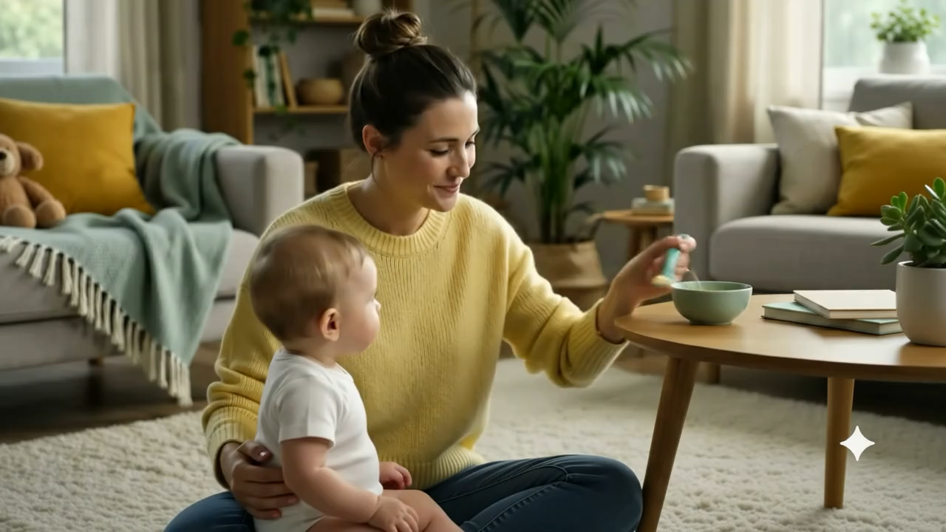
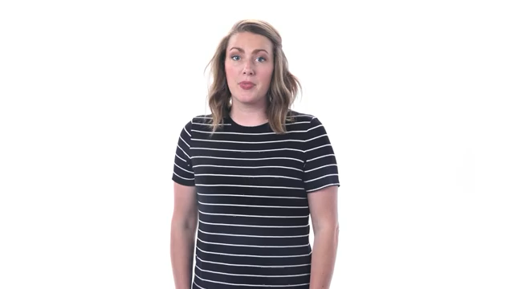
We capture the movement first. The next build is controlled avatar rendering.
The current POC captures movement as structured data. The next technical test is whether an avatar can follow it without changing the sign.
1. Generative AI attempt
2. Validated video
3. Intended POC output
Invents the hand, shape and timing
Movement source of truth
Next build: avatar preview
The capture works: 332 frames, 100% body tracked, 93.98% signing hand
If validated, the same motion-first pipeline is a KinderFlow asset that could later be explored in other structured communication contexts, with specialist validation.
Notes:
Direct generative video is not reliable enough for sign movement. It can change the fingers, the hand position or the timing. So, the POC uses Computer Vision to capture the movement first. The POC does not prove sign correctness. It tests whether motion can be captured as structured data. In testing, baby-based generative video created policy, privacy and reliability constraints. This is why the production path removes child video and starts from approved sign movement. Close on reuse: if validated, the same motion-first pipeline could later be explored in other structured communication contexts, always with specialist validation.

Slide 11
Two prototype layers: experience and operations
KinderFlow admin
Kinder Signs creates approved video
Movement check
Family card prepared
Expert review
Approved sign card, selected by the school
School-family experience
School selects an approved sign
It becomes the classroom routine that week
Family guidance continues at home
One governed library serves every school, without adding work to the classroom.
The school does not manage the AI workflow. It only uses approved content.
KinderFlow - Early-stage commercial validation
Notes:
This workflow is not something the school has to manage. It is an internal KinderFlow workflow to create and govern the content library: a sign from the school program goes in, Computer Vision summarizes the motion, the LLM drafts the family content, and a quality gate with human review releases the library item. LangSmith helps us check that the model stays grounded and avoids unsupported claims. It does not evaluate the video or sign correctness.
The school experience is much simpler. The educator teaches the sign in the classroom routine, and families receive the same guidance at home. This could be delivered through the existing school-family channel.
Bottom line: the school does not manage the AI workflow. It only selects and uses approved content, and professional validation is still required.

Slide 12
Implementation: how the content pipeline actually works
Pipeline and stack
Illustrative input schema
School content + CV summary MediaPipe landmarks, missing-frame analysis
LLM family draft n8n orchestration, structured prompt
Quality checks grounded fields, no unsupported claims
LangSmith trace evaluation of the content step
Draft pending approval released only after human review
sign_name: More
routine_context: Snack time / playtime
movement_notes: Use school reference only
do_not_claim: no acceleration, no diagnosis
Illustrative output schema
parent_title: This week's sign: More
when_to_use: Snack time, playtime
practice_tip: Follow the school reference
requires_human_review: true
LangSmith evaluates the content step, not the video or sign correctness.
KinderFlow - Early-stage commercial validation
Notes:
This is the technical detail behind the previous slide. Computer Vision (MediaPipe landmarks plus missing-frame analysis) turns the movement into a structured summary. An n8n workflow sends that summary, with a structured prompt, to the LLM, which drafts the family-facing content.
Quality checks keep the output grounded in the fields we provide and block unsupported claims. LangSmith traces and evaluates that content step, so we can measure grounding over time. Nothing is released automatically: the draft stays pending until a human approves it.
The example input and output show exactly what the model receives and returns. Note requires_human_review: true, and note the limit - LangSmith evaluates the content step, not the video or the sign correctness.

Slide 13
One purchase. Every family reached.
ONE PURCHASE BECOMES ONE FAMILY CARD
School account
Classroom group
Teacher
Child profile
Weekly sign
Prepared output
→
→
→
→
→
Basic
1-2 years
Teacher 1
family access
MORE
family card
Grows with premium packs.
No payments or login in the prototype.
We do not sell content. We sell a weekly routine.
KinderFlow - Early-stage commercial validation
12

Slide 14
A focused 8-9 week commercial validation phase, estimated €5.5k-€17.8k
Technical feasibility
Content workflow
Concept validation
Service test
Decision review
1 week
CV motion POC
1 week
n8n + LangSmith
2 weeks
Parent / educator feedback
3-4 weeks
3-5 signs
1 week
Continue / change / stop
€5.5k-€17.8k focused validation investment
This is not a launch budget. It is the cost of buying the evidence before building more.
KinderFlow - Early-stage commercial validation
Notes:
This is not a launch budget. It is a validation budget. The largest cost is not software. The main cost is expert review, user research and content testing. The goal of these eight to nine weeks is to reduce uncertainty before building more.

Slide 15
Why 8 to 9 weeks?
A short validation phase before scaling
1. Prepare
CV refinement
Content setup
Workflow setup
2. Test
Teacher feedback
Family feedback
Usability checks
3. Pilot
3 to 5 signs
One school routine
Real usage observation
4. Decide
Keep, refine or stop
Pricing hypothesis
Next build scope
Output after 8 to 9 weeks
Adoption signal
Workflow signal
Engagement signal
Pricing signal
The goal is not to launch the full product; is to validate demand, usability and willingness to pay before scaling.
KinderFlow - Early-stage commercial validation

Slide 16
School and home speaking the same language to the child. If validated, the same motion-first approach could later be explored in other structured communication contexts, with specialist validation.
KinderFlow - Early-stage commercial validation

Slide 17
The ask: a focused 8-9 week commercial validation investment of €5.5k-€17.8k
Credible today
Not proven yet
Next 8-9 weeks
Market access
Madrid ecosystem
Existing category
Clear positioning
Technical feasibility signal
Willingness to pay
Educator adoption
Engagement
Retention
Acquisition economics
Test 3-5 signs
Parent interviews
School workflow test
Expert review
Continue / change / stop
Proceed with a focused 8-9 week commercial validation phase before scaling.
The upside for KinderFlow: a differentiated B2B service to sell to early-years centers, built on a content pipeline we own.
KinderFlow - Early-stage commercial validation
Notes:
My recommendation is to continue validating Kinder Signs. The opportunity is credible, but not proven yet. The next step is to test a small number of signs with real families and educators.

