Slide 1
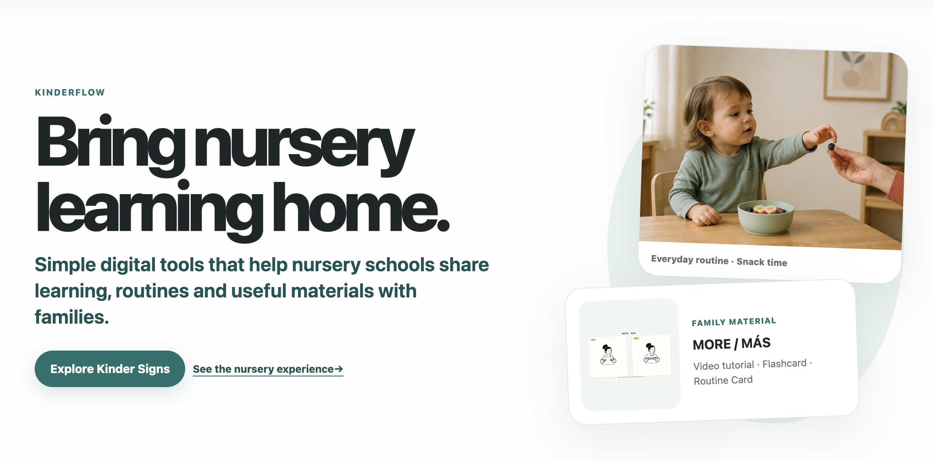
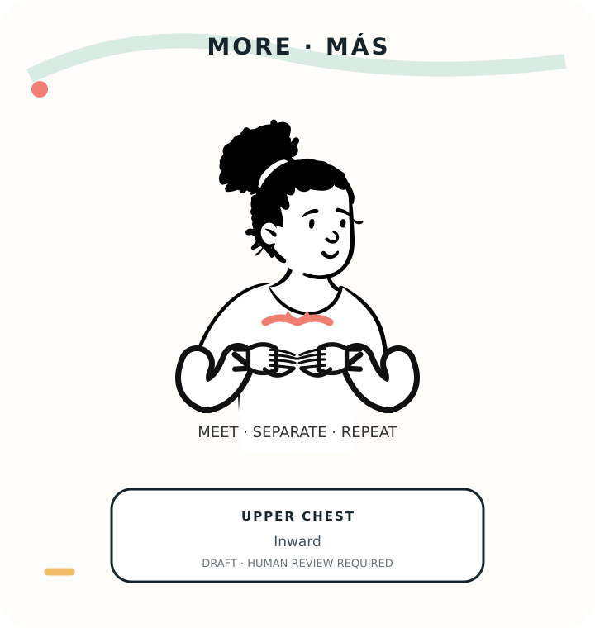
KINDERFLOW
INSERT 01_kinderflow_overview.png
KinderFlow turns nursery expertise into a school-to-home service.
Capture /content-studio.html at 1440 x 900. Keep KinderFlow name and value proposition visible.
Kinder Signs
Early childhood education
Gretel Ceballos
DRAFT VISUAL | HUMAN REVIEW REQUIRED

Slide 2
She teaches Baby Sign and sells training. Repeated family support is not yet a recurring digital service.
42
EUR 195k–238k
theoretical capacity
annual tuition lens
FOUNDER-OBSERVED UNITS
CALCULATED SCENARIO
That knowledge lives in conversations and materials she prepares herself.
11–15 h
monthly support-time range
PILOT HYPOTHESIS
Baseline KinderFlow recurring school revenue
EUR 0
Founder-observed inputs, public evidence and calculated scenarios. Not audited financial data.
Families ask for materials; income today is mainly one-off courses.
Source: docs/little_steps_operating_case_kpis.md; pseudonymised, not audited client financial data
2

Slide 3
01
02
03
04
05
06
Reviewed
reference
Computer Vision
evidence
Human-reviewed
sign asset
Family
materials
Nursery
assignment
Home
use
AI where it adds value
Control where reliability matters
MediaPipe checks the movement
AI drafts wording inside fixed limits
***Gemini FX: demo only, not in the product
The sign is retrieved, never invented
Fixed templates and quality checks
A person reviews before anything is published
The moat is not Spanish content. It is the school-to-home workflow and controlled reuse.
Sources: use_case_definition.md; ai_responsibility_matrix.json; Round 1 research
3

Slide 4
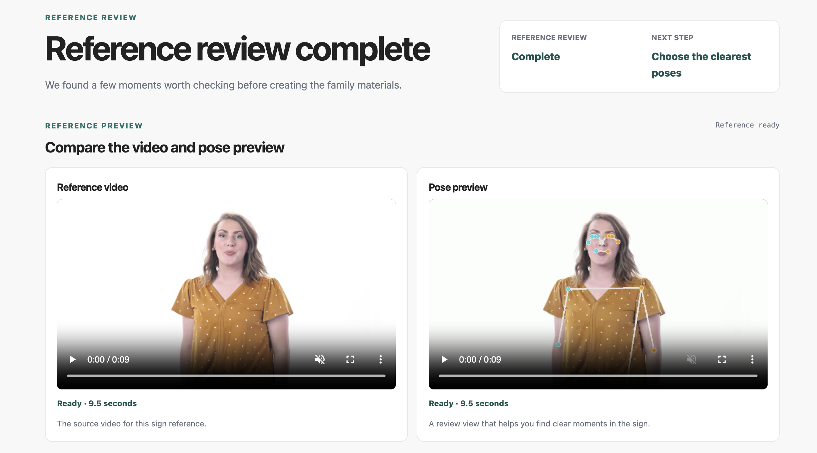
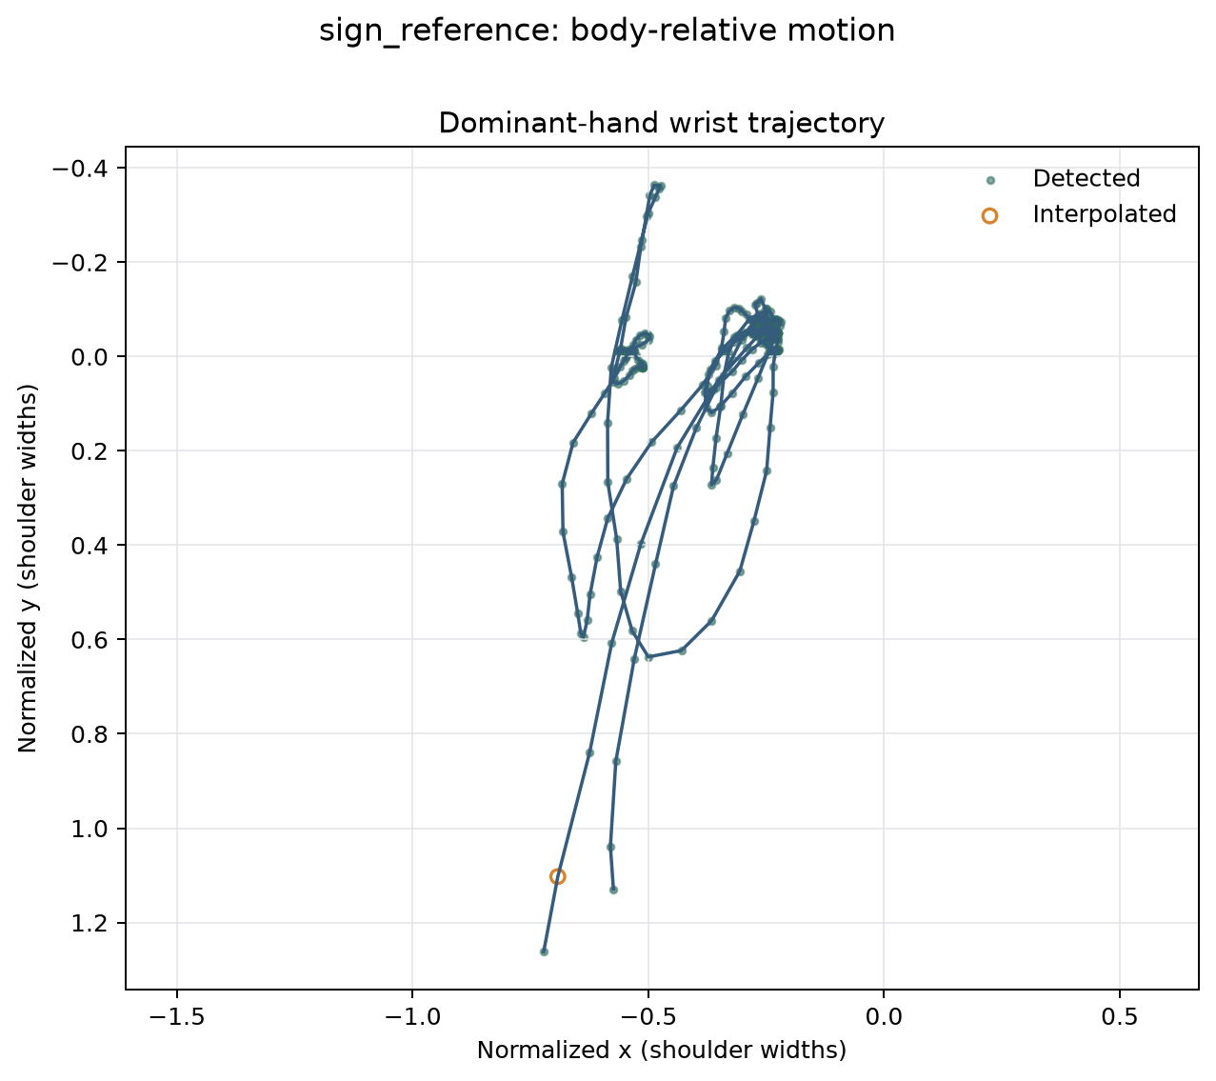
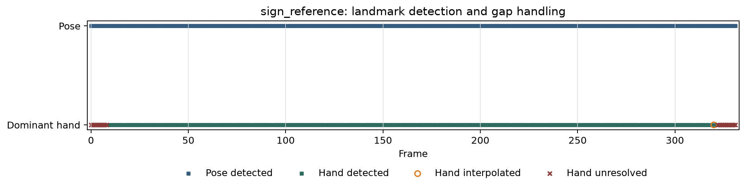
LIVE MVP DEMO + RECORDED BACKUP
1
2
3
4
VERSIONED MORE REFERENCE RUN
Reference
MediaPipe
Evidence
Human review
285
100%
frames processed
pose coverage
91.93%
25
dominant-hand coverage
missing hand frames
Capture quality is not sign-language certification.
Source: poc/poc_documentation.md and poc/output/; metrics apply only to the MORE run
4

Slide 5
Every first-year case is negative; scale drives the longer-term case.
Base case
ROI by scenario (%)
22.3% ROI
at 36 months
Break-even
Month 29.3
EUR 1,200
Calculated scenarios — not forecasts
base annual price hypothesis
Base ROI turns negative if price is 20% lower or centre-years are 25% lower.
Sources: presentation/roi_slide_inputs.md; roi_risk_assessment.md; add-on revenue set to EUR 0
5

Slide 6
01
02
03
Content fidelity
Willingness to pay
Rights + provenance
4 x 5 | DECISION-CRITICAL
4 x 5 | DECISION-CRITICAL
3 x 5 | MITIGATE
Current control
Current control
Current control
3–5 cleared signs, qualified review, zero critical incidents
Ask schools to choose between EUR 600, 1,200 and 1,800
Every asset keeps proof of permission, reuse, credit and withdrawal
Technical Lead + Qualified Reviewer
Commercial Lead + Nursery Sponsor
Content Operations + Rights Owner
The risks are manageable only through a controlled pilot.
Sources: roi_risk_assessment.md; docs/facts_risk.md; assets/registry/
6

Slide 7
PRELIMINARY INTENDED-PURPOSE ASSESSMENT
PRIVACY-MINIMISED BY DESIGN
EU AI Act
GDPR
Preliminary intended-purpose assessment: the current intended use does not appear to perform an education or biometric function listed as high risk in Annex III.
Current local MVP
Adult reference video, processed locally
Synthetic school and family records
No production delivery
No admissions or child scoring
No evaluation of learning outcomes
No level determination
No proctoring
No emotion recognition
No biometric identity or categorisation
No automated educational decisions
Legal basis: to be confirmed
Legal basis must be confirmed by processing purpose and controller before pilot.
Candidate Article 6 bases: contract, legitimate interests, legal obligation where applicable, and a nursery educational or public-task basis where applicable.
Adult reference media: consent, contract or legitimate interests, assessed against the real relationship.
Roles and legal bases for school and family data must be fixed before real pilot processing.
Preliminary and function-based. Not legal advice, not a regulatory classification and not a compliance certificate. Subject to reassessment if intended purpose, data, users or deployment change.
On the current intended purpose, a controlled pilot could move toward compliant deployment only after roles, lawful bases, DPIA, rights, security, retention and deletion controls are completed and tested.
Sources: preliminary internal EU AI Act and GDPR assessments; official EU/AEPD texts in source_map.md
7

Slide 8
Current MVP
Pilot readiness
Controlled test
Decision review
Limited deployment
Local connected proof
Rights, review, privacy
3 to 4 weeks
GO / ITERATE / STOP
Only after GO
Scope + workflow targets
GO decision requires
2–3 nurseries, 3–5 cleared signs
All 3 Little Steps groups active
First assignment in 2 minutes or less
80% or more finish without help
2+ repeat assignments per group
Families reach the agreed value thresholds
Every asset has complete rights and origin records
No critical or unreviewed deliveries
2+ schools would pay to continue at a stated price
Commercial model
Price hypotheses
Buyer: nursery owner or director
Model: B2B / B2B2C school subscription
Channel: founder-led pilot with 2–3 nurseries first
EUR 600 / 1,200 / 1,800 per centre per year
Base case: EUR 1,200 per centre per year
Not validated — the pilot tests whether nurseries would actually pay
The nursery pays; families are users.
The pilot is a decision instrument — not a launch.
Source: strategic_plan.md; proposed scale and duration are pilot hypotheses
8

Slide 9
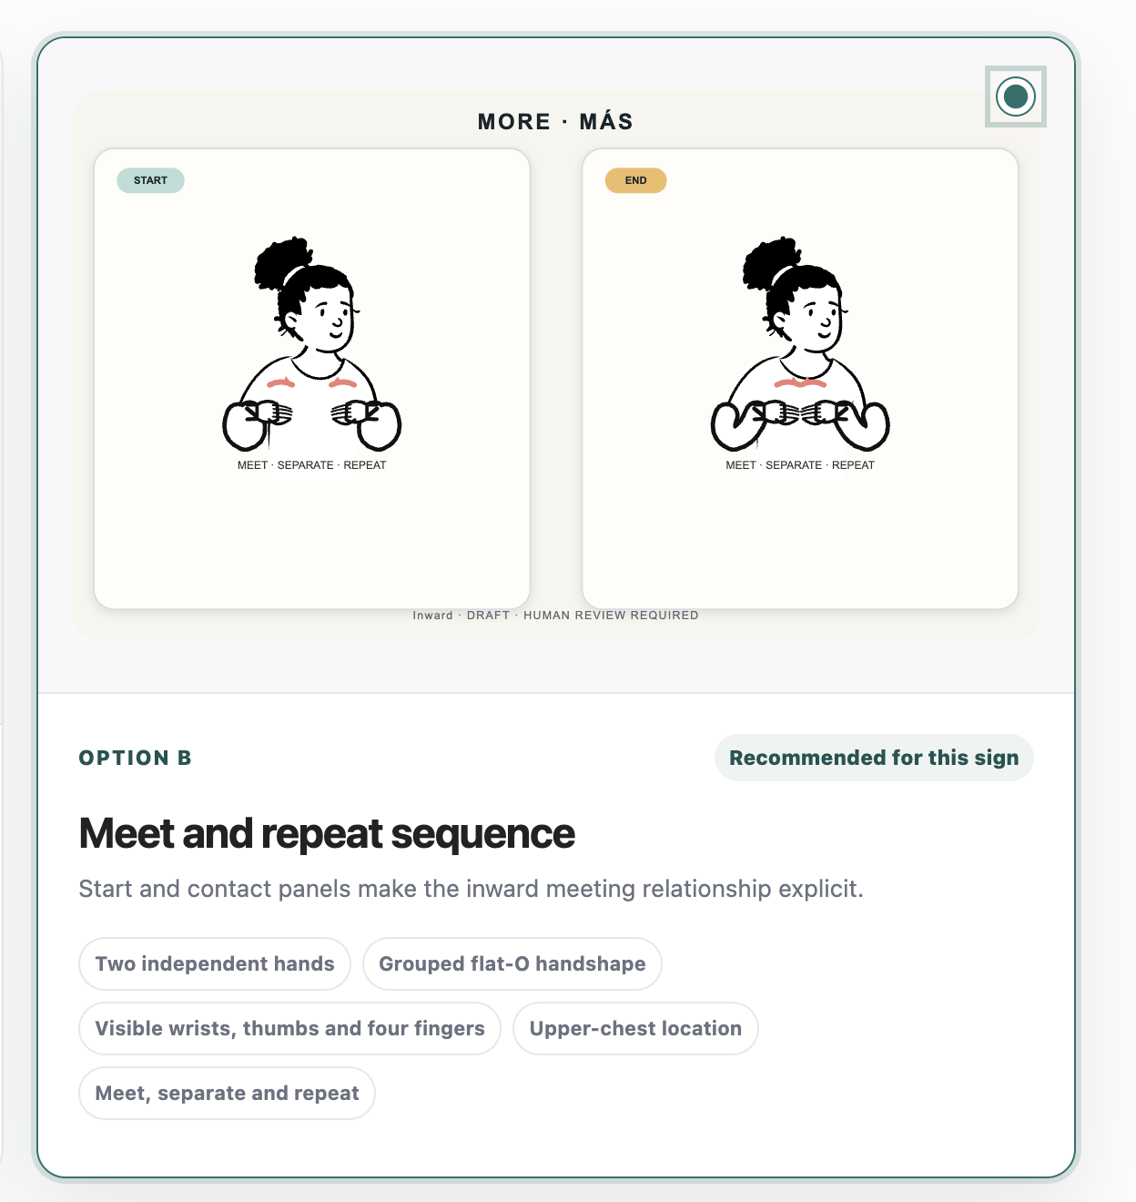
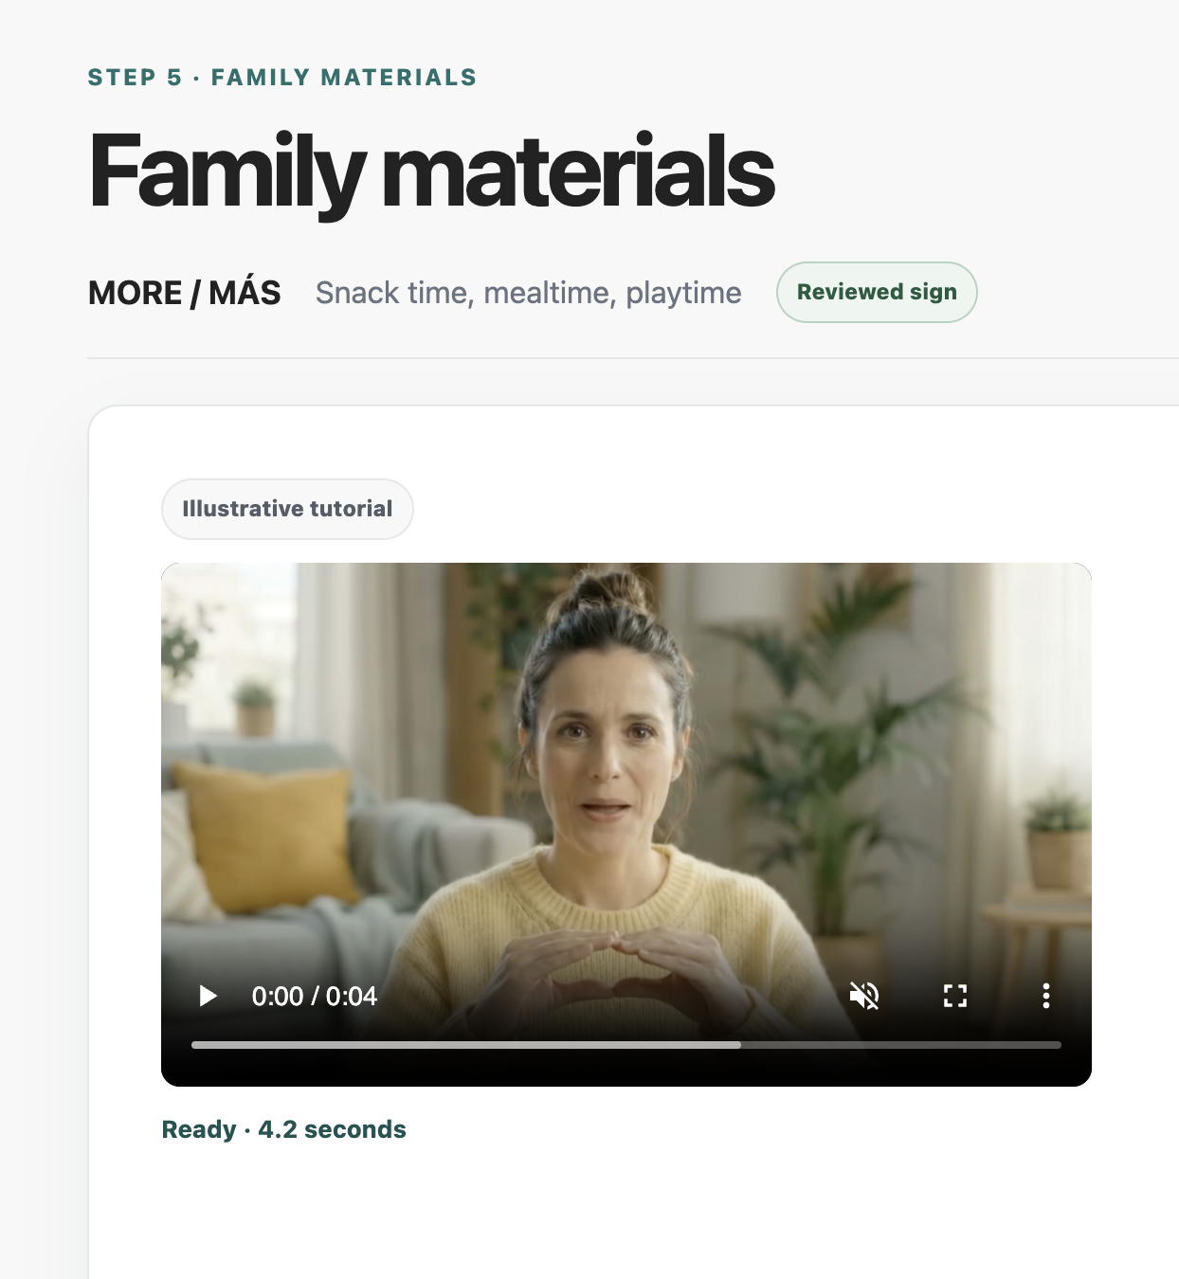
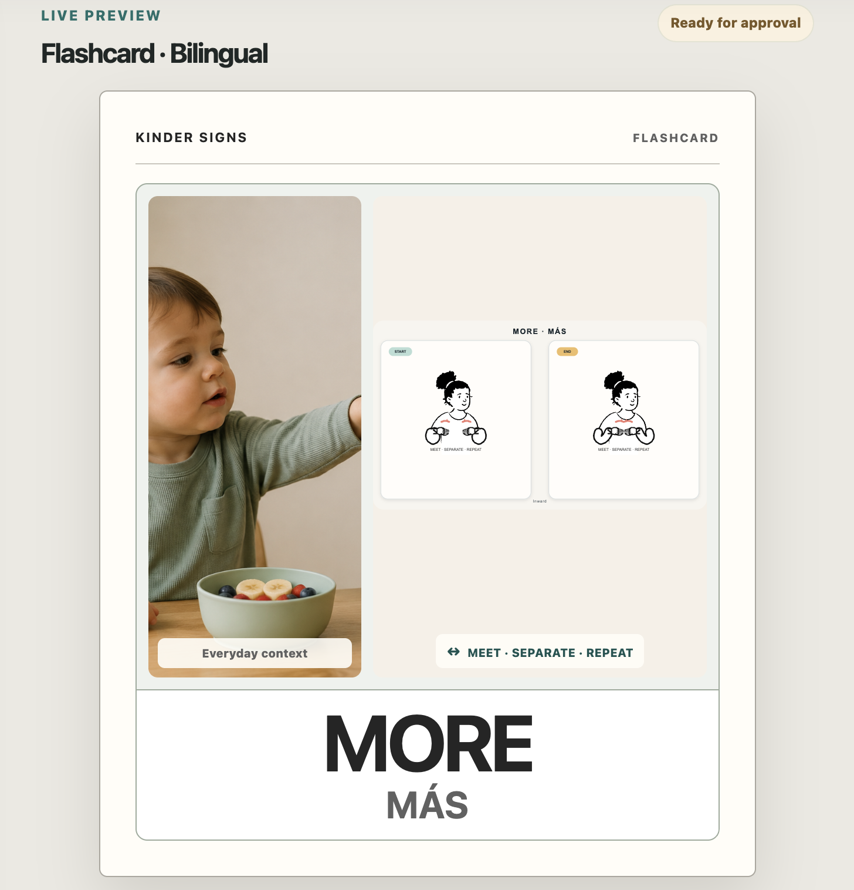
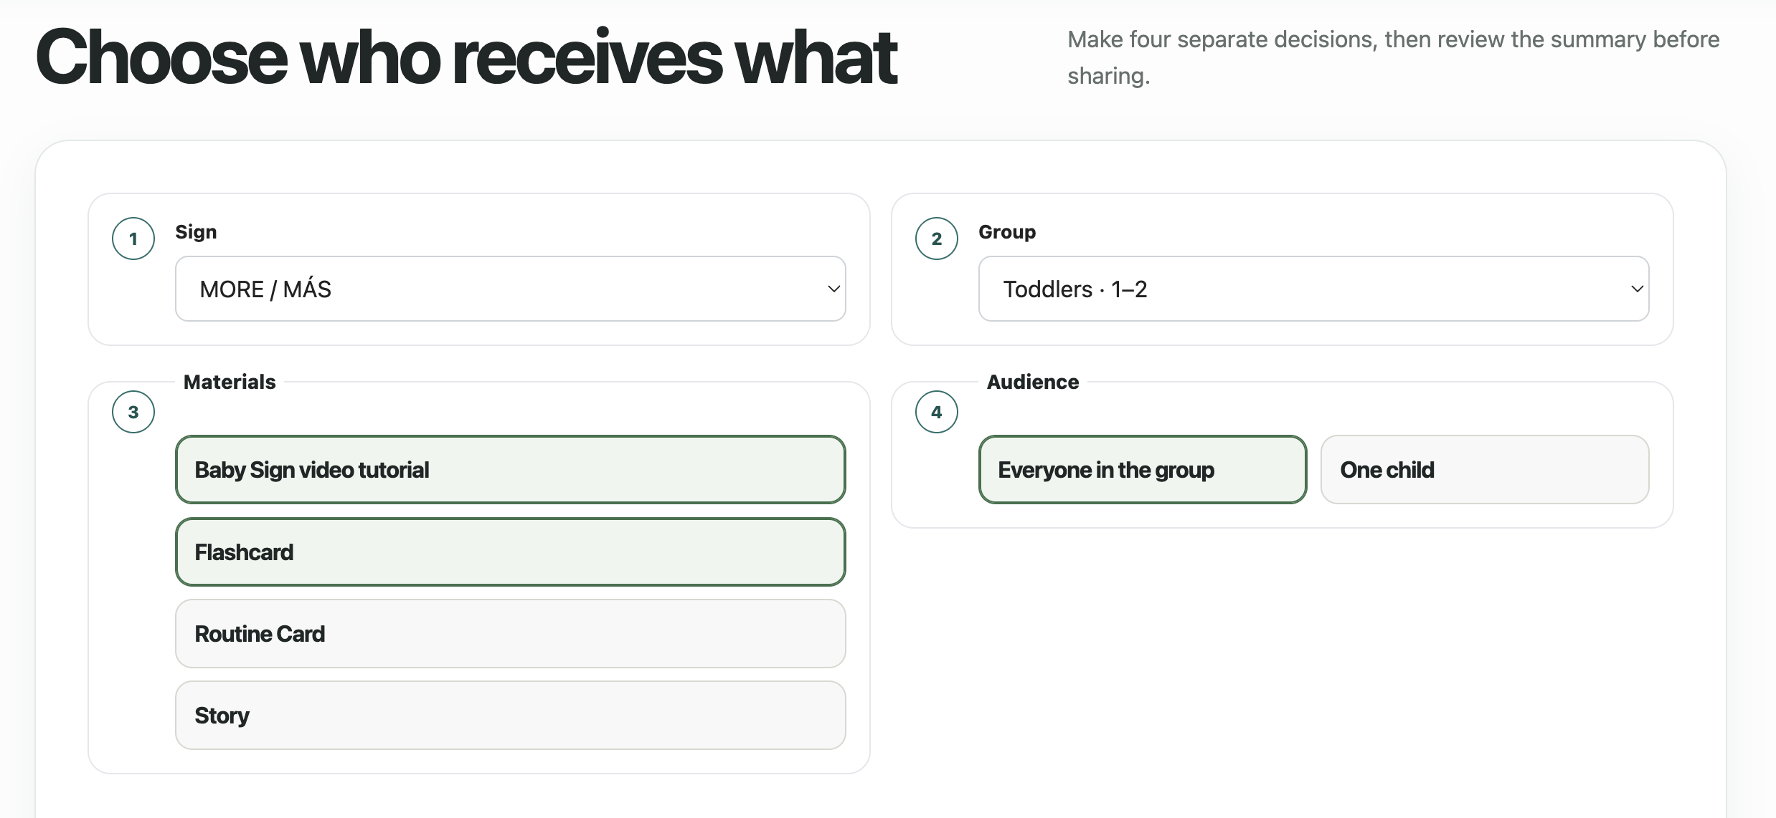
LIVE MVP DEMO + RECORDED BACKUP
REVIEW
CREATE
SHARE
Today: review → family materials → nursery assignment → a local family mini-library
Still to build: real logins, permanent database, real delivery, notifications, billing, integrations
Sources: prototype/; mvp/; current local workflow, not production delivery
9

Slide 10
RECOMMENDATION
Proceed with conditions: pilot before scale.
Buy evidence through a controlled pilot, not a public launch.
GO
ITERATE
STOP
Limits hold, families come back, and schools intend to pay
One gap left, with an owner, a cost, a target and a decision date
Unsafe or uncleared content, weak value, or nobody would pay
Approve an 8 to 9 week pilot with 2 to 3 nursery schools.
EUR 5.5k–17.3k validation budget • production build excluded • any GO scopes the next phase only

Slide 11
Technology
Role
Evidence
Boundary
MediaPipe + OpenCV + ffmpeg
Movement extraction, overlays and browser-ready video
CURRENT
No sign certification
Python + JavaScript / HTML / CSS
Local service and product interface
CURRENT
Not production infrastructure
Deterministic SVG + Open Peeps
Repeatable draft visuals and print layouts
CURRENT
Hand review still required
n8n
Governed orchestration design
IMPORTABLE
Live final runtime not evidenced
LangSmith
LLM trace and evaluation plan
DRY-RUN
Does not evaluate CV
Gemini FX
Illustrative future motion direction
DEMO-ONLY
Not landmark-driven or certified
Tableau + Git / GitHub
Market evidence and version control
CURRENT
Not product telemetry
Sources: docs/course_technologies_applied.md; mvp/; workflow/; dashboard/
11

Slide 12
Reference layer
CV layer
Evidence + registry
Content operations
Family materials
Nursery workflow
Adult video
Landmarks + diagnostics
Lineage + rights state
Rules + human gate
Deterministic print
Assignment prototype
CURRENT
CURRENT
CURRENT
CURRENT / DRY-RUN
CURRENT
LOCAL PROTOTYPE
Human review separates technical evidence from publication. Schools never operate the production pipeline.
Sources: docs/kinder_signs_content_operations_architecture.md; docs/kinder_signs_system_one_page.md
12

Slide 13
IMPORTABLE WORKFLOW DESIGN
LANGSMITH EVALUATION DRY-RUN
n8n
No network calls
Dataset: kinder_signs_microlearning_v1
Inputs: approved sign + CV summary
Output: structured family draft
Quality gate: PASSED
Human review: REQUIRED
Approved object
Schema check
LLM draft
Quality gate
Automatic publication: false
Would not evaluate: video, movement correctness, Baby Sign correctness, CV quality or professional validity.
Sources: exact n8n JSON and workflow/langsmith_dry_run_summary.json
13

Slide 14
DESIGN BOUNDARIES
We deliberately did not automate the decisions that require accountability.
NO Child scoring
NO Automatic sign certification
NO Autonomous publication
NO Unnecessary RAG
NO Unnecessary agent
NO LLM-based objective gates
AI creates evidence or a draft. A person controls release.

Slide 15
LOW
BASE
HIGH
EUR 600
EUR 1,200
EUR 1,800
annual subscription / centre
annual subscription / centre
annual subscription / centre
Centres Y1/Y2/Y3
Validation upfront
ROI at 12 months
ROI at 36 months
Break-even
3 / 5 / 8
EUR 5.5k
-84.3%
-60.9%
> 36 mo.
Centres Y1/Y2/Y3
Validation upfront
ROI at 12 months
ROI at 36 months
Break-even
6 / 15 / 30
EUR 11.4k
-66.7%
22.3%
29.3 mo.
Centres Y1/Y2/Y3
Validation upfront
ROI at 12 months
ROI at 36 months
Break-even
10 / 30 / 60
EUR 17.3k
-44.3%
116.1%
17.2 mo.
Add-on revenue = EUR 0 • production build, churn and measured CAC are excluded
Sources: presentation/roi_slide_inputs.md; roi_risk_assessment.md
15

Slide 16
Risk
Score
Gate
Action
Sign fidelity + content quality
4 x 5
Before pilot
3–5 cleared signs + qualified review
Willingness to pay + adoption
4 x 5
During pilot
Price-specific paid-continuation intent
Source + presentation rights
3 x 5
Before pilot
100% permission + provenance
Privacy scope creep
3 x 5
Before pilot
Group-first data + DPIA + security
Reviewer cost + throughput
3 x 4
During pilot
Time review, exceptions and rework
Runtime reliability
3 x 4
Before pilot
Frozen version + manual fallback
Educator workflow fit
3 x 4
During pilot
2 min / 80% / repeat-use targets
Sources: roi_risk_assessment.md; docs/facts_risk.md
16

Slide 17
01
02
03
Current local MVP
Before controlled pilot
Before production
Adult reference processed locally
Synthetic school/family records
No child assessment
No production delivery
Confirm roles and lawful basis
Complete DPIA and notices
Set retention, rights and deletion
Add authentication, security and DPA
Scalable security and monitoring
Vendor and transfer governance
Incident exercises
Change-triggered legal reassessment
A future child-assessment or decision-making feature triggers a new AI Act and GDPR assessment.
Sources: compliance/eu_ai_act_compliance.md; compliance/gdpr_documentation.md
17

Slide 18
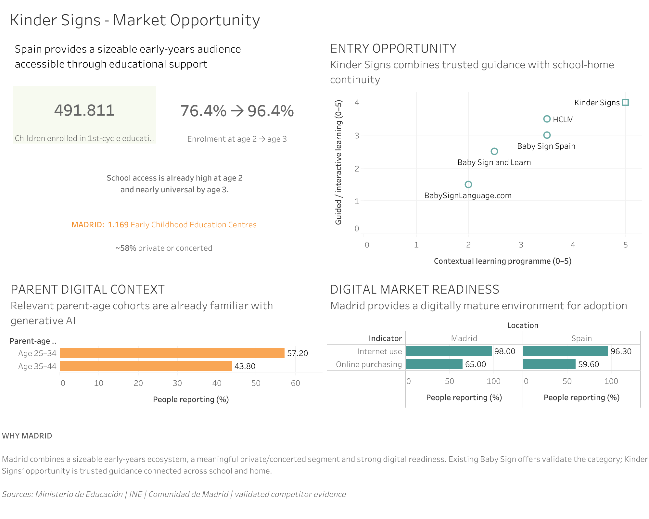
ROUND 1 | KEEP
Validated enough to continue
Market framing
School-led model
Three use cases compared
Kinder Signs selected
Static product concept
Initial CV feasibility
ROUND 2
Dynamic local CV + connected MVP + pilot decision
Sources: dashboard/tableau/; feedback/round1_decision.md
18

Slide 19
CURRENT
DRY-RUN
DEMO-ONLY
PILOT HYPOTHESIS
FUTURE
Local MP4 processing
MediaPipe evidence
Deterministic print
Local school/family prototype
LangSmith evaluation plan
Optional LLM wording path
No live trace evidenced
Separate Gemini FX previews
Not driven by landmarks
Rights confirmation needed
Price and willingness to pay
Adoption and repeat use
Content reuse economics
Production avatar
Persistent family delivery
Billing and integrations
Evidence maturity travels with the claim. It is never hidden in a footnote.
Sources: README.md; docs/round2_evidence_map.md; docs/mvp_reality_check.md
19

