Slide 1
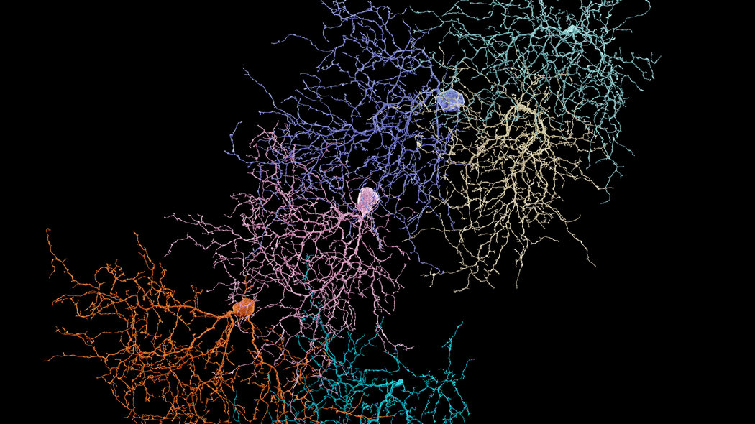
Nature...
...Or Not?
Training a Neural Net to recognize whether there are man-made objects in satellite images from
around the globe…and extra-terrestrial globes
Notes:
Who knows when artificial neural networks were first introduced? (1957)
Can anyone tell me how many layers there are in a “deep” neural network? (3 or more)
What is a Rectified Linear Unit? (Also known as RELU, it’s a function that sets any negative values to zero)
My project uses all of these things.
My name is Gretchen Riggs and my project is entitled “Nature...Or Not?”
I’ve trained a neural network to recognize the presence of man-made object in satellite imagery.

Slide 2
Motivation
Monitoring Land Use
Logistic Information for Nature Disaster Areas
Reconnaissance
Finding intelligent life on other planets...a long shot??? Perhaps not...

Slide 3

Traditional Neural Network
Notes:
Now I didn’t use a traditional neural network to do this.
I used a convolutional neural network.
What’s the difference? The main difference is that in a traditional neural network all neurons in one layer are fully connected to the next layer. That is, every neuron is connected to every neuron in the next layer. That’s a lot of connections.

Slide 4
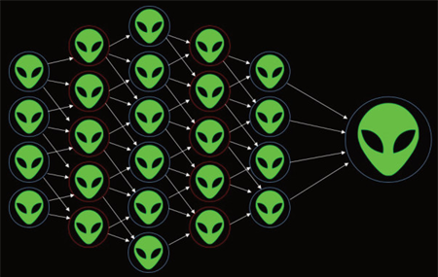
Convolutional Neural Network
Output Layer
Input Layer
Hidden Layer 4
Hidden Layer 1
Hidden Layer 3
Hidden Layer 2
Notes:
In a convolutional neural network, the neurons are sparsely connected.
The number of connections are local in space.
This is achieved by making the filter (or kernel) smaller than the input

Slide 5
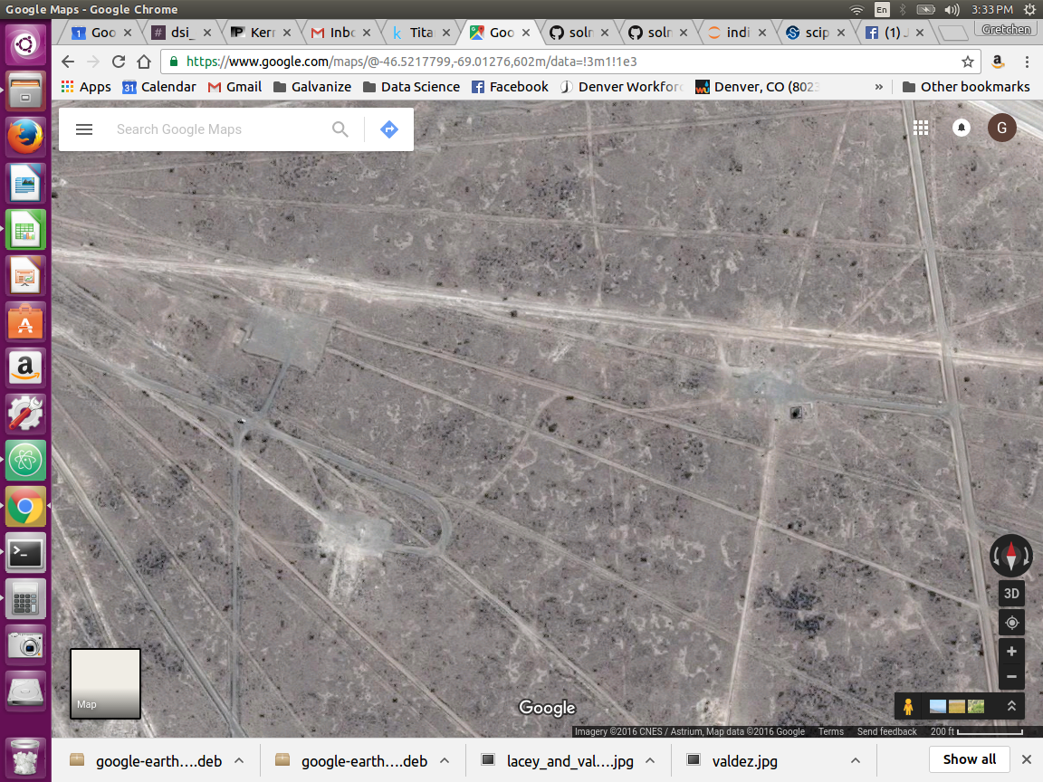
Convolutional Filtering
* With # of Filters
* With # of Filters
* With # of Filters
* With # of Filters
Notes:
As we can see here, the filter, usually of size 3x3 or 5x5, slides over the image and is convolved with just an area of the image, producing a specified number of feature maps.

Slide 6
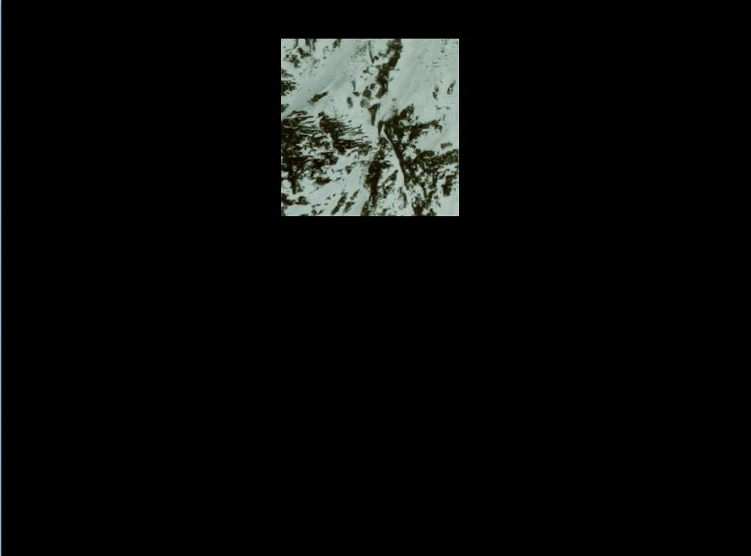
The Data
Notes:
The data was obtained from Google Maps using the Google Maps API and also by manual screen capture.
These larger images were cut down into 124x124x3 pieces.

Slide 7
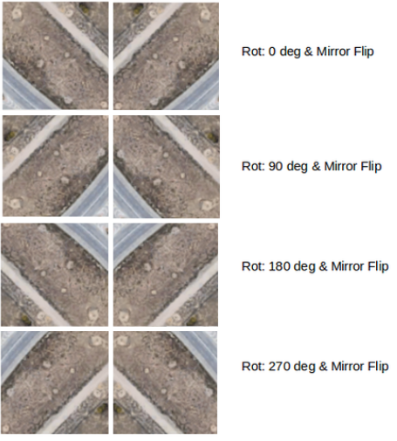
Rotating and Mirroring…
...Augment the data!
Notes:
Next, the data was augmented by rotating it 90, 180, & 270 degrees and then “mirrored” to create 8x as many images, 53,600 total.
I was able to label just ⅛ of the data as nature or containing man-made objects and copy these labels to the other 7 versions of the dataset.

Slide 8
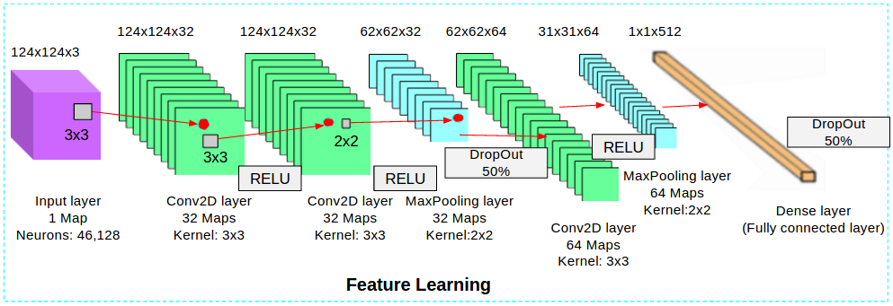
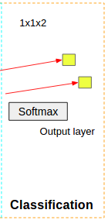
The CNN Architecture
Notes:
Here is the architecture used for my CNN.
My neural network starts off with 2 Convolutional Layers with RELU (Rectified Linear Unit) activations, which I mentioned previously, that set negative pixel values to 0, followed by a MaxPooling layer with some Dropout to prevent overfitting.
Next, a 3rd Convolutional Layer with RELU is applied fol owing by MaxPooling.
This goes into a Dense Fully-Connected Layer with some Dropout, again to prevent overfitting.
Then there is an application of the Softmax function which categorizes the image as “Natural” or “Containing Man-Made objects”.

Slide 9

The Results
 | Accuracy | Precision | Recall | F1-Score
3-layer CNN | 0.850 | 0.850 | 0.828 | 0.849
Notes:
The model was able to achieve about 85% accuracy, with similar scores for precision, recall, and F1-score.

Slide 10

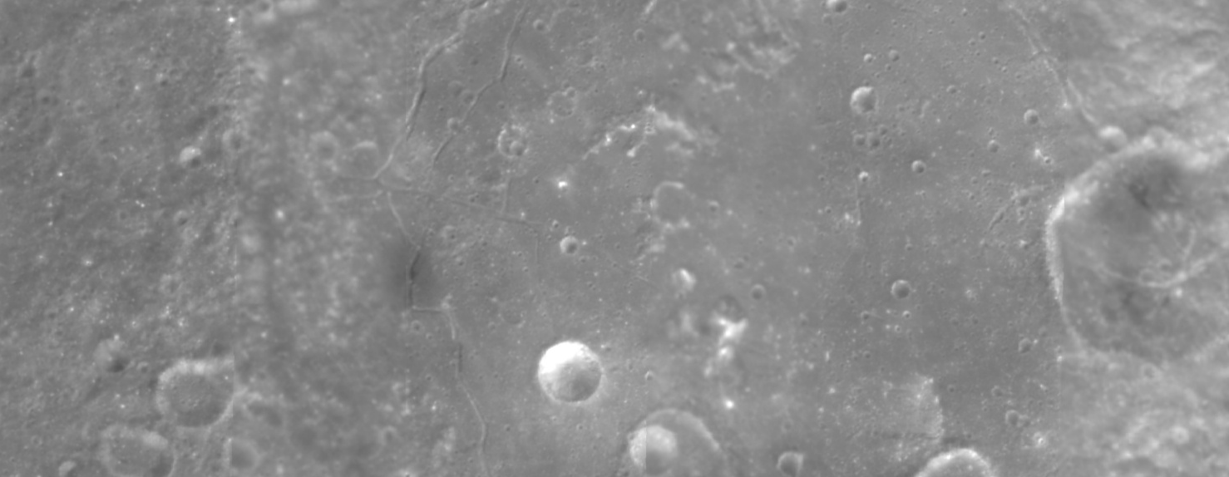

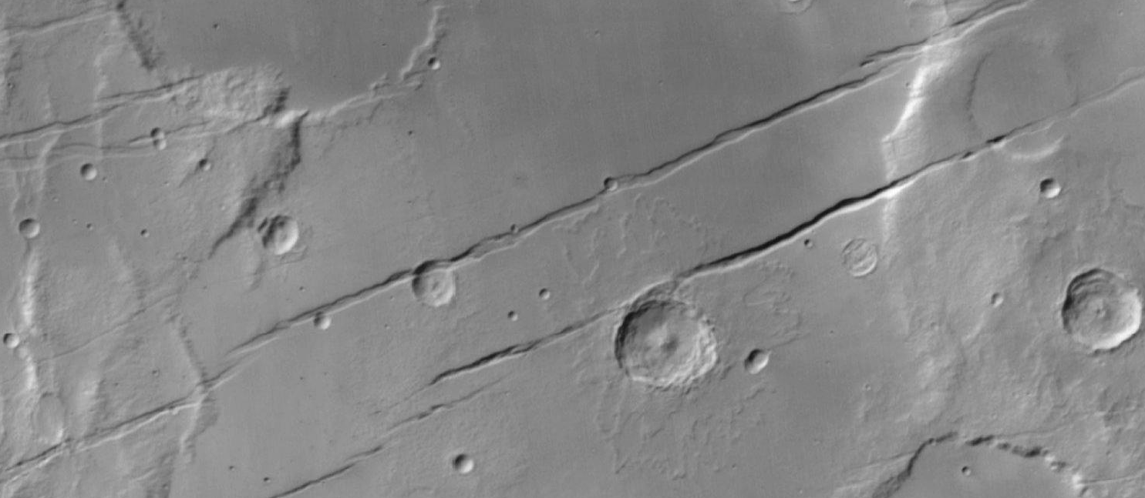
Fun Tests!
Notes:
As I hinted at previously, this technology could be used in predicting if there is intelligent life outside of Earth by observing large volumes of satellite imagery and finding patterns it recognizes as being unnatural.
To test this idea, I captured some images from Google Mars and Google Moon to see if the CNN model could correctly predict if the images only contained natural objects. Would the learning the model did on desert regions of the Earth be enough for it to make accurate predictions about the otherworldly images from the near cosmos? Or perhaps find where E.T. and his buddies live?
...well...it still remains to be seen. The Earth-prediction model could only predict about 50% of the images from the Moon and Mars as natural. This is most likely because of the gray scale images obtained and perhaps because of the many regular-appearing crater shapes. Or, could it be that aliens do inhabit these nearby celestial bodies?? Dun, dun, dunnnn...

Slide 11
Data Sources
Google Maps
DigitalGlobe
Province of British Columbia
County of Stettler
Getmapping PLC
Infoterra Ltd. & BlueSky
Isle of Man Government
GeoContent
Zenrin
Datasio
GeoEye
Parks Canada
NASA
USGS
Malin Space Science Systems
INEGI
GeoBasis - DE / BKG
European Space Imaging
Instituto Geográfico Nacional
AfriGIS (Pty) Ltd.
TerraMetrics
Orion Middle East
CNES / Astrium
Landsat / Copernicus
NOAA
U.S. Navy
GEBCO
Lunar and Planetary Institute
Arizona State University
Jet Propulsion Laboratory
Notes:
Here are the sources of the images obtained from Google Maps.

Slide 12








Technology Stack
Notes:
And here is the technology stack used in my project.

Slide 13
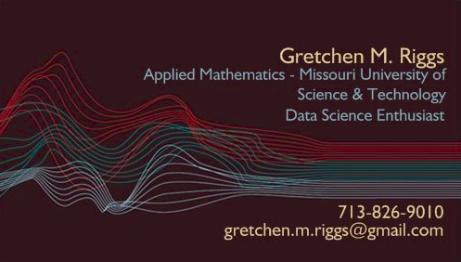
Contact Info
github.com/gretchenriggs
linkedin.com/gretchenriggs
Notes:
I’m Gretchen Riggs. Please come see me after the show! Any questions from the panelists?

