Slide 1
Fitts’ law Week 2
Grete Liis Reimand
au763212@uni.au.dk

Slide 2
Agenda
- Introduction
- Collaborative docs
- GitHub repo - Fitts’ law experiment - Data analysis - Real life examples of Fitts’ law

Slide 3
Hello :)
- Grete
- 5th semester BSc CogSci
- Contact: au763212@uni.au.dk

Slide 4
Expectations
What I expect of you
- that you ask all the questions you have - that you participate and give me feedback on how it’s going
What you can expect of me
- that I will answer your questions (or find an answer if I don’t know it) - I’m here to make this experience as good as possible for you guys

Slide 5
Collaborative brainstorm docs
(can be found on BS under Exam inspiration)
At the end of class write down any
thoughts/ideas/experiments which can
be used at the end of the semester when
choosing an exam topic

Slide 6
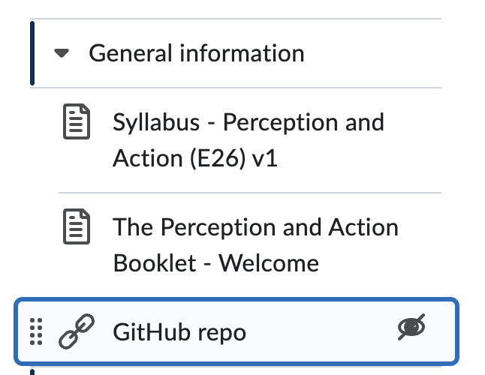

GitHub repository
(can be found on BS under General information)
All the code and data files will be shared in this GitHub repo
If you have any trouble with GitHub, I hopefully know how to help : )

Slide 7
Fitts’ law experiment
1. Go to this website:
https://www.csfieldguide.org.nz/en/interactives/fitts-law/
and complete the experiment
2. Download the data and copy it into the shared
sheet on Brightspace (give yourself a random ID)

Slide 8
Fitts’ law experiment
On GitHub (and BS today) there is a very simple analysis file just to show the results of the experiment
The solutions are already up on GitHub (however it’s a good practice exercise to get back to using R so I encourage you to try first)

Slide 9
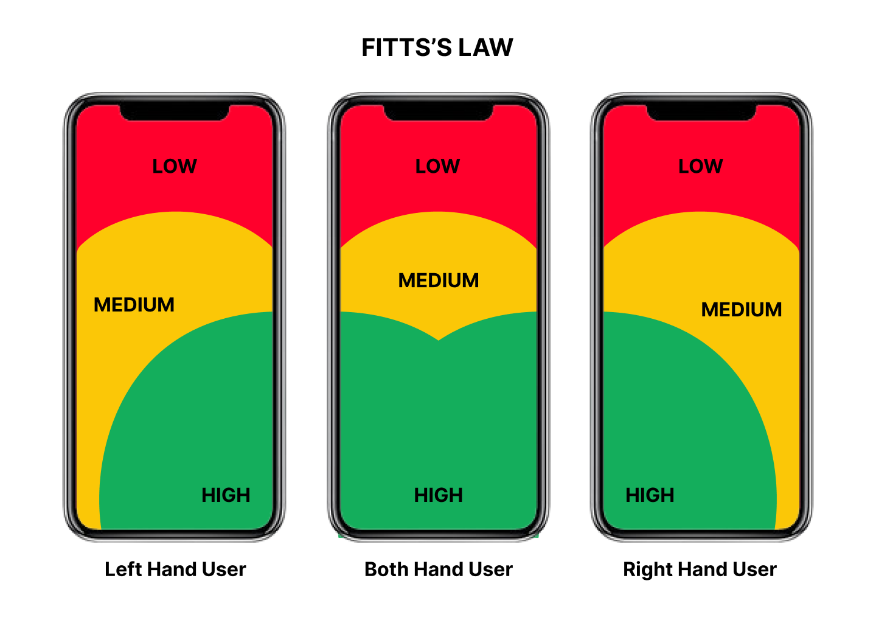
Fitts’ law examples in real life
Used heavily in UX design:
1. targets should be big enough 2. targets should have enough room between each other
3. targets should be in easily acquirable areas
https://lawsofux.com/fittss-law/
https://blog.yarsalabs.com/fittss-law-in-ux-design-navigating-the-world-of-precision-and-efficiency/

Slide 10
Wrapping up
Spend 5 minutes at your table coming up with any experiment ideas and add them to the brainstorm docs

Slide 11
See you next week!

