Slide 1
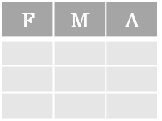
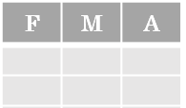



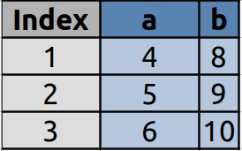
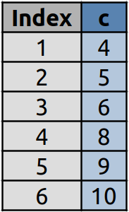
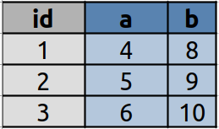
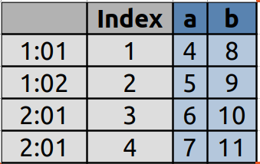
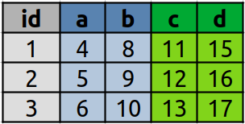
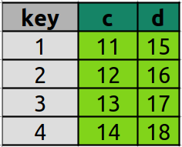
Data Handling
with Gretl Cheat Sheet
https://gretl.sourceforge.net/
Gretl Data
&
*
Tidy data complements Gretl’s vectorized operations. Gretl will preserve observations as you manipulate variables.
In a Gretl data set:
Gretl command reference, function reference & User's Guide
Each variable is saved in its own column
Each observation is saved in its own row
M
*
A
Creating Datasets
Reshaping Data – Change layout, sorting, reindexing, renaming
 | a | b | c
1 | 4 | 7 | 10
2 | 5 | 8 | 11
3 | 6 | 9 | 12
dataset sortby mpg
Order rows of dataset by values of series (low to high).
dataset addobs n
Adds n extra observations to the end of the dataset.
rename y year
Rename the series y of a dataset into year.
delete L
Drop list of series, L, from dataset.
setobs 1 1 --cross-section
Reset index of dataset to row numbers.
setobs 12 2000:1 --time-series
Set index of dataset to monthly time-series.
nulldata 3
series a = {4; 5; 6}
series b = {7; 8; 9}
series c = {10; 11; 12}
Specify values for each column.
list L = a b
series c = stack(L, n)
Stack n observations from each series in L.
dataset transpose
Gather columns into rows.
join dfile --ikey=id --okey=key
Left-join of another datafile dfile.
append filename
Append columns and rows from another file.
nulldata 4
series a = {4; 5; 6; 7}
series b = {8; 9; 10; 11}
setobs 2:2 --stacked-time-series
Create a panel dataset.
Subset Observations - rows
Working With Lists (ch. 15 in the User's Guide)
list L2 = mpg L1 Width
Append to a list individual series as well as lists.
list L3 = L1 || L2
Union of two lists removing duplicates.
list L3 = L1 && L2
Intersection of two lists incl. eventual duplicates.
list L3 = L1 - L2
Remain all elements of L1 that are not in L2.
list L2 = L1[1:4]
Only pass the first four members of L1.
nelem(L)
# of elements in list L.
inlist(L, y)
Return the 1-based position of series y if present in L, otherwise zero.
list H = X ^ Z
Compute interaction terms between xi and zi.
Print Values
smpl Length > 7 && Width < 3 \
--restrict
Restrict to rows that meet logical criteria.
dataset resample n
Randomly select n rows.
smpl a >= values(a)[n] --restrict
Select top n entries based on series a.
smpl a <= values(a)[end-2] --restrict
Select bottom n entries based on series a.
smpl 1 n
Select first n rows.
smpl ($tmax – n) $tmax
Select last n rows.
smpl full
Restore full dataset.
list L = Length Width
Add multiple series with specific names to list.
list L = 1 2 3
Add multiple series using the ID number to list.
list L = y_*
Add series with the prefix „y_“ to list using the wildcard character.
list L delete
Remove list L from memory.
delete L
Delete the series contained in list L.
L += x
Append series x to list L.
L -= x
Remove series x from list L.
print object
Print some object.
printf format , args
Print some object under control of a format string.
Open And Store Data
open denmark.gdt
Open a local dataset. Supports various data types such as plain text, csv, MS Excel, Stata, SPSS, GEOJson etc.)
store MyFile.csv
Save data to some file. Support for native format, csv, txt, GNU Octave and Stata.
store --matrix=mat MyFile.csv
Save a matrix as a dataset.
open dbnomics
Connect to the dbnomics database.
Logic in Gretl
< | Less than | != | Not equal to
> | Greater than | contains(object, S) | Object contains any of the elements of S
== | Equals | missing(y) | Is NaN
<= | Less than or equals | ok(y) | Is not NaN
>= | Greater than or equals | &&,|| | Logical and, or, not, xor, any, all
regex (Regular Expressions) Examples
regsub(S, "\.", ",") | Replace all ',' by '.'
regsub(S, "Foo$", "") | Delete 'Foo' if the string ends with 'Foo'
regsub(S, "^My", "") | Delete 'My' if the string starts with 'My"
Cheatsheet for Gretl by Artur Tarassow (https://github.com/atecon/gretl_cheatsheet). Originally written by Irv Lustig, Princeton Consultants, inspired by Pandas cheat sheet.

Slide 2
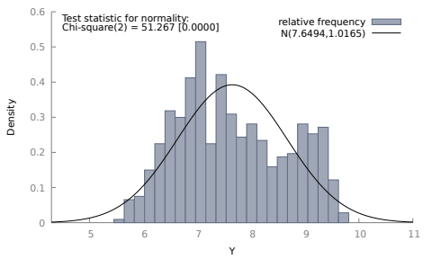
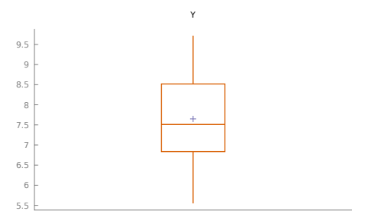
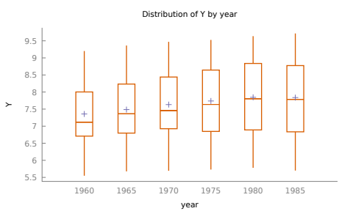
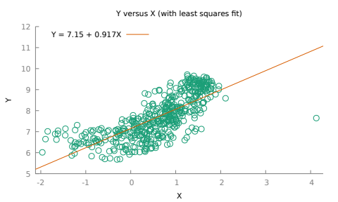
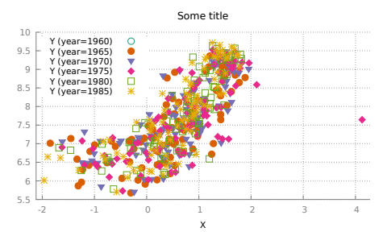
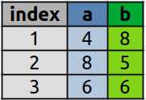
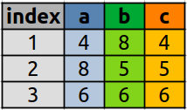
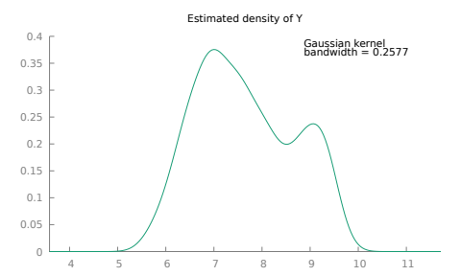
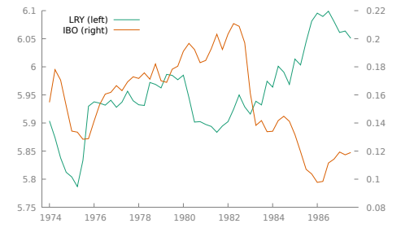
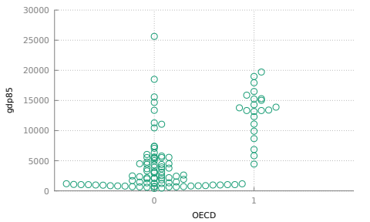
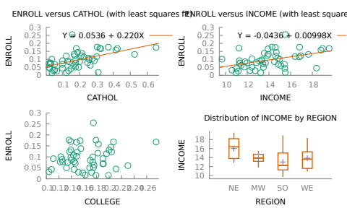
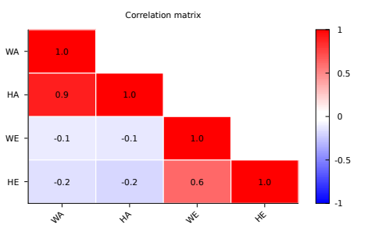
Summarize Data
Handling Missing Data
Plotting
nobs(y)
# of non-missing observations in dataset.
nelem(dataset)
# of variables in dataset.
values(y)
Distinct values of a series sorted in ascending order.
summary y x
Basic descriptive and statistics for variables. The table of statistics produced can be retrieved in matrix form via the $result accessor.
$nobs
# of observations of active dataset.
smpl L --no-missing
Drop rows of list L with any column having NA data.
series y = ok(y) ? y : value
Replace all NA data with value for series y (ternary operator).
b = replace(y, find, subst)
Replace each element of y (a scalar or vector).
freq y --normal --plot=display
Histogram for series y.
boxplot y --output=display
Boxplot for series y.
Make New Series
Gretl provides a large set of summary functions that operate on different kinds of Gretl objects (series, list and matrix) depending on the function.
For some of the functions, L can be a series, list or matrix.
boxplot y year --factorized \
--output=display
Boxplot for series y grouped by year.
If y is a series, the following functions return a scalar values.
series y = NA
Create a single series initialized with NA values.
series Volume = Length*Height*Depth
Create single series.
series lY = log(L)
Logarithm of a series.
series dY = diff(L)
First difference of a series.
series Ylag = Y(-1)
Create lag of series.
gnuplot y x --fit=linear \
--output=display
Scatterplot with linear fit.
sum(y)
Sum values of series.
nobs(y)
# of non-NA values of series.
median(y)
Median value of series.
quantile(y, 0.25)
Quantiles of series.
skewness(y)
Skewness of series.
min(y)
Minimum value of series.
max(y)
Maximum value of series.
mean(y)
Mean value of series.
var(y)
Variance of series.
sd(y)
Standard deviation of series.
series lY = ldiff(L)
First difference of logarithm.
series dY = sdiff(L)
Create seasonal difference the logarithm.
series Ylead = Y(+1)
Create lead of series.
gnuplot y x year --dummy \
--output=display \
{set title "Some title" \
font ',14'; set grid lw 2;}
Scatterplot for each discrete value of year
plus calling some gnuplot options for tweaking.
If y is a list, the functions return a series holding the applied summary statistics computed across all columns for each row.
kdplot y --output=display
Kernel density plot.
Aggregation
series min_ab = min(deflist(a, b))
Minimum across a list of series for each row.
gnuplot y x --with-lines \
--time-series \
--output=display
Time-series plot.
open data4-1
m = aggregate(null, bedrms)
Count the observations for each distinct value of byvar.
matrix m = aggregate(sqft, bedrms, mean)
Group by bedrms and compute the mean of sqft for each group.
list L = sqft price
eval aggregate(L, bedrms, sd)
Group each item of L by bedrms and compute the
standard deviation for each group.
list BY = bedrms baths
eval aggregate(L, BY, median)
Group each item of L by BY and compute the median for each group.
byvar count
3 5
4 9
byvar count f(x)
3.0000 5.0000 1563.8
4.0000 9.0000 2103.8
byvar count sqft price
3.0000 5.0000 610.20 125.94
4.0000 9.0000 488.98 59.404
gnuplot y x --output=display \
{ set jitter overlap 0.5;\
set grid;}
Scatter plot with jitter points.
The following built-in functions can be applied: sum, sumall, mean, sd, var, sst, skewness, kurtosis, min, max, median, nobs, gini, isconst, isdummy.
open data4-10
strings MyPlots
gpbuild MyPlots
gnuplot ENROLL CATHOL
gnuplot ENROLL INCOME
gnuplot ENROLL COLLEGE
boxplot INCOME REGION --factorized
end gpbuild
gridplot MyPlots --output=display
Matrix of subplots.
corr L --triangle --plot=display
Plot of a correlation matrix.
Using Packages (click)
Working Directory
pkg install addlist
Install package addlist from the gretl package server.
include addlist.gfn
Load the package into memory.
help addlist
Show the help file for the package.
$workdir
Find the current working directory (inputs are found
and output are sent).
set workdir PATH
Set current working directory.
$dotdir
Path for storing temporary files.
$sysinfo
Returns information on the capabili-
ties of the gretl build and the system.
Cheatsheet for Gretl (https://github.com/atecon/gretl_cheatsheet). Originally written by Irv Lustig, Princeton Consultants, inspired by Pandas cheat sheet.

