Slide 1
Discussion forum
By
Sarath S

Slide 2
Introduction
In today's interconnected world, online community forums serve as vital platforms for communication, collaboration, and knowledge sharing among users with shared interests.
These platforms foster vibrant communities where individuals can engage in discussions, seek advice, and contribute valuable insights.
However, as technology evolves and user expectations change, there arises a need to enhance existing forum systems or develop new ones that cater to the evolving needs of users.

Slide 3
Existing System
The existing community forum system represents a foundation upon which users currently engage in discussions and exchange information.
It likely incorporates fundamental features such as user registration, post creation, commenting, and categorization of content.
This system may have served its purpose well in the past, but as user expectations evolve and technology advances, there is a need to evaluate its effectiveness and consider enhancements or alternatives to better meet the needs of the community.
Some of the forum webs are Stack Overflow,Stack Exchange,Reddit,Quora,.Etc

Slide 4
Proposed System
The proposed system, leveraging the MERN stack, seeks to address the shortcomings of the existing system while introducing modern features and improved scalability.
Firebase Google Authentiation to login user by their google account.
MongoDB will serve as the database, providing flexibility and scalability for storing user data, posts, comments, and other relevant information.
Express.js will handle backend operations, facilitating communication between the frontend and the database.

Slide 5
Software required
Npm
Node js
React js
Mongo DB
Vim (Text editor)
Libraries : mongoose,dotenv,express,nodemon,firebase,etc.

Slide 6
Modules Used
Secure login using google
Questionnair Session
Interaction between users
Collecting data

Slide 7
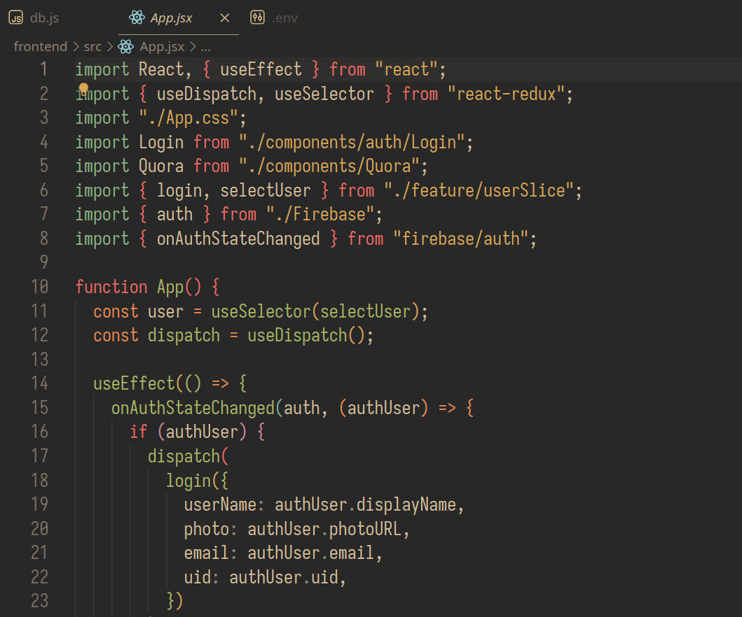
Code

Slide 8
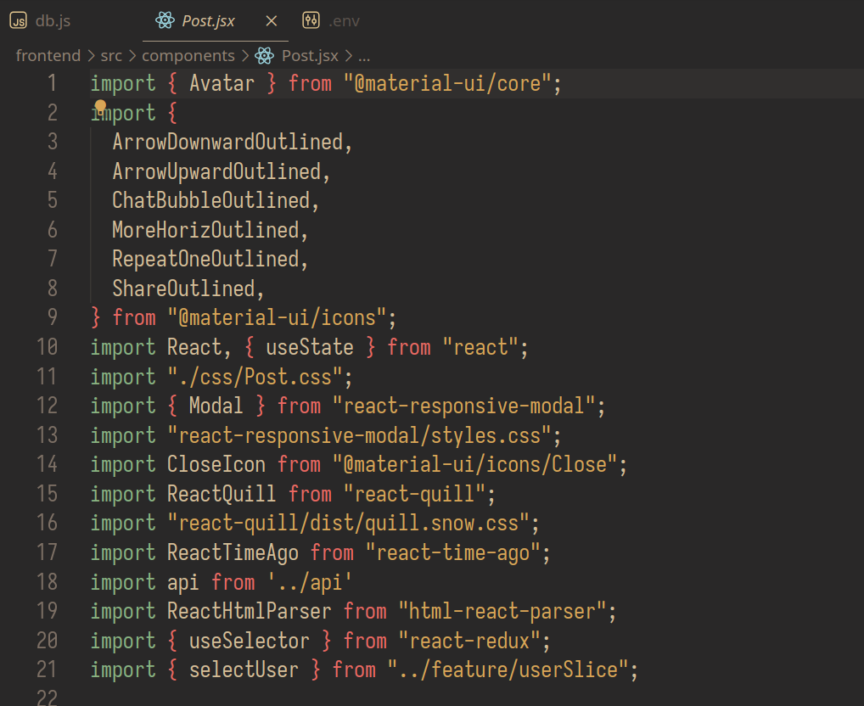
Code

Slide 9
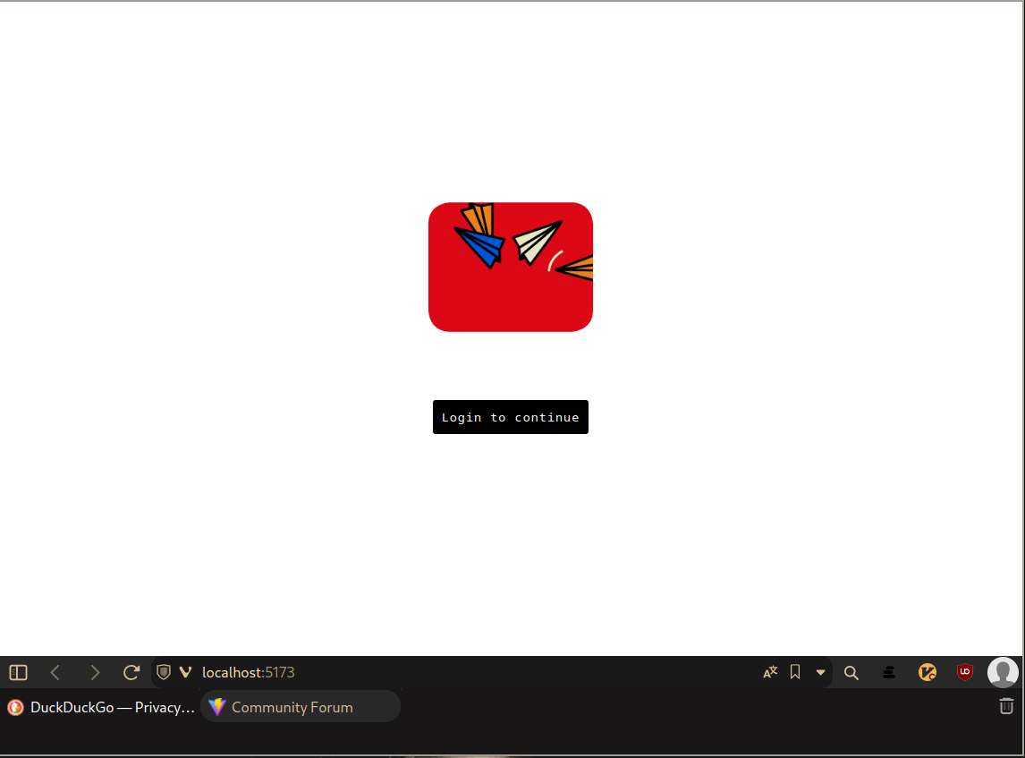
Output :

Slide 10
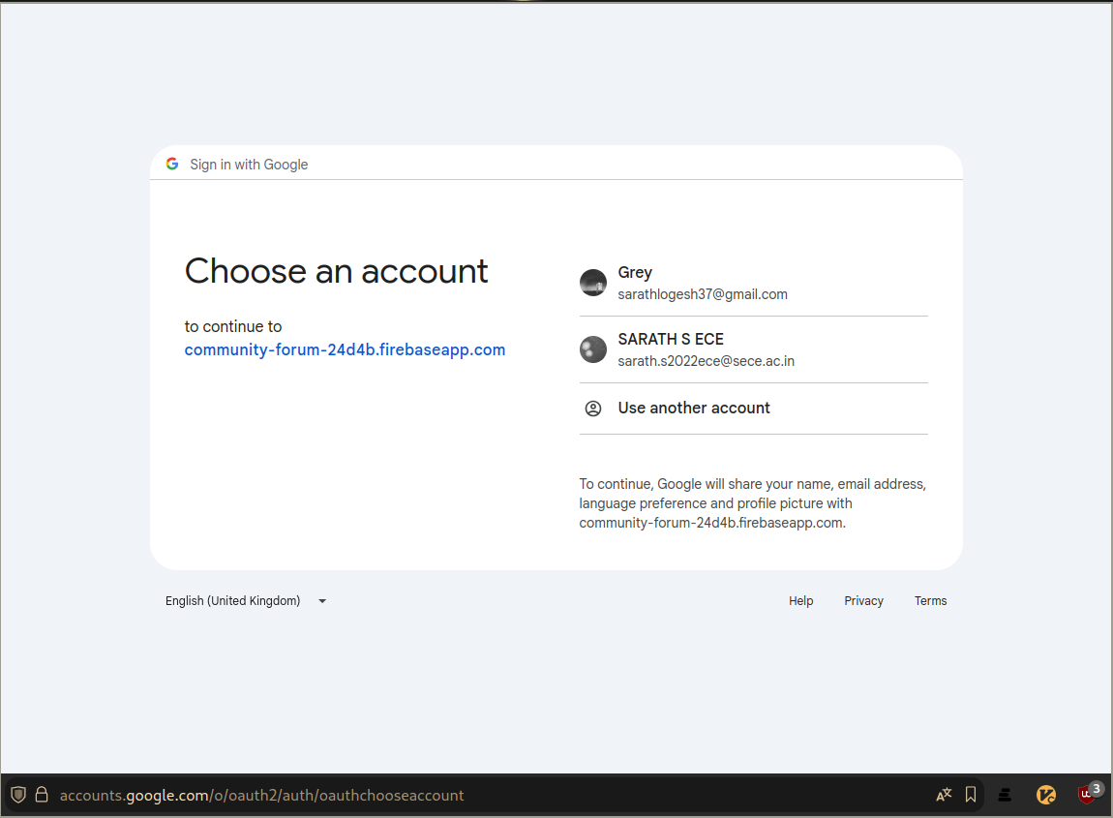
Output :

Slide 11
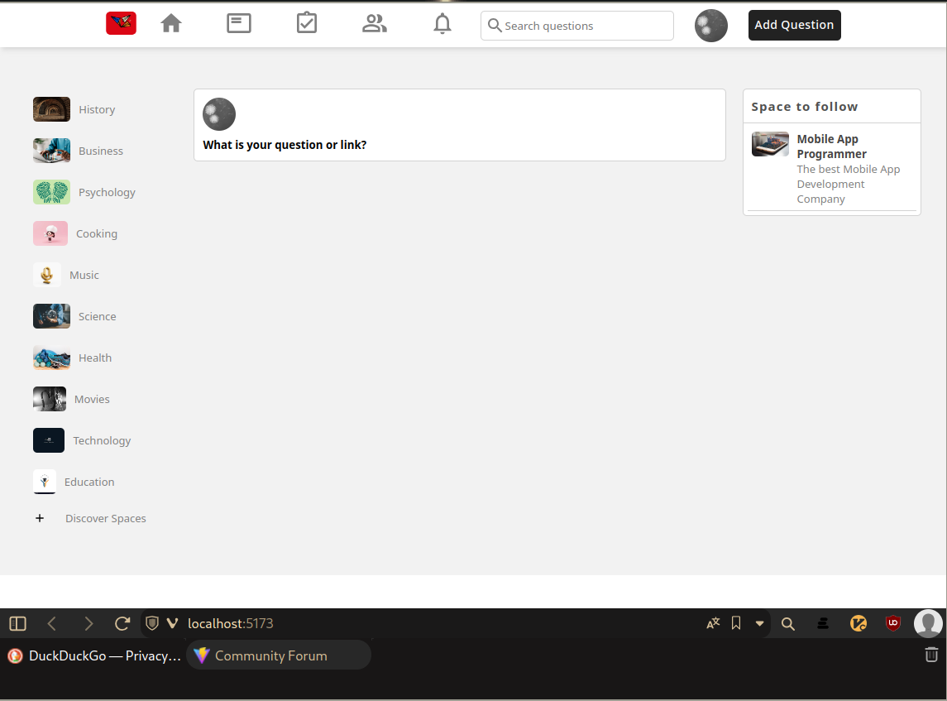
Output :

Slide 12
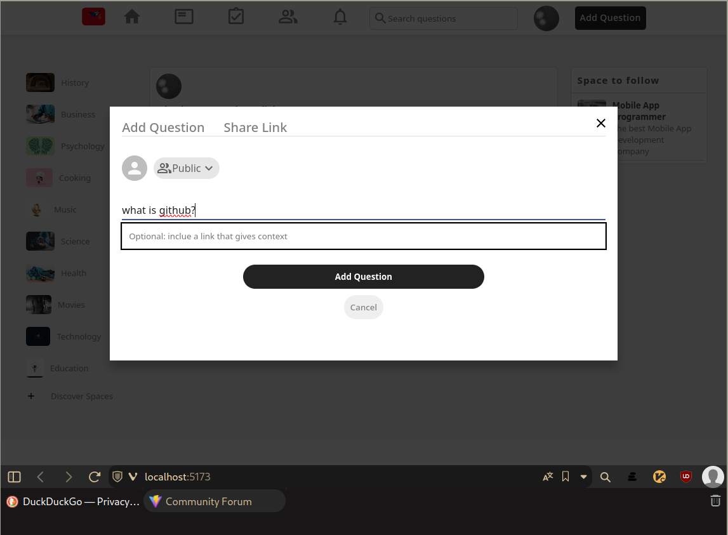
Output :

Slide 13
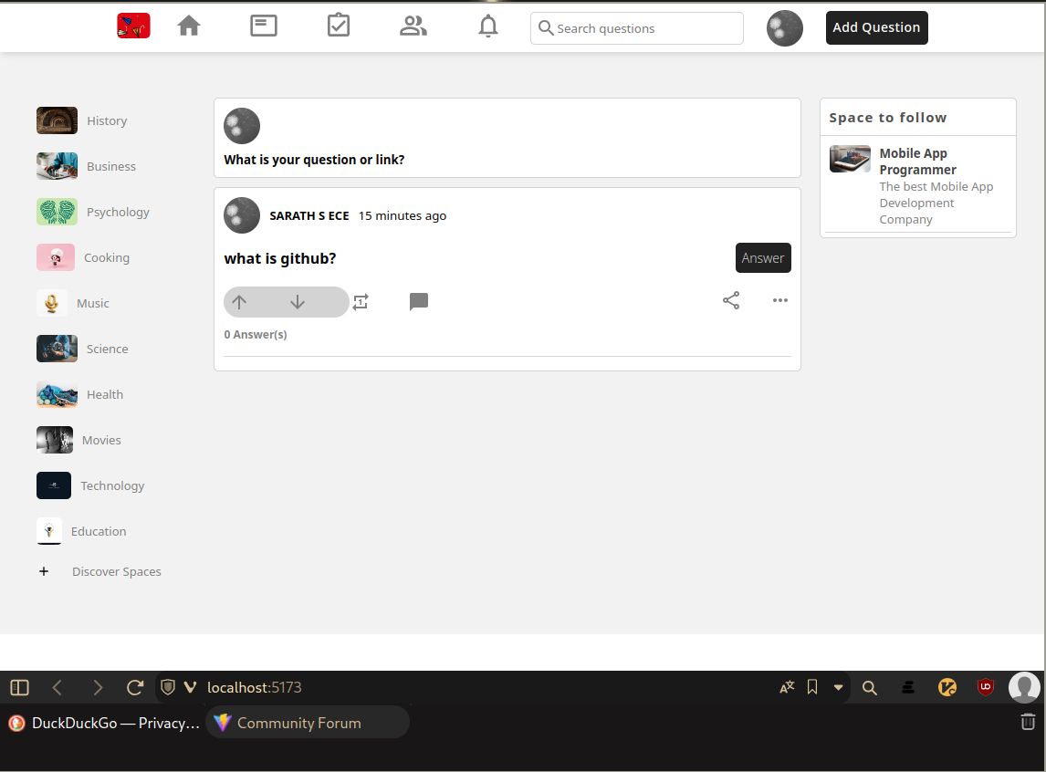
Output :

Slide 14
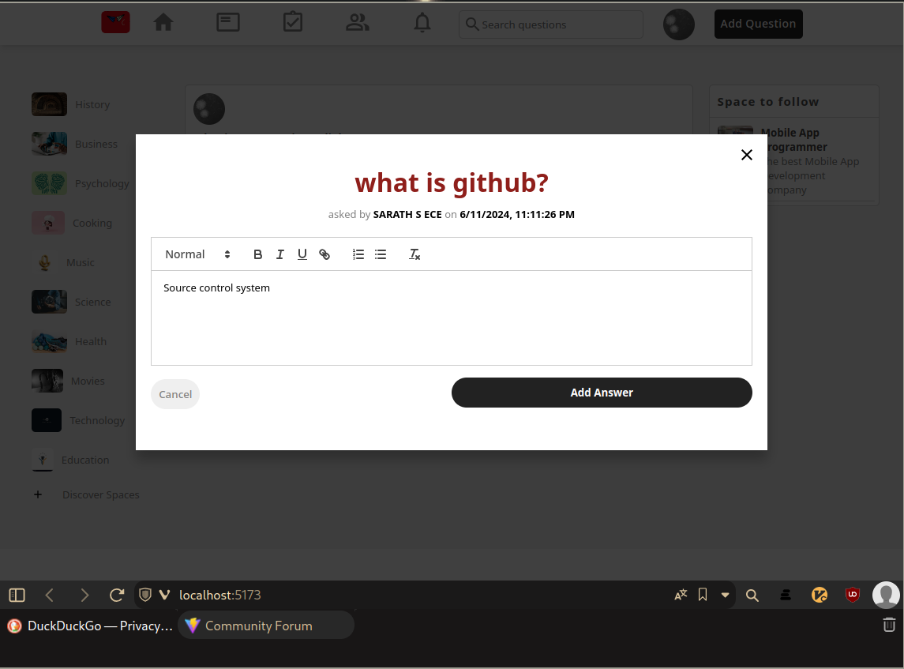
Output :

Slide 15
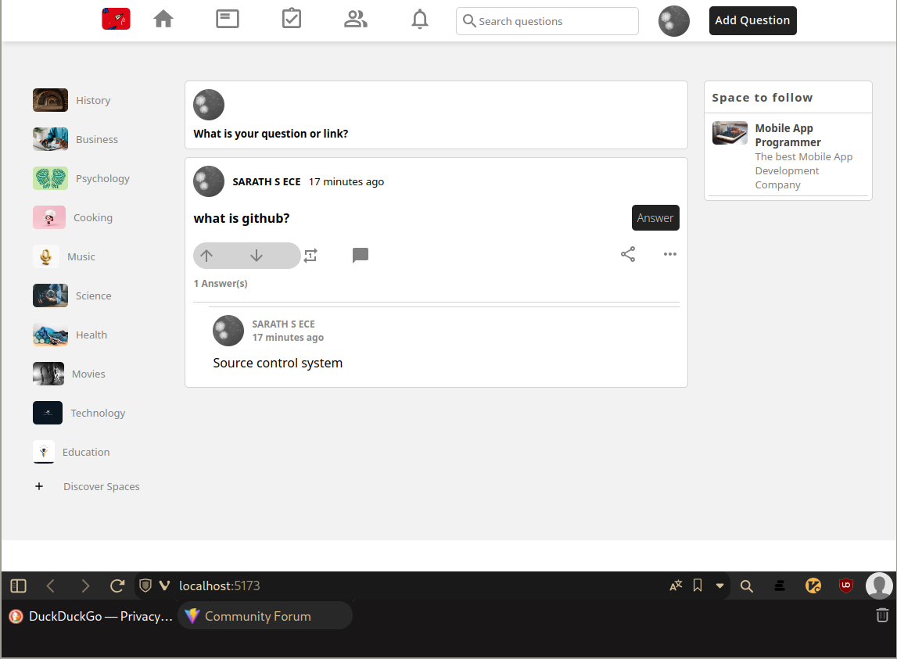
Output :

Slide 16
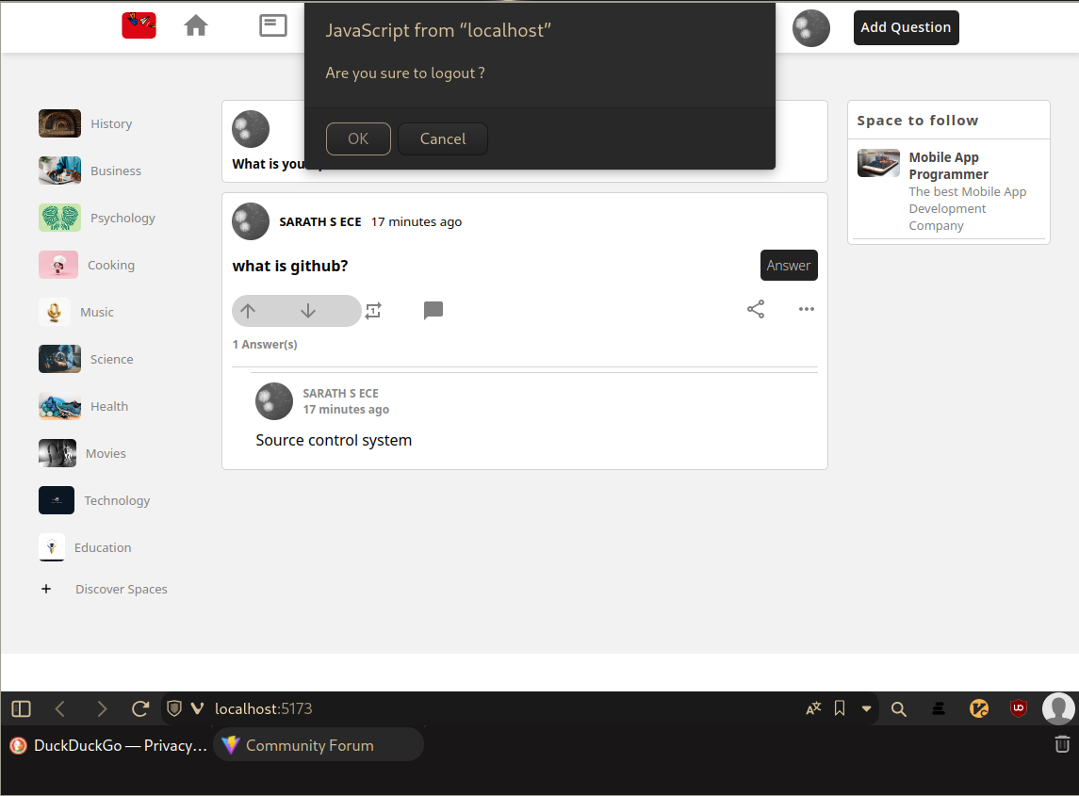
Output :

Slide 17
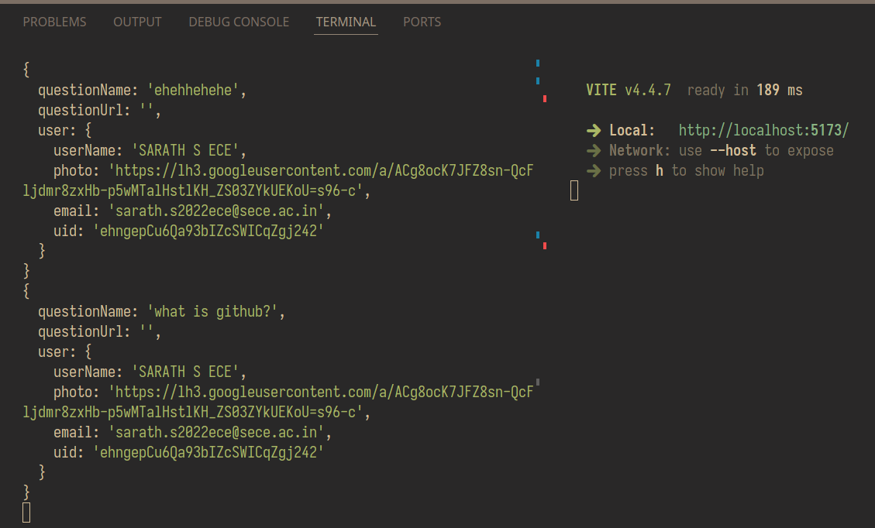
Output :

Slide 18
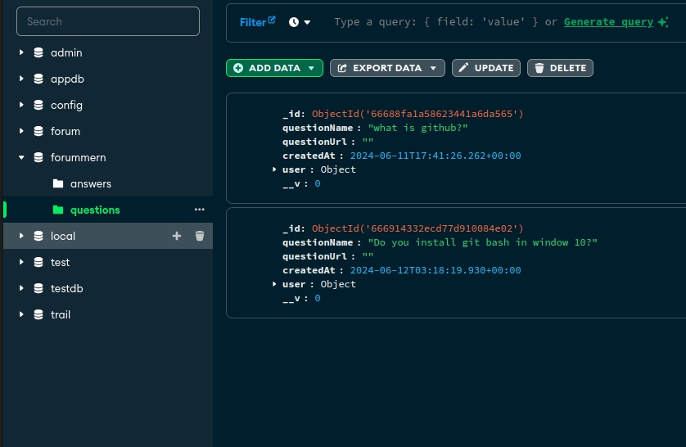
Output :

Slide 19
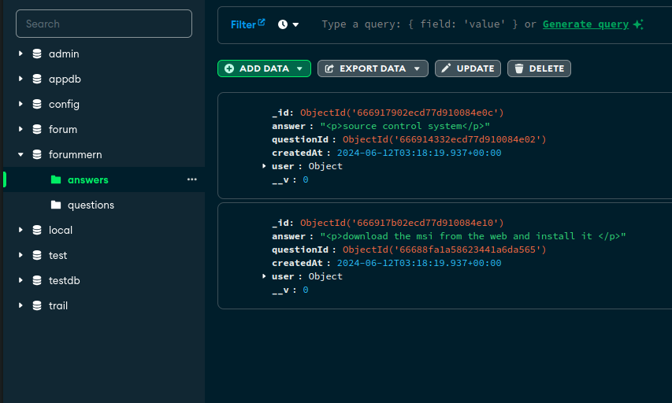
Output :

Slide 20
Future aspects
Search option
Sharing posts
Suggesting popular communities
Communities
Notifications
Add Friends

Slide 21
THANK YOU

