Slide 1
Surya Raj M
Final Project
3/21/2024 Annual Review

Slide 2
PROJECT TITLE
HR CHATBOT USING TRANSFORMERS AND LANGCHAIN
3/21/2024 Annual Review

Slide 3


AGENDA
Streamline Onboarding Procedures: Automate the delivery of onboarding materials and instructions to new hires, making it easier for them to understand and follow necessary steps without manual intervention from HR personnel.
Immediate Response to Queries: Provide instant, 24/7 assistance to new hires by answering FAQs about company policies, benefits, workplace culture, and procedural steps, reducing the workload on HR staff and speeding up the resolution of common issues.
Enhance Employee Experience: Offer a personalized onboarding experience that helps new employees feel welcomed and valued from day one, improving their overall perception of the
3/21/2024 Annual Review

Slide 4

PROBLEM STATEMENT
The onboarding process is a critical phase for integrating new hires into an organization, yet it is often fraught with challenges that can impact employee satisfaction and long-term retention. New employees typically face a steep learning curve related to understanding organizational policies, completing necessary paperwork, and integrating into the corporate culture. Traditional onboarding procedures rely heavily on human resource personnel to deliver information manually, handle queries, and ensure compliance with procedural requirements. This method is not only time-consuming but also prone to inconsistencies and delays, which can lead to frustration and a sense of isolation among new hires.
3/21/2024 Annual Review

Slide 5

PROJECT OVERVIEW
This project aims to develop an AI-powered chatbot designed to streamline the onboarding process for new employees, improving their initial experience and reducing the administrative burden on human resources departments. By integrating Natural Language Processing (NLP) and machine learning technologies, the chatbot will provide round-the-clock support, answering common queries, guiding new hires through documentation, and personalizing the onboarding experience based on individual needs and responses.
3/21/2024 Annual Review

Slide 6

WHO ARE THE END USERS?
New Hires
Human Resources (HR) Professionals
IT Support Staff
Compliance and Legal Teams
3/21/2024 Annual Review

Slide 7

YOUR SOLUTION AND ITS VALUE PROPOSITION
For New Hires:
Reduced Overwhelm: Simplifies the influx of new information, making it manageable and accessible at the pace the new hire prefers.
Enhanced Onboarding Experience: Offers a welcoming and supportive interaction, which can significantly boost a new employee's morale and initial perception of the company.
Empowerment through Information: Provides new hires with the resources and knowledge they need to feel confident and prepared, reducing the typical stress associated with starting a new job.
For HR Departments:
Increased Efficiency: Reduces the manual workload by automating responses to common questions and document processing, allowing HR professionals to focus on higher-value tasks.
Improved Compliance: Ensures that all required onboarding procedures, including legal documentation, are completed thoroughly and stored correctly.
Enhanced Employee Retention:
3/21/2024 Annual Review

Slide 8

THE WOW IN YOUR SOLUTION
Personalized Onboarding Experience
Seamless 24/7 Support
Interactive and Conversational Interface
Integration with HR Systems and Real-Time Updates
Automated Compliance and Documentation:
3/21/2024 Annual Review
8

Slide 9
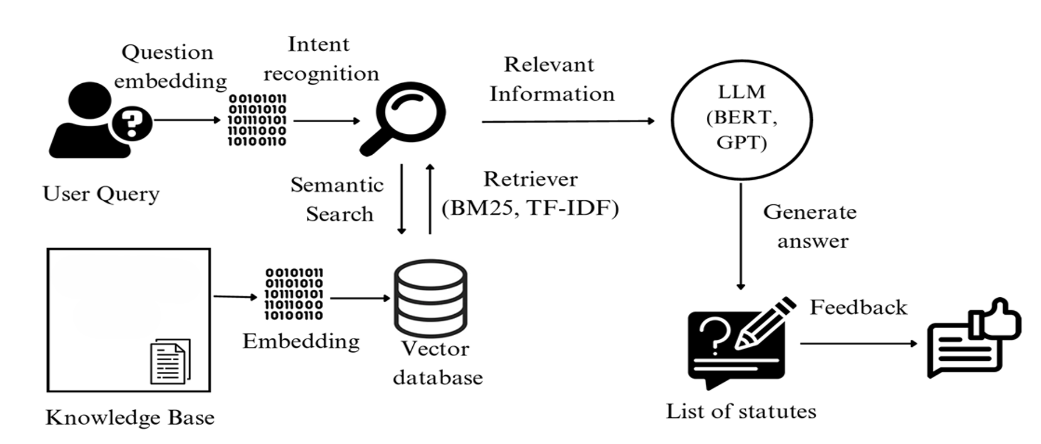
MODELLING
3/21/2024 Annual Review
9

Slide 10
RESULTS
Demo Link
3/21/2024 Annual Review
10

