Slide 1

Solving Math using Python Set 2
Department Of Computer Engineering
Python
Member Names: Aditya Yadav, Het Patel, Riddhi Narkar

Slide 2


Problem Statement
Solving math using Python set 2.
Unit Converter.
Calculate a simple Quadratic Equation.
Find the largest element amongst the list.
Create a multiplication table, asking about which multiplication table user wants and till which number user wants to create the multiplication table.
Python program to convert Decimal to Binary, Octal and Hexadecimal and vice versa.
Find Sum, Difference, Multiplication on a list and difference of 2 lists.
Find whether a number is divisible by another number or not.
To check whether the number is an Armstrong number or not.

Slide 3
Topic Description
In this coding project, we would be processing different numerical inputs, specifically a five type unit converter, simple quadratic equation solver, multiplication table calculator, number system converter, etc.
Outputs mainly would be the answers of the mathematical statements or as string statements, whether some input qualifies a condition or not.

Slide 4
Abstract
Workflow:
Since our project has many sub-topics, we would be using a myriad of modules as listed below:
1) Five type unit converter: This one will have a sub-menu list for the exact type of conversion you’d like to perform. Input would be a numerical measurement and output would be a number converted into the desired unit. The five provided conversions are:- (1) Kilometre to Mile, (2) Celsius to Fahrenheit, (3) Feet to Metre, (4) Pounds to Kilograms, and (5) USD to INR.
2) Simple Quadratic eq. solver: This code would solve any type of quadratic equation. Inputs would be coefficients of the equation in proper order, entered by adding a space between each new coefficient and output would be the roots.

Slide 5
Abstract
3) Largest element from list: Here we would accept a list from the user and output the largest number of that list.
4) Multiplication table: Here we would be accepting 2 integers, one for the number whose table is desired, and second, the integer until which the products are expected. Output would be in a detailed multiplication table format.
5) Number system converter: This script will convert decimal into binary, octal, and hexadecimal and vice-versa. This again, would have a sub-menu for the 6 possible types. The input would be in the desired number system and the output would be processed according to the user’s needs.

Slide 6
Abstract
6) Mathematical operations on a list: Here, we will have a sub-menu for addition, subtraction, multiplication, and difference with 2 lists operations. Input will be a list and the output would be the number achieved by carrying out the desired operation on the list’s elements. For the difference with 2 lists option, the input would be 2 lists of the same length and the output will be a list having corresponding elements’ difference in proper order.
7) Divisibility test: Here we will be inputting two integers. The output would be a string telling whether the other number is its divisor or otherwise.
8) Armstrong number: The input here would be an integer and the output would be a string specifying whether or not, the input is an Armstrong’s number. In case of a negative input, appropriate message is displayed and the user is prompted to re- enter the input.
With a view to make this code more user-friendly, we have tried to develop this code with exception handling.

Slide 7
Detail Project Workflow
Main function flow:
We have created a main menu with all the 8 problem statements’ requirements along with an additional option to end the program.
Every time the user choose an option number, he is re-directed to the appropriate function and further respective process takes place. If the input isn’t a valid option number, an error message prints and prompts the user to re-enter the same.
After the respective processing takes place in the function, output is printed, and again the user is re-directed to the main menu. This is developed with a view that the user can use the code as many times as he desires before he chooses to exit.

Slide 8
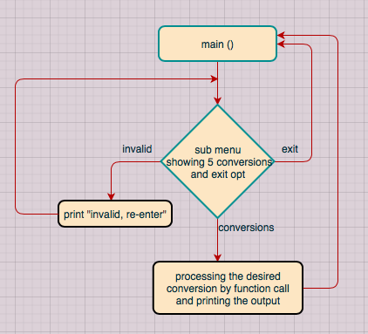
1) Unit convertor

Slide 9
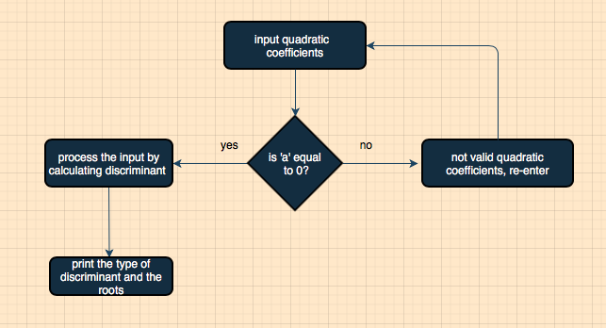
2) Quadratic equation solver

Slide 10
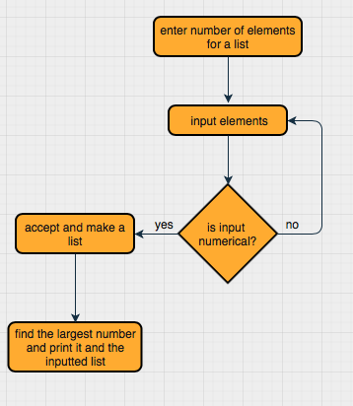
3) Largest number

Slide 11
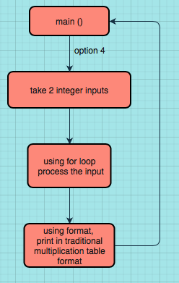
4) Multiplication table

Slide 12
5) Number system convertor
User is expected to select conversion type i.e., either from decimal to (binary, octal, hexadecimal) or (binary, octal, hexadecimal) to decimal.
For decimal to (binary, octal and hexadecimal) we have a while loop for storing the remainder in a list.
When the while is terminated, using inbuilt reverse function, list is reversed and is converted to string via a for loop.
For (binary, octal and hexadecimal) to decimal we have used inbuilt int() function for the conversion.
Based on the users selection decimal number is converted according to the bases: 2,8 and 16 respectively using int( ).

Slide 13
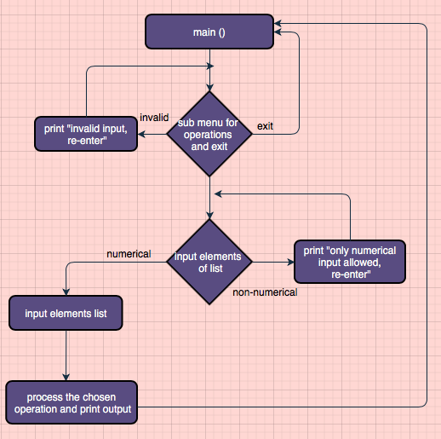
6) Basic math operations

Slide 14
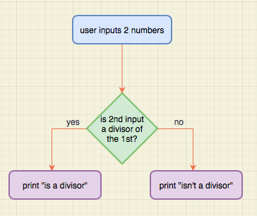
7) Divisibility test

Slide 15
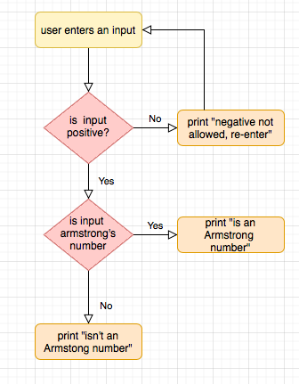
8) Armstrong’s number

Slide 16
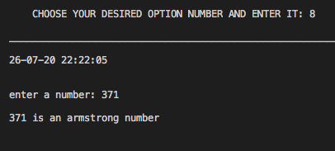
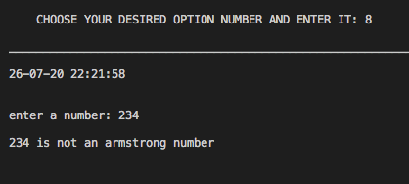
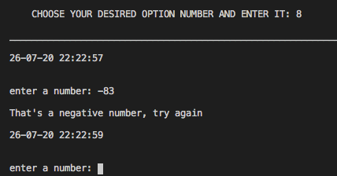
Output
Outputs for Armstrong’s number:-

Slide 17
Acknowledgement
We, Group 5, are glad that we got this opportunity to thank our college, APSIT for giving us a chance to polish our coding skills. It was great fun to try to code such wonderful programs and test them; we got a lot of insights in our repository of knowledge of coding, learnt a plethora of new essential skills which will be of a great help in our future endeavours.
We would also like to extend our thanks to Prof. Merlin Jacob, our faculty mentor, and Ms. Nimali Keny, our student mentor to help and guide us when things got unclear and tricky. We are fortunate to have such great mentors like them who helped me and my teammates to ace through this project confidently.
To conclude, we feel blessed to have had such a great support system for the successful completion of this project, a sincere thanks to all of you.

Slide 18
References
Coursera course- Crash Course on Python from Google
Coursera course- Programming for Everybody (Getting Started with Python)
Stack overflow for making Python 3 as default system interpreter
RealPython for try and except exception handling

Slide 19
Detail Project Workflow (Same as report)
Include Images and Flow charts

