Slide 1

Solving Math using Python Set 2
Department Of Computer Engineering
Python
Member Names: Aditya Yadav, Het Patel, Riddhi Narkar

Slide 2


Problem Statement
Solving math using Python set 2.
Unit Converter.
Calculate a simple Quadratic Equation.
Find the largest element amongst the list.
Create a multiplication table, asking about which multiplication table user wants and till which number user wants to create the multiplication table.
Python program to convert Decimal to Binary, Octal and Hexadecimal and vice versa.
Find Sum, Difference, Multiplication on a list and difference of 2 lists.
Find whether a number is divisible by another number or not.
To check whether the number is an Armstrong number or not.

Slide 3
Abstract
1) Five type unit converter: (1) Kilometre to Mile, (2) Celsius to Fahrenheit, (3) Feet to Metre, (4) Pounds to Kilograms, (5) USD to INR.
2) Simple Quadratic eq. solver
3) Largest element from list
4) Multiplication table
5) Number system converter
6) Mathematical operations on a list: (1) addition, (2) subtraction, (3) multiplication (4) difference with 2 lists operations.
7) Divisibility test
8) Armstrong number

Slide 4
Detail Project Workflow
Main function flow:
We have created a main menu with all the 8 problem statements’ requirements along with an additional option to end the program.
Every time the user choose an option number, he is re-directed to the appropriate function and further respective process takes place. If the input isn’t a valid option number, an error message prints and prompts the user to re-enter the same.
After the respective processing takes place in the function, output is printed, and again the user is re-directed to the main menu. This is developed with a view that the user can use the code as many times as he desires before he chooses to exit.

Slide 5
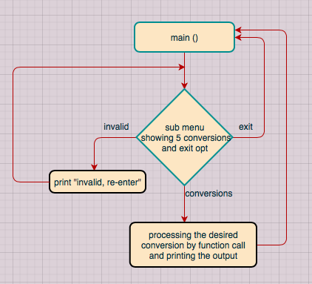
1) Unit converter

Slide 6
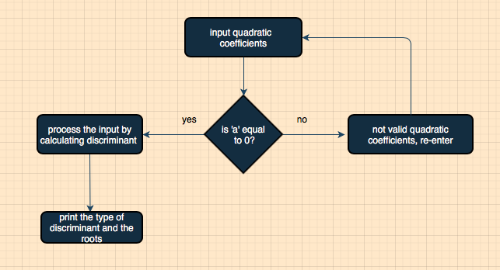
2) Quadratic equation solver

Slide 7
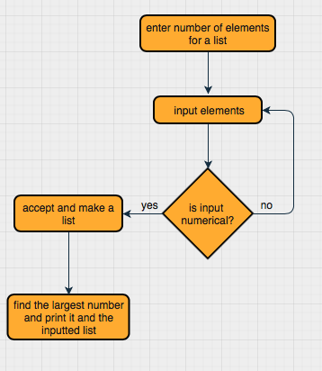
3) Largest number

Slide 8
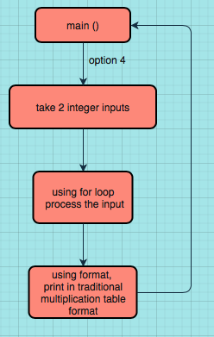
4) Multiplication table

Slide 9
5) Number system converter
User is expected to select conversion type i.e., either from decimal to (binary, octal, hexadecimal) or (binary, octal, hexadecimal) to decimal.
For decimal to (binary, octal and hexadecimal) we have a while loop for storing the remainder in a list.
When the while is terminated, using inbuilt reverse function, list is reversed and is converted to string via a for loop.
For (binary, octal and hexadecimal) to decimal we have used inbuilt int() function for the conversion.
Based on the users selection decimal number is converted according to the bases: 2,8 and 16 respectively using int( ).

Slide 10
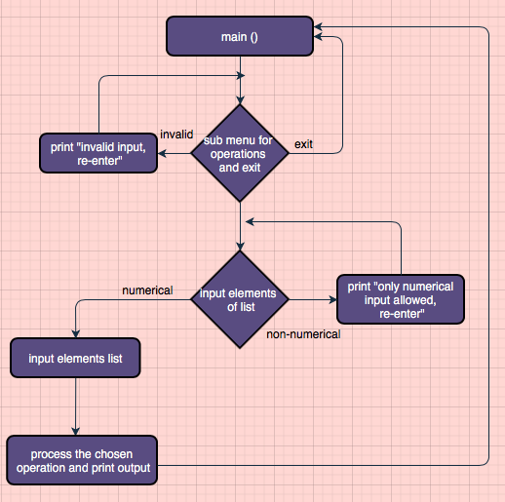
6) Basic math operations

Slide 11
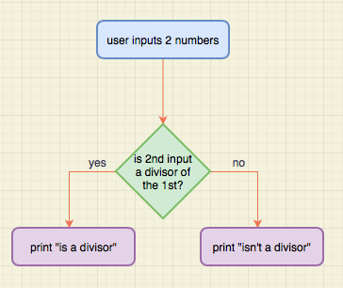
7) Divisibility test

Slide 12
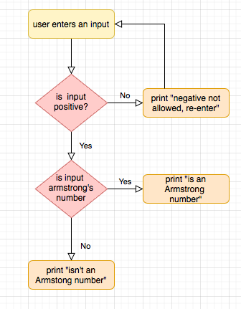
8) Armstrong’s number

Slide 13
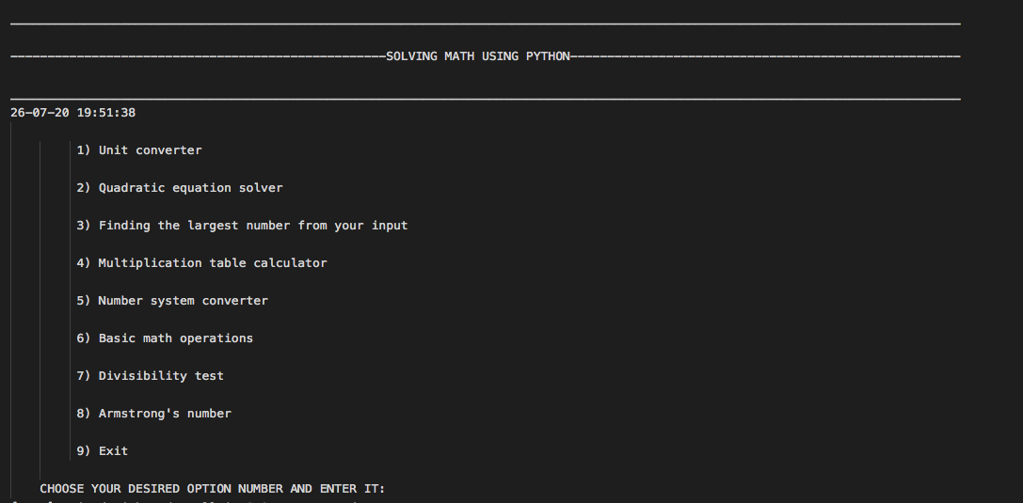
Output: Main menu

Slide 14
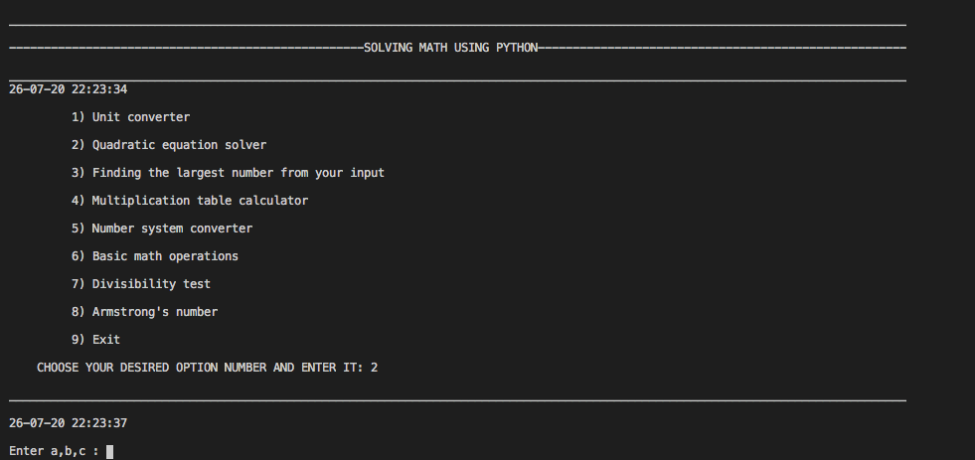
Output: Main menu

Slide 15
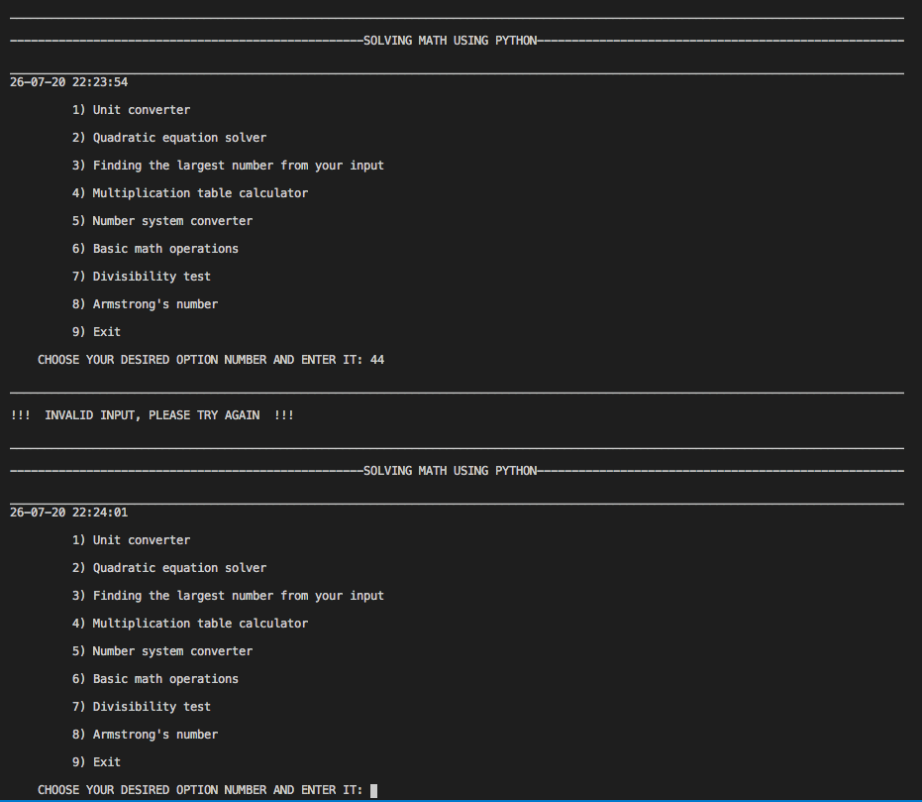
Output: Main menu

Slide 16
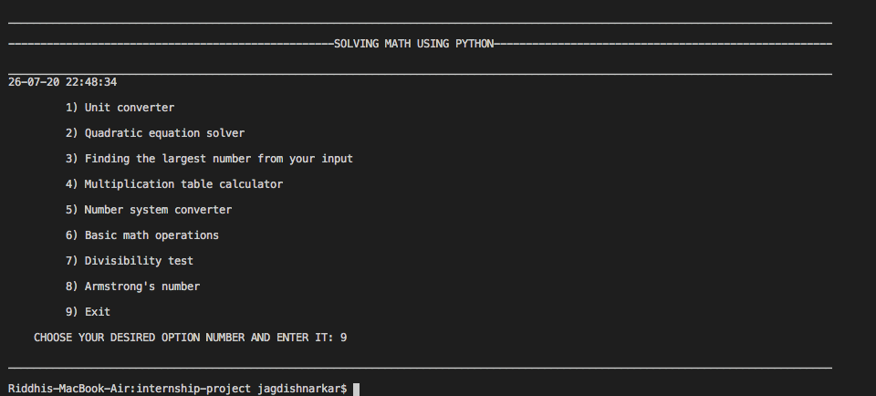
Output: Main menu

Slide 17
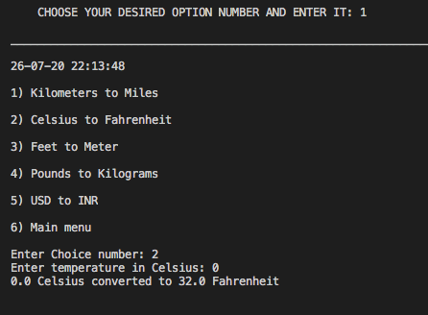
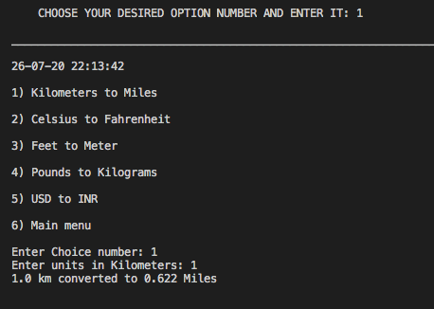
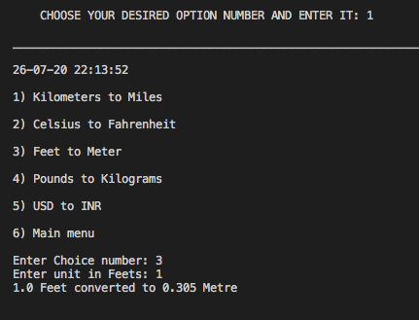
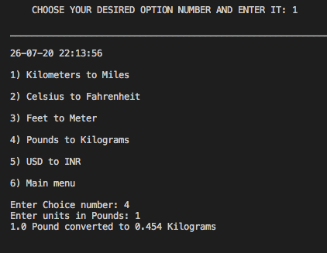
Output: Unit converter

Slide 18
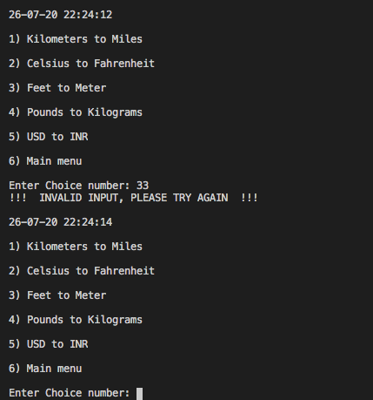
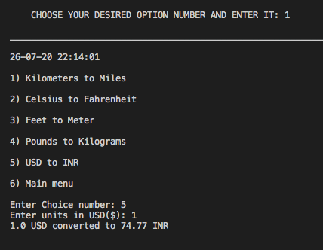
Output: Unit converter

Slide 19
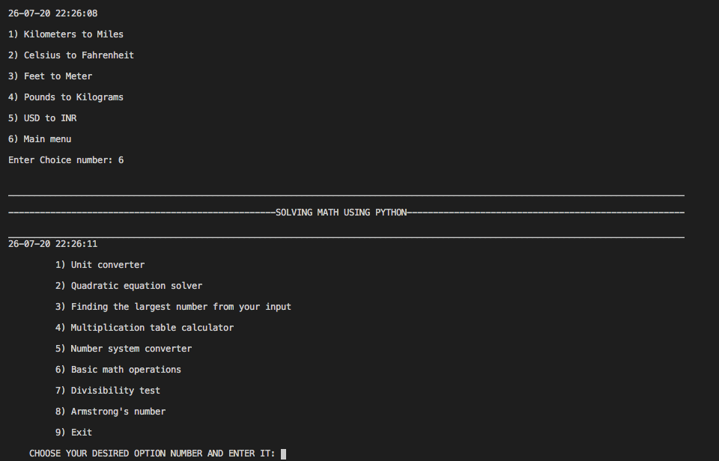
Output: Unit converter

Slide 20
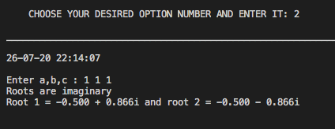
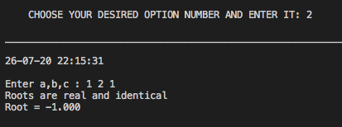
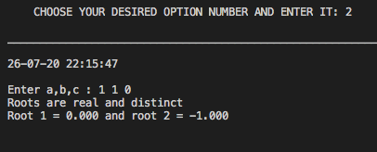
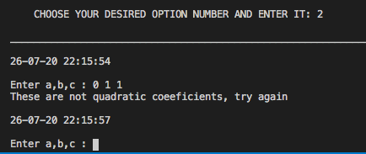
Output: Quadratic equation solver

Slide 21
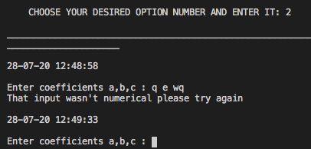
Output: Quadratic equation solver

Slide 22
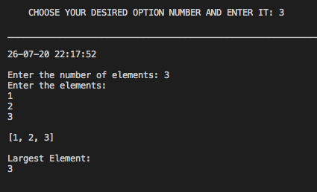
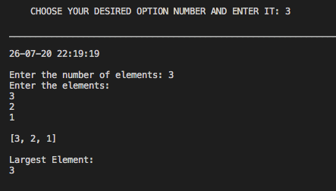
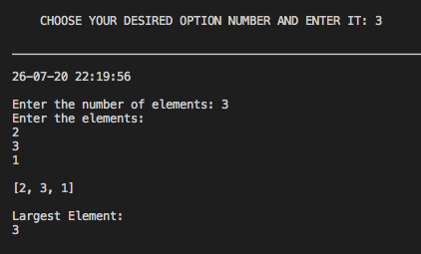
Output: Largest number

Slide 23
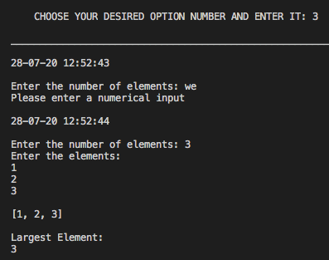
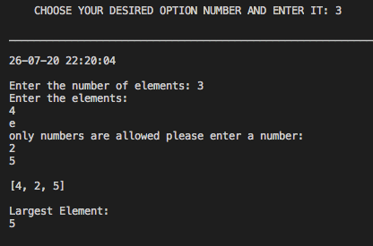
Output: Largest number

Slide 24
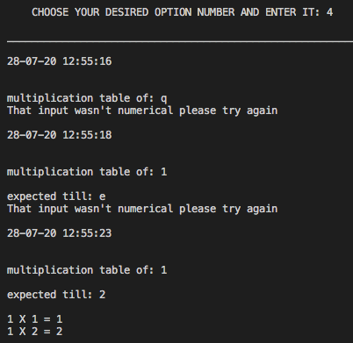
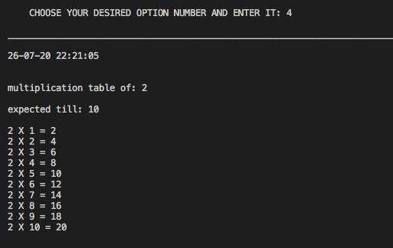
Output: Multiplication table

Slide 25
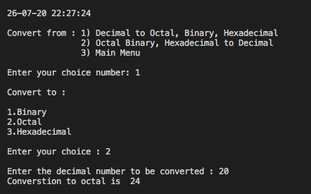
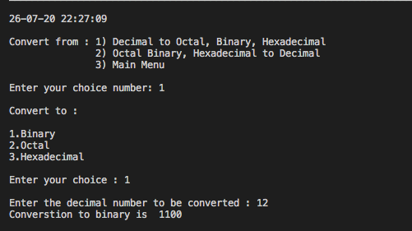
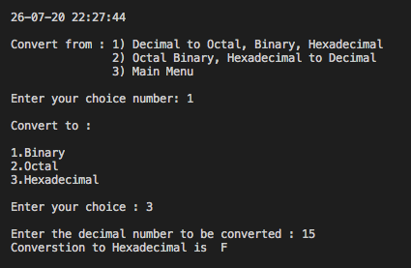
Output: Number system converter

Slide 26
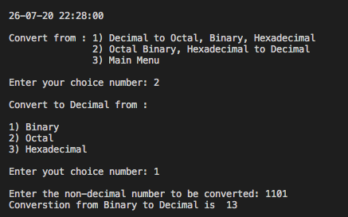
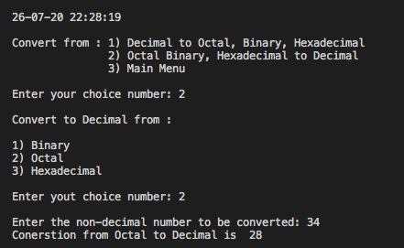
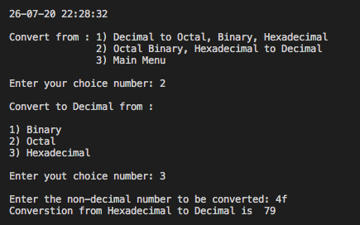
Output: Number system converter

Slide 27
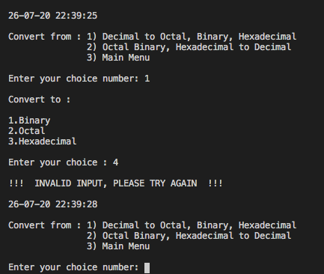
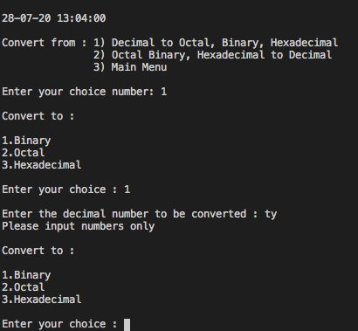
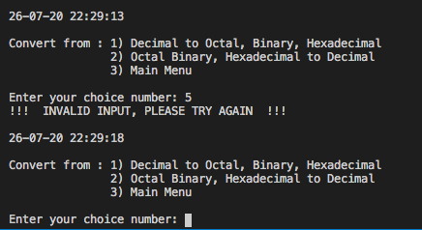
Output: Number system converter

Slide 28
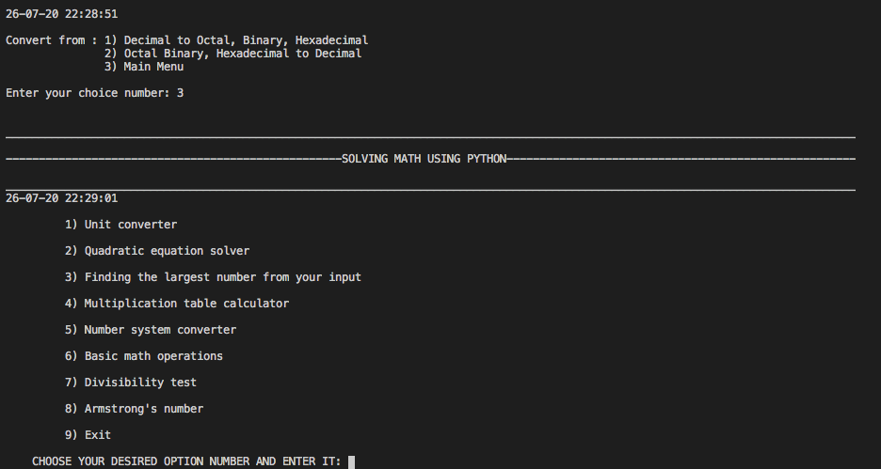
Output: Number system converter

Slide 29
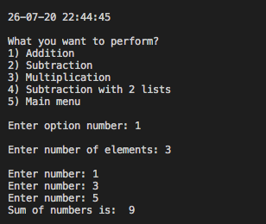
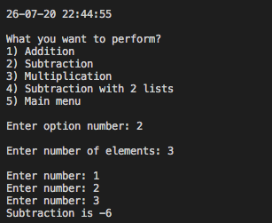
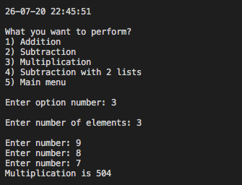
Output: Basic math operations

Slide 30
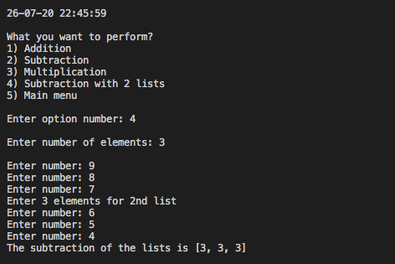
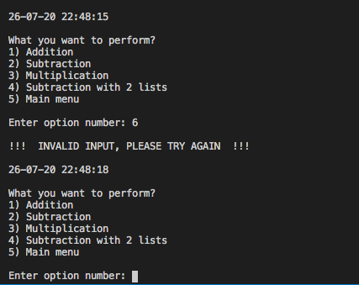
Output: Basic math operations

Slide 31
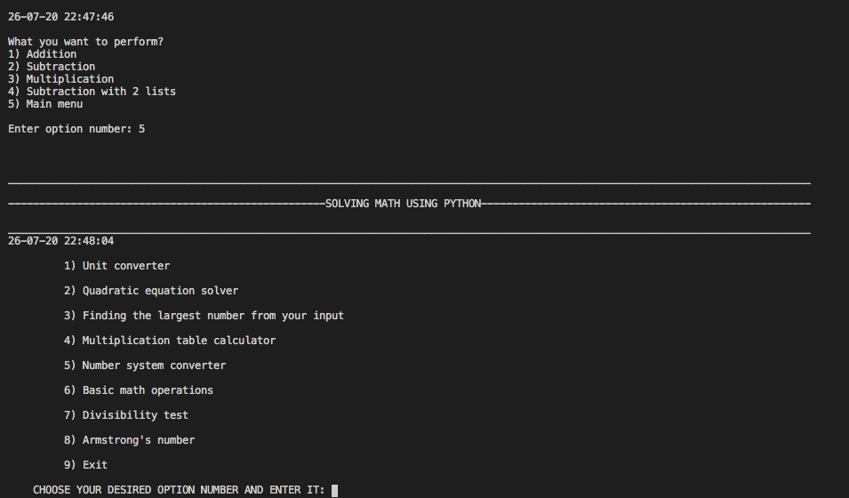
Output: Basic math operations

Slide 32
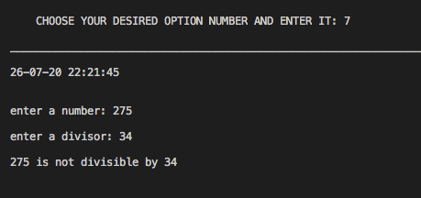
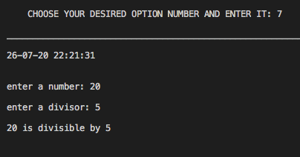
Output: Divisibility test

Slide 33
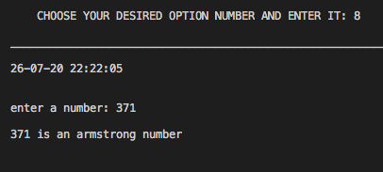
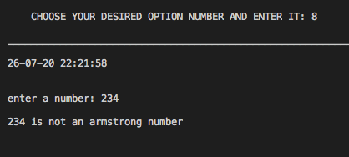

Output: Armstrong’s number

Slide 34
Acknowledgement
We, Group 5, are glad that we got this opportunity to thank our college, APSIT for giving us a chance to polish our coding skills. It was great fun to try to code such wonderful programs and test them; we got a lot of insights in our repository of knowledge of coding, learnt a plethora of new essential skills which will be of a great help in our future endeavours.
We would also like to extend our thanks to Prof. Merlin Jacob, our faculty mentor, and Ms. Nimali Keny, our student mentor to help and guide us when things got unclear and tricky. We are fortunate to have such great mentors like them who helped me and my teammates to ace through this project confidently.
To conclude, we feel blessed to have had such a great support system for the successful completion of this project, a sincere thanks to all of you.

Slide 35
References
Coursera course- Crash Course on Python from Google
Coursera course- Programming for Everybody (Getting Started with Python)
Stack overflow for making Python 3 as default system interpreter
RealPython for try and except exception handling

