Slide 1
2222

Slide 2
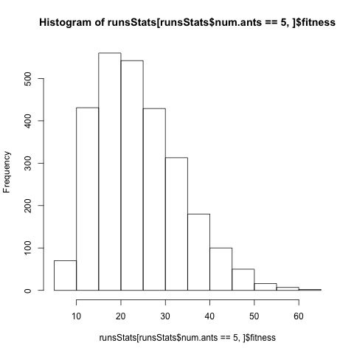
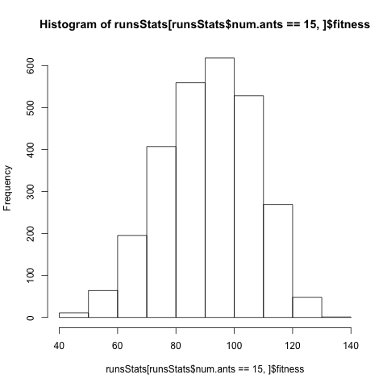
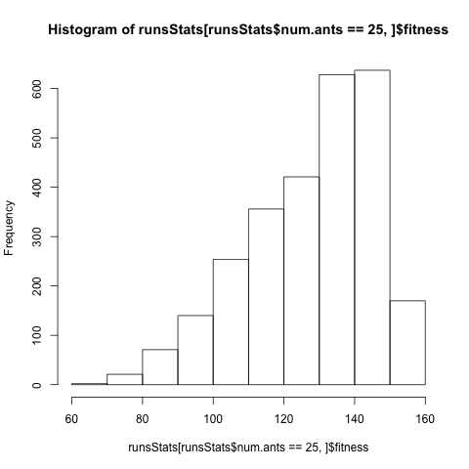
resultslslsls
Ave (over 20 runs) fitness for each configuration
The more ants, the more cavities able to guard, so range and fitness increases.
Independent of how smart ant selection is, better off with more ants. More ants, more robust.

Slide 3
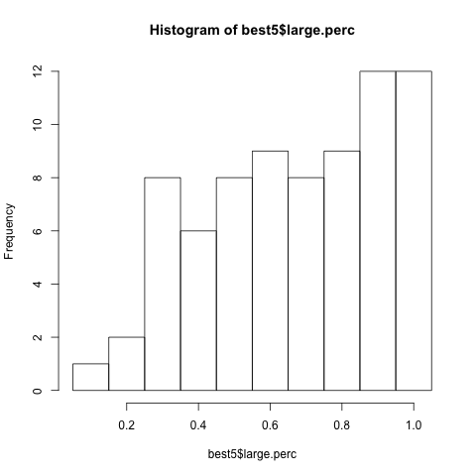
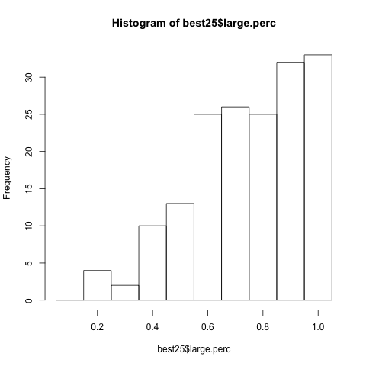
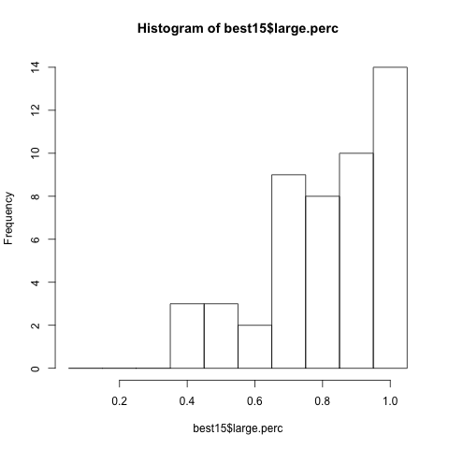
Distributions for configurations w/ the best fitness
Largeperc generally large, but there’s a wide spread

Slide 4
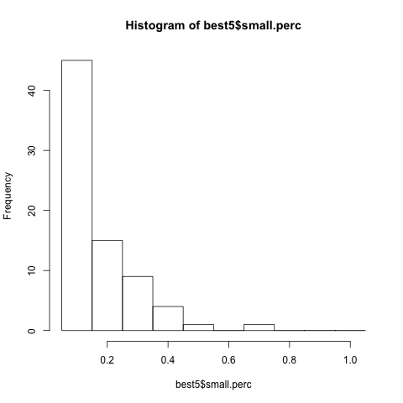
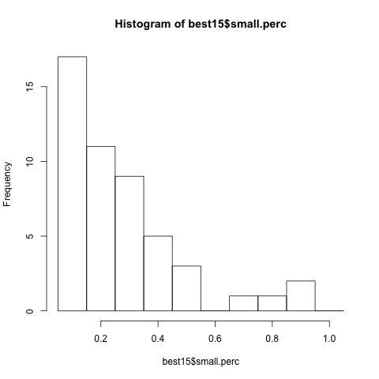
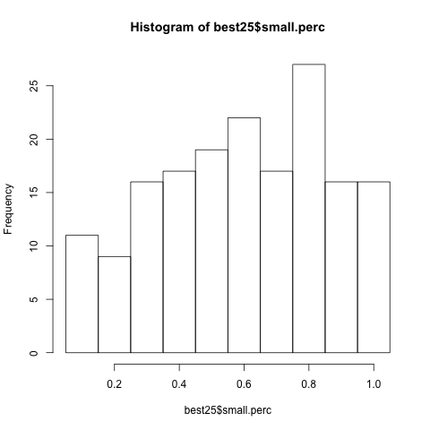
Small perc generally small,
especially when more ant limited

Slide 5
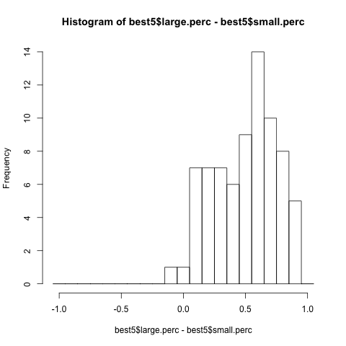
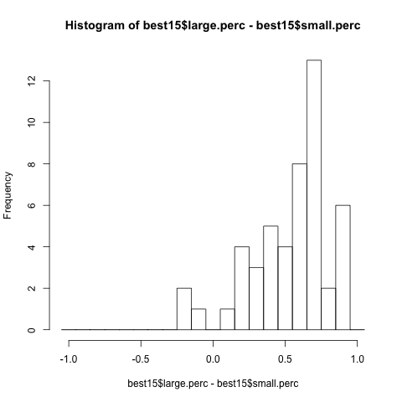
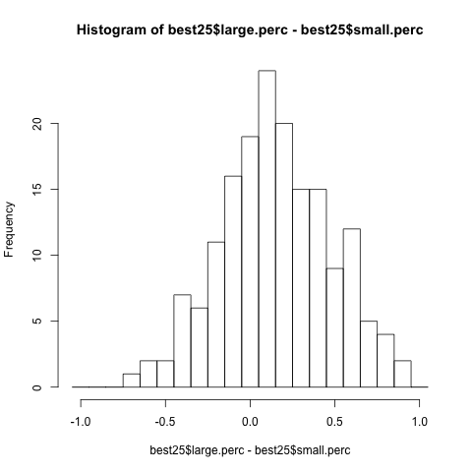
In ant limited cases,
Large perc > small percent the
Vast majority of the time, as
Exptected,
But when not as ant limitted,
Stops mattering as much.

Slide 6
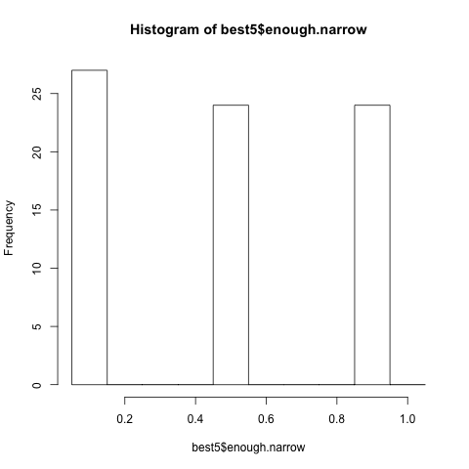
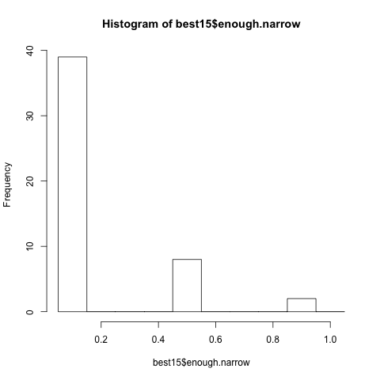
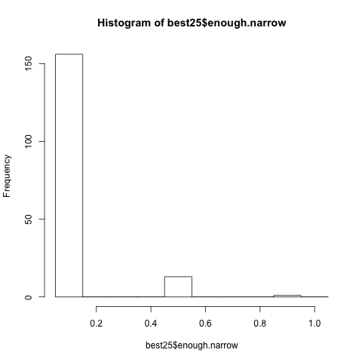
When more ants, becomes important that you don’t
“over guard” cavities. It is better to move on to guard
Somewhere else.

Slide 7

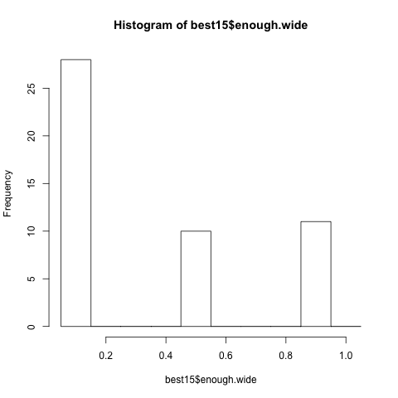
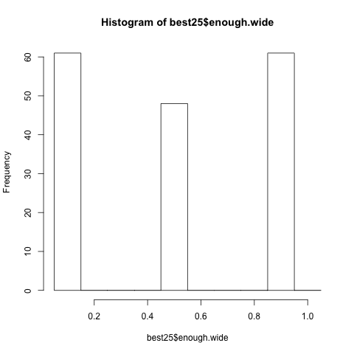
No clear data about
Enough wide, probably because
It rarely occurs.

Slide 8
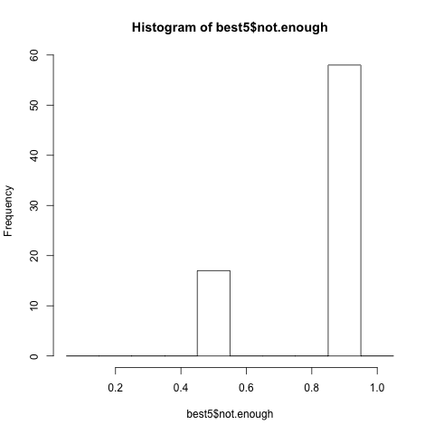
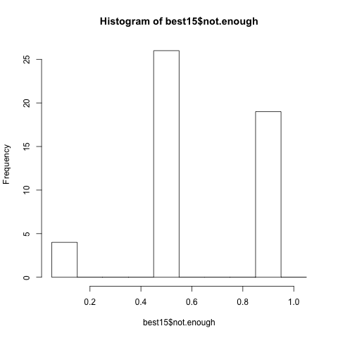
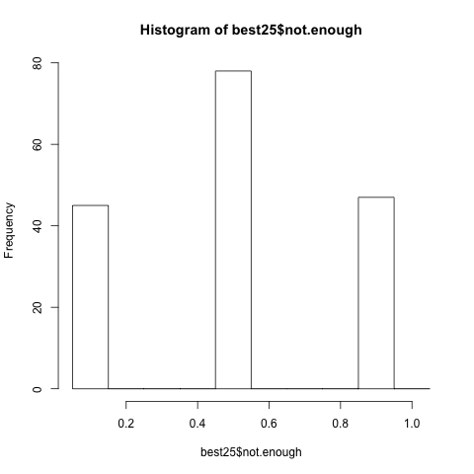
When extremely ant limited, very important to guard
As much as needed.
Less so when not ant limitted, probably because adding an
Ant to a wide-entranced cavity doesn’t largely effect fitnes..

