Slide 1

React Basics
Presented by Deepak Srivastava

Slide 2
React - Philosophy
Learn once; apply anywhere
Thinking in React: UI is application state representation
Component-based UI
Component
Manage its own state
Composable to make complex component
React UI is a components hierarchy
One way data flow
Declarative UI development - JSX

Slide 3
React - Performance
Virtual DOM
Reconciliation algorithm
Avoid unnecessary changes to DOM
Collect several changes and apply to actual DOM
Avoid accessing DOM directly
State rendering engine to re-render UI on state change
Treats UI as Component hierarchy
Re-render on state change
Collect changes and apply efficiently
HTML hierarchy for browser and widget hierarchy for mobile (iOS/Android)

Slide 4
React - Development
Programming language: JavaScript
React is View
Much less learning curve
Freedom to leverage the cool things - for example:
Typescript, ES6, ES5
Any libraries for routing, utilities, API communication, async operations
Data (state) management libraries: redux, mobx
React development
Building component by composable components
Managing data (state) for component

Slide 5
React Paradigm
UI is component hierarchy - Composition of Components
Component - state, state mutation logic, UI (HTML/mobile widgets)
Component maintains its own state (data)
Parent Component passes its state as props (immutable) to its children
Data flows in one direction from Parent to Children
Event flows in one direction from Child to Parent

Slide 6
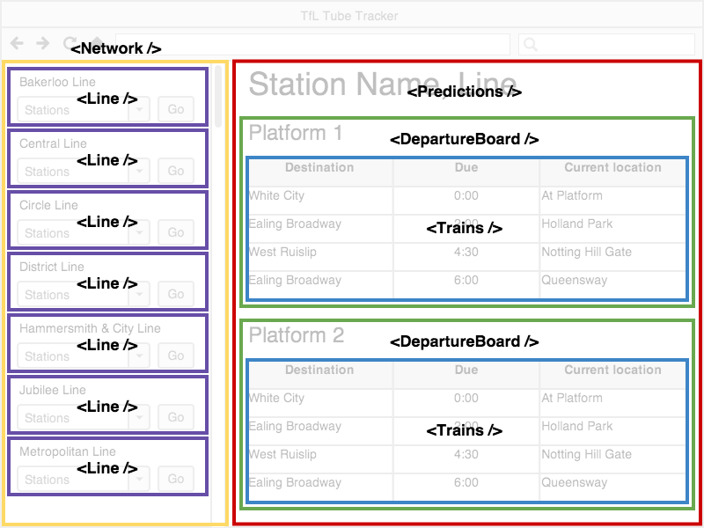
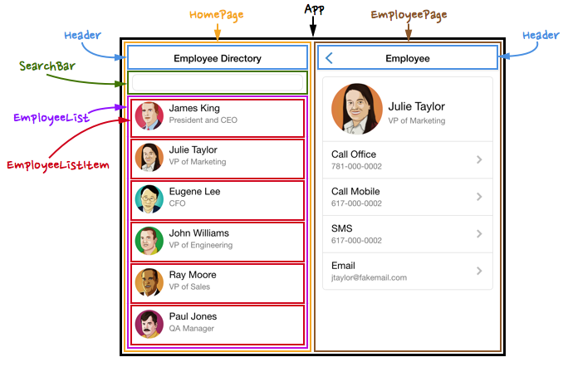
React Paradigm

Slide 7
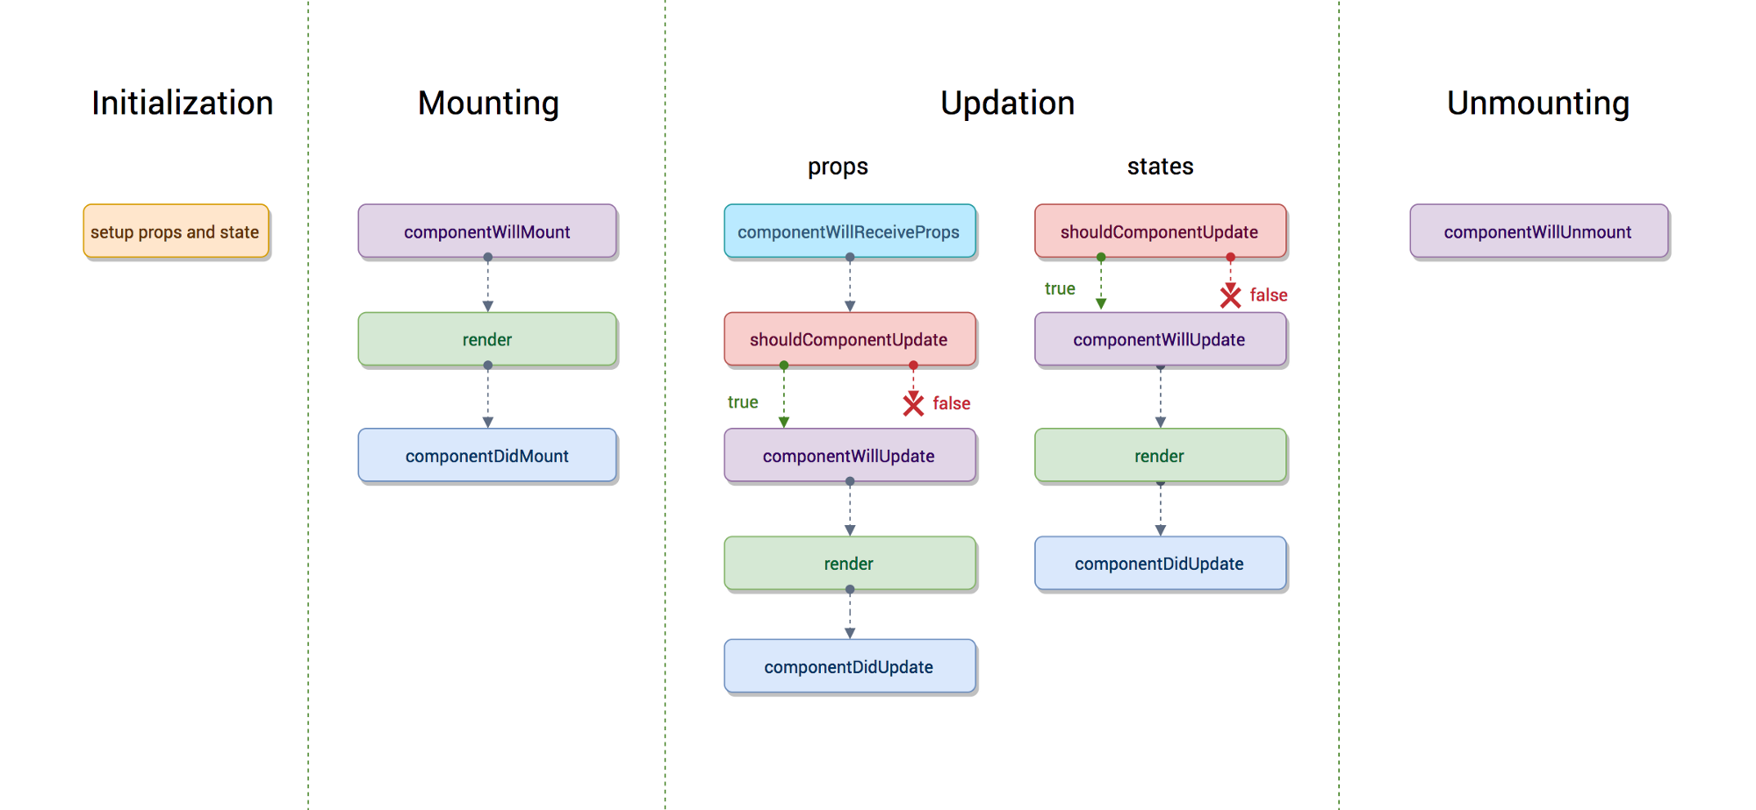
React Paradigm

Slide 8
React Community Support
Web | Common | Mobile (iOS/Android)
ReactJS - Core Library | Container-Component Design | ReactNative - Core Library
 | Redux- State Management
React-router: Routing | Utilities - lodash, ramda, saga | React-navigation, react-router-flux
React-bootstrap, material-ui |  | NativeBase, React-native material kit
 |  | React-native-fetch-blob, react-native-push-notification
 | Jest, Enzyme - Unit and Integration Testing

Slide 9
React vs. AngularJS 1.x
Angular is complete ecosystem to build UI for browser; React is View for state rendering
Angular has multi-way data flow, very easy to introduce complex coding pattern; React follows One Way Data Flow
Separation of concerns (Model, View and Controller) is philosophy of AngularJS; React is based on composable component
Dirty checking has poor performance for complex UI as compare to React’s Virtual DOM rendering
No Server side rendering support in AngularJS (for SEO)

Slide 10
React vs. Angular (5 and +)
Both are based on Component and one way data flow
Angular is a framework, React is just View
Mobile support:
Angular (Ionic)- Cross Browser Mobile Application
React - React-Native based mobile application; native widget without compromising on quality
Learning curve is much longer in Angular - Typescript, templates, filters, directives, DI, modules, services etc.; React is simple to learn
React: Virtual DOM and Angular: service worker thread, both have comparable performance on browser

Slide 11
React vs. Vue
Both have Components, one way data flow
Vue supports JSX and templates (pure HTML)
Vue supports directives and DI as Angular
Vue is a framework; close to Angular concepts but support of React features on View
For mobile, Vue supports framework7 for mobile webview; React supports react-native; Framework7 can be compared with bootstrap responsive webapp

Slide 12
React vs. Backbone
Backbone: Separation for Model and View, Data binding, custom events and collections; React is View, embedded model (state) and state mutation logic
Multi way data flow is common in backbone, React has strict one way data flow
React (View) + Backbone (Model, Binding) is perfect for backbone driven web application

Slide 13
React - Cons
It's not framework
React projects are each different in terms of architecture decisions
You deal with low level Javascript without framework level design principles
HTML template is easy for designers vs JSX
Need to take care about fast-moving supporting libraries
Update and migration with newer version

Slide 14
React - Best Fit Use Case
Building iOS/Android app and plan to build web application in future and vise-versa
Responsive web app - accessible from mobile browser
Non UI code will be shared across mobile and web
Common unit testing and integration testing
Facing performance issue with existing UI framework: React as View
Cost effective approach to target popular platform without compromising the performance and quality

Slide 15
React - Mobile Application
React Native: Consistent developer experience (JS and React)
Learn once apply anywhere
Native widgets (Android/iOS)
Ionic: Mobile optimized HTML, CSS and JS components, optimize for Angular
Webview based rendering
Xamarin: Enable .NET developer to use existing code, libraries and tools
Compiler to build Android, iOS and Window

Slide 16
Questions?
Please type your questions into the chat box.

