Slide 1
Perceptrons and Neural Networks
By Nishant Gupta

Slide 2
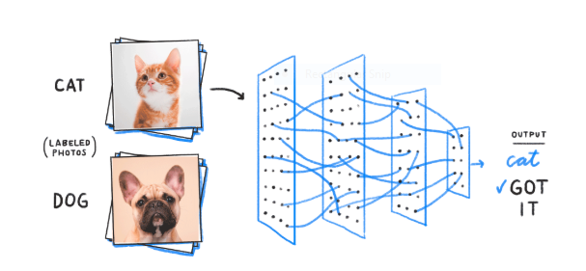
Perceptron
In machine learning, the perceptron is an algorithm for supervised learning of binary classifiers. A binary classifier is a function which can decide whether or not an input, represented by a vector of numbers, belongs to some specific class.^{[1]} It is a type of linear classifier, i.e. a classification algorithm that makes its predictions based on a linear predictor function combining a set of weights with the feature vector.

Slide 3
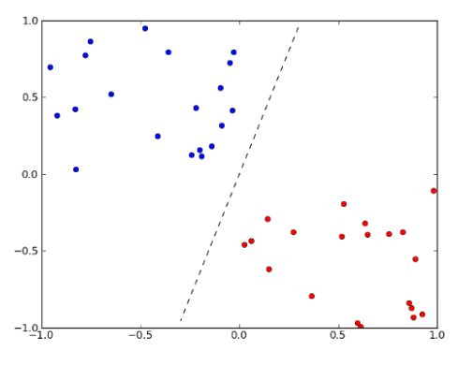
Why do we need Weights and Bias?
Weights shows the strength of the particular node.
A bias value allows you to shift the activation function curve up or down
Power of Perceptron ? A single perceptron can only be used to implement linearly separable functions

Slide 4
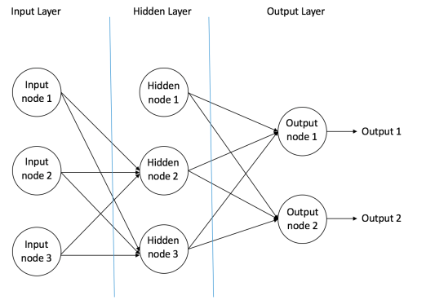

Slide 5
Input Nodes – The Input nodes provide information from the outside world to the network and are together referred to as the “Input Layer”. No computation is performed in any of the Input nodes – they just pass on the information to the hidden nodes.
Hidden Nodes – The Hidden nodes have no direct connection with the outside world (hence the name “hidden”). They perform computations and transfer information from the input nodes to the output nodes. A collection of hidden nodes forms a “Hidden Layer”. While a feedforward network will only have a single input layer and a single output layer, it can have zero or multiple Hidden Layers.
Output Nodes – The Output nodes are collectively referred to as the “Output Layer” and are responsible for computations and transferring information from the network to the outside world.

Slide 6
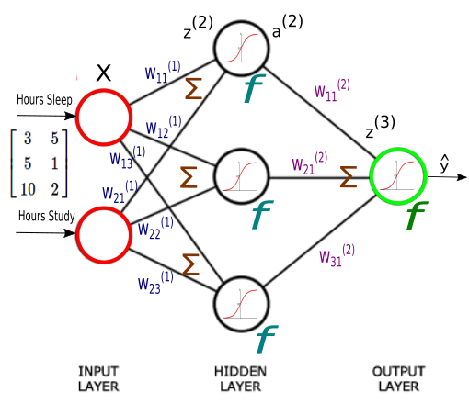
Flow of Input data In Two Layer Neural Network

Slide 7
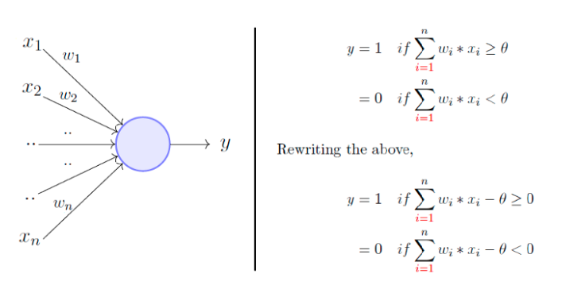
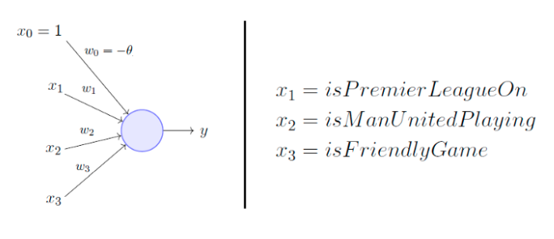
Consider the task of predicting whether I would watch a random game of football on TV or not using the behavioral data available. And let's assume my decision is solely dependent on 3 binary inputs (binary for simplicity).
.

Slide 8
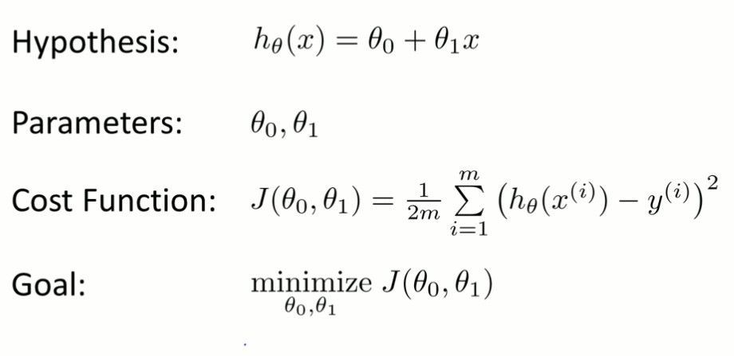
Objective of a classifier to come up with right weights that will determine the decision boundary
Commonly Gradient Descent is used to come up to the right parameters .

Slide 9
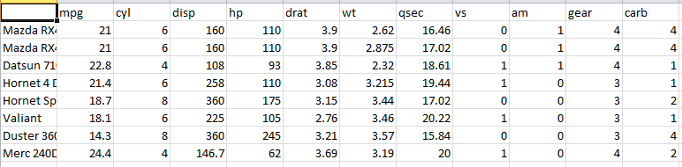
What is Cost Function ?
In ML, cost functions are used to estimate how badly models are performing. Put simply, a cost function is a measure of how wrong the model is in terms of its ability to estimate the relationship between X and y. This is typically expressed as a difference or distance between the predicted value and the actual value. The objective of a ML model, therefore, is to find parameters, weights or a structure that minimises the cost function.

Slide 10

Gradient Descent Applied To Neural Network
to reach a lake blindfolded?? and you have zero visibility
The best way is to check the ground near you and observe where the land tends to descend. This will give an idea in what direction you should take your first step. If you follow the descending path, it is very likely you would reach the lake.

Slide 11
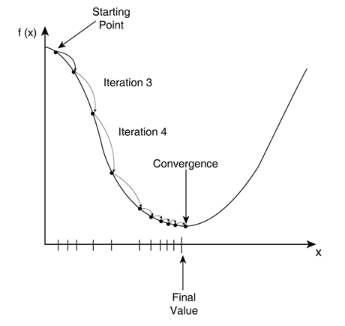
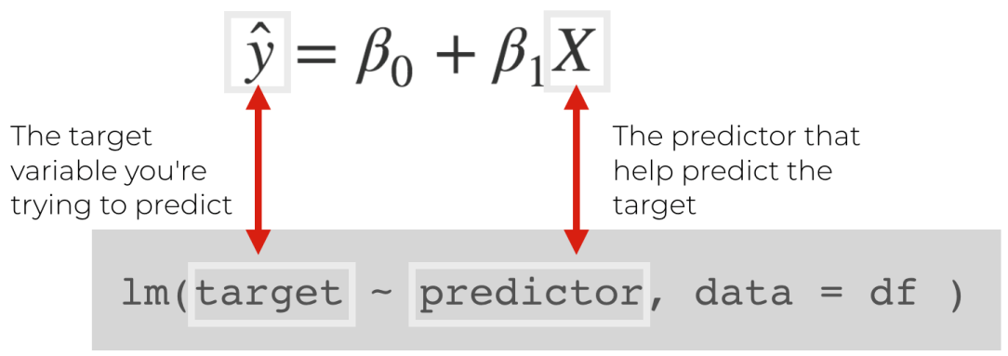
Gradient Descent applied to cost function
The gradient descent will help in learning the right
parameters.
Initially parameters are randomly initialized and then gradient will move in such direction that predicted value is close to actual value.

Slide 12

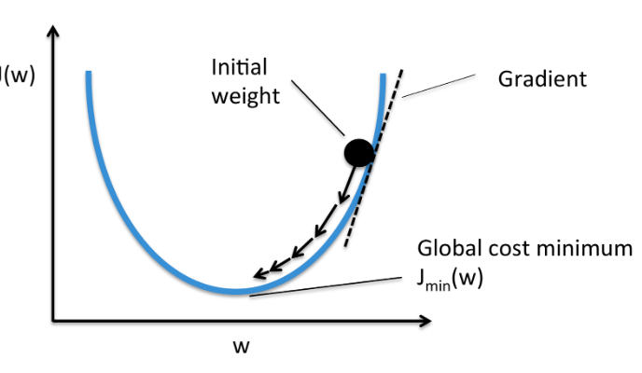
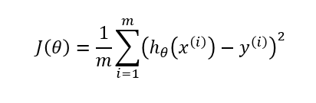
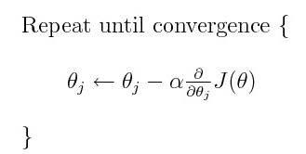
Objective -> To find equation of hyperplane (classifier boundary)

Slide 13
Logistic Regression / Single Layer Perceptron
A single neuron is same as Logistic Regression if activation function used in the output layer is logistic .
Are there neural network regression network also likewise Linear Regression ?
 | Regression | Classification
Activation Function in Output Layer | Linear Activation Function (Values are unbounded) | Softmax -> For Multi Class and Sigmoid -> For Binary Classification
 | In case of Regression we don’t want to bound our output in between some range | In case of classification we need to come up with probability of each class of which sum should be 1 .

Slide 14
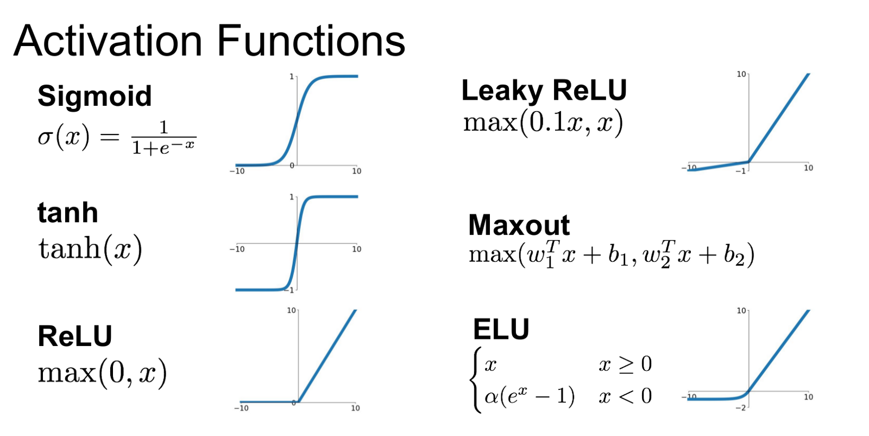
Generally Sigmoid and Softmax are used in output layer and others are used in hidden layer.

Slide 15
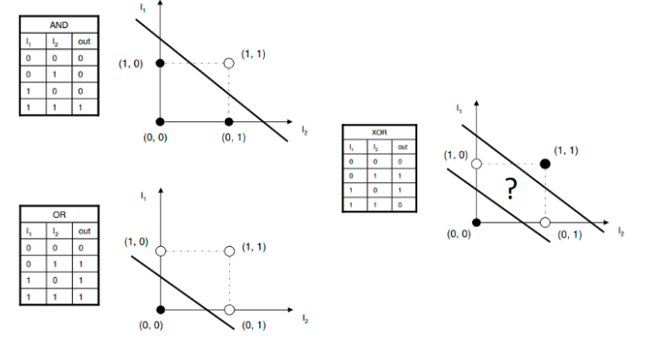
OR,AND Gate Using Perceptron XOR Gate Using Multi Layer Perceptron

Slide 16
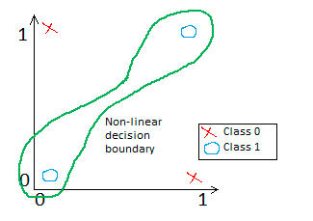
Drawbacks of Single Layer Perceptron
Single layer Perceptron can only learn linear
boundaries for implementing XOR
gate we need multi layer perceptron.

Slide 17
Uses of Perceptron in Industry

Slide 18
Case Study
We will use the wine data set from the UCI Machine Learning Repository. It has various chemical features of different wines, all grown in the same region in Italy, but the data is labeled by three different possible cultivars.
We will try to build a model that can classify what cultivar a wine belongs to based on its chemical features using Neural Networks.
You can get the data here .

