Slide 1
Basic Trello Board
With REACT.JS

Slide 2
Takeaways!
Basics of web applications (HTML, CSS, Javascript, JQuery, Frameworks)
Front-development and its place in web development
React Basics
React Components
Passing data between components in React
Drag and drop of elements in React
Content Editable Property
Demo!

Slide 3
Web applications
Any application that you view in a web browser
Browsers understand web applications
Why?
Because they understand
HTML
CSS
Javascript

Slide 4
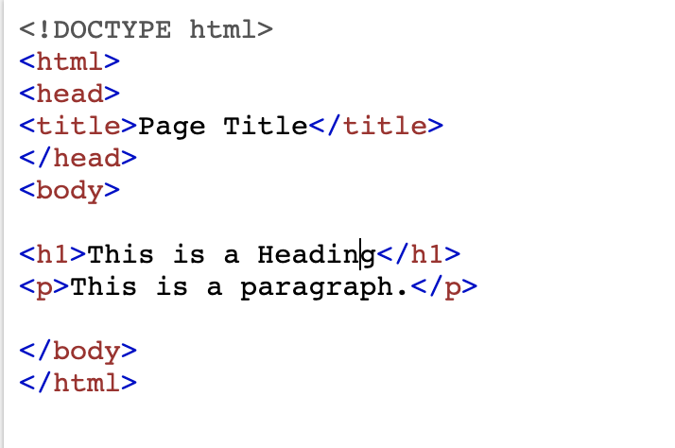
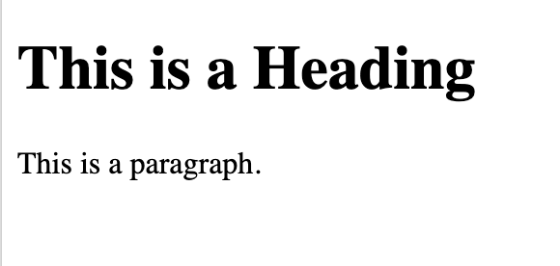
HTML
Hyper Text Markup Language
It is a way to mark text in a way that the browser gives it special meaning

Slide 5
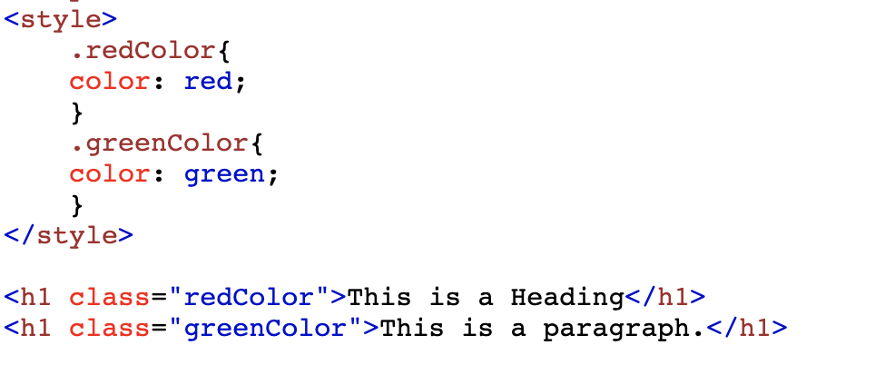
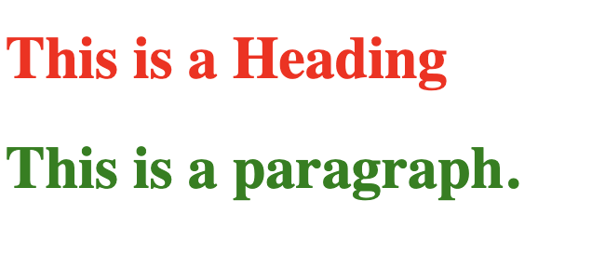
CSS
Cascaded Style Sheets
It is a way to style the marked text

Slide 6
Javascript
It is used to add interactivity to a web page
Example: Change color of on click of a button
But there are problems
The implementations for Javascript is different in different browsers
Also, code to do basic activity can be quite lengthy

Slide 7
Jquery
A Javascript library
Written in order to solve the problems with Javascript
Jquery is nothing but a set of Javascript functions written to simplify writing Javascript code
Javascript
document.getElementById(“ElementId”)
Jquery
$(“#ElementId”)

Slide 8
Problem?
Creating complex web applications require writing complex Jquery and Javascript code
There is lack of structure to the code
There is lack of consistency among developers
Hence, Javascript frameworks arose
One such framework is React.js

Slide 9
Demo

Slide 10
Thank you!

