Slide 1
Language Models

Slide 2
Natural Language Processing
The idea behind NLP: To give computers the ability to process human language.
To get computers to perform useful tasks involving human language:
Dialogue systems
Cleverbot
Machine translation
Question answering (Search engines)

Slide 3
Natural Language Processing
Knowledge of language.
One of the important information about a language: Is a string a valid member of a language or not?
Word
Sentence
Phrase
– …

Slide 4
Language Models
Formal grammars (e.g. regular, context free) give a hard “binary” model of the legal sentences in a language.
For NLP, a probabilistic model of a language that gives a probability that a string is a member of a language is more useful.
To specify a correct probability distribution, the probability of all sentences in a language must sum to 1.

Slide 5
Uses of Language Models
Speech recognition
“I ate a cherry” is a more likely sentence than “Eye eight uh Jerry”
OCR & Handwriting recognition
More probable sentences are more likely correct readings.
Machine translation
More likely sentences are probably better translations.
Generation
More likely sentences are probably better NL generations.
Context sensitive spelling correction
“Their are problems wit this sentence.”

Slide 6
Completion Prediction
A language model also supports predicting the completion of a sentence.
Please turn off your cell
Your program does not
Predictive text input systems can guess what you are typing and give choices on how to complete it.

Slide 7
Part of Speech Tagging
Another important use-case for language models is part-of-speech tagging. We’ll explore this in detail in this presentation and try to solve this in code too.
Mary saw Jane.
Jane saw Will.
Word | Noun | Verb
Mary | 1 | 0
saw | 0 | 2
Jane | 2 | 0
Will | 1 | 0

Slide 8
Part of Speech Tagging - Dilemma
Mary will see Jane.
Jane will see Will.
New Sentence:- Mary will see Will.
Word | Noun | Verb
Mary | 1 | 0
see | 0 | 2
Jane | 2 | 0
Will | 1 | 2

Slide 9
Bi-Grams (n-gram approach)
Mary will see Jane.
Jane will see Will.
New Sentence:- Mary will see Will.
Problem: UNK n-gram.
Word | N-V | V-V | V-N
Mary-will | 1 | 0 | 0
Will-see | 0 | 2 | 0
See-Jane | 0 | 0 | 1
Jane-will | 1 | 0 | 0
See-will | 0 | 0 | 1

Slide 10
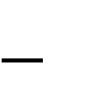
N-Gram Word Models
We can have n-gram models over sequences of words, characters, syllables or other units.
Estimate probability of each word given prior context.
P(phone | Please turn off your cell)
An N-gram model uses only N 1 words of prior context.
Unigram: P(phone)
Bigram: P(phone | cell)
Trigram: P(phone | your cell)
The Markov assumption is the presumption that the future behavior of a dynamical system only depends on its recent history. In particular, in a kth-order Markov model, the next state only depends on the k most recent states, therefore an N-gram model is a (N 1)-order Markov model.

Slide 11
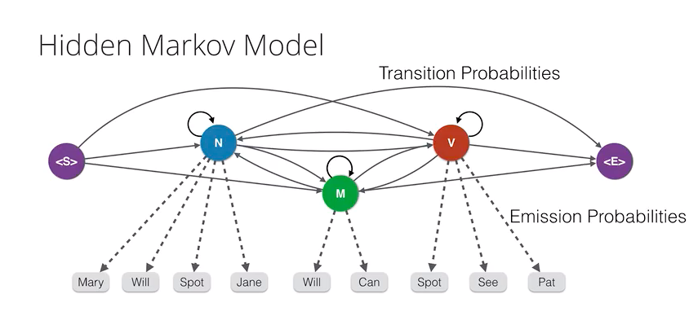
Hidden Markov Model

Slide 12
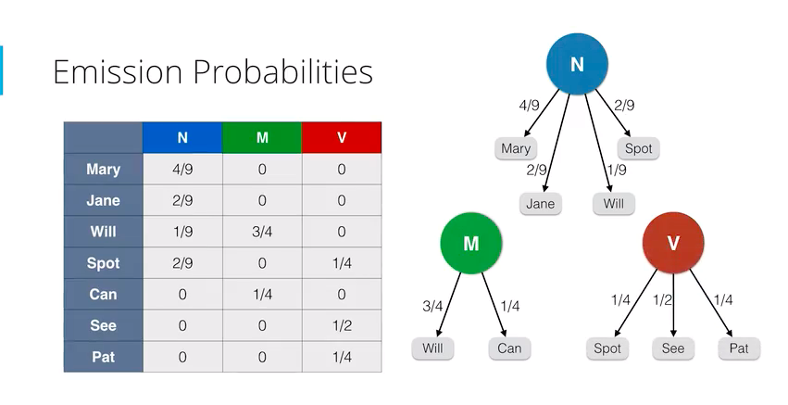
Hidden Markov Model

Slide 13
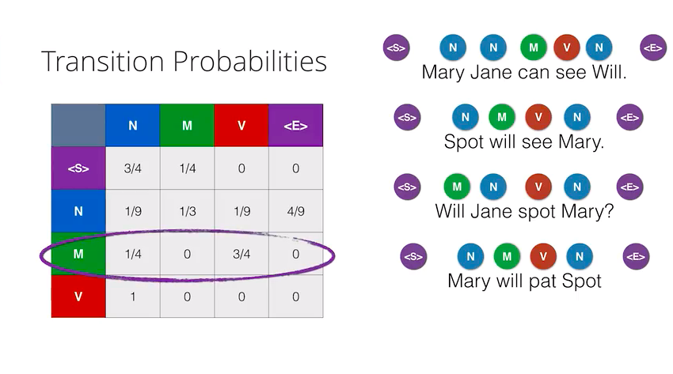
Hidden Markov Model

Slide 14
Unknown Words
How to handle words in the test corpus that did not occur in the training data, i.e. out of vocabulary (OOV) words?
Train a model that includes an explicit symbol for an unknown word (<UNK>).
Choose a vocabulary in advance and replace other words in the training corpus with
<UNK>.
Replace the first occurrence of each word in the training data with <UNK>.

Slide 15
Model Combination
As N increases, the power (expressiveness) of an N-gram model increases, but the ability to estimate accurate parameters from sparse data decreases (i.e. the smoothing problem gets worse).
A general approach is to combine the results of multiple N-gram models of increasing complexity (i.e. increasing N).

Slide 16
Summary
Language models assign a probability that a sentence is a legal string in a language.
They are useful as a component of many NLP systems, such as ASR, OCR, and MT.
Simple N-gram models are easy to train on corpora and can provide useful estimates of sentence likelihood.
N-gram gives inaccurate parameters for models trained on sparse data.

Slide 17
Part of these slides are developed using Raymond J.Mooney’s slides from University of Texas at Austin. (http://www.cs.utexas.edu/~mooney/cs388/) .

