Slide 1
lastname, firstname PIN
date of birth, age at surgery: yyyy-mm-dd, years old
surgery date: yyyy-mm-dd
surgeon:
surgical target
    left:
    right:
stimulation settings (clinic: yyyy-mm-dd)
    electrode: Abbott 6172 | Abbott 6173
    implantable pulse generator: Infinity RC | Infinity PC
    voltage: left: V, right: V
    frequency: left: Hz, right: Hz
    pulse width: left: μs, right: μs
    active contacts: left: , right:
    cycling:

Slide 2
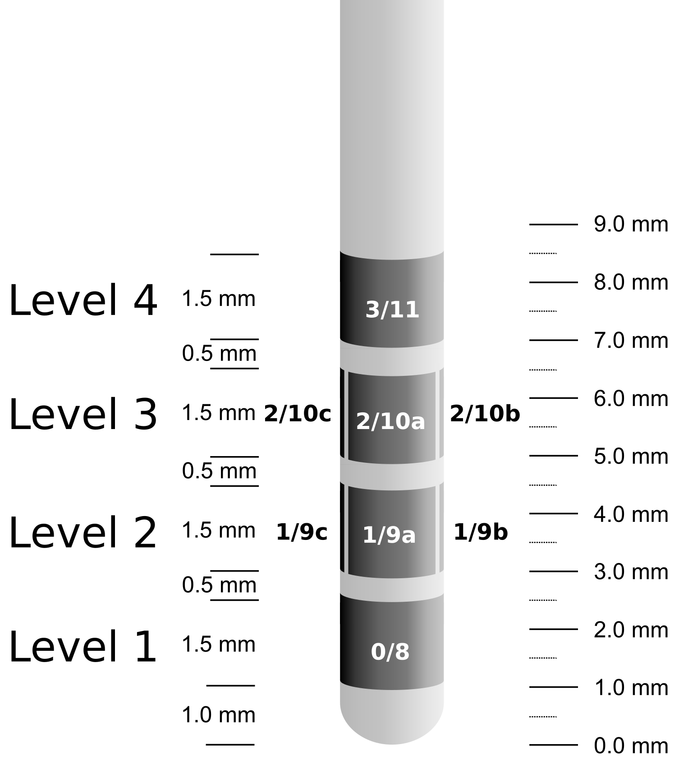
Left Brain: Level 1
actual lead
limbic STN
associative STN
motor STN
red nucleus

Slide 3
Left Brain: Level 1
actual lead
ANT
Mammillo. tract
mediodorsal
centromedian

Slide 4
Left Brain: Level 1
actual lead
caudate
putamen
GPe
GPi

Slide 5
Left Brain: Level 2

Slide 6
Left Brain: Level 3

Slide 7
Left Brain: Level 4

Slide 8
Right Brain: Level 1

Slide 9
Right Brain: Level 2

Slide 10
Right Brain: Level 3

Slide 11
Right Brain: Level 4

Slide 12
Summary
Left brain
    option 1:
    option 2:
Right brain
    option 1:
    option 2:

