Slide 1
lastname, firstname PIN
date of birth, age at surgery: yyyy-mm-dd, years old
surgery date: yyyy-mm-dd
surgeon:
surgical target
    left:
    right:
stimulation settings (clinic: yyyy-mm-dd)
    electrode: B.Sci. directional (db-2202) | linear (db-2201)
    implantable pulse generator: Vercise Gevia | Vercise PC | Vercise Genus
    current: left: mA, right: mA
    frequency: left: Hz, right: Hz
    pulse width: left: μs, right: μs
    active contacts: left: , right:

Slide 2
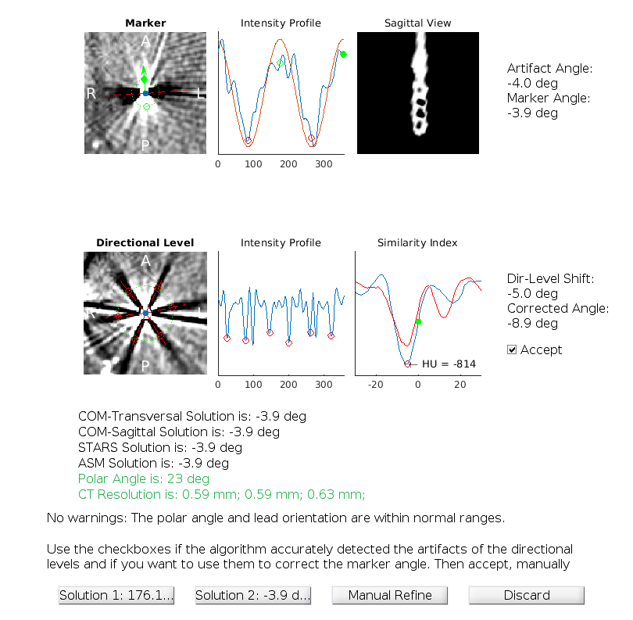
Electrode Rotation: Left Lead

Slide 3
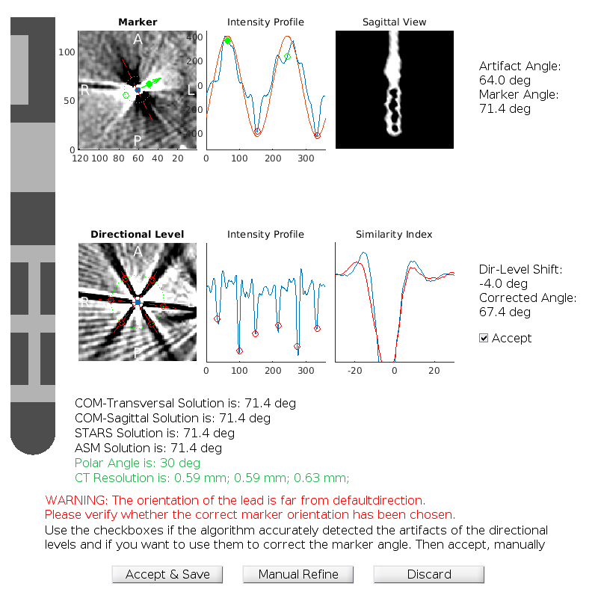
Electrode Rotation: Right Lead

Slide 4
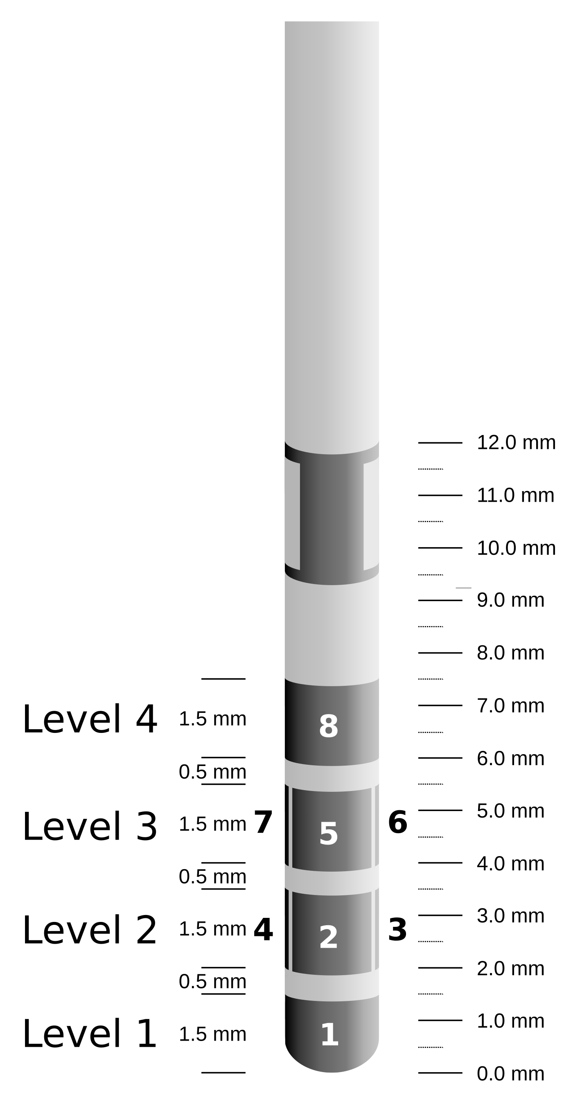
Left Side: Level 1
actual lead
limbic STN
associative STN
motor STN
red nucleus
SNr

Slide 5
Left Side: Level 1
ventral anterior
actual lead
ventral lateral
ventral intermediate
anterior nucleus
centromedian
lateral dorsal
ventral anterior
medial dorsal
mammillo. tract

Slide 6
Left Side: Level 1
actual lead
caudate
putamen
GPe
GPi

Slide 7
Left Side: Level 2

Slide 8
Left Side: Level 3

Slide 9
Left Side: Level 4

Slide 10
Right Side: Level 1

Slide 11
Right Side: Level 2

Slide 12
Right Side: Level 3

Slide 13
Right Side: Level 4

Slide 14
Volume of Activated Tissue (VAT) Simulations
Bi-lateral stimulation settings: 3.0mA, 130Hz, 60μs

Slide 15
VAT Left Side: Level 1
Actual lead
STN
Red Nucleus
Stimulation volume
SNr

Slide 16
VAT Left Side: Level 2

Slide 17
VAT Left Side: Level 3

Slide 18
VAT Left Side: Level 4

Slide 19
VAT Right Side: Level 1

Slide 20
VAT Right Side: Level 2

Slide 21
VAT Right Side: Level 3

Slide 22
VAT Right Side: Level 4

Slide 23
Summary
Left side
    option 1:
    option 2:
Right side
    option 1:
    option 2:

