Slide 1


Slide 2

Tutorial 1 Sections 009/010
TA: Greydon Gilmore
Physiology 2130
Sep 10th ,2019

Slide 3

Your TA reminding you…
1st Peerwise assignment (1.5%)
Post 2 MC questions: due Oct 16th @ midnight
Answer 5 MC questions: due Oct 18th @ midnight
1st Quiz (1%)
Opens: Oct 21st @ 4pm
Closes: Oct 22nd @ 4pm
1st Midterm - Oct 25th @ 6pm-7pm (15%)

Slide 4
Today
Course Review and Tutorial Details
Mastering/Learning Catalytics setup
Study Tips

Slide 5
Ice Breaker
Name
Department
Where you are from
Write any trepidations you have about this course
Anything that is worrying you right now about the course

Slide 6
A little about me…
B.Sc. Biotechnology
B.Sc. Neuroscience
M.Sc. Neuroscience
Currently: 2nd year PhD candidate in Biomedical Engineering

Slide 7
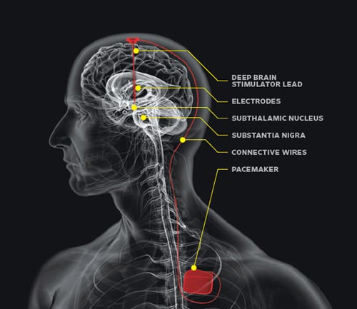
Deep Brain Stimulation

Slide 8
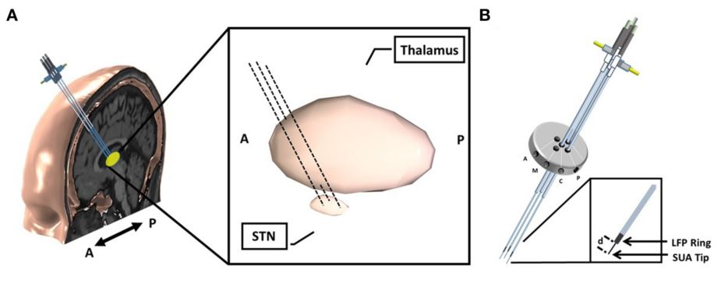
Deep Brain Stimulation

Slide 9
Contact
Office: University Hospital, Room BLL-250
Phone: 519-685-8500 ext 76708
Email: greydon.gilmore@gmail.com

Slide 10
Course Breakdown
4 Assignments (6%)
4 Quizzes (4%)
Midterm 1 (15%)
Oct 25th at 6:00pm (1 hour), 30-35 multiple choice questions
Midterm 2 (15%)
December Exam Period (Dec 10th – 21st) (1 hour), 30-35 multiple choice questions
Midterm 3 (15%)
Feb 28th at 6:00pm (1 hour), 30-35 multiple choice questions
Final Exam (40%)
April Exam Period (April 11th – 30th) (3 hours)
75-80 multiple choice questions (CUMULATIVE, focus on last quarter)
Tutorials Attendance and participation (5%)
22 tutorial sessions

Slide 11
Assignments
Through Peerwise (https://peerwise.cs.auckland.ac.nz/)
Write and submit TWO multiple choice questions
Answer FIVE questions
Will open on Sep 16th

Slide 12
Quizzes
Completed online through OWL
20 minutes
10 multiple choice questions
1 attempt

Slide 13
Tutorials
Bring your workbook to complete skipped exercises
Both lecture and tutorial questions can be asked in the forums
Attendance is mandatory:
Sign in every week for marks!
Complete Peerwise question to confirm you were present
Contact Dr. Woods (awall4@uwo.ca) with valid excuse/documentation if you can’t make any tutorial

Slide 14
Email Tips
Subject line includes: course number and tutorial section
Phys 2130 – [your section #]
Signature includes: full name and student number
Greydon Gilmore 250434943
Body of email:
Address: use proper title (e.g. Dr. [Surname]), use Greydon for me
Situation: explain the situation
Task: describe task you will (or are trying to) accomplish
Request action: explain the requested action on my part
Include relevant documents (e.g. Doctors notes)
Follow-up!
Please follow-up with the result (e.g. “Thank you, I understand now”)

Slide 15
Success in Phys 2130
Go to every class
Take notes
Plan your time
Class is early so get to bed at a decent time
Don’t procrastinate
Make friends in the class

Slide 16
Mastering/Learning Catalytics
Navigate to www.pearson.com/mastering
Under register, select student
Confirm you have the information needed, then select OK! Register now
Enter your instructor’s course ID: woods06987 and Continue
Enter your existing Pearson account username and password to Sign In
You have an account if you have ever used a MyLab or Mastering product
If you don’t have an account, select Create and complete the required fields
Select an access option
Enter the access code that came with your textbook or that you purchased separately from the bookstore

Slide 17
Mastering/Learning Catalytics
From the You're Done! page, select Go To My Courses
On the My Courses page, select the course name LECTURE Human Physiology 2130 2019-2020 to start your work
You will now register a second course, your specific tutorial section
Enter our course ID: woods38259 and continue
You will not need to re-enter your access code

Slide 18
Studying Tips
Lower Quality
Highlighting everything
Reading notes over and over
Write out notes over and over
Taking too much time making your notes “beautiful”
Higher Quality
Recall lecture note material without your notes
Review material right after class
Study frequently in short time periods
Teach your friends or parents a concept

Slide 19
Homeostasis and Body Fluid Compartments
Chapter 1: Dr. Woods
pp.

Slide 20
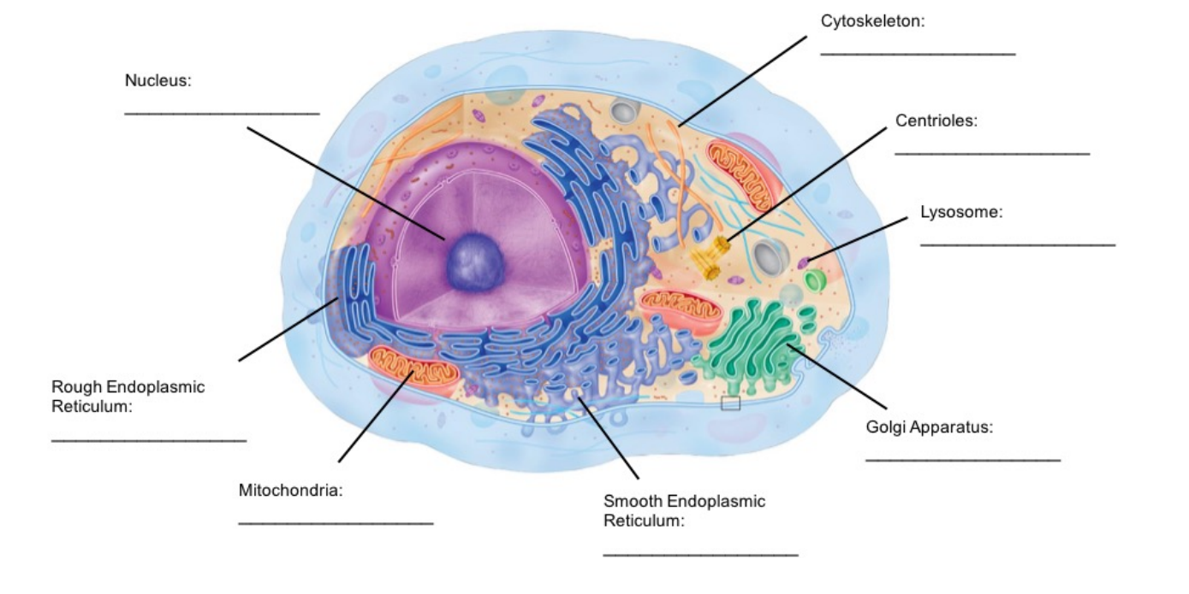
The Cell: Overview of Structures/Organelles (p.9)

Slide 21
Functions of organelles
Centrioles
Aid in cell division, in animals, by formation of spindle fibers that separate chromosomes during mitosis
Mitochondria
Supply the cell with energy in the form of ATP
Nucleus
Contains majority of cells genetic material
Plasma Membrane
Protect the cell from its surroundings
Composed of a phospholipid bilayer with embedded proteins

Slide 22
Functions of organelles
Smooth Endoplasmic Reticulum
Manufacturing of lipid (fat) molecules
Rough Endoplasmic Reticulum
Rough due to ribosomes being dispersed throughout the membrane to help in the production, folding and transportation of proteins
Golgi Apparatus
Modify, sort and pack macromolecules (mostly proteins coming from the Rough ER)

Slide 23
Functions of organelles
Lysosome
Houses enzymes for digestion and waste removal
Cytoskeleton
Composed filaments and tubules, extending from plasma membrane to nucleus
Provides the cell shape and protects it from damage

Slide 24
Next Tutorial (Sep 17th)
Chapter1 : The Interaction of the Cell with its Environment

Slide 25
What Questions Do You Have?
You can ask in the Owl forums as well!
Also anonymously ask questions in the online dropbox!!

