Slide 1


Slide 2

Tutorial 12 Sections 009/010
TA: Greydon Gilmore
Physiology 2130
Dec 3rd, 2019

Slide 3

Your TA reminding you…
2nd Quiz (1%)
Opens: Dec 2nd @ 4pm
Closes: Dec 4th @ 4pm
2nd Midterm (15%)
When: Dec 19th @ 9am-10am
Room Assignments:
ABBA-GANE: Alumni Hall 15
GHAB-POSA: Alumni Hall 201
PRIM-WOOD: Alumni Hall Stage
WU-ZIA: Somerville House 2316
2nd Midterm review session
When: Monday Dec 16th from 6-8pm
Where: Auditorium B University Hospital, 3rd floor

Slide 4
Today
Group work activity
Learning Catalytics Question
Almost finish cardiovascular anatomy

Slide 5
Group Work

Slide 6
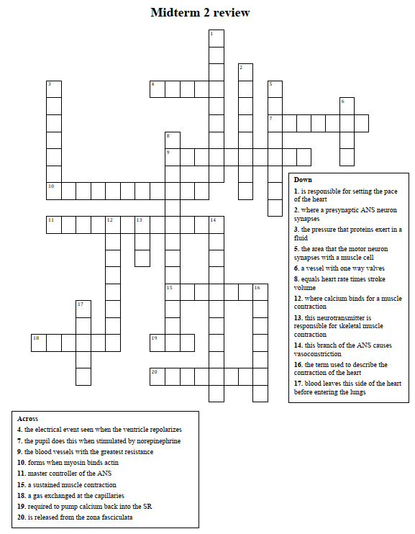
Crossword Puzzle!

Slide 7
Learning Catalytic Question

Slide 8
The Cardiovascular System: Mechanical Performance of the Heart
Chapter 7: Professor Stavraky

Slide 9
Heart Rate (HR)
Average: 70 bpm
Lower HR = “healthier” (i.e. athletes: 45 bpm)
Max HR = 220 – age
Controlled by autonomic nervous system
PS-NS: decreases HR
S-NS: increases HR

Slide 10
Stroke Volume = EDV -ESV
End-Diastolic Volume (EDV): volume of blood in ventricles at end of ventricular diastole (just before they contract; end of Phase 1)
End-Systolic Volume (ESV): volume of blood in ventricles at end of ventricular systole (just after contraction; end of Phase 3)
Stroke volume = EDV –ESV
= 160 ml –90 ml
= 70 ml
Altering either EDV or ESV will change stroke volume

Slide 11
Cardiac output can be determined by which of the following formulas?
HR – SV
HR divided by SV
HR + SV
HR x SV

Slide 12
Cardiac output can be determined by which of the following formulas?
HR – SV
HR divided by SV
HR + SV
HR x SV

Slide 13
Cardiac Output (CO)
Volume of blood pumped by each ventricle per minute
CO = Heart Rate x Stroke Volume
Heart Rate = Beats per minute
Stroke Volume = Amount of blood pumped by each ventricle per beat
At rest:
CO = 5 L/min
HR = 70 beat/min
SV = 70-80 mL/beat
CO = (70 beat/min)(0.07 L/beat) = 4.9 L/min
During exercise:
CO can increase to 20-40 L/min
How? By changing HR and/or SV!

Slide 14
Which of the following is INCORRECT regarding diastole (filling of the heart)?
Atrioventricular valves are open.
Semilunar valves are closed.
Blood is flowing from the atria into the ventricles.
Pressure in the ventricles is greater than in the atria.

Slide 15
Which of the following is INCORRECT regarding diastole (filling of the heart)?
Atrioventricular valves are open.
Semilunar valves are closed.
Blood is flowing from the atria into the ventricles.
Pressure in the ventricles is greater than in the atria.

Slide 16
Overall Control of SV by ANS
Stroke volume is amount of blood pumped by each ventricle per beat
Two factors that affect stroke volume:
ANS
Preload (End diastolic volume)
PS-NS decreases SV
Ca²⁺ flow into cardiac cells
force of contraction
S-NS increases SV
Ca²⁺ flow into cardiac cells
force of contraction

Slide 17
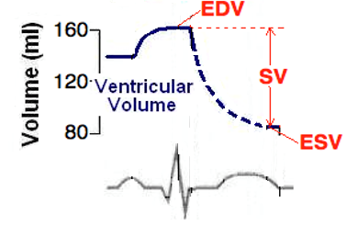
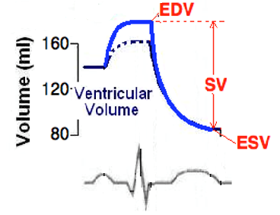
Stroke Volume
During exercise, the S-NS is activated:
Heart contracts more forcefully and ejects more blood
Thus, ESV decreases
Meanwhile, the heart is filling with more blood
Thus, EDV increases

Slide 18
Stroke Volume and Preload
Preload: The “load” on the cardiac muscle before contraction
This “load” comes from the blood in the ventricles that stretches the ventricular muscle
Thus, higher EDV = greater preload

Slide 19
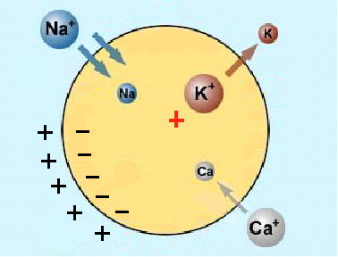
PNS Effect on HR
PNS innervates SA and AV nodes through vagus nerve
PNS releases Ach, which binds to receptors on cells of SA and AV nodes
K⁺ permeability (i.e. more exits cell) and Ca²⁺ permeability (i.e. less enters cell)
Net effect:
K⁺ = HYPERPOLARIZATION
Ca²⁺ = Decreases slope of pacemaker potential

Slide 20
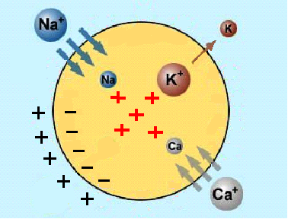
SNS Effect on HR
SNS innervates SA, AV nodes and ventricular muscles
SNS releases NE, which binds to receptors on cells of nodes and muscle
Na⁺ and Ca²⁺ permeability (i.e. more enters cell)
Net effect: DEPOLARIZATION and increased slope of pacemaker potential

Slide 21
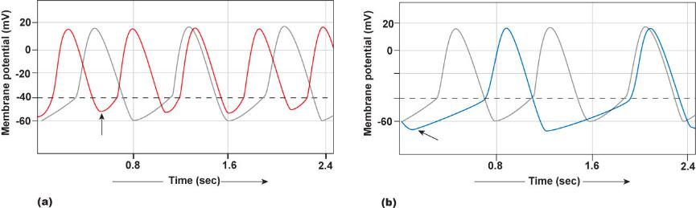
Which graph represents sympathetic influence on heart rate (in both cases the light grey line is under resting conditions)?

Slide 22
Which graph represents sympathetic influence on heart rate (in both cases the light grey line is under resting conditions)?

Slide 23
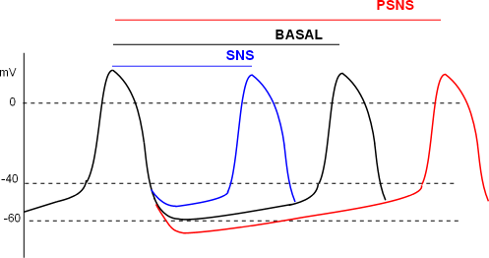
Summary of ANS Control of Heart Rate
PSNS
Acetylcholine released onto these areas
Increase K+, decrease Ca2+ permeabilities
Decreases slope of pacemaker potential
SNS
Release norepinephrine onto these areas (indirect: epinephrine)
Increases heart rate and force of contraction
Increase Na and Ca permeability
Increase slope of pacemaker potential

Slide 24
Frank-Starling Law
Frank-Starling Law states that “an increase in EDV will increase stroke volume”
An increase in EDV = An increase in preload
Increases the stretch of myocardial cells
Increases the force of contraction of these cells when the heart contracts
Increases the amount of blood ejected
Increases Stroke Volume (Increases Cardiac Output)

Slide 25
Frank-Starling Law and Venous Return
How to increase EDV? Increase venous return to the heart!
During dynamic exercise:
Muscle Pump: Contracted skeletal muscle around veins pushes blood to heart
Respiratory Pump: Changes in pressure during breathing pushes blood towards the heart
S-NS: Constriction of veins squeezes blood to heart

Slide 26
Frank-Starling Law and Venous Return

Slide 27
The aortic semilunar valve prevents blood from returning to the _____.
left ventricle
Aorta
Right ventricle
Left atrium

Slide 28
The aortic semilunar valve prevents blood from returning to the _____.
left ventricle
Aorta
Right ventricle
Left atrium

Slide 29
The Cardiovascular System: Vascular Function
Chapter 7: Dr. Stavraky

Slide 30
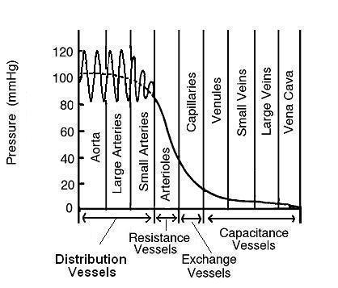
Blood Vessels
Structural properties of vessels are what contribute to the blood pressure characteristics seen in circulation

Slide 31
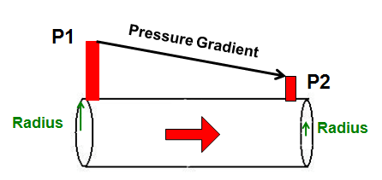
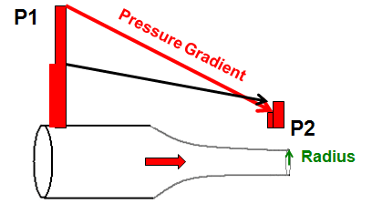
Vessel Constriction and Blood Flow
As the radius decreases the pressure gradient increases.

Slide 32

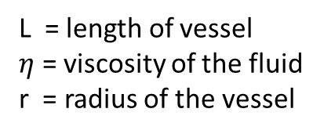
Relationship Between Pressure, Flow and Resistance (Page 232)
$$Resistance= \frac{L η}{r^{4}}$$
$$Resistance= \frac{1}{r^{4}}$$
$Blood Flow= \frac{P_{1}−P_{2}}{\frac{1}{r^{4}}}= \left(P_{1}−P_{2}\right) ∗ r^{4}$
L = length of vessel
$η$ = viscosity of the fluid
r = radius of the vessel
Just know this part of the equation
A small change in radius will have a LARGE effect on blood flow

Slide 33
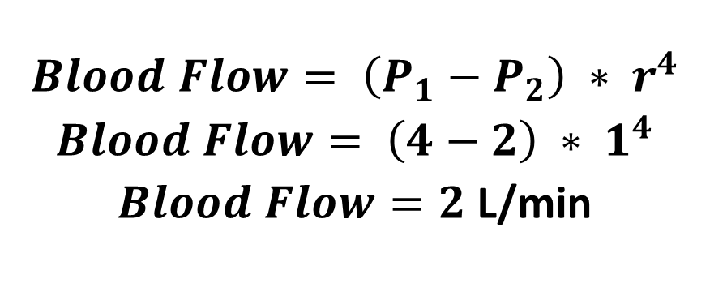
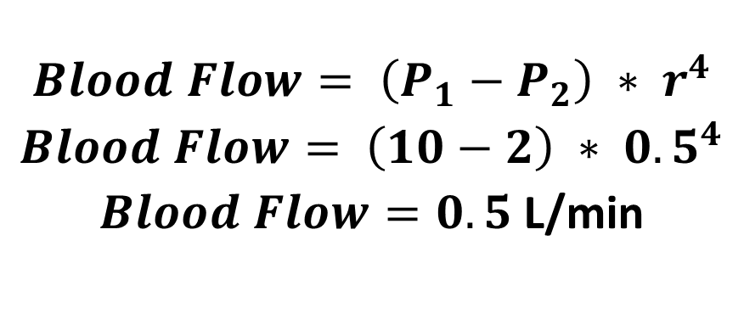
Relationship Between Pressure, Flow and Resistance
$$Blood Flow= \left(P_{1}−P_{2}\right) ∗ r^{4}$$
$Blood Flow= \left(4−2\right) ∗ 1^{4}$
$Blood Flow=2$ L/min
$$Blood Flow= \left(P_{1}−P_{2}\right) ∗ r^{4}$$
$Blood Flow= \left(10−2\right) ∗ {0.5}^{4}$
$Blood Flow=0.5$ L/min
A small change in radius will have a LARGE effect on blood flow

Slide 34
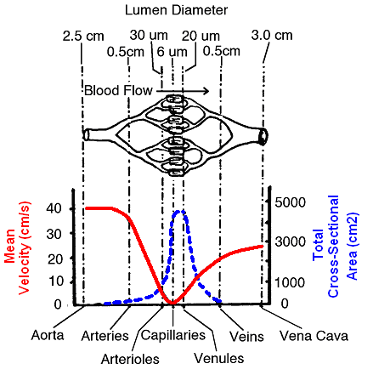
Defining terms
Blood velocity (cm/sec): speed at which blood is moving through particular blood vessel
Fluid flows faster through a narrow tube than a larger tube
As cross sectional area increases mean velocity decreases
Blood flow (L/min): volume of blood moving through set of vessels.

Slide 35
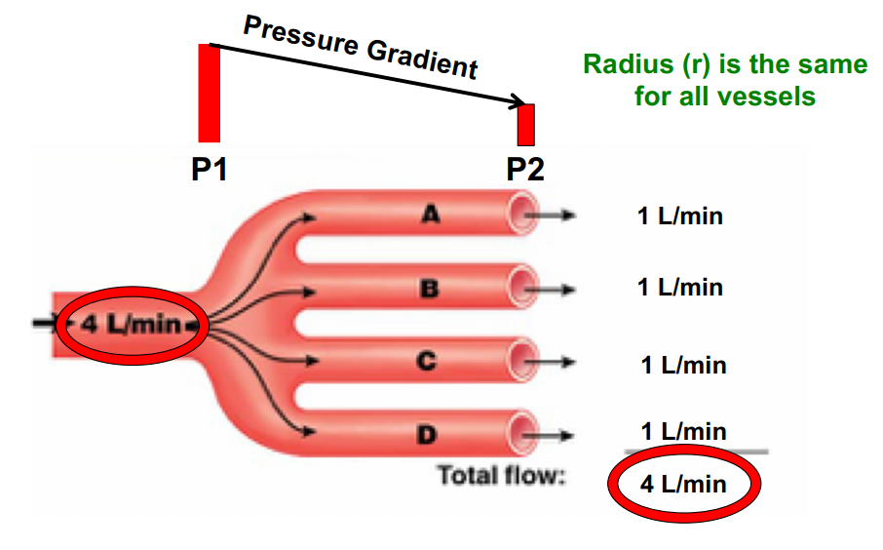
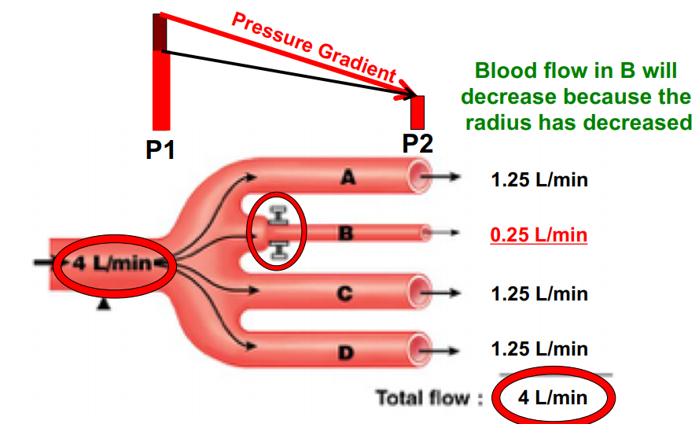
Overall blood flow does not change
Blood velocity can change but total blood flow needs to remain constant
If you have 5L of blood you can’t add or subtract… unless you have a wound

Slide 36
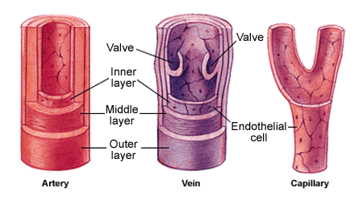
Arteries and Veins
Contain three layers:
Outer Layer – Tunica externa
Fibrous connective tissue
Middle Layer – Tunica media
Smooth muscle and elastic tissue
Inner Layer – Tunica interna
Endothelial cells
Veins contain valves
Capillaries have single layer of endothelial cells

Slide 37
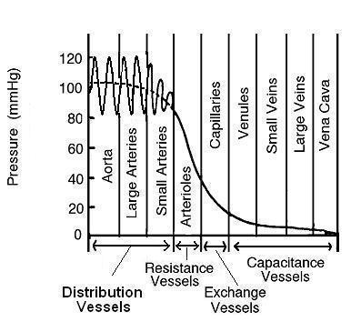
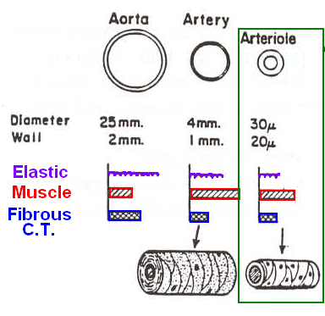
Aorta and Large Arteries
 | Blood Characteristics | Structure | Purpose
Aorta/Large Arteries | High blood pressure 80-120 mmHg High blood velocity | Large diameter Elastic tissue Thin walls Easily distended Low resistance to blood flow Small drop in blood pressure | ‘Shock absorbers’ Distribute the blood

Slide 38
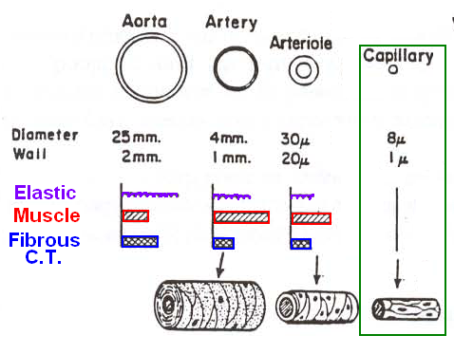
Capillaries
 | Blood Characteristics | Structure | Purpose
Capillaries | Low blood pressure Small drop in blood pressure Very low blood velocity (1-2 cm/sec) | One endothelial cell thick Large cross sectional area Very large surface area Diffusion of gas, nutrients and waste | Exchange vessels

Slide 39
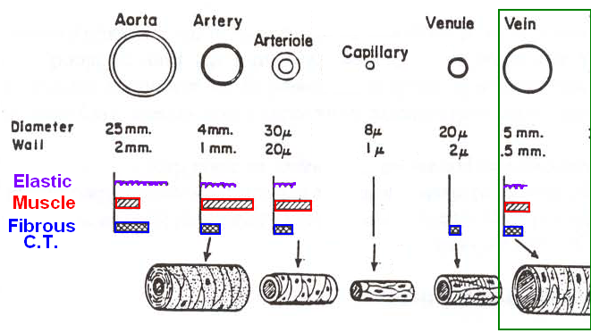
Veins
 | Blood Characteristics | Structure | Purpose
Veins | Low blood pressure Low to medium blood velocity (5-10 cm/sec) | Very thin walls with large diameter Contain valves Some elastic tissue Smoth of smooth muscle innervated by ANS Vasoconstriction/dilation | Capacitance vessels: 70% of TBV

Slide 40
Starling Forces
Two hydrostatic pressures
Capillary hydrostatic pressure
Interstitial fluid hydrostatic pressure
Two osmotic pressures
Plasma osmotic pressure
Interstitial osmotic pressure

Slide 41
Exchange In Capillaries
Diffusion
Down concentration gradients
Oxygen, CO², O², lipid soluble substances
Filtration and reabsorption (Starling forces)
Filtration: movement of fluid out of capillary
Reabsorption: movement of fluid back into capillary

Slide 42
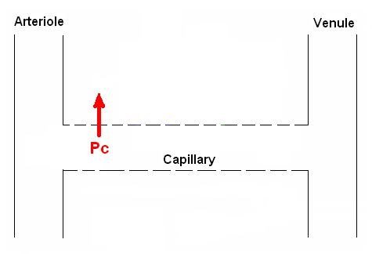
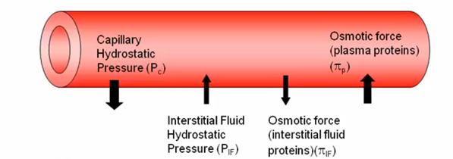
Capillary Hydrostatic Pressure (P_{c})
Pressure exerted by fluid in the capillary
Pressure drives fluid OUT of capillary and is generated by ventricular systole (Filtration)
25 mmHg
10 mmHg

Slide 43
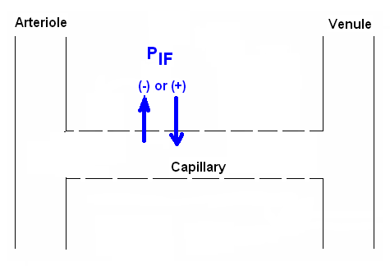
Interstitial Fluid Hydrostatic Pressure (P_{IF})
Pressure exerted by fluid in the interstitial space between cells in the tissue
Movement depends on pressure in the tissue
Can be negative → Filtration into tissue
Can be positive → Reabsorption into capillary
Subcutaneous tissues: -6mmHg
Interstitial fluid: +6mmHg

Slide 44
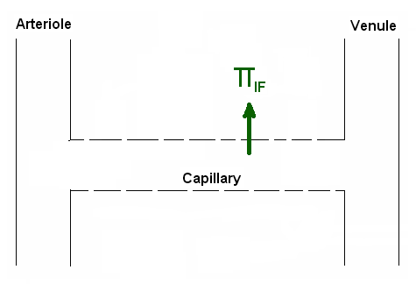

Interstitial Osmotic Pressure ($π$_{IF})
Pressure caused by osmosis due to few proteins in interstitial fluid (5mmHg)
Pressure drives fluid OUT of capillary and into tissue (Filtration)

Slide 45
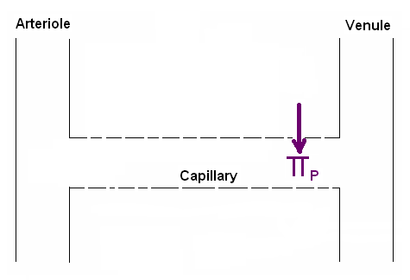

Plasma Osmotic Pressure ($π$_{P})
Pressure caused by osmosis due to proteins in plasma (28mmHg)
Pressure drives fluid INTO capillary (Reabsorption)

Slide 46
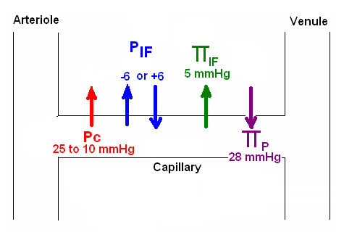
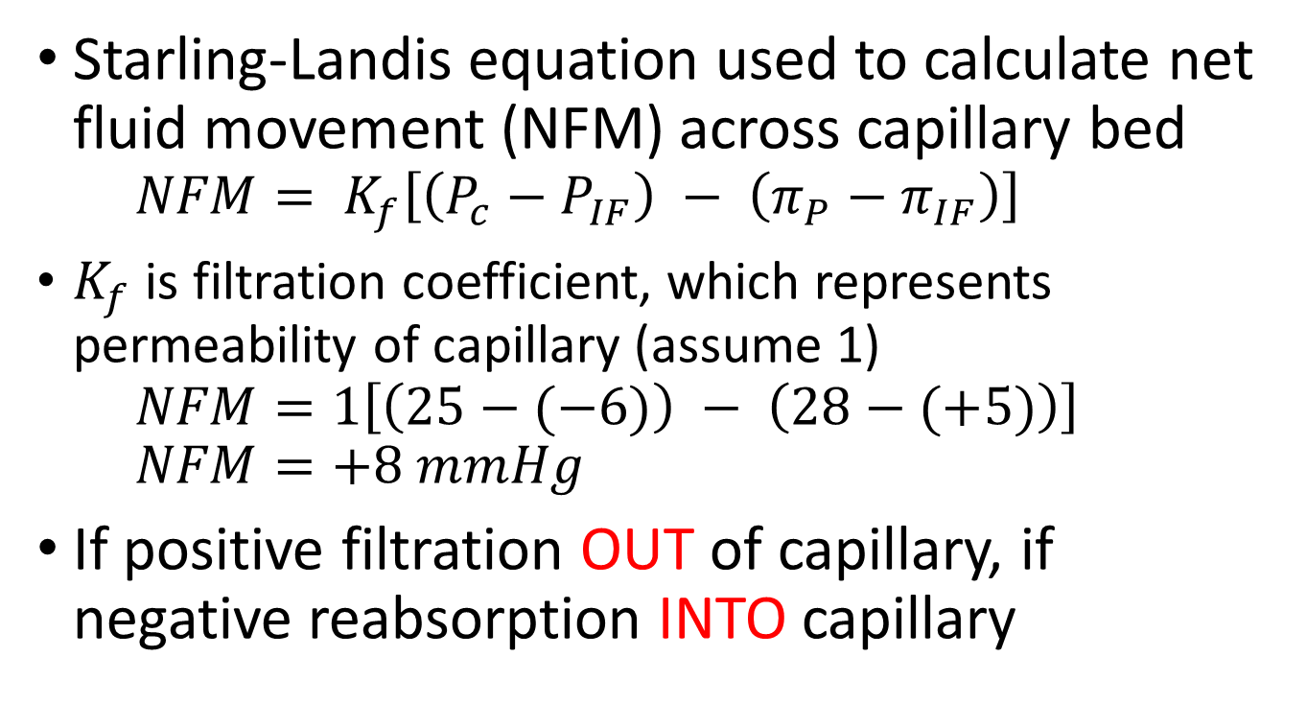
Balance of Starling Forces
Starling-Landis equation used to calculate net fluid movement (NFM) across capillary bed
$$NFM= K_{f}\left[\left(P_{c}−P_{IF}\right) − \left(π_{P}−π_{IF}\right)\right]$$
$K_{f}$ is filtration coefficient, which represents permeability of capillary (assume 1)
$$NFM=1\left[\left(25−(−6)\right) − \left(28−(+5)\right)\right]$$
$$NFM=+8 mmHg$$
If positive filtration OUT of capillary, if negative reabsorption INTO capillary

Slide 47
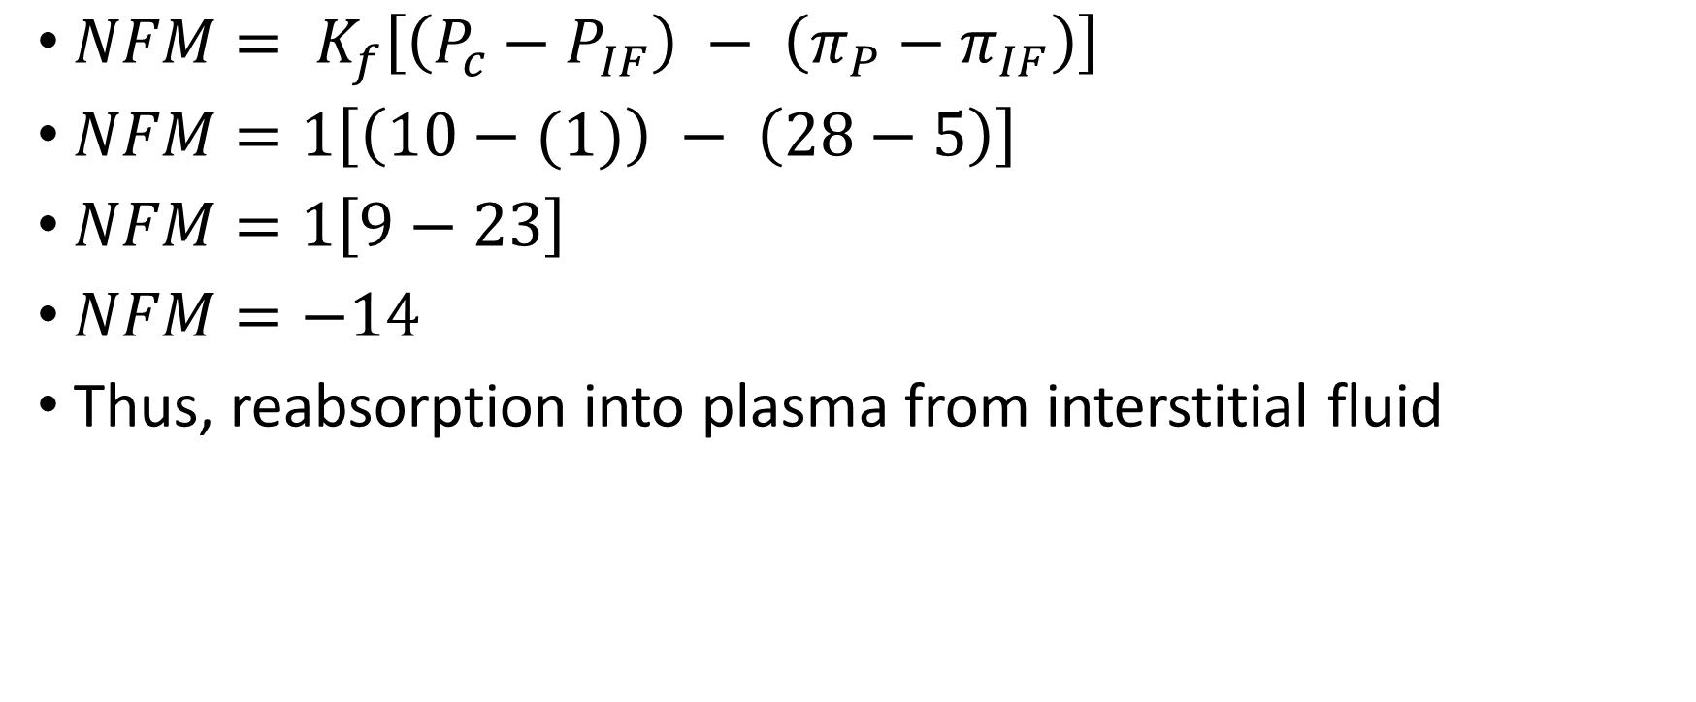
P_{C} = 10, P_{IF} = 1, π_{IF} = 5, π_{C} = 28
$NFM= K_{f}\left[\left(P_{c}−P_{IF}\right) − \left(π_{P}−π_{IF}\right)\right]$
$NFM=1\left[\left(10−(1)\right) − \left(28−5\right)\right]$
$NFM=1\left[9−23\right]$
$NFM=−14$
Thus, reabsorption into plasma from interstitial fluid

Slide 48
Next Tutorial (Jan 14th)
Have a great New Year!

Slide 49
What Questions Do You Have?
You can ask in the Owl forums as well!
Also anonymously ask questions in the online dropbox!!

