Slide 1


Slide 2

Tutorial 2 Sections 009/010
TA: Greydon Gilmore
Physiology 2130
Sep 17th, 2019

Slide 3

Your TA reminding you…
1st Peerwise assignment (1.5%)
Post 2 MC questions: due Oct 16th @ midnight
Answer 5 MC questions: due Oct 18th @ midnight
1st Quiz (1%)
Opens: Oct 21st @ 4pm
Closes: Oct 22nd @ 4pm
1st Midterm - Oct 25th @ 6pm-7pm (15%)

Slide 4
Today
Learning Catalytics Quiz
Complete Survey on OWL
Homeostasis and body fluid compartments
Interaction of cell with environment
Osmolarity and tonicity

Slide 5

Online Suggestion Box…
Please post a pdf version of your ppt thank you :)
Done!

Slide 6
Student Poll Answers
Worried about memorization (16 students)
Too much detail – where to focus (8 students)
Not a solid background in chemistry (6 students)
Very little theoretical chemistry in course
Cumulative Final Exam (6 students)
Will provide more tips later on in the course
Correct ways to study (5 students)
Will provide more tips during first review session
Pace profs teach at (5 students)
Do readings before lecture to be prepared
Lots of math? (Nope!)
Excited about everything in course, heard great reviews! (4 students)

Slide 7
Learning Catalytics

Slide 8
Q1: Glucose is moving across a membrane down a concentration gradient. However, it requires a protein which changes conformation to do so. What is its mode of transport?
A gap junction
Active transport
Facilitated diffusion
Movement into a hypertonic solution

Slide 9
Q2: If a protein is hydrophobic, which of the following is a false statement?
It would be soluble in the interstitial fluid
It would be found contained in the cell membrane
It would associate with lipids
It could be a gap junction

Slide 10
Q3: A cell signals by a paracrine mechanism. What would be true about this signaling?
The chemical will enter the interstitial fluid to signal the cell(s)
The chemical is a hormone
This chemical will be signaling the very same cell that produced it
This chemical will be a transmembrane glycoprotein and directly contact a neighbouring cell

Slide 11
Q4: If the extracellular fluid is hypertonic and the cell membrane is not permeable to solutes (eg. glucose, ions), which one of the following would occur?
Osmosis would not occur
Water would move out of the cell
The fluid inside the cell would have more solutes in it than the outside
Ions would move into the cell

Slide 12
Q5: Which of the following would not be an example that results in homeostasis?
sweating to restore normal body temperature
activation of a negative feedback loop
eating a meal when you’ve been fasting
drinking water when you are overhydrated

Slide 13
Online Survey https://uwo.eu.qualtrics.com/jfe/form/SV_bylQS9AIvAXeIrr

Slide 14
How To Write A MC Question
DO:
Write questions that cover material that was taught in lecture
Be clear and brief in the question
Try to test understanding, not just simple recall
Provide 4 options, indicate 1 option that is correct in PeerWise
The other answer options (called distractors) should be incorrect
TIPS
Make the distractors as believable as possible
Use distractors that are plausable
Use words that sound important or have associations with the question

Slide 15
How To Study For Phys
Notes:
Part 1: before class, review notes from previous class and complete all readings
Part 2: Focus on prof. listen for key signals (most important, remember that, be sure to include etc.)
Use abbreviations in your notes, write quickly, put ‘?’ beside things you want to review later
Part 3: re-write your notes, answer ‘?’, combine workbook and your notes together

Slide 16
How To Study For Phys
Flashcards:
Make them as you study
Organize into topics
Write words on one side and definitions on other (flip over the card and learn info both ways)
Add pictures to your cards (less boring!)
One piece of info per card
Shuffle them regularly (so you don’t just remember which card comes next)
https://www.cram.com/

Slide 17
Homeostasis and Body Fluid Compartments
Chapter 1: Dr. Woods
pp.

Slide 18
Which of the following statements about homeostasis is FALSE?
Homeostasis is a dynamic process in which the body maintains a relatively constant internal environment.
Small ranges in blood pH and glucose are examples of normal fluctuations.
The pancreas secreting insulin (a hormone) in order to lower blood sugar levels after a meal is an example of our body maintaining homeostasis.
Positive feedback is the main mechanism used to maintain homeostasis.

Slide 19
Which of the following statements about homeostasis is FALSE?
Homeostasis is a dynamic process in which the body maintains a relatively constant internal environment.
Small ranges in blood pH and glucose are examples of normal fluctuations.
The pancreas secreting insulin (a hormone) in order to lower blood sugar levels after a meal is an example of our body maintaining homeostasis.
Positive feedback is the main mechanism used to maintain homeostasis.

Slide 20
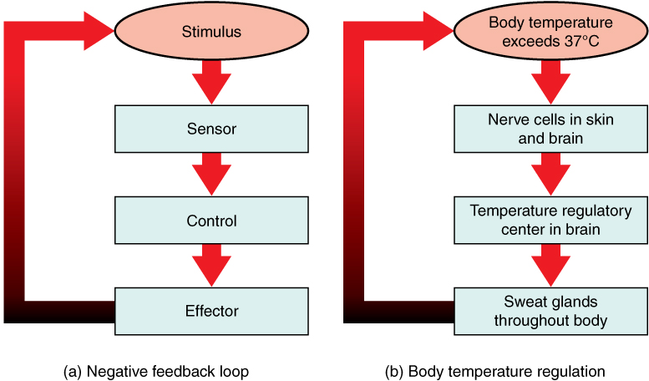
Negative feedback loops
Monitor and respond to changes in the internal environment in order to maintain homeostasis

Slide 21
An individual suffers from severe hemorrhage (blood loss) following a car accident. They would exhibit:
A decrease in intracellular fluid
An increase in intracellular fluid
A decrease in extracellular fluid
An increase in extracellular fluid

Slide 22
An individual suffers from severe hemorrhage (blood loss) following a car accident. They would exhibit:
A decrease in intracellular fluid
An increase in intracellular fluid
A decrease in extracellular fluid
An increase in extracellular fluid

Slide 23
Body Fluids (42L TBW)
Intracellular fluid (67%) : Fluid inside the cell
Cytoplasm
Extracellular fluid (33%): Fluid outside the cell
Interstitial fluid AND plasma (blood)

Slide 24
Interaction of the cell with its environment
Chapter 1: Dr. Woods
pp.

Slide 25
Functions of Membrane Proteins
Ion Channels
Enzymes – catalyze reactions
Receptors
Membrane carriers

Slide 26
Mechanisms of Membrane Transport
Endo/exocytosis
of small molecules
Diffusion through lipid bilayer
fat-soluble
Diffusion through protein channels
water soluble
Facilitated diffusion
large/bulky
Active transport
Against concentration gradient

Slide 27
Membrane Transport: True/False
Diffusion is a passive process
True
Molecules move from area of lower concentration to an area of higher concentration
False: High concentration to low concentration
The larger the concentration gradient, the faster the diffusion rate
True
Once molecules reach equilibrium, the diffusion and movement of molecules stop
False: Still movement but not overall net movement
Smaller molecules diffuse slower than larger molecules
False: Smaller is faster

Slide 28
Membrane Transport: True/False (page 16)
The diffusion rate of a molecule is affected by its lipid solubility
True
The hydrophobic core of the cell membrane prevents water soluble molecules from passing through
True
The membrane composition can affect diffusion
True
The larger membrane’s surface area, the less molecules can diffuse through
False: increase in SA means increase in diffusion
The thicker the membrane, the harder for the molecules to diffuse through
True

Slide 29
Comparison chart (p.20)
 | Simple Diffusion | Diffusion | Facilitated Transport | Active Transport
Selective?
Competitive inhibition?
Goes with concentration gradient?
ATP required?

Slide 30
Comparison chart (p.20)
 | Simple Diffusion | Diffusion | Facilitated Transport | Active Transport
Selective? | No (still needs to be small & hydrophobic)
Competitive inhibition? | No
Goes with concentration gradient? | Yes
ATP required? | No

Slide 31
Comparison chart (p.20)
 | Simple Diffusion | Diffusion | Facilitated Transport | Active Transport
Selective? | No (still needs to be small & hydrophobic) | Yes
Competitive inhibition? | No | No
Goes with concentration gradient? | Yes | Yes
ATP required? | No | No

Slide 32
Comparison chart (p.20)
 | Simple Diffusion | Diffusion | Facilitated Transport | Active Transport
Selective? | No (still needs to be small & hydrophobic) | Yes | Yes
Competitive inhibition? | No | No | Yes
Goes with concentration gradient? | Yes | Yes | Yes
ATP required? | No | No | No

Slide 33
Comparison chart (p.20)
 | Simple Diffusion | Diffusion | Facilitated Transport | Active Transport
Selective? | No (still needs to be small & hydrophobic) | Yes | Yes | Yes
Competitive inhibition? | No | No | Yes | Yes
Goes with concentration gradient? | Yes | Yes | Yes | No
ATP required? | No | No | No | Yes

Slide 34
Osmosis, tonicity and the resting membrane potential
Chapter 1: Dr. Woods
pp.

Slide 35
Osmosis
Osmosis is the net movement of WATER down its concentration gradient
It is affected by:
permeability of the membrane
concentration gradient of solutes
pressure gradient across the cell membrane
Osmolarity is concerned only with the NUMBER OF PARTICLES in solution (NOT size or type/composition)

Slide 36
Tonicity
Tonicity: the ability of a solution to cause osmosis across biological cell membranes
Isotonic: same osmolarity as body fluids
Hypotonic: lower osmolarity than body fluids
Hypertonic: higher osmolarity than body fluids
Chemical Gradient: molecules move from high concentration to low concentration
Electrical Gradient: electrically charged molecules (ions) move to areas of opposite charge

Slide 37
A red blood cell is placed in a 200 mM BeCl2 solution. The cell will _______ because the solution is _______.
shrink; hypotonic
shrink; hypertonic
swell; hypotonic
swell; hypertonic

Slide 38
A red blood cell is placed in a 200 mM BeCl2 solution. The cell will _______ because the solution is _______.
shrink; hypotonic
shrink; hypertonic
swell; hypotonic
swell; hypertonic
RBC = 300 mOsm
Solution = 200 mM x 3 ions
= 600 mOsm
The solution is hypertonic
Water moves out of cell into the solution, causing the cell to shrink

Slide 39
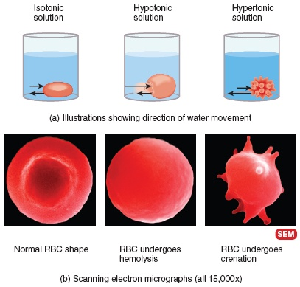
Tonicity: Review
Less solute
More solute

Slide 40
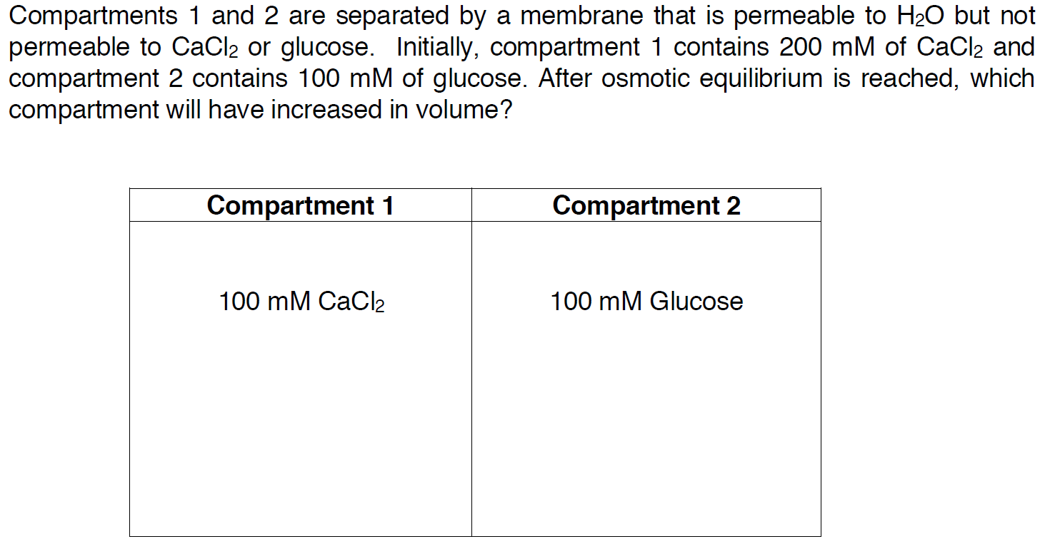
Compartment Question
200mM

Slide 41
Compartment Question
200mM
= (200 mM x 1 Ca²⁺) +
(200 mM x 2 Cl⁻)
= 600 mOsm
= 100 mOsm

Slide 42
Terms you should know
Active transport: moves molecules against their concentration gradient and requires an outside source of energy
Extracellular fluid: body fluid compartment found outside of cells
Facilitated diffusion: a mediated-transport process that moves molecules from higher to lower concentrations across a membrane by means of a transporter until the two concentrations become equal.
Gap junctions: allow chemical and electrical signals to pass directly from cell to cell
Glycoprotein: protein with sugar groups attached
Homeostasis: the maintenance of a relatively constant internal environment
Hydrophobic: molecules that do not dissolve easily in water
Hypertonic: a fluid bathing a cell that would cause a cell to shrink
Interstitial fluid: extracellular fluid surrounding cells, excludes plasma
Paracrine: a chemical that is secreted and communicates locally with a neighbouring cell
Plasma: the liquid portion of blood, a component of extracellular fluid

Slide 43
Next Tutorial (Sep 24th)
The action potential!

Slide 44
What Questions Do You Have?
You can ask in the Owl forums as well!
Also anonymously ask questions in the online dropbox!!

