Slide 1


Slide 2

Tutorial 8 Sections 009/010
TA: Greydon Gilmore
Physiology 2130
Oct 29th, 2019

Slide 3

Your TA reminding you…
2nd Peerwise assignment (1.5%)
Post 2 MC questions: due Nov 27th @ midnight
Answer 5 MC questions: due Nov 29th @ midnight
2nd Quiz (1%)
Opens: Dec 2nd @ 4pm
Closes: Dec 3rd @ 4pm

Slide 4
Today
Group work activity
Learning Catalytics Question
Thyroid Gland and Adrenal Gland

Slide 5
Group Work

Slide 6

Diagnose me!
All of the following patients have conditions that affect various hormones in their body. Your job is to diagnose them and explain the physiological reasons for each symptom and hormone imbalance.

Slide 7
Patient #1: Miranda C.
As a hospital physiotherapist, you get a call to see a new patient who needs assistance with her mobility. When you check her chart, you read that she has very thin arms and legs and an enlarged abdomen. She is complaining of severe muscle weakness. You are told that she has been taking high doses of hydrocortisone (synthetic cortisol) orally for 6 months for her Crohn’s disease. Her blood tests show normal TSH levels, low CRH, low ACTH, and normal T3/T4.
What would you diagnose her with and why? What other symptoms might your find in her chart? What caused her condition?

Slide 8
Learning Catalytic Question

Slide 9
Patient #1: Miranda C. Answer
Diagnosis:
The low CRH and ACTH suggests it is some abnormality with cortisol
She is experiencing symptoms of Cushing’s disease: thin arms and legs, enlarged abdomen (weight gain), severe muscle weakness.
Other symptoms:
Recurring infections due to immune suppression, pronounced stretch marks from tearing of the skin, a moon face, possible osteoporosis, and high blood sugar.
What is the cause:
Cushing’s is due to high levels of cortisol, which would explain why CRH and ACTH are low (negative feedback is “on”)
These symptoms would be caused by the hydrocortisone. While her body isn’t making its own due to negative feedback, each time she takes the drug, her blood cortisol levels rise.

Slide 10
Patient #2: Reginaldo D.
You start a new practice as a recent graduate of medical school. Reginaldo is one of the first patients you see, who was transferred to your practice. On his physical exam you notice he has a slow heart rate. You ask if he’s tired a lot and he confirms he has. When you feel his neck, you discover a large growth in the front, which worries you. You send him off for some specialized blood work and book a follow up consult.
Based on what you observed in the clinic, what would you suspect his diagnosis to be? What would his blood work show for ACTH, CRH, cortisol, TSH, TRH, and T3/T4? What treatment would you recommend?

Slide 11
Learning Catalytic Question

Slide 12
Patient #2: Reginaldo D. Answer
Diagnosis:
He is showing signs of a goiter (enlarged/hypertrophy of the thyroid). This could be hyperthyroidism OR hypothyroidism. However, the slowed heart rate and fatigue would suggest it is hypothyroid (low T3/T4).
Blood work for TSH, TRH, and T3/T4 , ACTH, CRH, cortisol:
The goiter suggests the thyroid is still being stimulated by TSH. So TSH and TRH levels are likely high.
But how can T3/T4 be low? He is unable to make thyroid hormone.
Negative feedback is not “on”, raising the levels of TSH and TRH to increase production BUT if he is experiencing iodide deficiency (or low thyroglobulin/tyrosine which we never discussed in class), he can’t make the hormone and the vicious cycle continues.
We would expect CRH and ACTH to likely be normal since this is a thyroid issue.
Treatment:
He would be treated with synthetic thyroid hormone: clinically we use thyroxine. The reason we don’t use T3 is that T4 remains in the blood longer (longer ½ life) and can be converted into T3, the more potent hormone.

Slide 13
Endocrine: Thyroid Gland and Adrenal Gland
Chapter 3: Dr. Beye

Slide 14
Adrenal Gland: Layers
 | Layers | Categories of Hormones | Example | Stimulus | Effect
Cortex | Zona glomerulosa | Mineralocorticoids | Aldosterone | RAAS pathway (@ low BP) | Increase Na⁺ reabsoprtion
Cortex | Zona fasciculata | Glucocorticoids | Cortisol | ACTH | -
Cortex | Zona reticularis | Androgens | DHEA | - | -
Medulla | Medulla | Catecholamines | Epinephrine | Sympathetic Nervous System | SNS response
Three classes of steroids: Mineralocorticoids, Glucocorticoids and Androgens

Slide 15
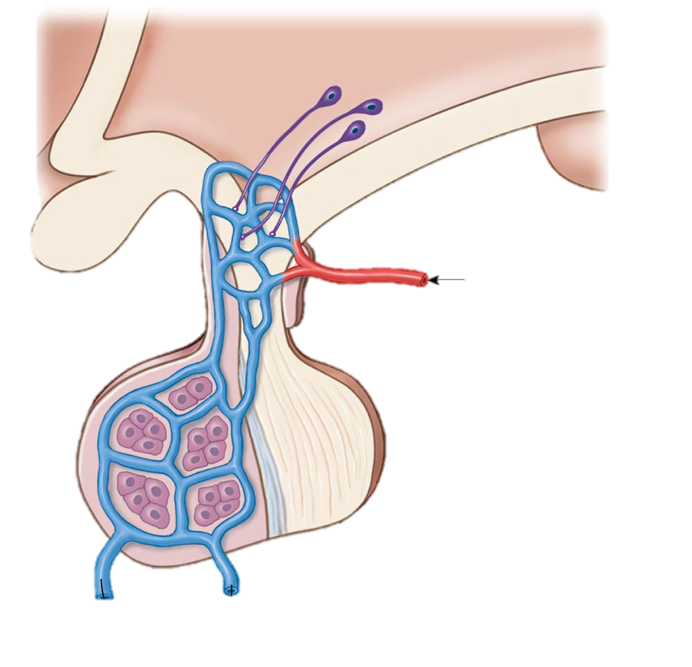
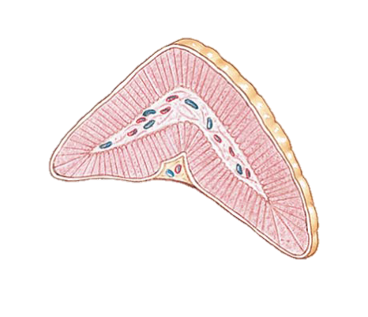
Cortisol Feedback
Hypothalamus
Cortisol Releasing Hormone (CRH)
Anterior Pituitary
Adrenocorticotropic Hormone (ACTH)
Zona Fasciculata
Cortisol

Slide 16
Cortisol
Cortisol
Muscle
Liver
Adipose
Protein catabolism
Gluconeogenesis
Lipolysis
Immune system
Immune suppression
Proteins into amino acids
Form new glucose from amino acids, glycerol and other substrates
Triglycerides into glycerol and fatty acids
Decrease inflammatory mediators
Cortisol is catabolic: Break down larger molecules
Cortisol levels peak early morning and decline throughout the day
Cushing’s disease (hypercortisolism): thinning skin, muscle wasting and weakness, stunted growth, increased infections, redistribution of fat tissue

Slide 17
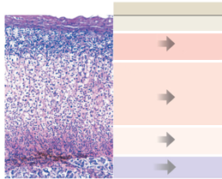
Hormones
Aldosterone
Released by the adrenal cortex and is a mineralocorticoid
Angiotensin II hormone that stimulates aldosterone release
Not from hypothalamus, comes from the renin-angiotensin-aldosterone system (RAAS)
RAAS upregulates when blood pressure low (sodium reabsorption)
More sodium within the blood would increase the osmolarity (thus more water would flow into the blood and increase pressure)
Epinephrine
Released by the medulla and is a catecholamine
Sympathetic nervous system triggers epinephrine for release
Target effects: increase gluconeogenesis, increase heart rate, relaxes lung airways and increases blood pressure (constrict vessels)
Zona
glomerulosa
Medulla

Slide 18
Pancreas
 | Glucagon | Insulin
Tissue | Islet of Langerhans | Islet of Langerhans
Made by | α- cells | β- cells
Stimulus | Blood glucose Hypoglycemia | Blood glucose Hyperglycemia
Effect | Blood glucose (cells release glucose) | Blood glucose (cells take up glucose)
Class | Peptide | Peptide
Antagonistic Effect

Slide 19
Next Tutorial (Nov 12th)
Autonomic nervous system

Slide 20
What Questions Do You Have?
You can ask in the Owl forums as well!
Also anonymously ask questions in the online dropbox!!

