Slide 1


Slide 2

Tutorial 10 Sections 009/010
TA: Greydon Gilmore
Physiology 2130
Nov 19th, 2019

Slide 3

Your TA reminding you…
2nd Peerwise assignment (1.5%)
Post 2 MC questions: due Nov 27th @ midnight
Answer 5 MC questions: due Nov 29th @ midnight
2nd Quiz (1%)
Opens: Dec 2nd @ 4pm
Closes: Dec 3rd @ 4pm
2nd Midterm (15%)
When: Dec 19th @ 9am-10am
Room Assignments:
ABBA-GANE: Alumni Hall 15
GHAB-POSA: Alumni Hall 201
PRIM-WOOD: Alumni Hall Stage
WU-ZIA: Somerville House 2316
Same place!

Slide 4
Today
Group work activity
Learning Catalytics Question
Finish muscle anatomy

Slide 5
Group Work

Slide 6
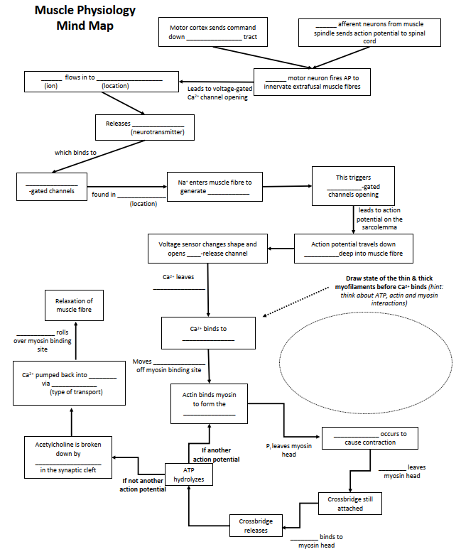
Mind Map!

Slide 7
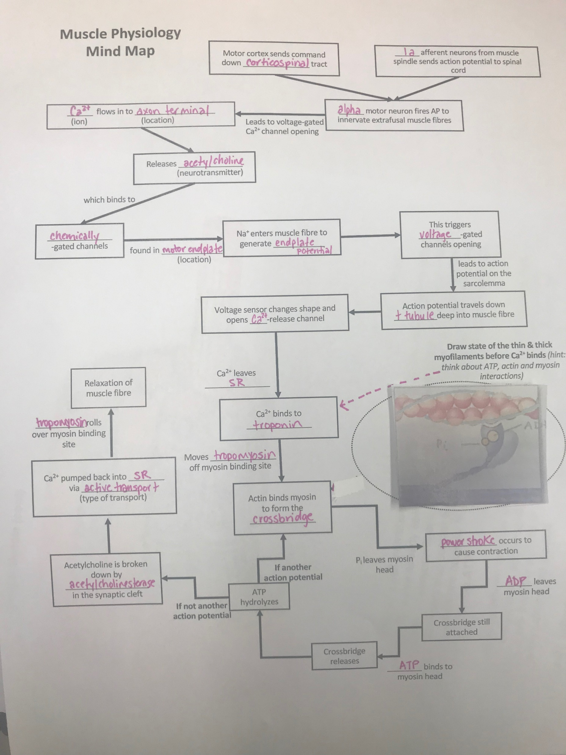
Mind Map!

Slide 8
Learning Catalytic Question

Slide 9
Muscle Anatomy
Chapter 6: Professor Stavraky

Slide 10
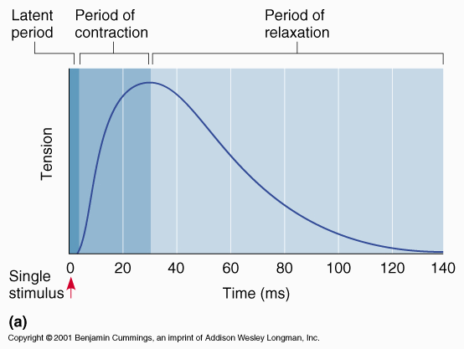
Muscle twitch
Result of one AP from the motor neuron
Difference in AP duration vs. twitch duration = allows summation

Slide 11
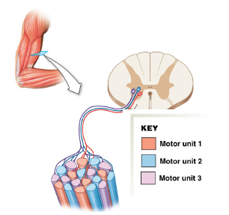
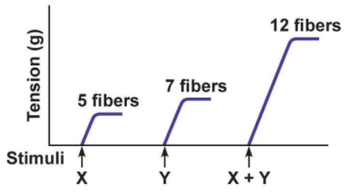
Grading of muscle contraction
Recruitment
Recruiting additional motor units
e.g. motor unit 1 innervates 6 fibers
Summation
Increase the twitch frequency in the same motor unit (summation)

Slide 12
Tetanus
Unfused tetanic contraction (or unfused tetanus)
Medium to high frequency APs will cause twitches to summate
Still has time to relax before next twitch
Complete tetanus
At very high frequencies there is no relaxation between twitches
Twitches will summate to form smooth, sustained contraction

Slide 13
Next Tutorial (Nov 26th)
Cardio physiology!

Slide 14
What Questions Do You Have?
You can ask in the Owl forums as well!
Also anonymously ask questions in the online dropbox!!

