Slide 1


Slide 2

Tutorial 15 Sections 009/010
TA: Greydon Gilmore
Physiology 2130
Jan 28th, 2020

Slide 3

Your TA reminding you…
3rd Peerwise assignment (1.5%)
Post 2 MC questions: due Feb 12th @ midnight
Answer 5 MC questions: due Feb 14th @ midnight
3rd Quiz (1%)
Opens: Feb 24th @ 4pm
Closes: Feb 25th @ 4pm
3rd Midterm (15%)
When: Feb 28th @ 6pm-7pm

Slide 4
Today
Group work activity
Feedback survery
Learning Catalytics Question
Renal Physiology

Slide 5
Review from last week

Slide 6
Calculate Sandra’s GFR
[Sodium]_{plasma} = 8 mg/L [Potassium]_{plasma} = 2 mg/L [Creatinine]_{plasma} = 2 mg/L [Glucose]_{plasma} = 15 mg/L [Magnesium]_{plasma} = 20 mg/L | [Sodium]_{urine} = 10 mg/L [Potassium]_{urine} = 12 mg/L [Creatinine]_{urine} = 120 mg/L [Glucose]_{urine} = 0 mg/L [Magnesium]_{urine} = 15 mg/L
Urine volume = 2.5 L/day
GFR = [creatinine]_{urine} * total urine volume/[creatinine]_{plasma}
GFR = (120 mg/L * 2.5 L/day)/ 2 mg/L = 150 L/day

Slide 7
What is the filtered load of sodium
[Sodium]_{plasma} = 8 mg/L [Potassium]_{plasma} = 2 mg/L [Creatinine]_{plasma} = 2 mg/L [Glucose]_{plasma} = 15 mg/L [Magnesium]_{plasma} = 20 mg/L | [Sodium]_{urine} = 10 mg/L [Potassium]_{urine} = 12 mg/L [Creatinine]_{urine} = 120 mg/L [Glucose]_{urine} = 0 mg/L [Magnesium]_{urine} = 15 mg/L
Urine volume = 2.5 L/day
filtered load of sodium = [Sodium]_{plasma} * GFR
filtered load of sodium = 8 mg/L * 150 L/day = 1200 mg/day

Slide 8
What is the filtered load of glucose
[Sodium]_{plasma} = 8 mg/L [Potassium]_{plasma} = 2 mg/L [Creatinine]_{plasma} = 2 mg/L [Glucose]_{plasma} = 15 mg/L [Magnesium]_{plasma} = 20 mg/L | [Sodium]_{urine} = 10 mg/L [Potassium]_{urine} = 12 mg/L [Creatinine]_{urine} = 120 mg/L [Glucose]_{urine} = 0 mg/L [Magnesium]_{urine} = 15 mg/L
Urine volume = 2.5 L/day
filtered load of glucose = [Glucose]_{plasma} * GFR
filtered load of glucose = 15 mg/L * 150 L/day = 2250 mg/day

Slide 9
What is the filtered load of magnesium
[Sodium]_{plasma} = 8 mg/L [Potassium]_{plasma} = 2 mg/L [Creatinine]_{plasma} = 2 mg/L [Glucose]_{plasma} = 15 mg/L [Magnesium]_{plasma} = 20 mg/L | [Sodium]_{urine} = 10 mg/L [Potassium]_{urine} = 12 mg/L [Creatinine]_{urine} = 120 mg/L [Glucose]_{urine} = 0 mg/L [Magnesium]_{urine} = 15 mg/L
Urine volume = 2.5 L/day
filtered load of magnesium = [Magnesium]_{plasma} * GFR
filtered load of magnesium = 20 mg/L * 150 L/day = 3000 mg/day

Slide 10
What is the renal handling for potassium
[Sodium]_{plasma} = 8 mg/L [Potassium]_{plasma} = 2 mg/L [Creatinine]_{plasma} = 2 mg/L [Glucose]_{plasma} = 15 mg/L [Magnesium]_{plasma} = 20 mg/L | [Sodium]_{urine} = 10 mg/L [Potassium]_{urine} = 12 mg/L [Creatinine]_{urine} = 120 mg/L [Glucose]_{urine} = 0 mg/L [Magnesium]_{urine} = 15 mg/L
Urine volume = 2.5 L/day
First calculate the filtered load of potassium:
filtered load of potassium = [Potassium]_{plasma} * GFR
filtered load of potassium = 2 mg/L * 150 L/day = 300 mg/day
How much potassium is excreted per day?
Rate of potassium excretion = [Potassium]_{urine} * total urine volume
Rate of potassium excretion = 12 mg/L * 2.5 L/day = 30 mg/day
Determine % reabsorption (to determine renal handling)
% reabsorbed = (K⁺ filtered load – K⁺ excretion rate)/ K⁺ filtered load *100
% reabsorbed = (300 mg/day – 30 mg/day)/300 mg/day *100 = 90% reabsorbed

Slide 11
Calculate the net filtration pressure if the forces are determined as the following
P_{GC} = 60 mmHg P_{BC} = 35 mmHg π_{GC} = 25 mmHg π_{BC} = 5 mmHg
NFP = (P_{GC} + Π_{BC}) - (P_{BC} + Π_{GC})
NFP = (60 mmHg + 5 mmHg) – (35 mmHg + 25 mmHg)
NFP = 5 mmHg
Is this person filtering a normal volume, less or more volume of fluid per day?
Since it is less than normal, this person would filter less fluid per day than a healthy individual.

Slide 12
Group Work

Slide 13
Build A Concept Map
As a group, place all of the following words in a concept map to help summarize renal physiology. All words in this list must be connected to at least one other word. Add connecting words as necessary (ie. increases, decreases, if, when, detects, released, etc.) and additional renal terminology to your map as you wish. You can also add images to your map.
ADH
Afferent arteriole
Aldosterone
Angiotensin II
Ascending limb
Baroreceptor
Collecting duct
Creatinine
Glomerulus
Proximal tubule
Descending limb
Distal convoluted tubule
Efferent arteriole
GFR
High urine volume
Impermeable to water
Juxtaglomerular cells
Low urine volume
Macula densa
Osmoreceptor
Reasborbs ions
Renin
Sodium
Water

Slide 14
Feedback Survey https://uwo.eu.qualtrics.com/jfe/form/SV_4MCJLtiTiXtBUvr

Slide 15
Learning Catalytic Question

Slide 16
Transport Mechanisms
Chapter 8: Dr. Woods

Slide 17
Cells of the Tubule

Slide 18
Cells of the Tubule
Reabsorption
Transcellular:
Two-step process
Moves through luminal, then basolateral membrane
Paracellular:
One-step process
In between tubule cells
Secretion
Always Transcellular:
Moves through basolateral, then luminal membrane
No Paracellular

Slide 19
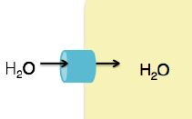
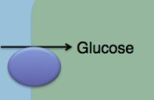
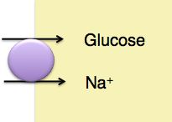
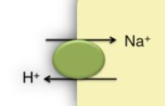
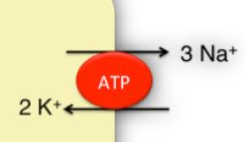
Review of Transport Mechanisms
Channels: Passive diffusion through a protein pore in membrane (ex: aquaporin)
Transporters: Carries molecule across membrane
Uniporters: Move a single molecule across membrane (ex: glucose uniporter)
Symporters: Moves two molecules in the same direction across membrane. At least one molecule must move down its concentration gradient (ex: Na+/glucose symporter)
Antiporters: Moves two molecules in opposite directions across membrane. At least one molecule must move down its concentration gradient (ex: Na⁺/H⁺ antiporter)
Primary Active Transporters: Require ATP to move molecules against their concentration gradients (ex: Na⁺/K⁺ ATPase)

Slide 20
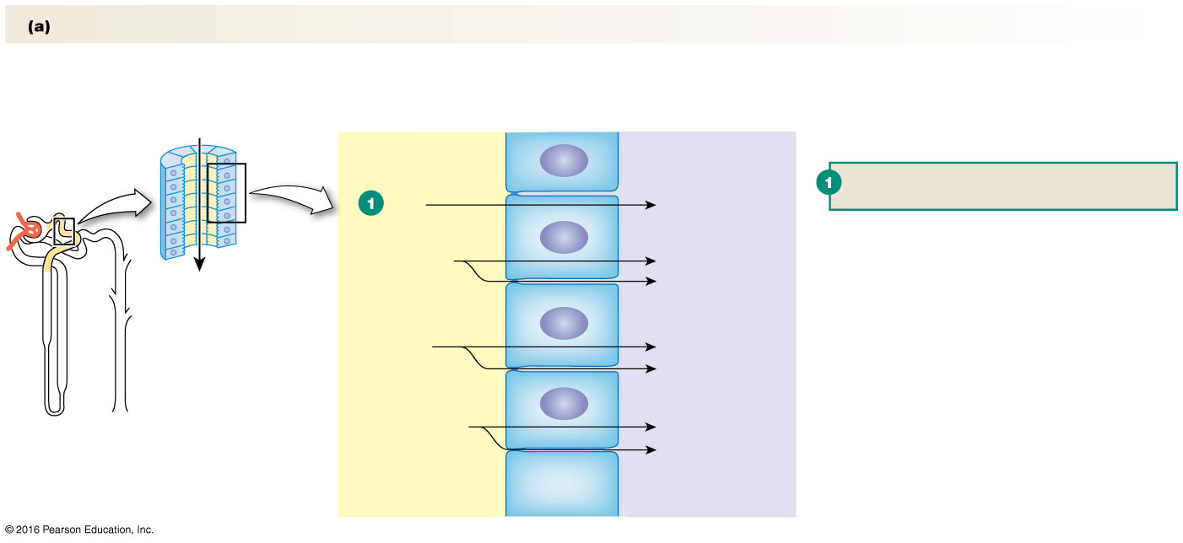
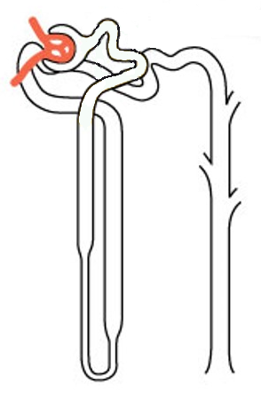
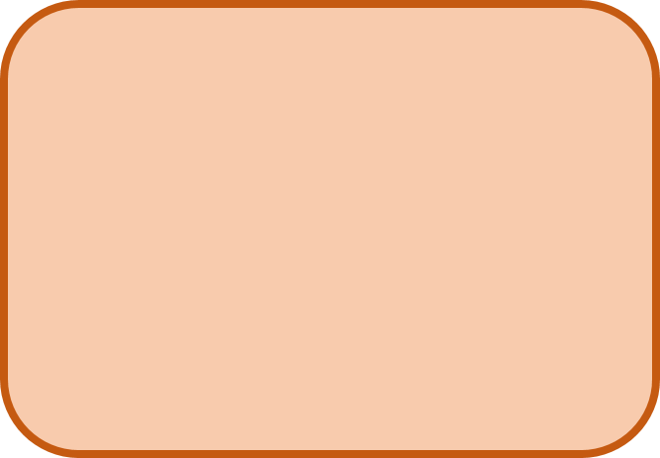
Proximal Tubule
Overall Goal:
REABSORPTION
Lumen of Proximal Tubule
Tight
Junctions
Tight
Junctions
Tight
Junctions
Luminal Membrane
Tubule (Epithelial) Cell
Basolateral Membrane
Interstitial Space
Blood vessel near proximal tubule

Slide 21
Sodium Potassium Pump
K⁺
ATP
Na/K ATPase: Maintains concentration gradients needed to drive transport of other molecules
Na⁺

Slide 22
Reabsorbing Amino Acids
Na⁺/Amino Acid Symporter: Uses Na⁺ gradient to carry an amino acid across luminal membrane against its concentration gradient
Na⁺
Amino
Acid
K⁺
ATP
Amino Acid Uniporter: Carries amino acid across basolateral membrane down its concentration gradient
Na⁺
Amino
Acid

Slide 23
Reabsorbing Glucose (100%)
Na⁺/Glucose Symporter: Uses Na⁺ gradient to carry glucose across luminal membrane against its concentration gradient
Na⁺
Amino
Acid
Na⁺
Glucose
K⁺
ATP
Glucose Uniporter: Carries glucose across basolateral membrane down its concentration gradient
Na⁺
Amino
Acid
Glucose

Slide 24
Reabsorbing Water
Aquaporin 1 (AQ1): Water Channel
Na⁺
Amino
Acid
Na⁺
Glucose
H₂O
K⁺
ATP
Amino
Acid
H₂O
Aquaporin 1 (AQ1): Water Channel
Na⁺
Glucose

Slide 25
Reabsorbing Ions and More Water
Paracellular Transport
Na⁺
Amino
Acid
Na⁺
Glucose
H₂O
K⁺
ATP
Na⁺
Amino
Acid
Glucose
H₂O
H₂O, Cl⁻, K⁺

Slide 26
Regulating pH of filtrate/urine
Na/H+Antiporter/Exchanger:
Uses Na gradient to carry H+
across luminal membrane into filtrate
H⁺
Na⁺
Amino
Acid
Na⁺
Glucose
H₂O
Na⁺
K⁺
ATP
Na⁺
Amino
Acid
Glucose
H₂O
H₂O, Cl⁻, K⁺

Slide 27
Which are hormonally regulated?
Angiotensin II
H⁺
Na⁺
Amino
Acid
Na⁺
Glucose
H₂O
Na⁺
K⁺
ATP
Na⁺
Amino
Acid
Glucose
H₂O
H₂O, Cl⁻, K⁺

Slide 28
RAAS
Angiotensin Converting Enzyme
Large (452 aa) protein
No function
Smaller (10 aa) protein
No function
Small (8 aa) protein
Function: Hormone
Released by JG cells
Due to Na
***Rate Limiting Step***
Angiotensin II can only be made if renin is present

Slide 29
Angiotensin II
Made by cleavage of:
angiotensinogen angiotensin I angiotensin II
Peptide hormone (= requires cell-surface receptor on luminal membrane)
Stimulus
Release of renin by JG cells due to Na⁺
Goal
Increase Na⁺ reabsorption in proximal tubule
How
Increase activity of Na⁺ /H⁺ exchanger and Na⁺ /K⁺ ATPase in proximal tubule
Decrease GFR by constricting afferent arteriole

Slide 30
Renin
Renin released due to low sodium levels

Slide 31
Descending LOH
Overall Goal:
REABSORPTION
Lumen of Descending LOH
Tight
Junctions
Tight
Junctions
Tight
Junctions
Luminal Membrane
Tubule (Epithelial) Cell
Basolateral Membrane
Interstitial Space
Blood vessel near Descending LOH

Slide 32
Descending LOH
Overall Goal:
REABSORPTION
Aquaporin 1 (AQ1): Water Channel
H₂O
H₂O
H₂O
Aquaporin 1 (AQ1): Water Channel
H₂O
H₂O
H₂O
Other Key Points:
No Ion Reabsorption
No Paracellular Transport
No Hormonal Regulation

Slide 33
Ascending LOH
Overall Goal:
REABSORPTION
Lumen of Ascending LOH
Tight
Junctions
Tight
Junctions
Tight
Junctions
Luminal Membrane
Tubule (Epithelial) Cell
Basolateral Membrane
Interstitial Space
Blood vessel near Ascending LOH

Slide 34
Ascending LOH
Overall Goal:
REABSORPTION
Paracellular Transport
Na⁺
Na⁺
K⁺
2Cl⁻
K⁺
ATP
Na⁺
K⁺
Cl⁻
Na⁺
Other Key Points:
No Water Reabsorption
No Hormonal Regulation

Slide 35
Distal Convoluted Tubule
Overall Goal:
REABSORPTION
Lumen of Convoluted Tubule
Tight
Junctions
Tight
Junctions
Tight
Junctions
Luminal Membrane
Tubule (Epithelial) Cell
Basolateral Membrane
Interstitial Space
Blood vessel near Convoluted tubule

Slide 36
Distal Convoluted Tubule
Overall Goal:
REABSORPTION
Parathyroid
Hormone
Na⁺
Na⁺
K⁺
2Cl⁻
Ca²⁺
K⁺
Na⁺
ATP
Na⁺
K⁺
Cl⁻
Ca²⁺
Other Key Points:
No Water Reabsorption
No Paracellular Transport

Slide 37
Collecting Duct
Overall Goal:
Fine Tuning of H₂O Na⁺ Reabsorption
Lumen of Collecting Duct
Tight
Junctions
Tight
Junctions
Tight
Junctions
Luminal Membrane
Tubule (Epithelial) Cell
Basolateral Membrane
Interstitial Space
Blood vessel near Collecting Duct

Slide 38
Collecting Duct
Aldosterone
Overall Goal:
Fine Tuning of H₂O Na⁺ Reabsorption
ADH
Aquaporin 2 (AQ2)
Na⁺
K⁺
H₂O
K⁺
ATP
Aquaporin 3 and 4 (AQ3 and AQ4)
Na⁺
H₂O

Slide 39
Aldosterone
Made by adrenal gland
Steroid hormone (= intracellular receptor)
Stimulus
Angiotensin II, High K⁺, ACTH
Goal
Increase Na⁺ reabsorption in collecting duct
How
Na⁺ and K⁺ channels in luminal membrane: by translocation and protein expression
Na⁺ /K⁺ ATPase activity and protein expression

Slide 40
Anti-Diuretic Hormone (aka Vasopressin)
Made by hypothalamus (by neuroendocrine cells)
stored/released by posterior pituitary
Peptide hormone (= requires cell-surface receptor on basolateral membrane)
Stimulus
High plasma osmolarity = Low ECF volume = Low BP
Goal
water reabsorption = ECF volume = BP

Slide 41
Anti-Diuretic Hormone (aka Vasopressin)
plasma osmolarity (fluid is hyperosmotic)
Osmoreceptors (in hypothalamus) shrink
ADH is released from posterior pituitary
Travels in blood to collecting duct
Binds to receptors on basolateral membrane
Increases # of AQ2 channels on luminal membrane
water reabsorption

Slide 42
Anti-Diuretic Hormone (aka Vasopressin)
BV = BP
Baroreceptors (in aortic arch and carotid sinus) fire less AP to hypothalamus
ADH is released from posterior pituitary
Travels in blood to collecting duct
Binds to receptors on basolateral membrane
Increases # of AQ2 channels on luminal membrane
water reabsorption = BV = BP

Slide 43
Atrial Natriuretic Peptide (ANP)
Made by cardiac atrial cells
Peptide hormone
Stimulus
High blood pressure
Goal
Decrease Na⁺ reabsorption
How
Inhibits aldosterone secretion by adrenal glands
Dilates afferent arterioles → increasing GFR
This increases flow of filtrate through tubule, leads to increase in Na⁺ excretion

Slide 44
Atrial Natriuretic Peptide (ANP)
blood volume, high Na⁺ and high ECF volume
Distension of cardiac atria
Atrial myocardial cells release ANP
Kidney - Afferent arteriole dilated
Adrenal Cortex
Increased GFR
Inhibits aldosterone
Increased Na⁺ excretion

Slide 45
Summary of Transport
 | Proximal Tubule | Descending Limb | Ascending Limb | Distal Tubule | Collecting Duct
Goal | Reabsorption of everything | Water reabsorption | Ion reabsorption | Ion reabsorption | Fine tuning (water and Na)
Water | Yes | Yes | No | No | Yes
Ions | Yes (Na⁺, Cl⁻, K⁺) | Minimal (Na⁺) | Yes (Na⁺, Cl⁻, K⁺) | Yes (Na⁺, Cl⁻, K⁺, Ca²⁺) | Yes (Na⁺)
Paracellular Transport | Yes | No | Yes | No | No
Hormone Regulation | Angiotensin II | - | - | PTH | Aldosterone ADH

Slide 46
Summary of Hormonal Regulation
Hormone | Made By | Hormone Type | Stimulus | Response
Renin | Kidneys | N/A | Increased sodium | N/A
Angiotensin II | Angiotensin Converting Enzyme | Peptide | Renin – released due to low sodium | Increase sodium reabsorption in proximal tubule: Increase activity of Na⁺ /H⁺ exchanger and Na⁺ /K⁺ ATPase Constrict afferent arteriole (decreasing GFR)
Aldosterone | Adrenal Gland | Steroid | Angiotensin II and high K⁺ | Increase sodium reabsorption in collecting duct: Increase Na⁺ and K⁺ channels in luminal membrane Increase activity of Na⁺ /K⁺ ATPase
Atrial Natriuretic Peptide | Cardiac atrial cells | Peptide | High blood pressure | Decrease sodium reabsorption: Inhibit aldosterone secretion from adrenal glands Dilates afferent arteriole (increasing GFR)

Slide 47
Next Tutorial (Feb 4th)
Respiratory physiology!

Slide 48
What Questions Do You Have?
You can ask in the Owl forums as well!
Also anonymously ask questions in the online dropbox!!

