Slide 1

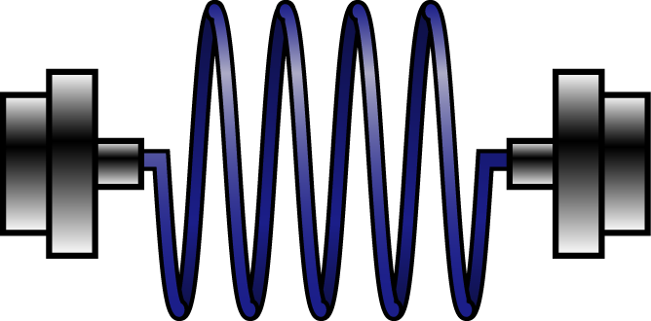






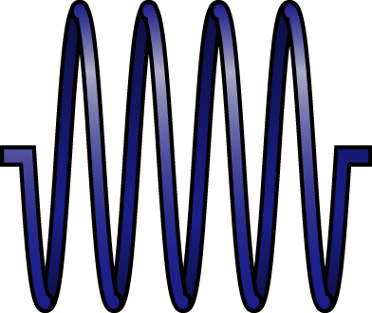

(a)
+z
Vacuum chamber
Spatial
filter
DBS 1
NA0.78
1064nm
EOM1
EOM2
Int. modulator
Pol. modulator
9:1 BS
532nm
telescope
Beam block
DBS 2
9:1 BS
9:1 BS
D-Shape mirror in Y
D-Shape mirror in X
+z
-z
-y
+y
-x
+x
Balance detector
Balance detector
Feedback system

