Slide 1
CSAW Finals 2015 – Forensics/Stego 300
Siddarth Senthilkumar
9/29/16

Slide 2
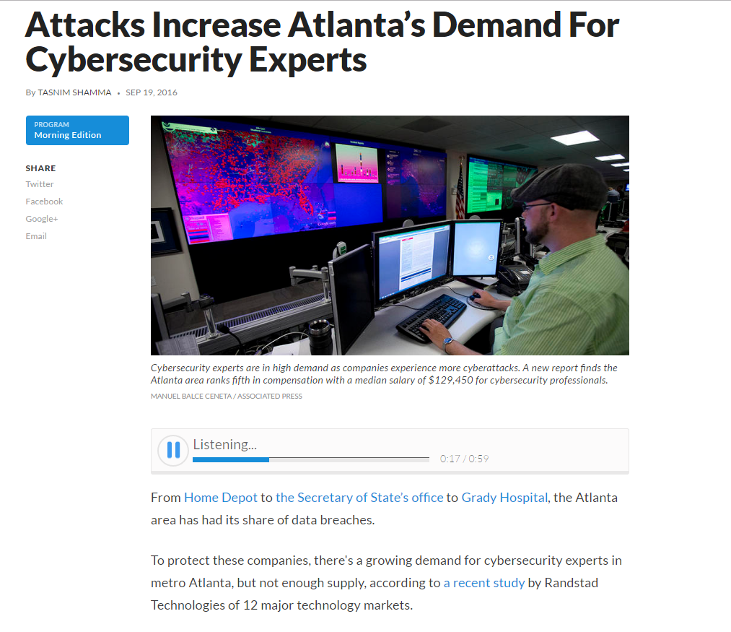
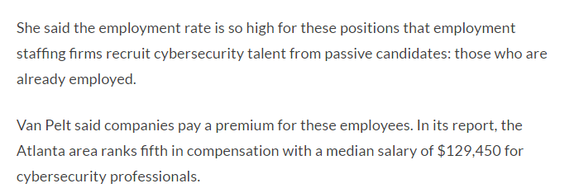
In other news…

Slide 3
Things you’re going to need:
Windows
Needed to use the program: Free File Camouflage
If you don’t have Windows, just look on with a friend who does
Linux
We’ll be using some useful Linux Utilities, so now is a good time to download and get a copy for yourself if you don’t have one already!
Specifically, you’ll want the Kali distribution.
https://www.kali.org/downloads/
A VM to run it, if you’re not dual booting:
I use Virtual Box: https://www.virtualbox.org/wiki/Downloads
Nice Website with pictures & PowerPoint tutorial to install it:
http://www.blackmoreops.com/2014/04/08/detailed-guide-installing-kali-linux-on-virtualbox/

Slide 4
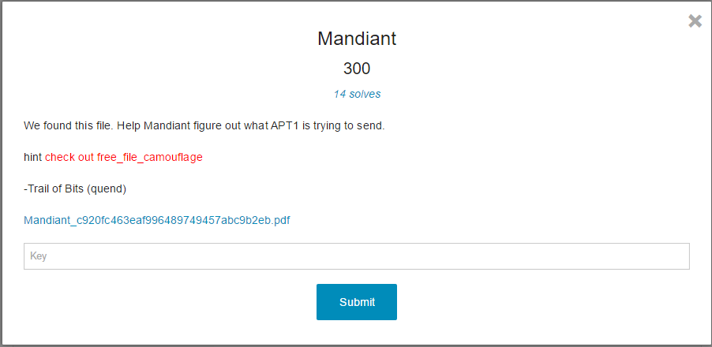
The Problem
https://www.dropbox.com/s/jg0yy4evuhcdfoj/Mandiant_c920fc463eaf996489749457abc9b2eb.pdf?dl=0

Slide 5
Step 1: Analyze the PDF file
Opening the document and reading reveals nothing interesting.
(OK, it’s about an elite Chinese government sponsored hacker squad that the U.S. has been collecting evidence and intelligence on for a while – so it might be a little interesting).
This is a legitimate document – let’s see if we can find the actual version on Google, not the one provided to us by the CTF.
We can! http://intelreport.mandiant.com/Mandiant_APT1_Report.pdf
Notice – CSAW PDF is 7.00MB but the actual one is 6.48MB.
So, even though the contents of the PDF appear to be identical, there is definitely some appended information in our version being transmitted.

Slide 6
Step 2a: Looking at PDF data
In PDFs, we can “embed” files and objects into them.
This means there may be files or code present that a normal reader may not even be aware of.
http://blog.didierstevens.com/2009/07/01/embedding-and-hiding-files-in-pdf-documents/
Note from this website: The metadata is case sensitive.
Let’s open up our PDF in a hex editor and search for “EmbeddedFiles” to see if we can see anything directly.

Slide 7
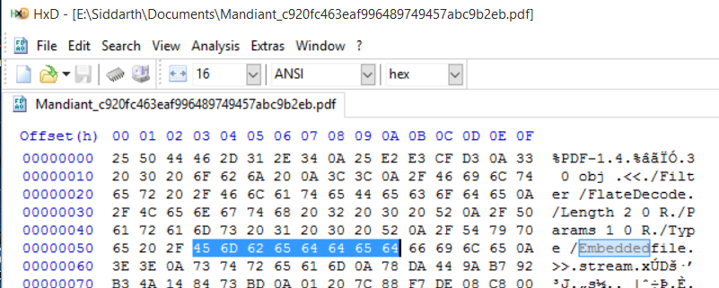
Step 2b
Notice the string “Embeddedfile”
The PDF will not recognize the embeddedfile unless it is properly cased (see the link I posted in previous slide)
So, let’s edit the hex value at 0x5B to be the letter “F” instead of “f”
Save your changes.

Slide 8
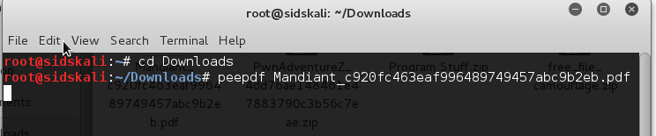
Step 3a: Digging Deeper
Fire up Kali and make sure you have the edited PDF on the machine.
Open terminal
cd into the directory with the PDF.
Run the following command:
You’ll see a bunch of information about the PDF file listed.

Slide 9
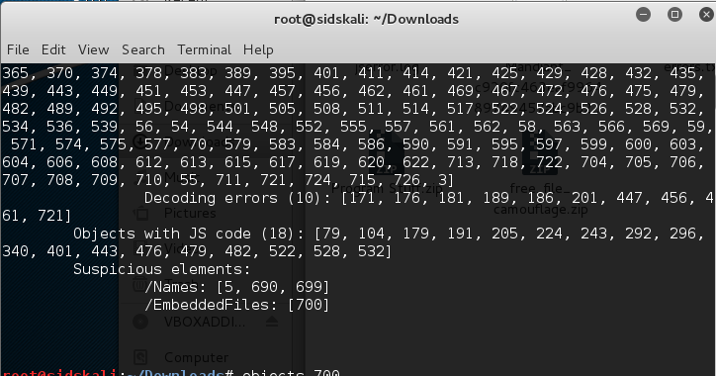
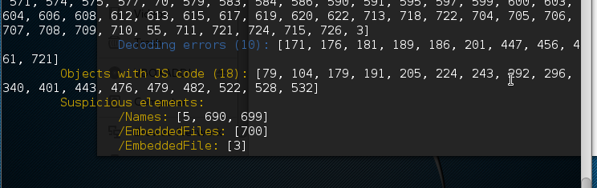
Step 3b
peepdf is an extremely useful PDF analysis tool written in python.
It can give you information on any code or files that are embedded into the PDF that you may not have noticed and makes the information easily accessible.
Command line tool makes it easier to pipe information as we’ll see later.
It even flags “Suspicious elements” for us.
Notice: Before we changed the PDF hex and after:

Slide 10
Step 4: Extracting hidden data from a PDF
In PDFs, the data is stored in “Objects”. We can use peepdf to view the contents of any of these objects using the interactive console (just use the –i option when analyzing the PDF).
We will then be able to interact with the objects of the PDF and view any of them individually.
So type in your terminal:
You should get a dump of all the information about the objects, and your terminal will say “PPDF>” on the left instead of the usual.
We are now in the interactive peepdf console.
Notice the suspicious elements: /EmbeddedFile: [3]
This signifies that Object 3 is an embedded file and is suspicious enough to be worth checking out.
To check it out, simply type “object 3” and press enter after the “PPDF>”
You should get a huge seemingly illegible string of text. But wait! It’s base 64!

Slide 11
Step 5a: Base64 Decode with Python
We are going to want to view this string in a more convenient manner.
We will pipe it into a text file in the same directory:
Now, in the directory with the PDF file, there should be a file called “obj3_dump.txt”
Why are we looking at this base64 text anyway?
It’s been flagged suspicious.
There’s really no reason for a huge base64 string to be embedded into the PDF like that – this PDF appears to just be words and text (informative document).
You’ll see in the txt file some meta data (<< /Length … >> stream) and (endstream) at the end.
Delete this text so that the only text remaining in the file is the b64 string. It does not provide any useful information. Then save.

Slide 12
Step 5b
Could the base64 encoded string be just ascii characters?
Unfortunately no – I will save you the trouble of checking. It translates to something illegible.
So what could it be?
Let’s try converting it to hex values and creating a file.
Use a python script (or whatever really) to convert the base64 string and convert it to hex.
I have a completed script to help you guys save some time: https://www.dropbox.com/s/ur1vnq5rn4kuded/Conversion.py?dl=0
Type “quit” into the terminal. Make sure the script file is in the same directory and type “python Conversion.py”
Open the output file, copy the hex data.
Open a hex editor and paste the hex data in.
Notice at the top of the file you can see “bmp” in the file signature area.
This file must be an image.
Save the file as a bmp file and open it.

Slide 13
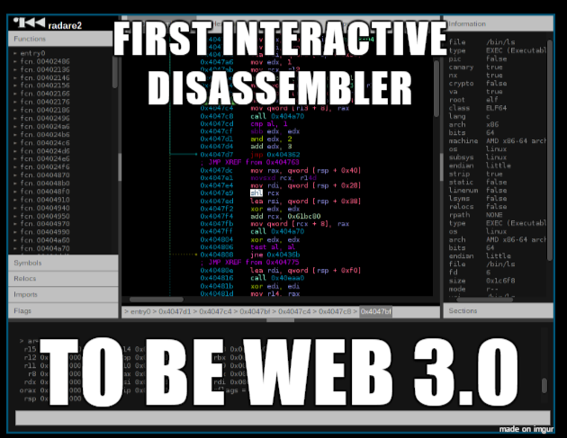
Step 6a: Extract a text file from a BMP (binwalk)
You should get an image like this if you did everything right:
The image itself doesn’t matter so much. If we observe the hex data at the end of the file, notice there is something that looks like “secret.txt”. This indicates the existence of some txt file embedded into the image.

Slide 14
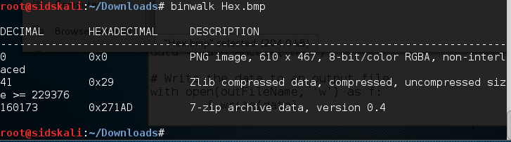
Step 6b
In terminal, type:
Binwalk is a unix utility that checks for embedded files and archives inside other files (very often images).
So we can clearly see there is some 7zip archive at the end of the image, starting at 0x271AD in the hex. So let’s copy everything from that hex value and on in into a new file, like how we did for the image. Notice before hex 0x271AD is the value “IEND”, which usually signifies the end of a png file.

Slide 15
Step 7: Extract the zip
Save the new file as a 7z file.
7z is a file extension like zip or rar or tar.
If you have 7zip installed, right click the archive file created after saving the hex data and click “extract”.
If everything has been done right so far, you’ll be able to successfully extract the file and you’ll get a file called “secret.txt”.
Inside it, you’ll see more base64!
Again, decoding as ASCII is a fail so we will try the hex approach again.
Use the same script as last time, but change the filename and outFileName variables. Run the script from terminal.

Slide 16

Step 8: JPEGs
Look at the first few bytes: we see FF D8 FF E0 …
From this, we know that this file is a JPG!
Save the file as a .jpg file.
Should look like:
Now, we can finally use that hint! We’re going to move this image over to a Windows machine and download a program called “Free File Camouflage”.
This program stegonographically hides files inside jpegs.
We will use the program to do the reverse and decrypt the file to extract a text file.
Right click the image file and click Send To > De-crypt file using standard password
The output file will be written to a file called a.out in the same directory.
ALMOST THERE!

Slide 17

Step 9: Running an elf file
Opening a.out in a hex editor, we see “.ELF” in the file header.
ELF files are executables that run on Linux.
So let’s move this file back to Linux!
cd into the directory with the file.
To make the file executable, type in terminal:
chmod +x a.out
Then, to actually run the file, type in terminal:
./a.out
And finally! We get: flag{s3v3r4l_l4y3r5_d33p_&_2m4ny_l4yers_w1d3}

Slide 18
Step 10: Enter flag, get points, and profit
Takeaways:
CTFs are tiring.
They are multistep processes.
Every time you think you’re there, you’re not.
They are annoying.
I didn’t show you the 6.02 * 10^23 wrong turns I took trying to find out where the flag was; I only showed you the right ones.
They are doable.
None of this was magic – I didn’t know any of the tools when I started out, but I Googled the sh*t out of them and learned as I went along through the problem.
They are incredibly rewarding.
Things learned from one problem: peepdf pdf analysis tool, Linux, hex data modifications, base64 conversions, file signatures, Python fileIO and libraries, steganography in image files, binwalk utility, ELFs & executables on Linux, and more.
There’s no feeling on earth like the feeling of finding a flag after a well-fought battle.

Slide 19
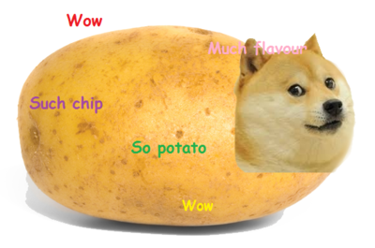
Questions?
Thanks for staying through the whole thing!
Here’s a potato for your troubles:

