Slide 1

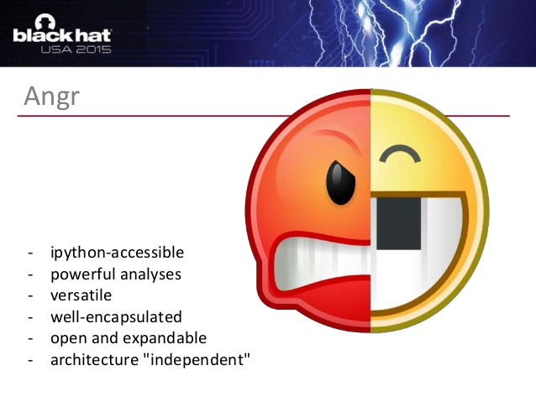
ANGR
9-8-16
ALOK TRIPATHY
SIDDARTH SENTHILKUMAR

Slide 2
NEWS
Dropbox – 68M password hashes and emails (2012)
Bcrypt and SHA1
Salted
Employee pass hacked on other site and reused on DropBox
Last.fm – 43M passwords (2012)
MD5
~2 hours, 96% of passwords visible in plaintext
Not even salted
iOS 9.3.5 / OS X Yosemite / OX X El Capitan
Remotely jailbreak and install monitoring software
Update that ish
Notes:
As I do these over the semester, should be interesting to see how many hacks we get

Slide 3
Upcoming Events
CTF Meetings Monday – CoC 346, 7-8pm
Meet Manas!
9/22/16 – Cisco Company Visit
Done or know something cool with security?
Talk to me about sharing it at GreyHat!
Not on mailing list or FB groups? Talk to me!

Slide 4
Today - Angr
Should have tool installed if you want to follow along
Details in email

