Slide 1

Department of ECE
GE19612 - Professional Readiness for Innovation, Employability and Entrepreneurship (Mini Project)
2023-24- Even
III Year ECE C section
Zeroth Review – 14.02.2024

Slide 2
Advanced Mobile Seismic Monitoring System
Batch Members :
Ritvik Prasad M 210801159
Nityasri Kumar P N 210801127
Tharun 210801701
Supervisor:
Dr. M. Sathish
^{Professor, ECE}

Slide 3
OUTLINE
Abstract
Objective
Literature Survey
Summary of Literature
Proposed System & Novelty
Block Diagram
Hardware/Software requirements
References

Slide 4
Abstract
Advanced Mobile Seismic Monitoring System integrates deep learning with portable sensors for real-time seismic analysis. It uses a Recurrent Neural Network architecture for real time data analysis and processing which collects data from accelerometer and alerts on 2.4GHz spectrum in case of any anomaly. It empowers rapid event monitoring, aiding researchers and emergency responders in risk mitigation and disaster management.

Slide 5
Objective
To develop a portable solution that integrates deep learning algorithms with seismic sensors for real-time analysis of seismic activity.
To expand the concept of seismic monitoring in rural areas.
To empower rapid detection and prediction of seismic events, enhancing situational awareness for researchers, emergency responders mainly focussing on disaster management.
To achieve range of (approximately 200 acres) which ensures a comprehensive coverage of area.

Slide 6
Literature Survey
TITLE | YEAR | AUTHOR | TECHNIQUE
Volcano Seismic Signals Classification | 2018 | Manuel Titos | Neural Networks Link
Earthquake Detection | 2023 | Yongzhi Wang | Stack Normalized Neural Networks Link
Phase Neural Operator for Multi-Station Picking of Seismic Arrivals | 2023 | Hongyu Sun | Deep Neural Networks Link

Slide 7
Summary of Literature
Research published by Manuel Titos introduces the application of recurrent neural networks (RNN), long short-term memory (LSTM), and gated recurrent unit (GRU) models for detecting and classifying continuous volcano-seismic signals.
Research published by Yongzhi Wang explored the use of stack normalized recurrent neural networks to estimate the impact and depth of a seismic event given a latitude and longitude.

Slide 8
Proposed System
Integrates hardware components, including the Raspberry Pi 5, MPU-6050 accelerometer module, and 2.4GHz (ISM band) antenna to create a seismic monitoring solution.
Raspberry Pi 5 serves as the central processing unit, providing computational power and connectivity for data analysis and transmission. Its compact size and low power consumption make it ideal for deployment in portable monitoring systems.
MPU-6050 accelerometer module, the system can accurately detect and measure seismic vibrations in multiple axes.
2.4GHz antenna facilitates wireless communication between monitoring nodes, enabling real-time data transmission and remote monitoring capabilities upto an optimum range of approximately 200 acres .

Slide 9
Novelty in Proposed System
The proposed system introduces advancements in seismic monitoring by integrating deep learning techniques with portable sensors.
This innovative approach enables real-time analysis of seismic activity with high accuracy and efficiency, empowering rapid detection and prediction of events.
Uniquely suited for on-the-go monitoring, enhancing situational awareness and enabling proactive risk mitigation efforts, particularly in disaster management scenarios.

Slide 10
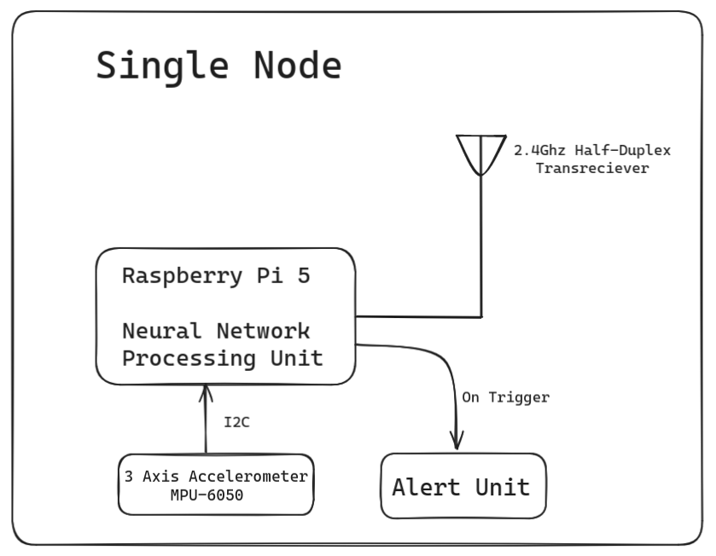
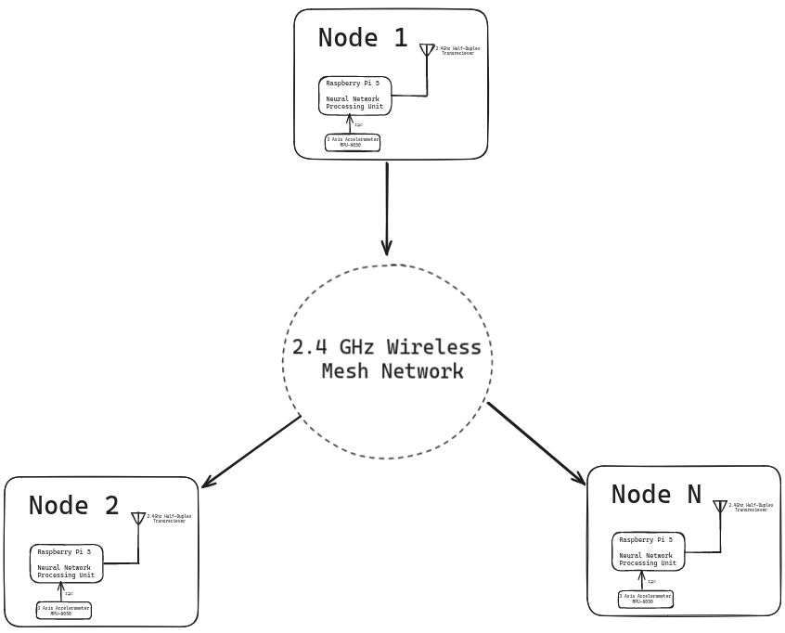
Block Diagram

Slide 11
Hardware/Software Requirements
Hardware Requirement
^{Raspberry pi 5}
2.4GHz Half Duplex Transreciever
^{3-axis Accelerometer}
Software Requirement
^{Linux Environment (server)}
^{Pytorch}
^{Micropython}

Slide 12
References
Earthquake Prediction Using QSVM
Aditya Katole;Vishakha Batheja;Atharv Deshmukh;Falguni Dekate;Ashish Soni
2024 IEEE International Students' Conference on Electrical, Electronics and Computer Science (SCEECS)
Earthquake Detection Using Stacked Normalized Recurrent Neural Network (SNRNN) Appl. Sci. 2023, 13(14), 8121; https://doi.org/10.3390/app13148121
https://www.mdpi.com/2076-3417/13/14/8121
https://ieeexplore.ieee.org/abstract/document/8481708

