Slide 1

Department of ECE
EC19603 – Problem Solving using AI and ML Techniques
(Mini Project)
2023-24- Even
III Year ECE C section

Slide 2
Integrated Surveillance System Using Machine Vison
Batch Members :
Ritvik Prasad M 210801159
Nityasri Kumar P N 210801127
Tharun 210801701
Supervisor:
Dr. M. Sathish
Professor, ECE

Slide 3
OUTLINE
Abstract
Objective
Literature Survey
Summary of Literature
Proposed System & Novelty
Block Diagram
Hardware/Software requirements
References

Slide 4
Abstract
This project presents an integrated surveillace ststem leveraging advanced license plate recognition (LPR) technology. The primary objective is to develop a robust platform capable of efficiently identifying and recording vehicles based on their licence plates, thereby enhancing tracking and surveillance capabilities in various contexts. The YOLOv8 model is used for initial object segmentation followed by fine-tuning through transfer learning to specialize in license plate recognition/ An optical character recognition(OCR) model is applied to identify the license plate. The collected data, along with corresponding timestamp and the image of the vehicle is stored in a database for analysis.

Slide 5
Objective
To develop a robust and efficient license plate recognition system capable of accurately identifying and extracting alphanumeric characters from license plates captured in real-time video streams.
Integrate the license plate recognition system with a comprehensive surveillance framework to enable seamless monitoring and tracking of vehicles entering and exiting designated areas, enhancing security and access control measures.
Ensure scalability and adaptability of the surveillance system, allowing for easy deployment and customization to suit diverse surveillance requirements and environments, thereby maximizing its effectiveness and utility in various security and monitoring applications.

Slide 6
Literature Survey
TITLE | YEAR | AUTHOR | TECHNIQUE
A Multi-Stage Deep-Learning-Based Vehicle and License Plate Recognition System with Real-Time Edge Inference | 2023 | Adel Ammar | Convolutional Neural Networks Link
Deep Learning and SVM-Based Approach for Indian Licence Plate Character Recognition | 2023 | Nitin Sharma | Support Vector Machines Link

Slide 7
Summary of Literature
The research published by Adel Ammar introduces a real-time vehicle and license plate recognition system for edge devices, combining object detectors, an image classifier, and a multi-object tracker. By leveraging Saudi license plate characteristics, the system achieves high accuracy while running efficiently on edge GPUs. Experimental results demonstrate substantial improvements over existing methods, with identified future directions focusing on enhancing model accuracy in unconstrained environments and addressing security concerns.
The research published by Nitin Sharma proposes a hybrid approach combining Convolutional Neural Network (CNN) and Support Vector Machine (SVM) classifiers for Automatic License Plate Recognition (ALPR), achieving a recognition rate of 98.45% for Indian license plates. Future research directions include further hybridization, extension to other languages, and applications in traffic management and law enforcement.

Slide 8
Proposed System
The proposed system integrates Raspberry Pi 5 and a webcam for video capture, utilizing PyTorch with YOLOv8 model for object detection, specifically targeting license plate recognition.
The model is trained based on transfer-learning to identify licence plates.
With the inclusion of an OCR model, alphanumeric characters are extracted from recognized plates and stored along with timestamps in a SQL database.
Real-time alerts are sent upon on demand specific vehicle detection, and a user-friendly web interface facilitates monitoring and configuration.

Slide 9
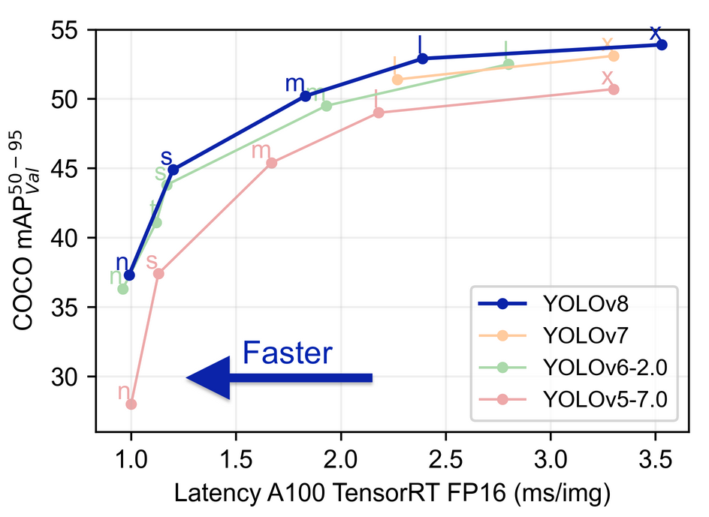
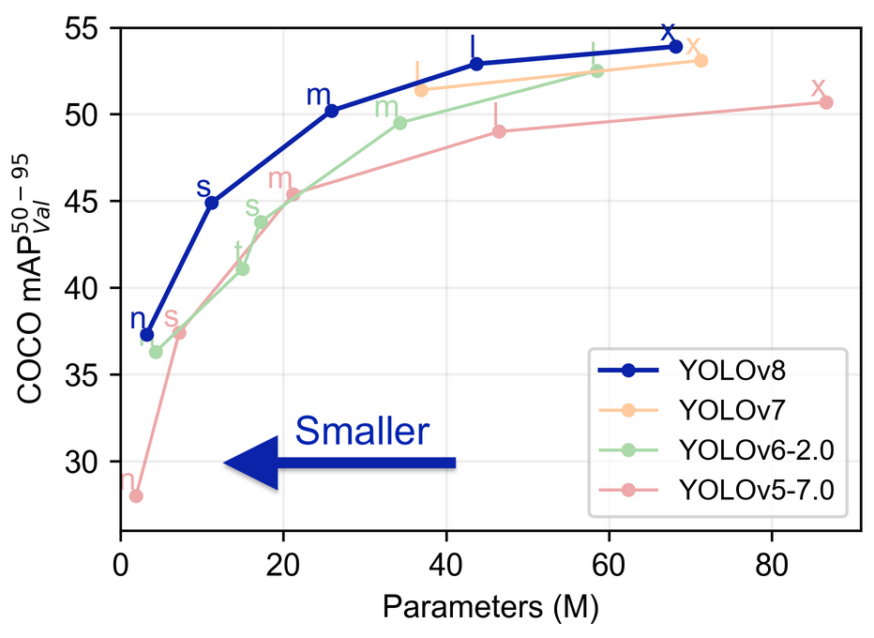
Novelty in Proposed System
The proposed system introduces YOLOv8 architecture algorithm, which is most fastest and effective in segmentation tasks and detection.
This innovative approach enables real-time surveillance leveraging the quick response time of the algorithm .
The project proposes a hybrid approach for license plate recognition, combining deep learning techniques with Optical Character Recognition. By cascading YOLOv8 for object detection and an OCR model for character extraction, the system achieves high accuracy in recognizing license plates, even in varying environmental conditions and with different plate formats.

Slide 10
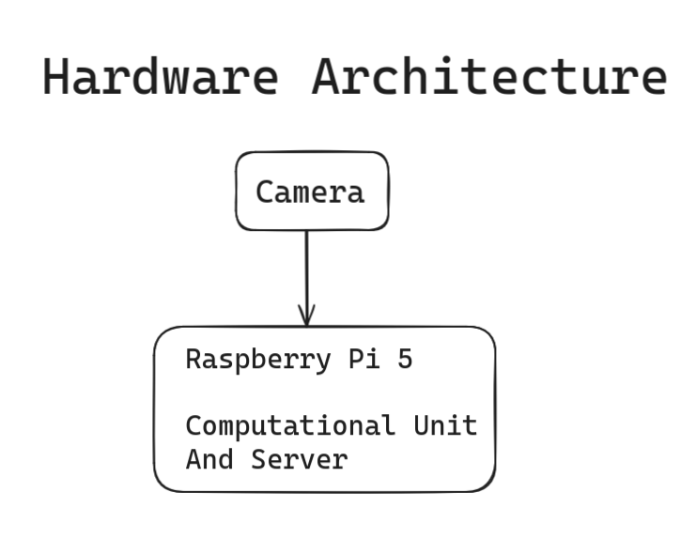
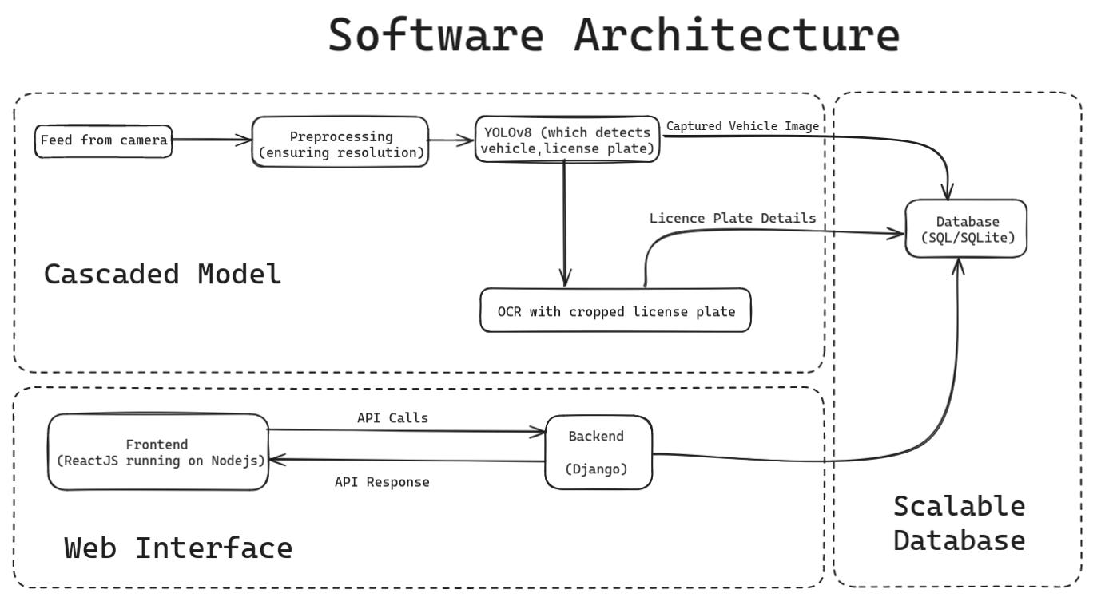
Block Diagram

Slide 11
Hardware/Software Requirements
Hardware Requirement
^{Raspberry pi 5}
^{Camera}
Software Requirement
Pytorch (with pytorch and django)
^{SQL server}
^{Nodejs with reactJs}

Slide 12
References
T. Thapliyal, S. Bhatt, V. Rawat and S. Maurya, "Automatic License Plate Recognition (ALPR) using YOLOv5 model and Tesseract OCR engine," 2023 First International Conference on Advances in Electrical, Electronics and Computational Intelligence (ICAEECI), Tiruchengode, India, 2023
H. Fakhrurroja, D. Pramesti, A. R. Hidayatullah, A. A. Fashihullisan, H. Bangkit and N. Ismail, "Automated License Plate Detection and Recognition using YOLOv8 and OCR With Tello Drone Camera," 2023 International Conference on Computer, Control, Informatics and its Applications (IC3INA), Bandung, Indonesia, 2023, pp. 206-211, doi: 10.1109/IC3INA60834.2023.10285750
G. Kaur, A. K. Jaiswal, R. Kumar and K. Thakur, "Automatic License Plate Recognition System," 2023 14th International Conference on Computing Communication and Networking Technologies (ICCCNT), Delhi, India, 2023, pp. 1-6, doi: 10.1109/ICCCNT56998.2023.10307008

