Slide 1

HORA
Mobile Application and Data Science

Slide 2

Booking easy with our Hotel Recommender Application

Slide 3
Problems
A huge number of hotels for every destination
Can be an overloading task for customers
Confused
Overwhelmed
Bad Experience

Slide 4
Input
Tripi
OTAs

Slide 5
Solution
Hotel Recommendation System
Mobile Application
Mapping
Ranking
Recommendation System

Slide 6

HORA - Mobile Application

Slide 7
Technology on Front-end
React Native
Expo

Slide 8
Technology on Back-end
Flask
MongoDB

Slide 9
Technology on Data Science
Data Explore
Python
Seaborn
Machine Learning
Recommender Engine
Scikit-learn
Word2vec

Slide 10
Mapping
Input : 200.000 hotels
Similar point: 0.9
Output: 18.000 hotels

Slide 11
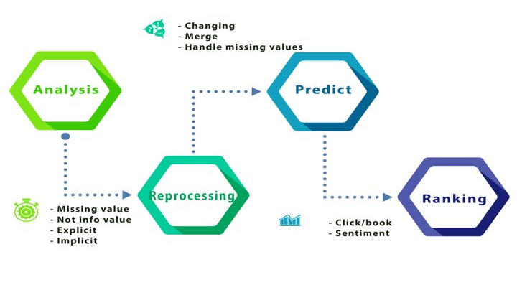

Slide 12
Machine Learning
Clicking / Booking -> Important Feature
Search / Click / Book num
Missing Values Prediction
Sentiment

Slide 13
Ranking
Score:= Overall Score + Review Score + Check num + Book num + others

Slide 14
Recommendation System
Hotel / Content based
Click / Session based

Slide 15
Content-based
Item-to-item
Input: 1 hotel
Method: find nearest neighbor
Output: 5 relevant hotels

Slide 16
Session-based
Item to Vec
Input: User's Session
Method: Word2Vec
Output: 5 suggested hotels

Slide 17

Future

Slide 18

OVN Team Member
Anh Ta – Product Manager
Dat Tran - App Developer
Luong Nguyen - Data Scientist
Minh Anh – Data Scientist
Viet Nguyen – Data Scientist

Slide 19

Thank you !

