Slide 1
HORA
DevC Innovation Challenge

Slide 2
Mobile Application and Data Science
Booking easily with our Hotel Recommender System

Slide 3
The problem
"A huge number of hotels for every destination can be an overwhelming task for customers"

Slide 4
The solution
A mobile application where users can search for hotels through our recommendation system

Slide 5
Product demo

Slide 6
Demo
Video

Slide 7
Technology on Front-end
React Native
Expo
Npm

Slide 8
Technology on Back-end
Flask
MongoDB

Slide 9
Technology on Data Science
Data Explore
Python
Seaborn
Datagrid
Machine Learning
Google Colab
Scikit-learn
Recommender Engine
Word2Vec

Slide 10
Main problems
MAPPING: similar point
RANKING: SCORE

Slide 11
Mapping
Input: 200.000 Hotels
Similar point: 0.9
Output: 11.000 Hotels

Slide 12
11.000
The number of hotels from Tripi and other OTAs

Slide 13
Ranking
Analysis:
Explicit
Implicit
Preprocessing
Cleaning
Merge
Handle missing values
Prediction
Clicks / Books
Sentiment
Score
Ranking

Slide 14
Data analysis
Overall Score, Search, Book, search-click-book Pie Chart
Common facilities/services Bar Chart

Slide 15
Machine Learning
Clicking / Booking --> Important feature
Search / Click / Book num
Missing values prediction
Sentiment

Slide 16
Processing
Prepared data --> Training data + Test data
Model
Evaluation

Slide 17
Models Comparison

Slide 18
Sentiment
Describe: Sentiment analysis for hotels reviews
Input: Hotel review
Processing
Output: Negative or Positive
Evaluation

Slide 19
Ranking
SCORE = w1*Overall Score(Tripi + OTAs) + w2*Review Score + w3*Search/Click/Book num
Result

Slide 20
Recommendation System
Hotel Content-based
Click Session-based

Slide 21
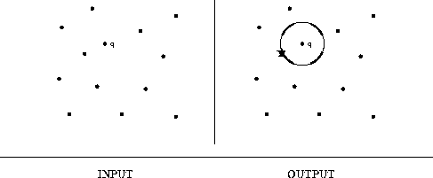
Content-based
Item-to-item
Input: Hotel info
Method: Finding Nearest Neighbors
Output: 5 relevant hotels

Slide 22
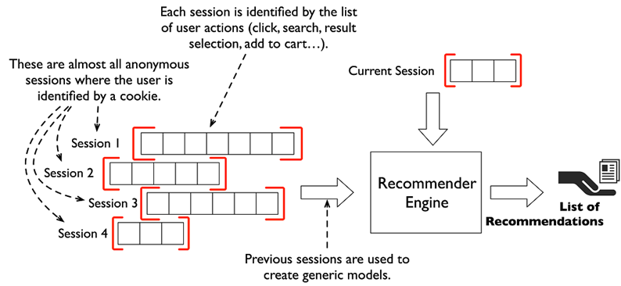
Session-based
Item-to-Vec
Input: user's session
Method: Word2Vec
Output: 5 suggested hotels

Slide 23
Future plans
Optimize model and application performance
Predict click / book through differentially features (as hotels pictures)
Develop review/score prediction features for new hotels
Develop multi-language service

Slide 24
O'VN Team
Anh Ta – Product Manager
Dat Tran - App Developer
Luong Nguyen - Data Scientist
Minh Anh – Data Scientist
Viet Nguyen – Data Scientist

Slide 25
Thank you !
Do you have any questions ?

Slide 27
Timeline 1.0
1'00 --> Intro: 60s
3'00 ----> Demo: 120s
3'30 -> Tech: 30s
4'00 -> Mapping: 30s
5'00 --> Ranking: 60s
6'00 --> Rec Sys: 60s
6'30 -> F-Plan: 30s
7'00 -> End: 30s
0--1'----3'-3''-4'--5'--6'-6''-7'

Slide 28
Machine Learning

Slide 29
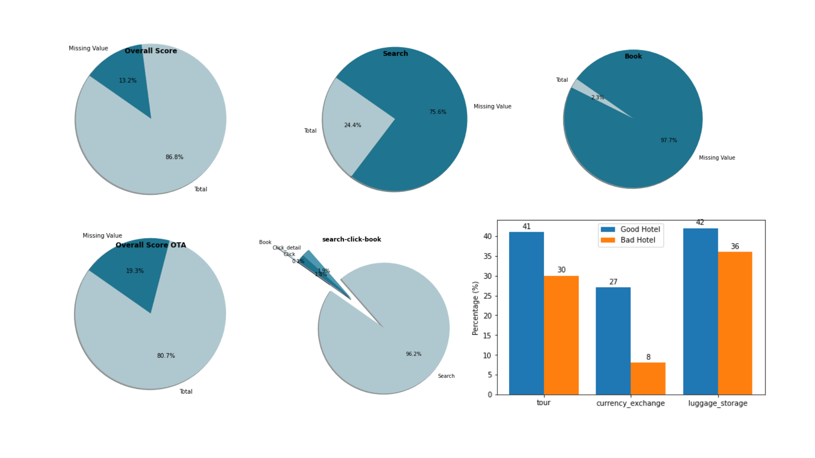

Slide 30
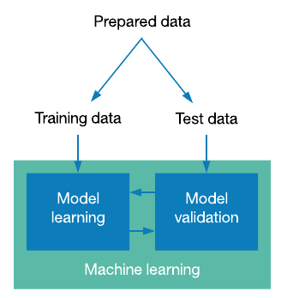
Processing

Slide 31
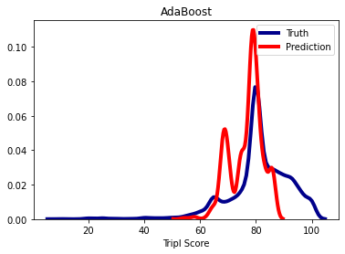
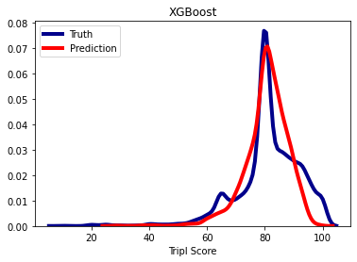
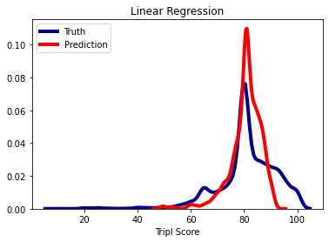
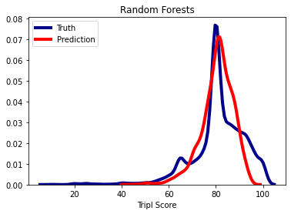
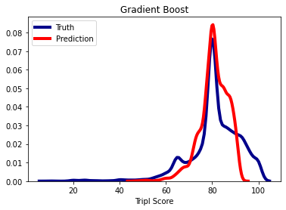
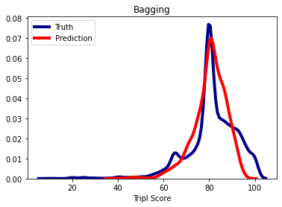
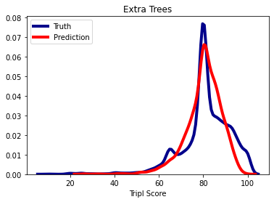
Model comparison of filling NaN of Tripi Score

Slide 32
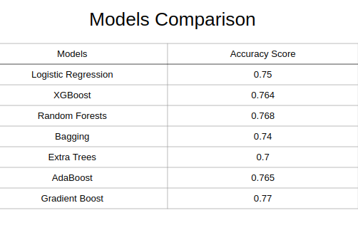
Click/ Book or Not

Slide 33
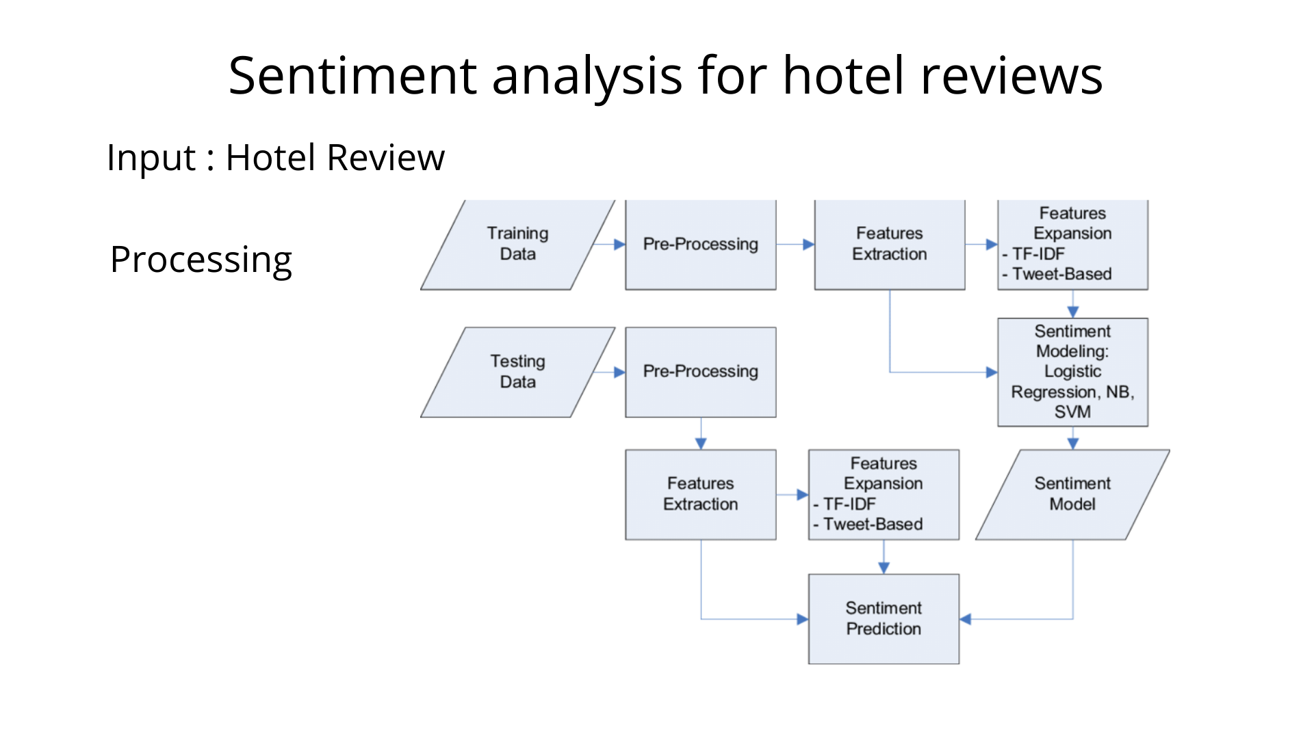

Slide 34
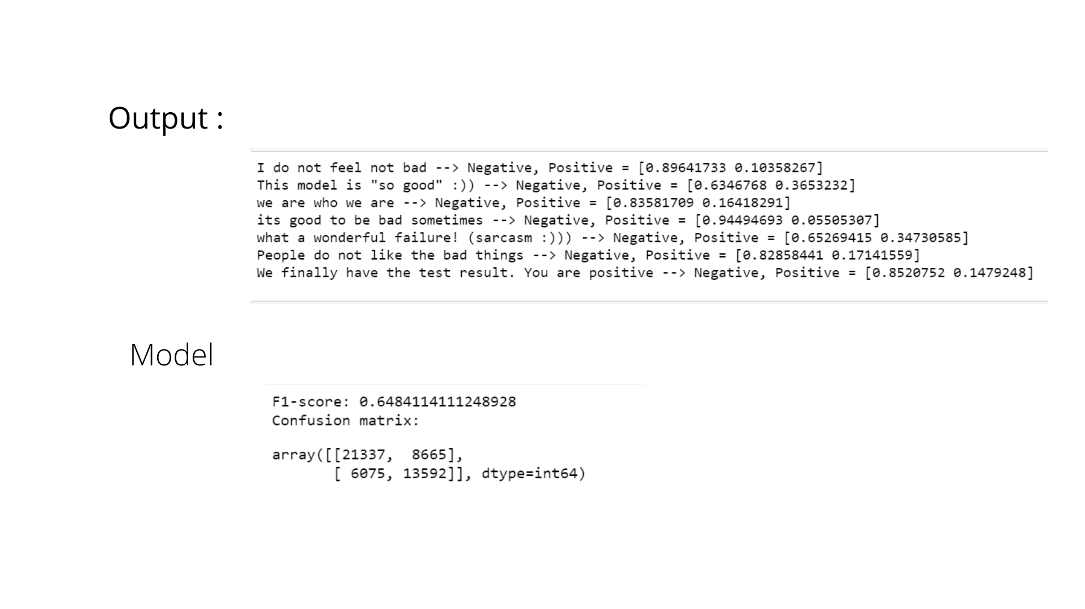

Slide 35
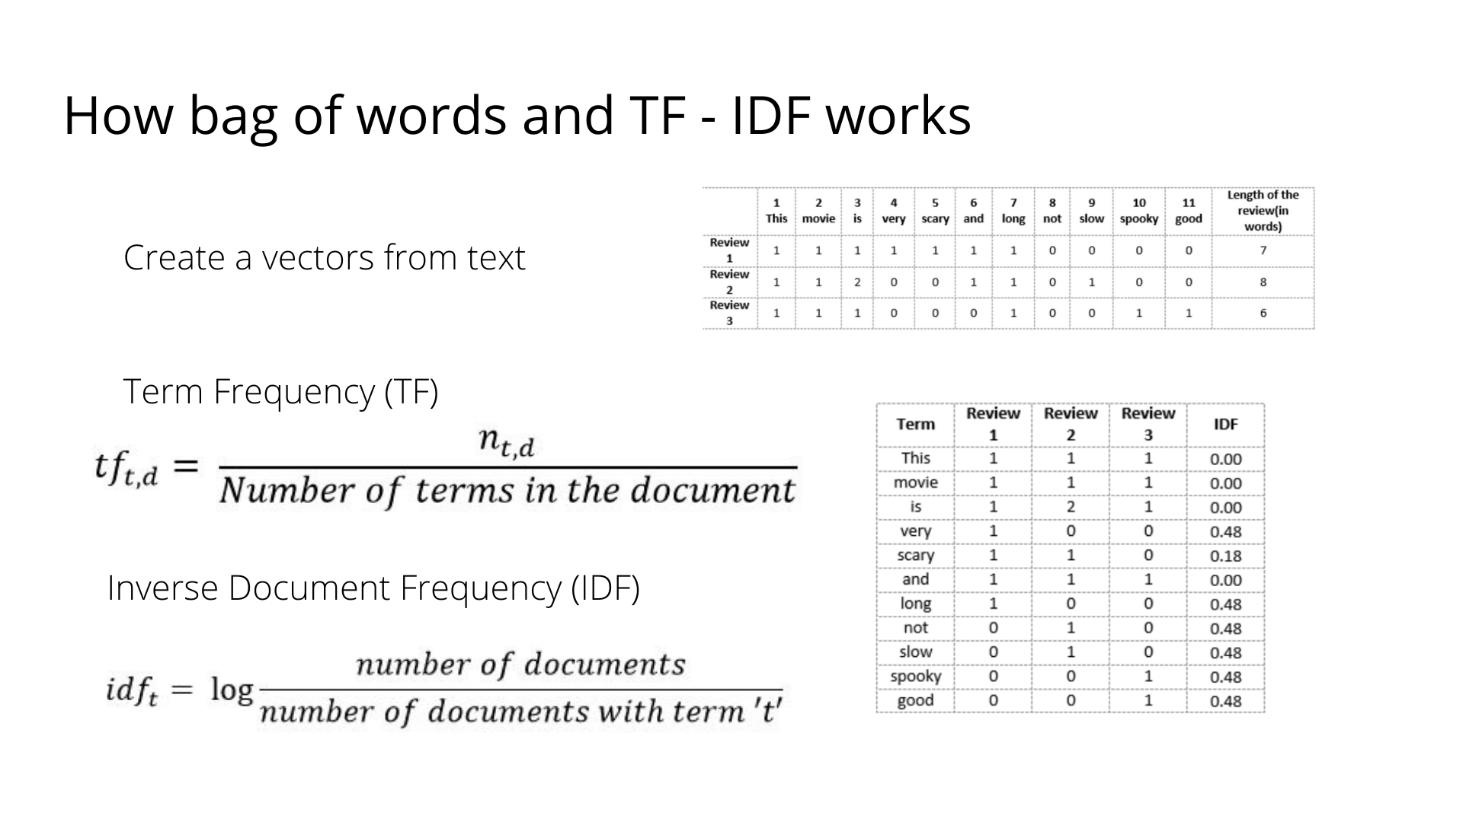

Slide 36
Nearest neighbors

Slide 37
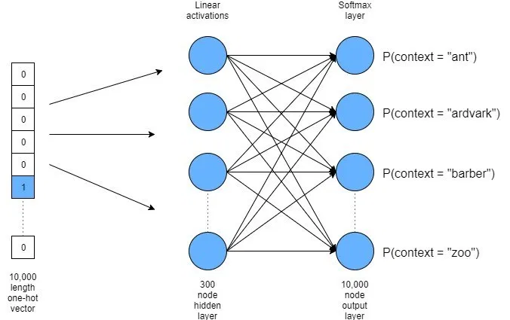
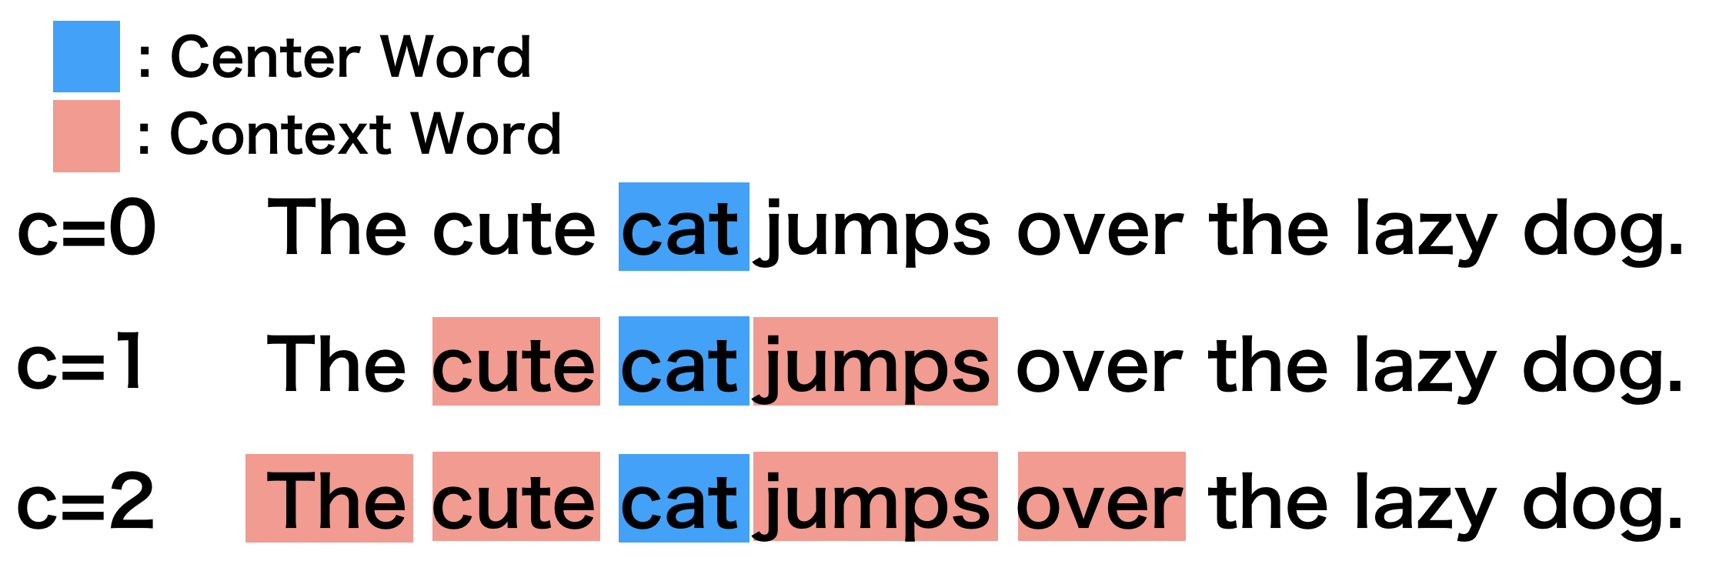
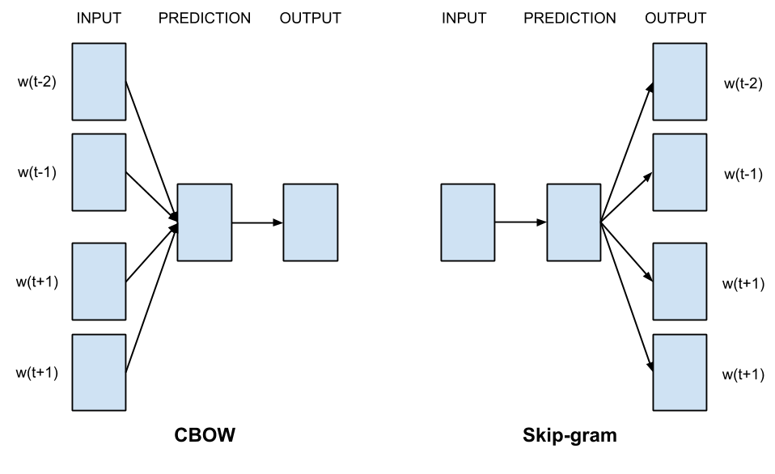
Word2Vec
Neural Network
Center word & Context word
CBOW & Skip-gram

Slide 38
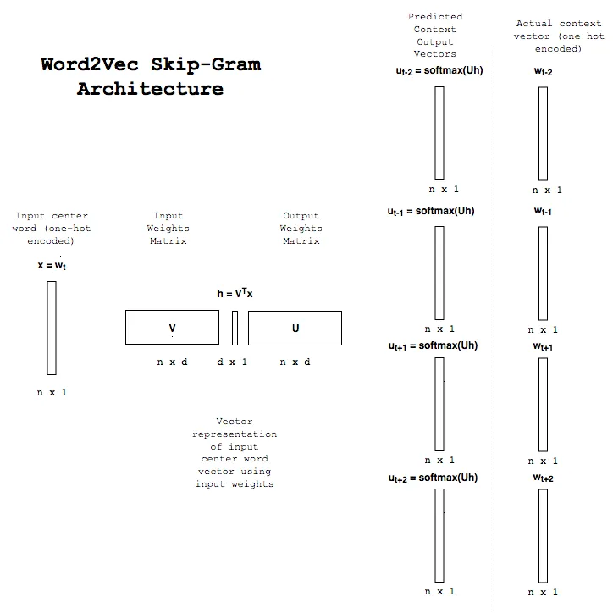
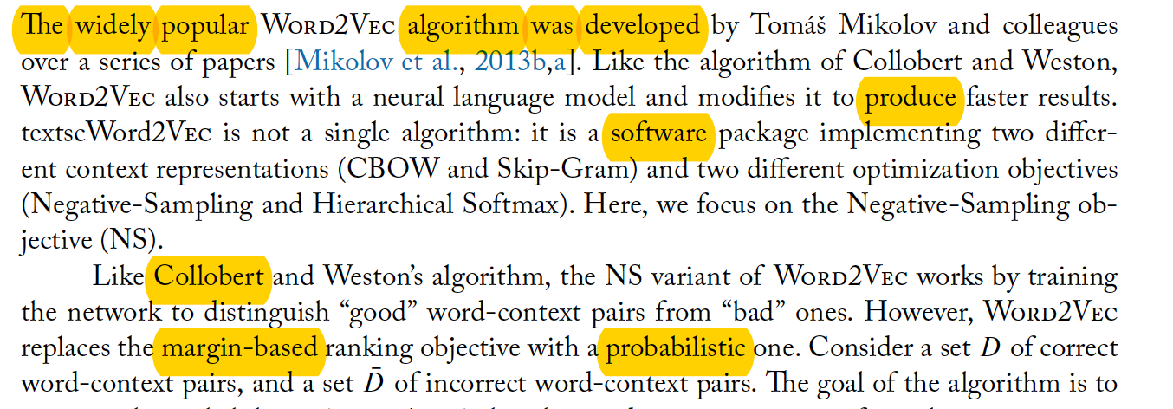

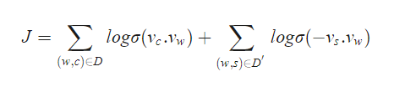
Skip-gram model
Negative Sampling
Using center-word for prediction
Maximum

Slide 39
Item2Vec
Words = hotels
Sessions = user's sessions

