Slide 1


D & C
DIVIDE AND CONQUER
PLAN OVERVIEW

Slide 2

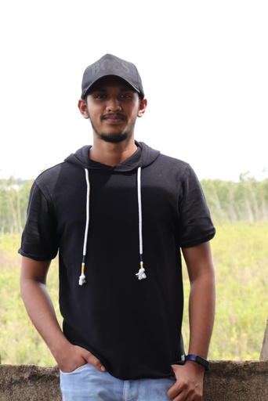

The Team
SHARVES
RESEARCH ANALYST
ARAVIND
TECH PERSON
SHOBANA
PYTHON EXPERT

Slide 3



TASK1
EDU BOT
Our Bot Helps Higher secondary students to find a proper path for their career.

Slide 4
Our Plan - ChatBot
Step 3
Step 4
Step 1
Step 2
Step 5
Find Questions and answers to train
Train the Bot by fnising Domain and NLU file
Learn RASA Platforn
Preparing necessary softwares
Test the Bot with different scenario
Step 6
Step 7
Step 8
Complete Framework and webpage for chatbot
Implement the files on Gcloud
Upload on Github Repo

Slide 5

TASK2
Voice Synthesizer
We have trained our page efficiently with smaller Voice dataset. TTS works very similar to the original voice.

Slide 6
Our Plan - Voice Synthesize
Step 4
Step 5
Step 1
Step 2
Step 3
Compare the Original Audio and Extracted Audio
Finish the Coding part to synthesize the audio
Learn about the opensource software
Record Audio samples to train
Extract the Audio needed
Step 7
Step 6
Step 8
Complete Framework and webpage for TTS
Testing all created voices
Upload on Github Repo

