Slide 1
Multi-model Sentiment
Analysis
A Mini-project by
Dr. T. Sujatha
Assistant professor
Abdul Basith M (20EUAI002)
Aditya S (20EUAI003)
Aravind G (20EUAI005)
Bharathi Ramanan D (20EUAI006)

Slide 2
Introduction
Sentiment analysis studies the subjective information in an expression.
Multimodal Sentiment Analysis does analyse different emotions using different input.

Slide 3
Objective
Multimodal Sentiment Analysis that will extract the sentiments using the three modes:
Audio Sentiment Analysis
Text Sentiment Analysis
Video Sentiment Analysis

Slide 4
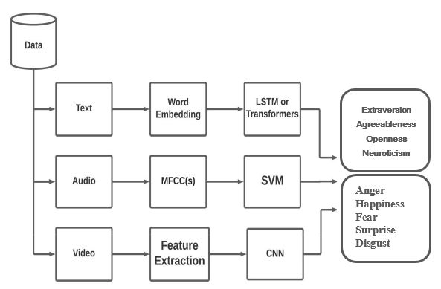
Architecture

Slide 5
Algorithms
RNN
One of the most common architectures because of the ability to handle variable-length texts.
They are networks with multiple loops in them, allowing information to continue.

Slide 6
Algorithms
LSTM
LSTMs are explicitly designed to ignore the long-term dependency problem.
LSTM is a synthetic RNN architecture employed in the sphere of deep learning.
Has feedback connections.

Slide 7
Algorithms
MFCC
Mel Frequency Cepstral Coefficients.
The Mel scale relates perceived frequency, or pitch, of a pure tone to its actual measured frequency.
Mel scale: M(f) =1125 ln(1+f/100)

Slide 8
Implementation
Text Sentiment (Steps)
Text is cleaned.
Creating Bag Of Words.
Embedding Matrix is created.
This embedding matrix data is put as an input to the Attention Based Model that we will custom create with Bidirectional LSTM Encoders, Attention Layer, and the Decoders.
Many to One LSTM’s are used to predict the label using the text.

Slide 9
Implementation
Audio Sentiment (Steps)
Extract 15 seconds audio and add some noise to the data.
Signal Pre-processing will be done in the next stage.
MFCC’s calculated, which are the input data that will be used for the model.
Classification models can be used to predict one of the six labels of sentiment.
Printing a bar plot of the sentiments is achieved by using Argmax computation.

Slide 10
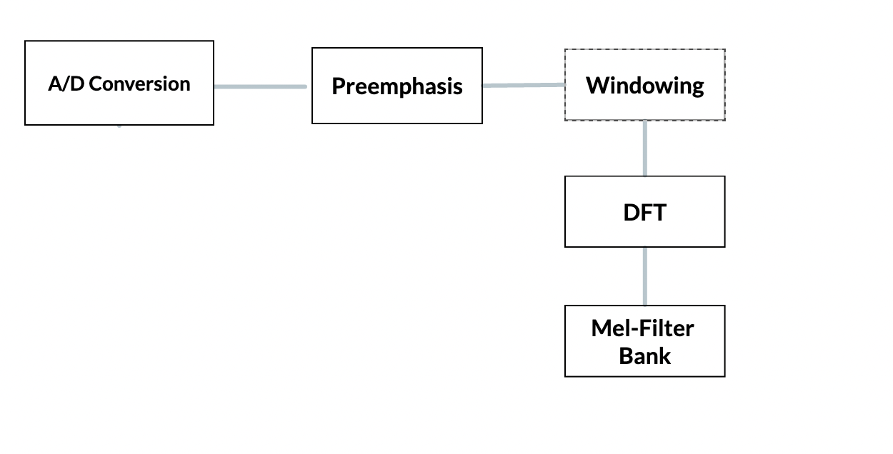
MFCC

Slide 11
Implementation
Video Sentiment (Steps)
The video is split into frames, and the analysis is done step by step.
Filters are used after getting the frames, and Convolution Operations are per- formed.
Features Extraction is done, and landmark points are located in those frames.
The image is flattened and fed to the Exception Model for an output.

Slide 12
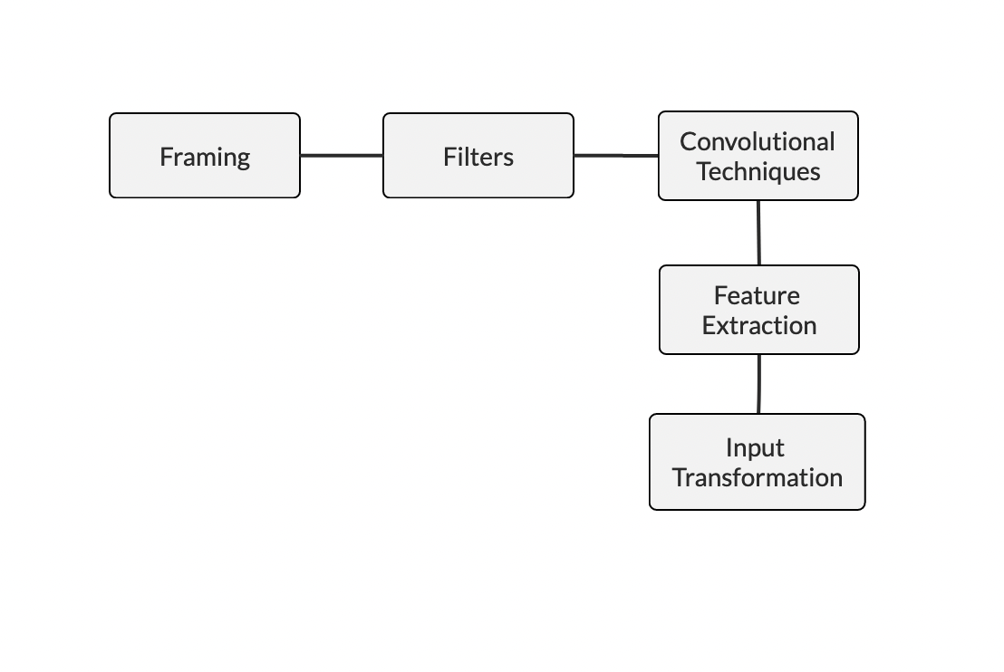
Implementation
Video Sentiment (Steps)

Slide 13
Flow of the App

Slide 14
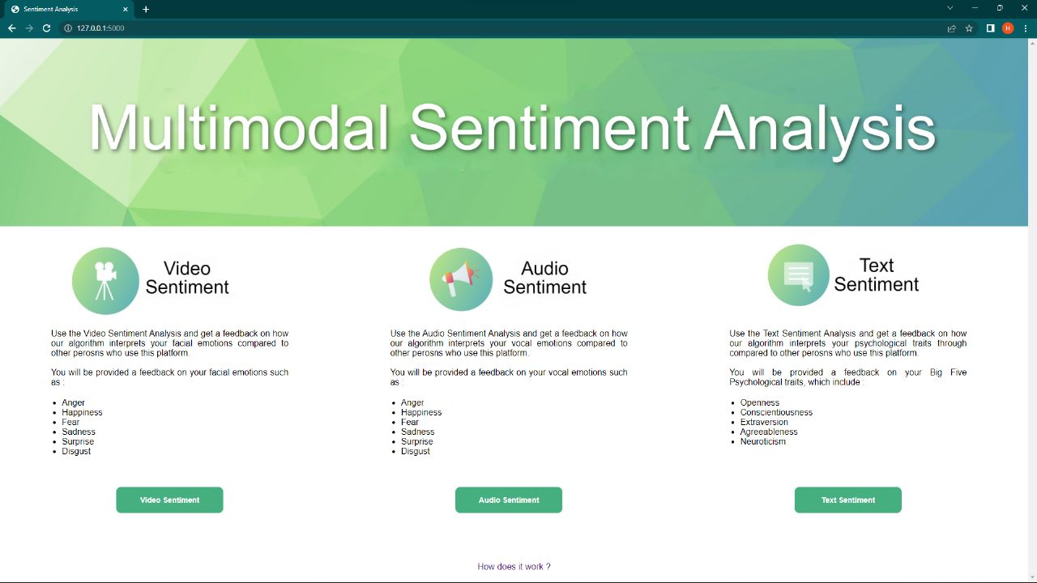

Slide 15
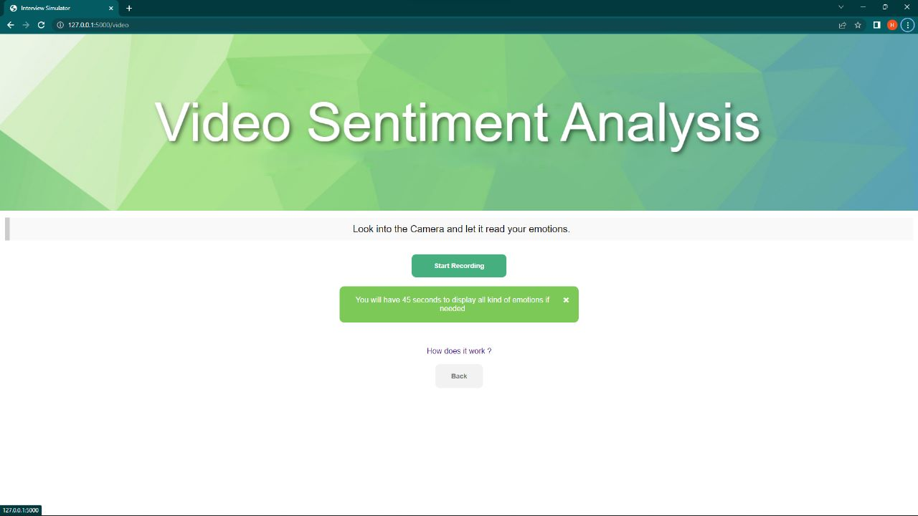

Slide 16
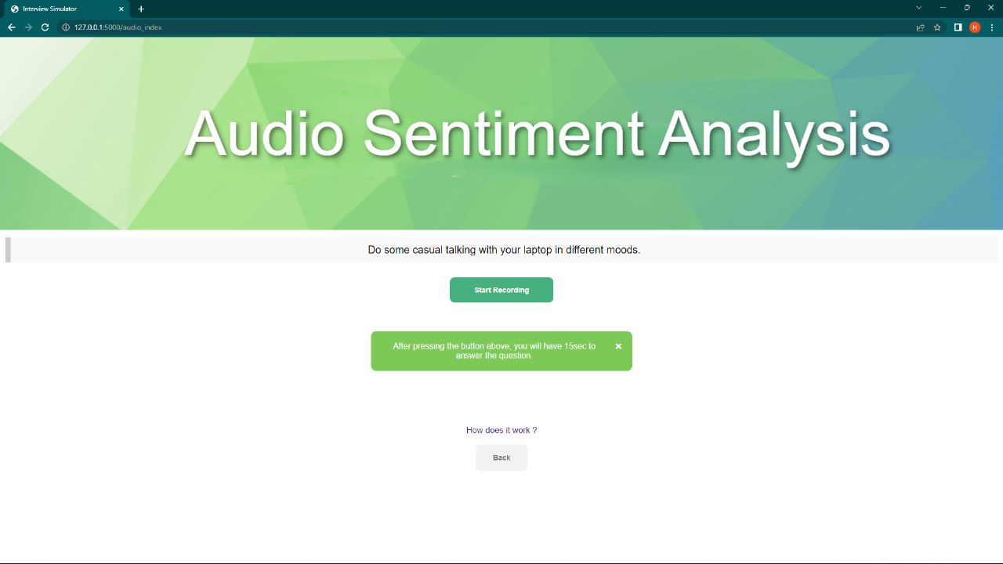

Slide 17
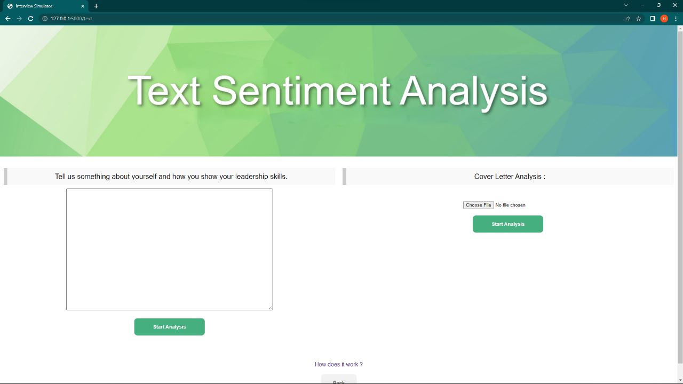

Slide 18
Results
Text
The accuracy by using different models is shown below. The method that has been used is Word-2-Vec embedding with LSTM and SVM models. Both the accuracy of the test set is shown below.
Model | EXT | NEU | AGR | CON | OPN
Word2Vec + SVM | 46.18 | 48.21 | 49.65 | 49.97 | 50.07
Word2Vec + LSTM | 55:07 | 50:17 | 54:57 | 53:23 | 53:84

Slide 19
Results
Audio
This Audio modal have been implemented with MFCC’s calculation and then fed those MFCC’s to the Classification Network using the Neural Networks. The confusion matrix accuracy of each label is given below.
 |  |  | Predicted labels
 | Happy | Sad | Angry | Scared | Neutral | Disgusted | Surprised
Happy | 80.0% | 0.0% | 5.7% | 5.7% | 5.7% | 2.9% | 3.4%
Sad | 8.1% | 81.1% | 0.0% | 0.0% | 2.7% | 8.1% | 1.5%
Angry | 6.3% | 6.3% | 75% | 0.0% | 6.3% | 6.3% | 0%
Scared | 6.7% | 0.0% | 4.4% | 71.1% | 8.9% | 8.9% | 4.7%
Neutral | 11.1% | 5.6% | 2.8% | 8.3% | 66.7% | 5.6% | 0.3%
Disgusted | 0.0% | 8.7% | 0.0% | 4.3% | 2.2% | 84.8% | 2.9%
Surprised | 0.0% | 8.7% | 0.0% | 4.3% | 2.2% | 84.8% | 67.3%

Slide 20
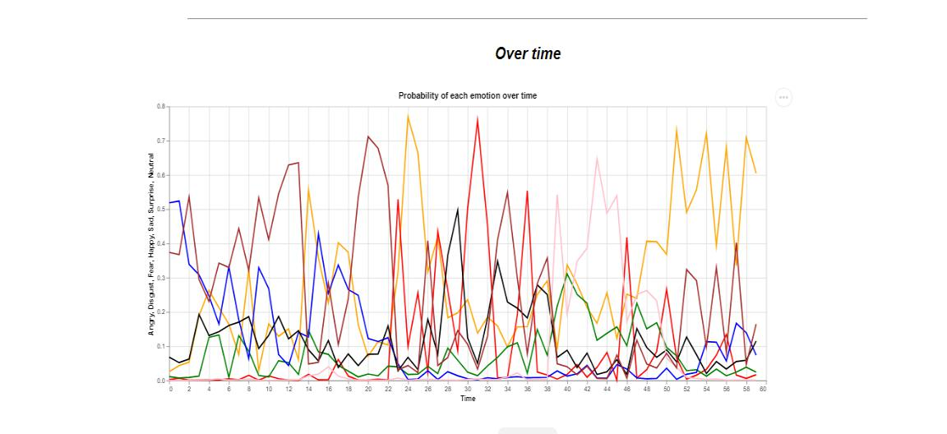
Results
Video

Slide 21
Applications
Social media monitoring.
Customer support ticket analysis.
Business Intelligence Buildup.
Market Research and Analysis.

Slide 22
Conclusion
We have developed a web application that helps us in identifying the emotions of an Individual.
Multimodal Sentiment Analysis that extracts the sentiments using the three modes :
Audio
Text
Video

Slide 23
Future scope
The Text model can be improved by using BERT techniques.
The Audio field can be improved by combining multiple techniques HMM, CNN, and MFCC, together.
The model can give more accurate results if we use 2 modes at once like Audio and Video together to get the better accuracy for the predicted labels.

Slide 24
References
https://www.researchgate.net/publication/337732023_Sentiment_analysis_using_deep_learning_architectures_a_review
Cambria E, Poria S, Gelbukh A, Thelwall M (2017) Sentiment analysis is a big suitcase. IEEE Intell Syst 32(6):74–80. https://sentic.net/sentiment-analysis-suitcase.pdf
Y. Jia and S. SungChu, “A deep learning system for sentiment analysis of service calls,” ArXiv, vol. abs/2004.10320, 2020. https://link.springer.com/chapter/10.1007%2F978-1-4614-3223-4_13

Slide 25
Thank You

