Slide 1
Tackling Command and Control
How to Catch a Mattson Before its Too Late

Slide 2

$ whoami
I play with malware a lot
Hunt bad things
GREM holder
Security Stuff:
Medium.com/@greypiper
Twitter.com/greypiperr

Slide 3
Content Overview
Understanding the Terminology
C2 Infrastructure and Topology
Functionality
Inspecting API Calls
Behavior Over the Wire
Detecting Beacons
Investigating Potential C2 behavior

Slide 4
Understanding the Terminology
Command and Control (C2): Client/Server system used for issuing commands to an infected host’s implant.
Implant: Malware client that reaches out to a C2 server to retrieve commands.
C2 Server: Attacker controlled server used to issue commands to an implant.
C2 Proxying: Technique that is commonly used by C2 server operators to avoid raw exposure to their infrastructure by hosting proxies on alternate or compromised web servers.
Beaconing: Rapid network traffic generated by the implant that is necessary for command retrieval from the C2 server.
Beachhead: Initial point of compromise and entry that an attacker uses as a base of operations to move laterally.

Slide 5

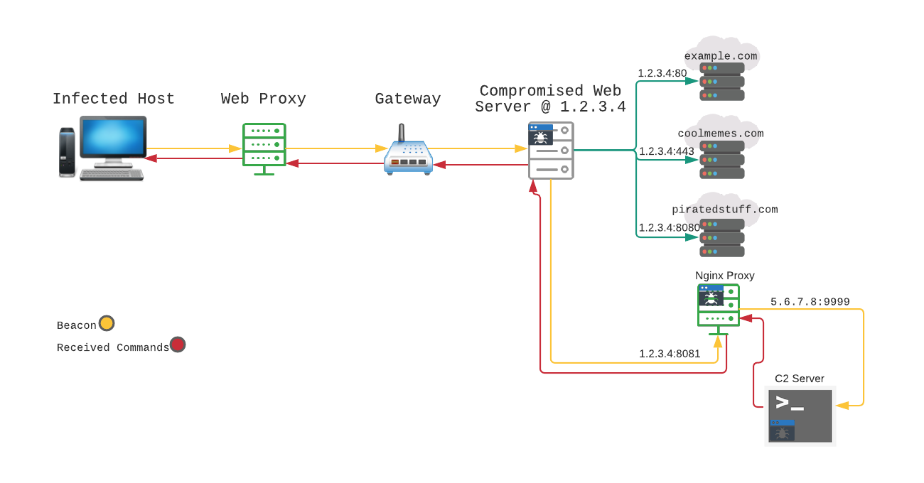
C2 Topology

Slide 6
C2 Infrastructure
C2 servers are set up on attacker controlled infrastructure
C2 server numbers are usually much smaller than the number of C2 proxies used to access them. This is because one C2 server can issue commands to a relatively infinite number of machines – and is only limited by its resources. This is usually not the case as optimization, organization, segmentation, and redundancy are important when conducting large scale attacks.
Proxies are deployed on alternate or compromised web servers
Attackers use either low-cost providers (Digital Ocean) or victim infrastructure to host proxy servers. Compromised hosts will often listen on non-standard ports relative to the protocol used due to standard ports being bound to active and legitimate traffic.
Implants are deployed on a target host to retrieve commands
Implants run on the infected host and attempt to retrieve commands at a pre-determined time interval. This is done to circumvent the problem of NAT, firewalls, connectivity, and other problems experienced with traditional bind and reverse shells.

Slide 7
Functionality
Implants can be stand-alone C2 clients or delivered malware itself
The term ‘implant’ generally refers to stand-alone C2 client modules for exploitation frameworks and other tools, but this term can also be applied to malware performing its communication routines as well. While not common practice, I will be referring to all C2 clients as ‘implants’ from here on.
Malware-based C2 clients are different from stand-alone tools
Most Malware will attempt to contact their C2 servers as soon as possible. Cobalt Strike on the other hand, is not usually deployed on the beachhead and is often indicative of a much larger attack.
Communication protocols vary from client-to-client
HTTP and HTTPS are by far the most common protocols utilized by C2 today (RIP IRC), however, there are many more less-common protocols that are utilized for C2 as well such as DNS and ICMP. To make matters worse, the client may be using a custom C2 protocol that will go unparsed and unrecognized by common network analyzers

Slide 8
Functionality: Comms Protocols
There are 4 major categories of C2 comms protocols
Common Protocol | Common Port HTTP:80
Common Protocol | Uncommon Port HTTP:443
Custom Protocol | Common Port TCP:80
Custom Protocol | Uncommon port TCP:9547
Difficulty to detect each category varies from org-to-org
The right tooling might easily identify an unknown protocol communicating outbound rapidly. The same environment may struggle to sift through extreme amounts HTTP:80 data.

Slide 9
Functionality: Custom Comms
Protocol is not an existing implementation
Custom C2 protocols are defining features of complex and evasive malware families, where unknown protocols are used. The protocols may be nearly identical to existing implementations. This unique characteristic may make them harder to detect, but trivial to fingerprint and attribute once found.
Custom Comms still use common APIs to create connections
This is because (excluding driver installation) the routine MUST eventually result in low-level syscalls within kernel space. This means that even with a completely custom protocol, there are still elements of predictability as high-level functions translate to syscalls. In the case of Windows, the Sockets API, WinInet API, URLMon API, and COM all make calls to the Win32 subsystem – so in essence, even the most complicated protocols are comprised of the same components.

Slide 10
Functionality: Windows C2 Client API Calls
IP Helper [ICMP]
IcmpCreateFile()
IcmpSendEcho() or IcmpSendEcho2() or IcmpSendEcho2Ex()
IcmpParseReplies()
IcmpCloseHandle()
Winsock API
socket()
connect()
bind() [optional]
send()
recv()
WinInet API [Non-HTTP]
InternetOpen()
InternetConnect() or InternetOpenURL()
InternetWriteFile()
InternetReadFile()
WinInet API [HTTP]
InternetOpen()
InternetConnect() or InternetOpenURL()
HttpOpenRequest()
HttpSendRequest()
InternetReadFile()
URLMon API
URLDownloadToFile()
URLDownloadToCacheFile()
URLOpenStream()
URLOpenPullStream()
COM [IExplorer]
CoInitialize()
CoCreateInstance()
Passed CLSID value of IE:
0002DF01-0000-0000-C000-000000000046
Navigate() or Navigate 2

Slide 11
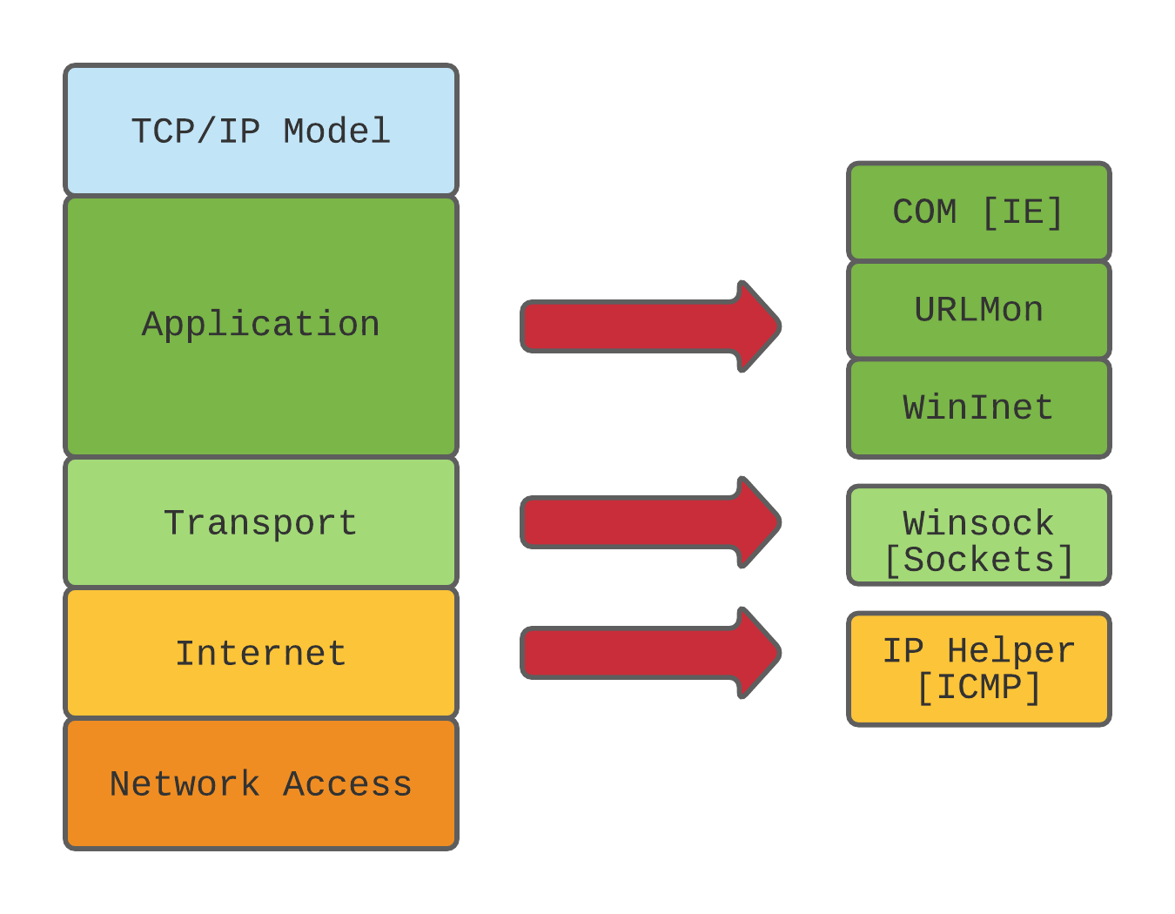
Functionality: C2 Layer Translation
T1071
T1095
T1095

Slide 12
Questions?

Slide 13
Inspecting API Calls: IP Helper
Interested in:
IcmpSendEcho() or IcmpSendEcho2()
This function is required to make a request. The ReplyBuffer and RequestData parameters are of interest, as they will contain the received commands and data to be sent, respectively.
WriteProcessMemory() or Memcpy()
Although not part of the API itself, these functions are called in conjunction with the other previously mentioned calls such as IcmpSendEcho. When data is received, a usable buffer has to be created in order to pass the information to the appropriate functions.

Slide 14
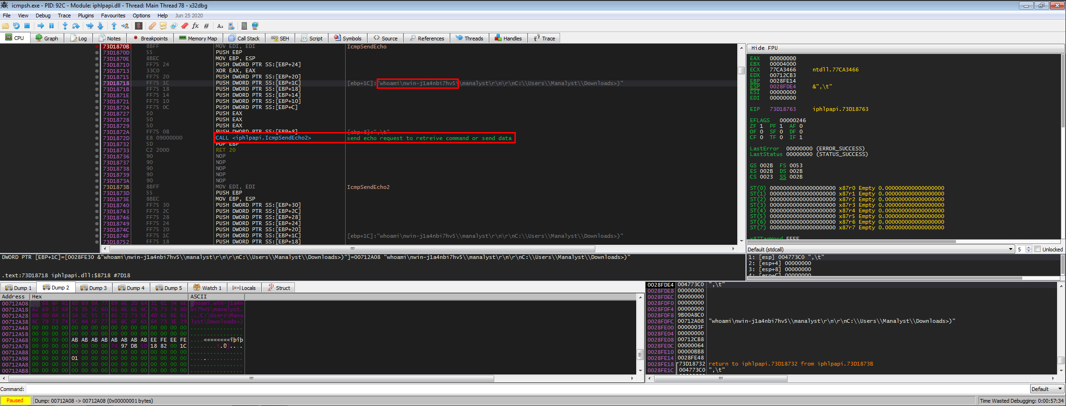
Inspecting API Calls: Inside of icmpsh
This sub-routine is called from main and is used to initiate the Comms sequence. If command data is received, the implant will attempt to run it via the open shell. If not It will sleep briefly, then attempt to ping the host again for commands. This same sub-routine is also used to upload command results once run, which can be seen below in the parameter passed to IcmpSendEcho2.

Slide 15
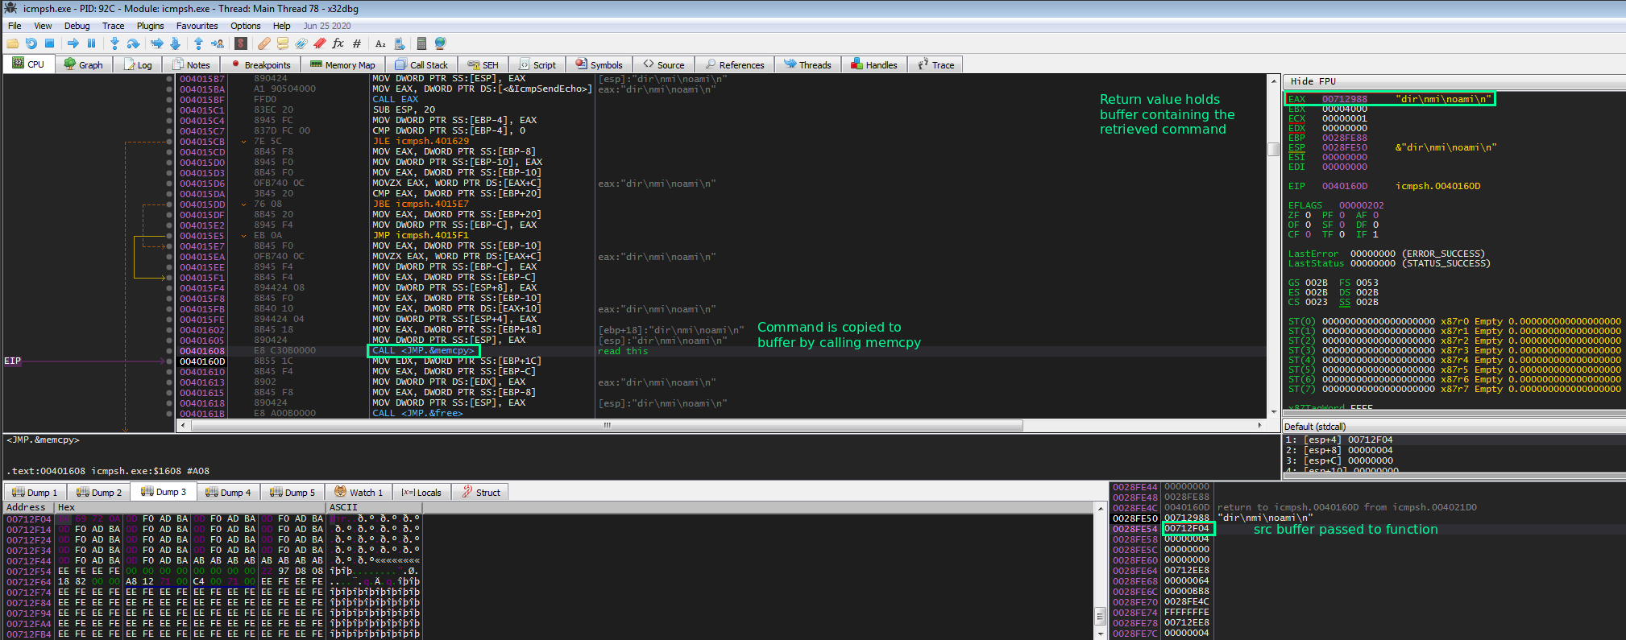
Inspecting API Calls: Inside of icmpsh
Memcpy() is called which makes viewing the src and dest buffers possible. Both of these contain the command that was retrieved through IcmpSendEcho2. Because EAX is the return register, EAX can be monitored in a dump window to allow Memcpy()to finish execution and return the new buffer value.

Slide 16
Inspecting API Calls: Winsock
Interested in:
send()
This is the data being sent to the remote host. Looking at the parameters being passed to it can reveal the data being sent to the C2 server.
recv()
This is the function used to read the data being retrieved from the server in response. Inspecting the subroutine this is located in can give context and purpose to the C2 comms routine for the malware in question.
Notable:
Encrypted data passed to send() or recv():
This means that the comms routine likely supports an encryption protocol or was passed this data from a separate encryption routine. Locating and inspecting the encryption routine, especially in the case of RC4, may allow you to derive a key for further automation in C2 server list extraction.
Usage of bind() in client comms:
Indicates that a port is being specified for egress traffic. This may be done in attempt to circumvent firewall egress filtering (IE only traffic over :80 is allowed) If a consistent port is used, this can work as an attribute in IOC creation.

Slide 17
Inspecting API Calls: WinInet
Interested in:
InternetWriteFile()
Data passed to this function will contain the information to be sent to the C2 server. Monitor this to identify what is being transmitted.
InternetReadFile()
Reads the response data from the C2 server and may contain commands or other useful information.
HttpOpenRequest()
Similar to InternetWriteFile in its transmission, however this an HTTP specific function that builds a header to be sent to server. Not all fields are required and will be provided default values if not filled.
Notable:
Unique HTTP attributes in request:
Although not as prone to human error in anomaly generation, crafted HTTP headers for C2 purposes often contain unique attributes that are useful in detection engineering.
One example is of the infamous “Mozilla/4.08 (Charon; Inferno)” user agent that was utilized by PonyLoader (and more recently Loki Bot).

Slide 18
Inspecting API Calls: URLMon
Interested in:
URLDownloadToFile()
As the name implies, this is a high-level function that takes any URL interpretable by Internet Explorer as an input, then downloads the file. High level and volatile attributes can be obtained from inspecting this function. This utilizes COM but reversing the COM functionality is not necessary for extracting useful data.
URLDownloadToCacheFile()
Functions similarly to URLDownloadToFile but saves the retrieved file to the IE cache and returns the name.
Notable
URLOpenStream() and URLOpenPullStream()/URLOpenBlockingStream():
This can be used to download a file and store it in memory – to then be read without ever touching the disk. This technique is a bit obscure, but obscure techniques one year can easily become common place the next.

Slide 19
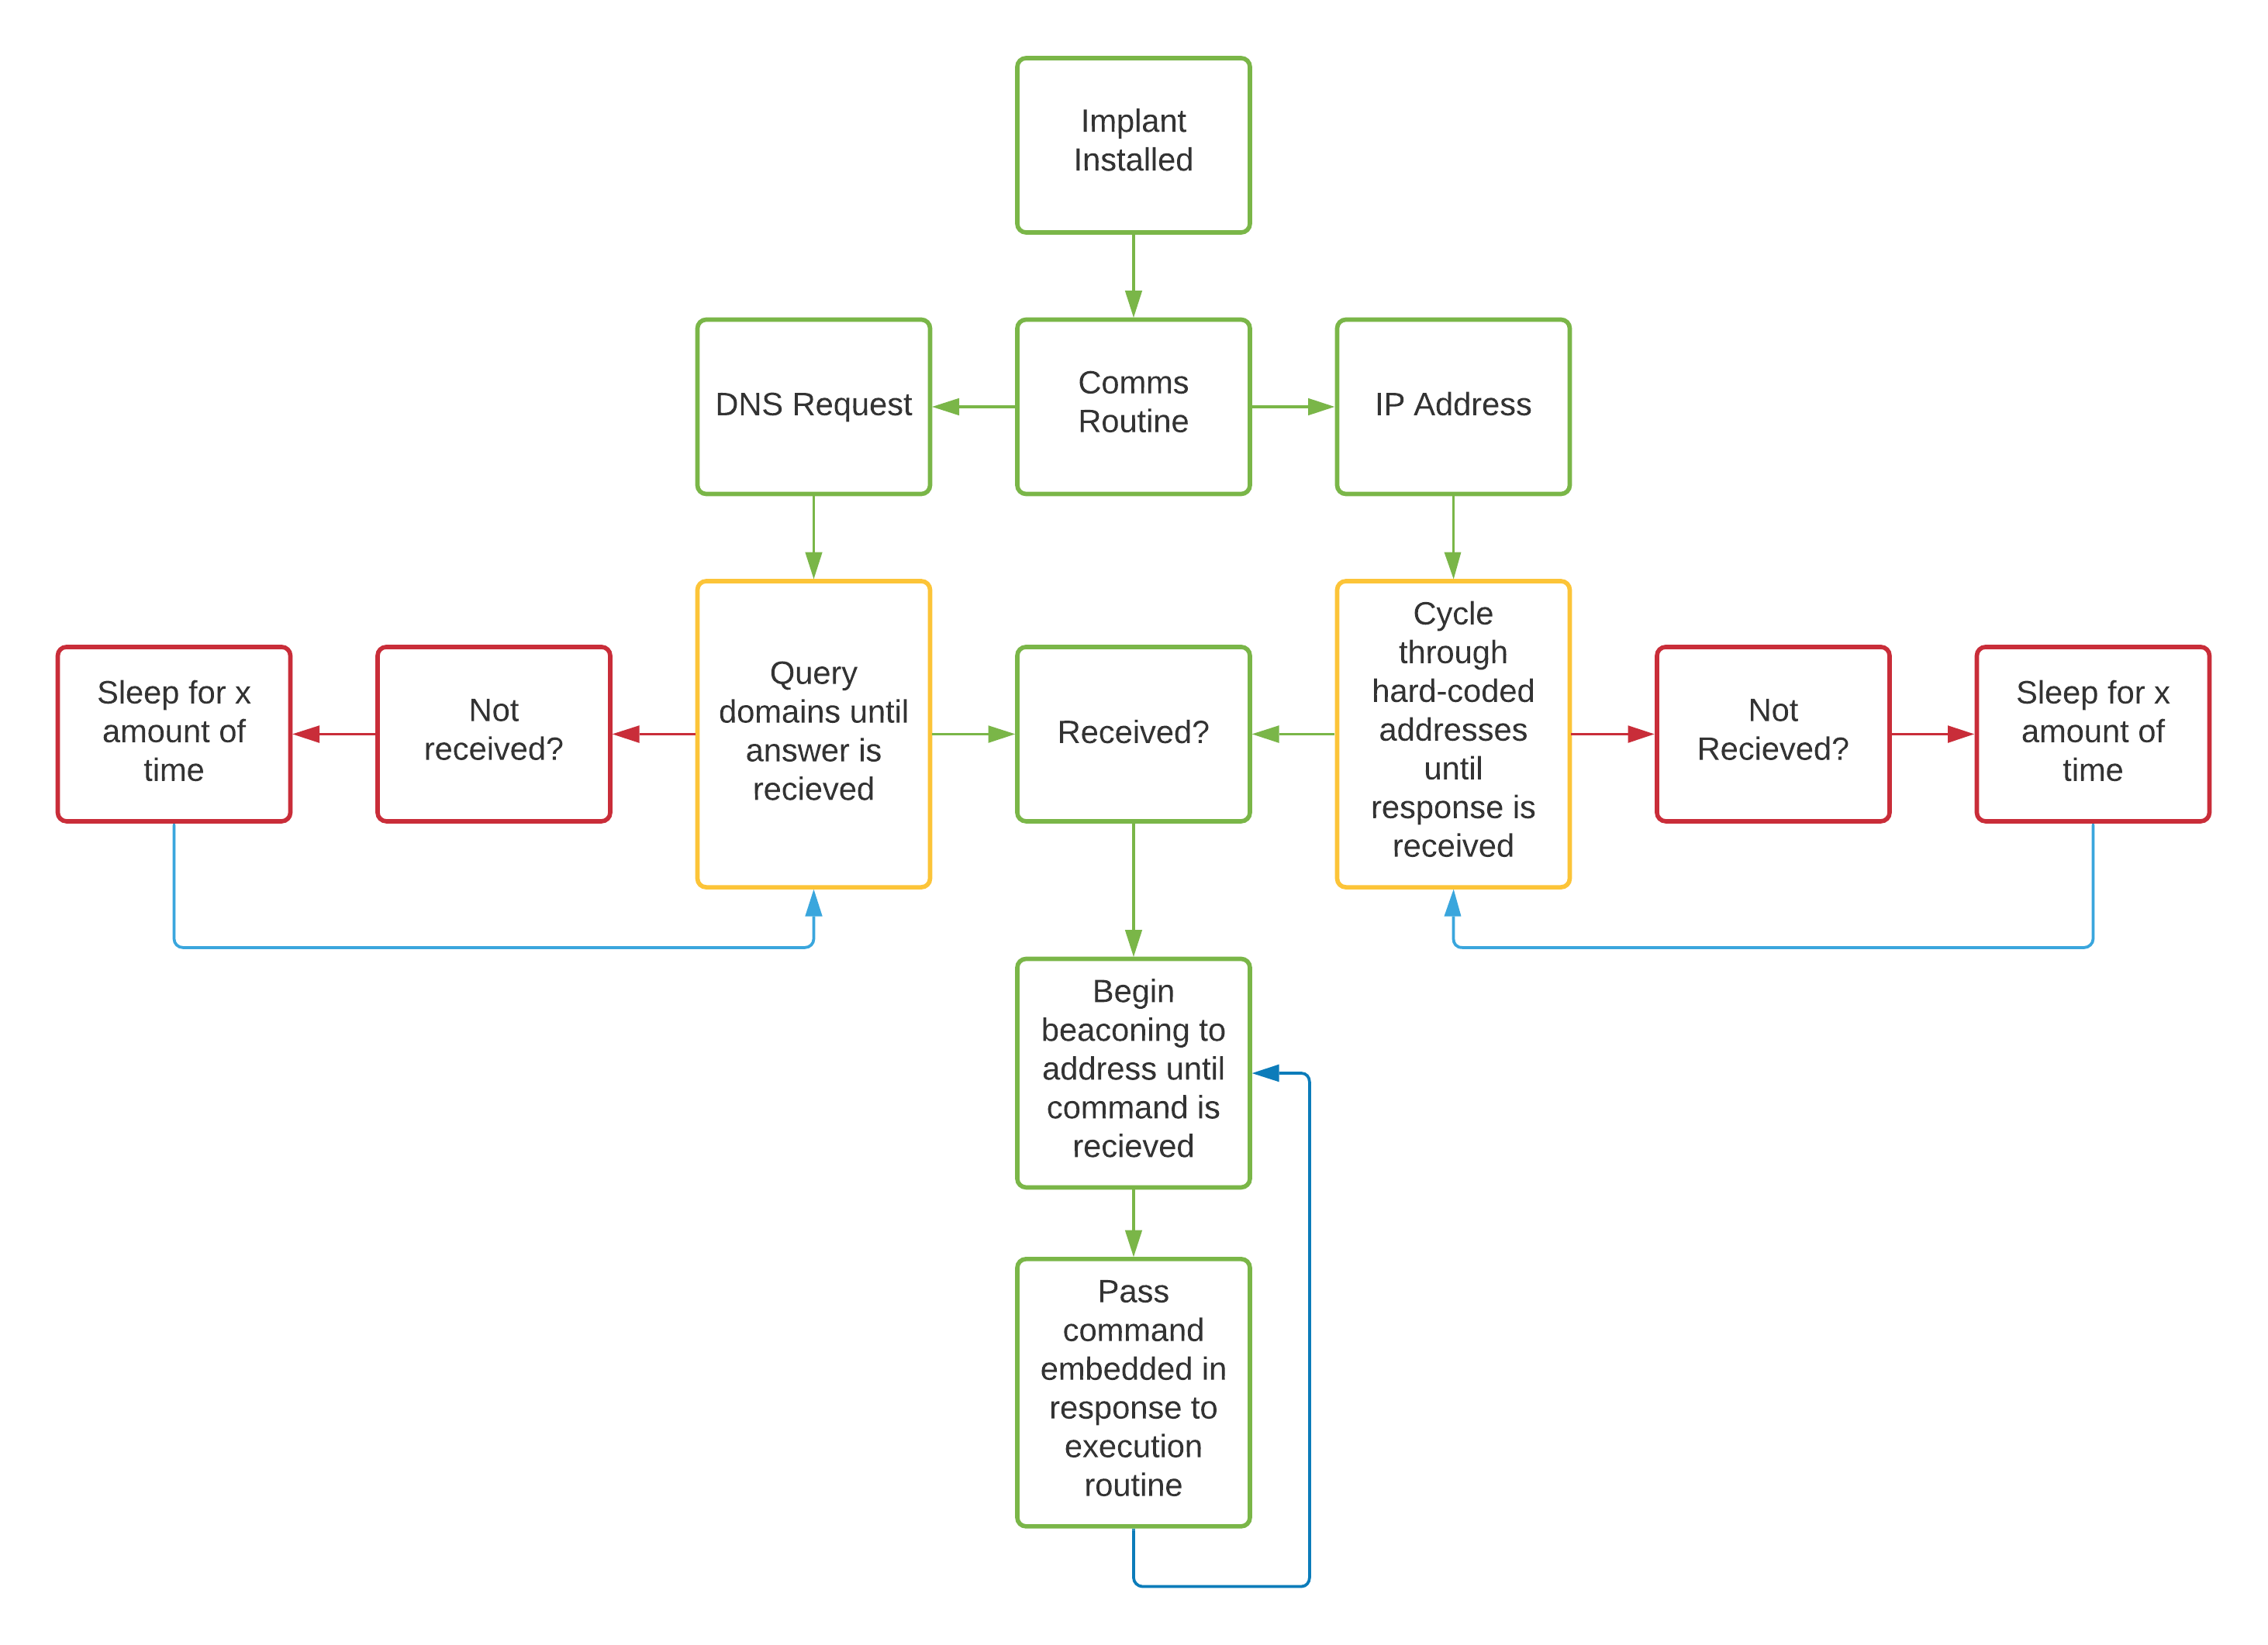
Behavior Over the Wire:C2 Execution

Slide 20
Behavior: Dynamic Address Resolution
Historically, lists of IP addresses were commonly hardcoded into malware to connect back to C2 servers. Traditional botnets thrived using this method until responders began proactively blocking these IP addresses through intel sharing. The landscape has changed a lot since this was an effective technique.
Dynamic Resolution (T1568) is the technique of resolving DNS records to IP addresses to retrieve the C2 connection information. This is done to circumvent any existing blocks – as well as to avoid downed servers.

Slide 21
Behavior: Fast Flux Domains
Fast Flux DNS is a sub-technique of T1568
The concept behind FF is to distribute DNS record resolution to various IP addresses with a low TTL value, so that a querying client will receive rapidly changing addresses. This is done for various reasons, but primarily to avoid tool analysis of long-lasting beacons to the same IP address – as well as circumvention of existing blocks.
Fast Flux is not as common anymore, although can still be observed in some C2 activity.
Keep in mind that Fast Flux can look very similar to load balancing

Slide 22
Behavior: DNS Tunneling
DNS tunneling is the (ab)use of DNS to communicate and exfiltrate encrypted data to a server via the query and response system the protocol is built upon.
This was traditionally done with tools like DNScat but is now more commonly seen with Cobalt Strike’s ‘DNS Beacon’ module – which borrows from the basic features of DNS tunneling clients of yesteryear, while being fully implemented in a post-exploitation framework.
With Beacon’s ‘Pure DNS’ mode, this looks like the implant creating a request for [encoded_data].maliciousdomain.com. This will be a series of random looking characters (similar to a DGA) that will be lengthy and quickly identifiable.

Slide 23
Behavior Over the Wire: Implant Beaconing
Once an implant has been installed, it will begin rapidly sending communication requests to the C2 server on a preconfigured interval dictated by the comms routine. This is beaconing.
This will often be in similarly sized transmission byte/packet counts. Common patterns will look something like the following: 1 Packet containing 2 bytes 1.2.3.4:44894 > 5.6.7.8:9999 2 Packets containing 5 bytes 5.6.7.8:9999 > 1.2.3.4:44894 1 Packet containing 2 bytes 1.2.3.4:44894 > 5.6.7.8:9999 2 Packets containing 5 bytes 5.6.7.8:9999 > 1.2.3.4:44894 1 Packet containing 2 bytes 1.2.3.4:44894 > 5.6.7.8:9999 2 Packets containing 5 bytes 5.6.7.8:9999 > 1.2.3.4:44894 1 Packet containing 2 bytes 1.2.3.4:44894 > 5.6.7.8:9999 2 Packets containing 5 bytes 5.6.7.8:9999 > 1.2.3.4:44894

Slide 24
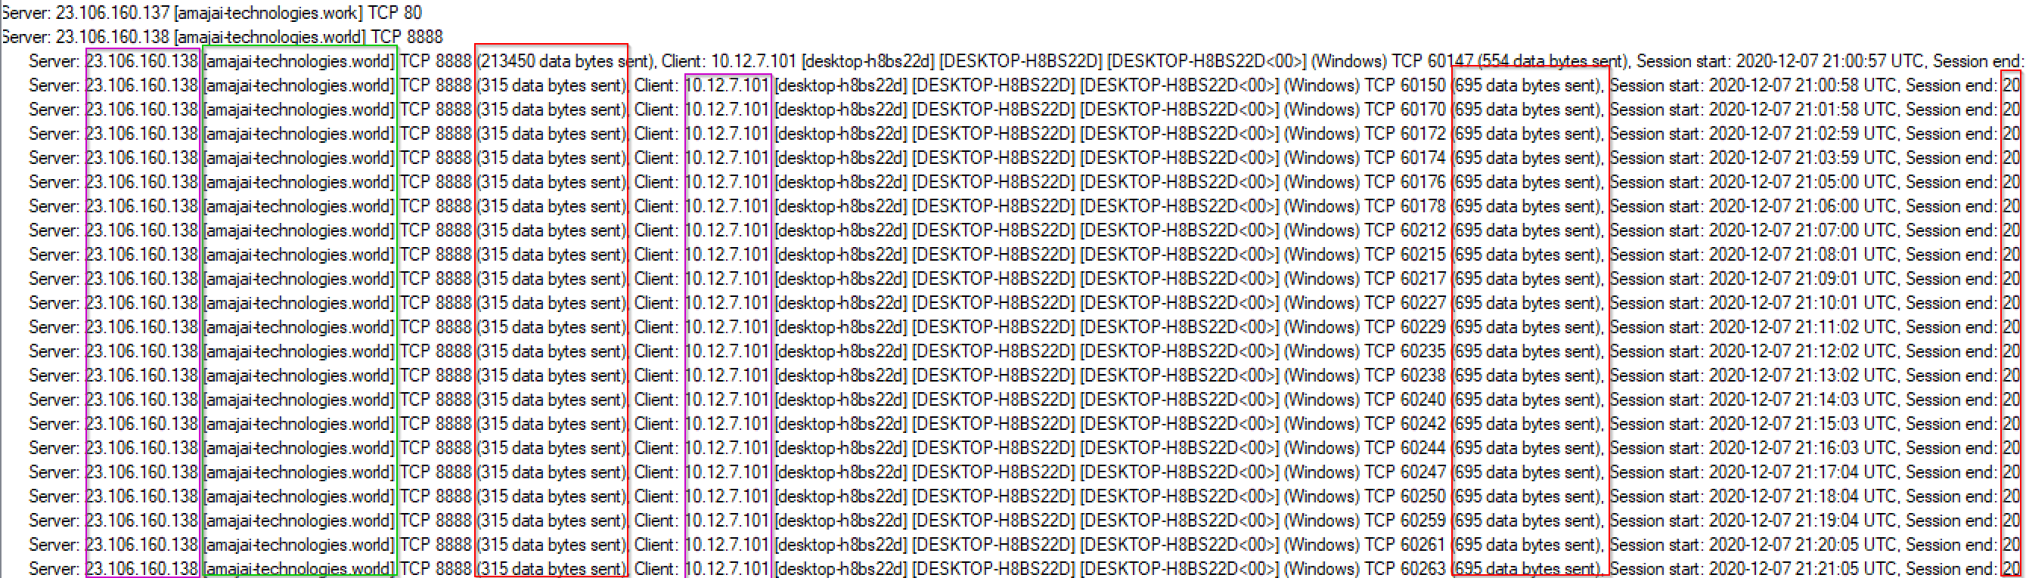
Behavior: Implant Beaconing
Network Miner analysis of QBot infected host that delivered a Cobalt Strike implant
Credit to malware-traffic-analysis.net for the PCAP
https://www.malware-traffic-analysis.net/2020/12/07/index.html

Slide 25
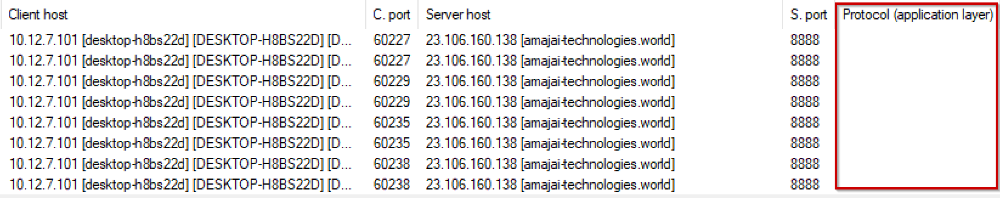
Behavior: Implant Beaconing
Same PCAP but from the perspective of the ‘sessions’ tab in Network Miner
Shows lack of identified application layer protocol, which aligns with the concepts covered earlier

Slide 26
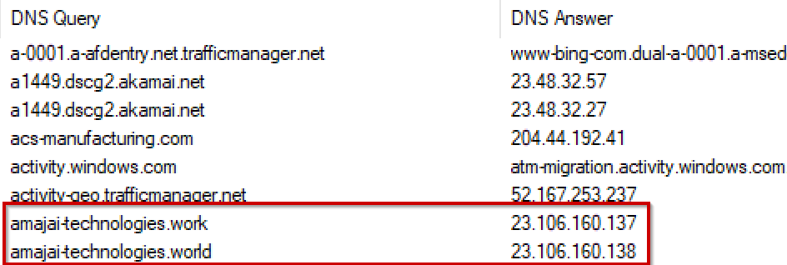
Behavior: Implant DNS Resolution
DNS queries that started it all
Important to note that if answers had not been returned for these domains, the comms routine would have cycled through additional domain names to attempt to resolve an addressable server
This is done to prevent failure due to downed servers

Slide 27
Questions?

Slide 28
Detecting Beacons: Clustering and Stacking
When working with large data sets, major statistical analysis must be performed to identify and create useful ‘leads.’ Much of the hard part is done by tooling through protocol categorization or log ingestion and organization.
Clustering is the process of taking a large data set of data and identifying groups based on data points sharing similar attributes.
Example: Querying all outbound HTTP traffic for the last 24 hours by port will create groups for each port despite all being of the same protocol traffic.
Stacking is the process of taking a value out of a data set, counting the number of occurrences, then analyzing the extremes produced as a result.
Example: Taking the group for port 80, looking for count of POST requests by source IP, then inspecting the traffic for the IP with the highest count.
These are the two most basic methods of statistical analysis that will drive your detection logic and hunts

Slide 29
Detecting Beacons: Clustering and Stacking
Tools of the trade
Wireshark (or another network analyzer)
Zeek
RITA
Proxy logs
SIEM logs
DNS logs
Knowing your environment
The following demonstration will be focusing on the Zeek and RITA as an introduction to the concept

Slide 30
Detecting Beacons: Applied
To show what beaconing looks like within these tools, I used a lab environment consisting of a Windows box for log monitoring, a REMnux box for traffic analysis and log forwarding, and an infected Windows 7 machine as the victim.
I used an older Emotet binary for this example:
SHA1: f1ab1fa6d2b93ae55b448b96733ff195
https://www.virustotal.com/gui/file/045c4ab485bd45781234451af0eae62f23abceae375d5434cff37c3e5620f872/details
I configured the victim machine (WIN7) to use the REMnux box as a gateway, then monitored the forwarded Zeek logs via Splunk on the WIN10 machine
I ran INetSim to emulate valid server responses for outbound traffic from an internet connected machine, in order to force the Emotet binary to cycle through its C2 address list and not terminate itself.

Slide 31
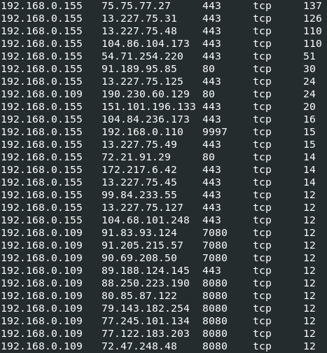
Detecting Beacons: Zeek
# zcat /usr/local/zeek/logs/2020-12-15/conn.*.log.gz | ./zeek-cut -Cd id.orig_h id.resp_h id.resp_p proto | awk 'BEGIN{ FS="\t" } { arr[$1 FS $2 FS $3 FS $4] += 1 } END{ for (key in arr) printf "%s%s%s\n", key, FS, arr[key] }' | grep tcp | sort -nrk 5
Piping zcat’s output to zeek-cut uncompresses the logs and allows for custom visualization of the data through AWK
This query stacks TCP connections by port and protocol, as TCP is the most commonly used transport protocol for C2
While extremes are often the subject of initial stack count inspection, other patterns hold greater significance when looking for beacons
Note the number of connections being made from 192.168.0.109 (WIN7) to various remote addresses over uncommon ports
12 seems to be the pattern here, but filtering down to the source of the unusual traffic should help include important outliers

Slide 32
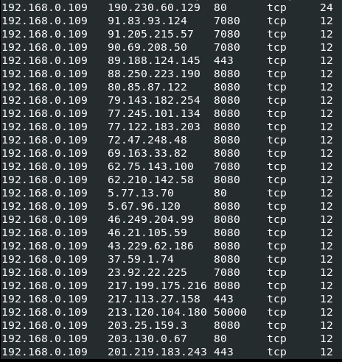
Detecting Beacons: Zeek
# zcat /usr/local/zeek/logs/2020-12-15/conn.*.log.gz | ./zeek-cut -Cd id.orig_h id.resp_h id.resp_p proto | awk 'BEGIN{ FS="\t" } { arr[$1 FS $2 FS $3 FS $4] += 1 } END{ for (key in arr) printf "%s%s%s\n", key, FS, arr[key] }' | egrep 'tcp' | egrep '192.168.0.109' | sort -nrk 5
Filtering by the WIN7 host shows a long list of easily grouped connection patterns
The presence of unusual ports such as 7080 cropping up repeatedly for different addresses, juxtaposed with similar connection numbers, strongly suggests beaconing
This warrants further investigation via the full conn log data for these connections.

Slide 33
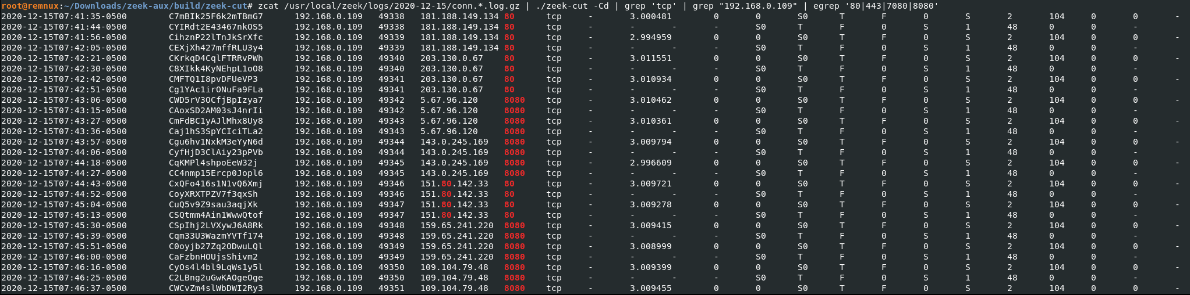
Detecting Beacons: Zeek
Filtering by source, destination ports, and protocol shows the concerning traffic previously discussed with more connection data
Note the sent and response bytes (48 and 104 respectively)
The response bytes will not be truly accurate as this server is running in a lab
What the 48 and 104 indicate however, is repeated transmission of the same data (or at least of the same chunk size)
Also note the session time that averages around 3 seconds
# zcat /usr/local/zeek/logs/2020-12-15/conn.*.log.gz | ./zeek-cut -Cd | grep 'tcp' | grep "192.168.0.109" | egrep '80|443|7080|8080'

Slide 34
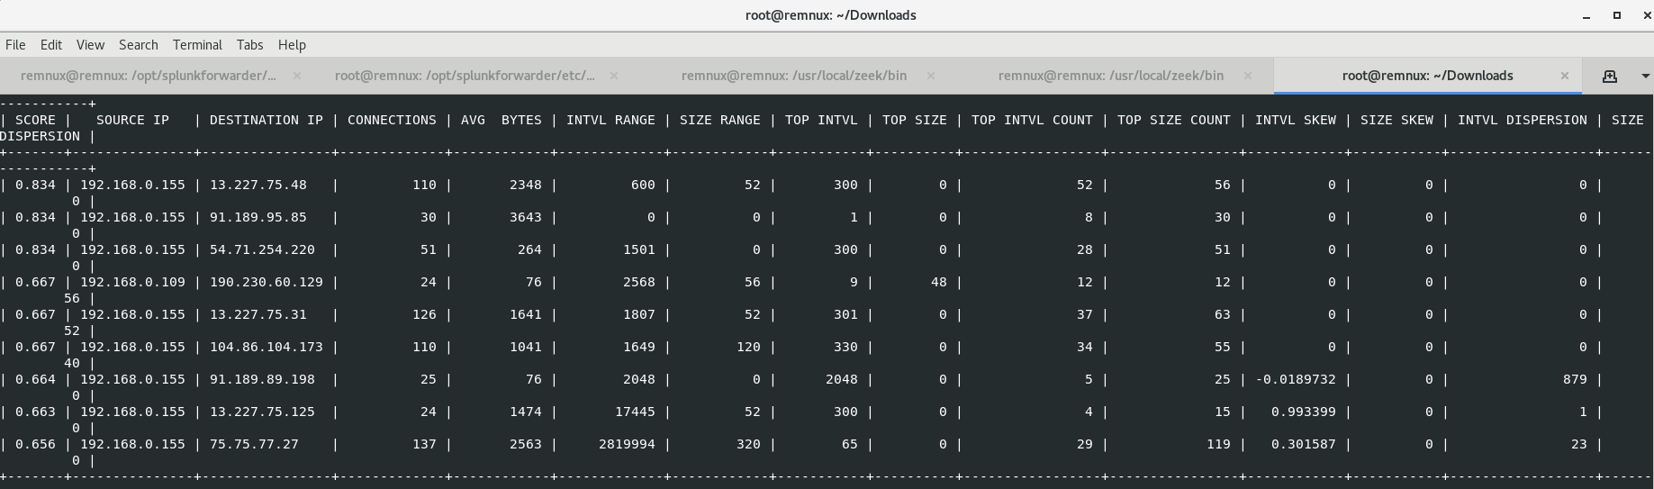
Detecting Beacons: RITA
Rita uses a score to denote accuracy. The closer to 1.0 the number is, the closer it is to being a ‘perfect’ beacon. This requires large datasets to be effective.
Often the address of interest is the higher score, but the logs did not have enough data to detect all of the beaconing traffic
As a result, the only beacon identified from the earlier results is 190.230.60.129
If the Emotet process was allowed to run longer, RITA’s results would include the other sessions in the previous slides
# rita show-beacons database1 -H

Slide 35
Questions?

Slide 36
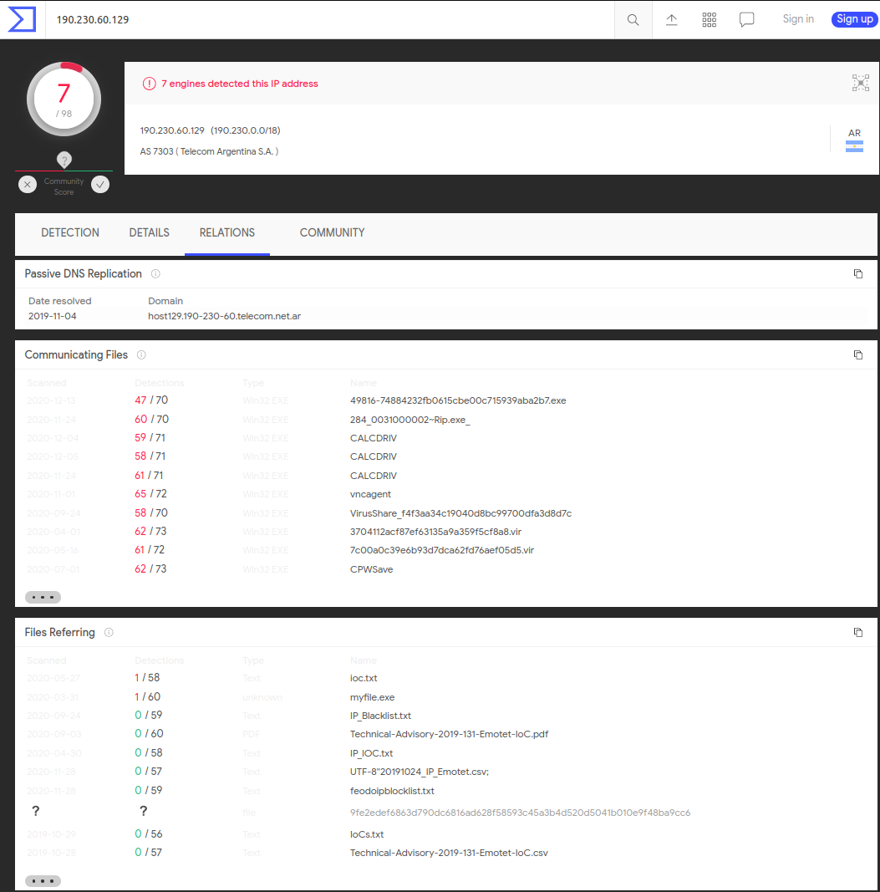
Investigating Potential C2
Taking 190.230.60.129 from RITA’s results and plugging it into Virus Total provides a panel with two useful elements:
Communicating Files
Files Referring
The top result for communicating files is an Emotet sample
Files Referring lists multiple Emotet related IoC lists
Remember that this is all contextual:
The weight of contextual data increases as occurrences of related evidence increase
In other words, this is of significant interest ONLY because of the beacon hunting performed earlier that identified this address – along with many others in a similar group

Slide 37
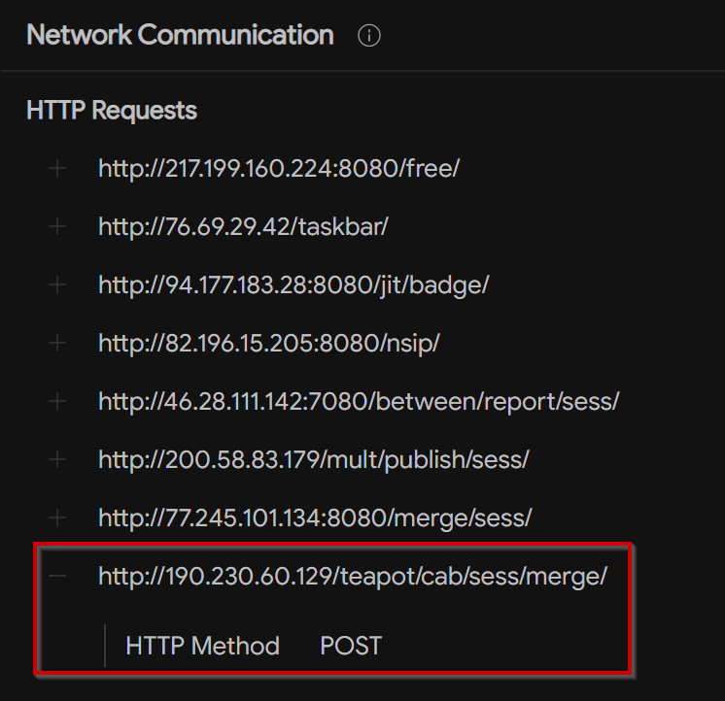
Investigating Potential C2
Communicating File
So what more can be gathered from Virus Total?
Pivoting to the top Communicating File’s Network Communication section reveals that the address was accessed via HTTP
At this point, you would search your HTTP logs for traffic to this address over port 80
Unfortunately, I did not run an HTTP server for this exercise – which is why logs do not exist for the traffic
If this traffic is NOT over 80, it is most likely not relevant to what VT is reporting
Another thing to note is URI pathing (and parameters if applicable)
Taskbar, jit, nsip…and teapot?
These are attributes of Emotet C2 traffic – otherwise known as network artifacts – that can be used later

Slide 38
Investigating Potential C2: When Hard Gets Harder
C2 servers are often hosted on otherwise legitimate infrastructure
IP addresses may be multitenant – meaning they route to multiple hosts
Webservers may be compromised and then used to host C2
This is easy to investigate when all the data is available over unencrypted application layer protocols – but what about TLS and other encryption?
When investigating a potential beacon, differentiating between the legitimate and malicious components can become tricky
If the connection is TLS based, limited data will be available
Under TLS, if the destination host is a legitimate web-front the URI pathing and passed parameters will not be visible. This makes determination difficult as a specific directory of the website may be compromised and holding the C2 receiver binary and commands.

Slide 39
Investigating Potential C2: When Hard Gets Harder
Easy steps first
Try googling the hostname and other metadata for current intel hits
Various intel producing organizations such as Recorded Future or RiskIQ may hold information that is useful in analysis
Now onto the hard steps
If the previous reports on the IP or domain have shown a significant amount of recent benign activity, this may point to a compromised web server
Use a service like Censys.io or Shodan to enumerate active services
Note inconsistencies in logic, like 2 different web proxies running
Note services running on the ports observed during internal traffic analysis
Attempt to connect to the suspect port and note the latency vs connecting to a known benign port
These steps are taken to try and further prove that what is being dealt with is likely command and control. When proxies are stood up on compromised servers, the requests will be chartered through a network of nodes to retrieve data. This delay analysis only works if another proxy is running with normal data as a baseline.
Caution: Always utilize an isolated and dedicated analysis machine when interacting with malicious infrastructure

Slide 40
Investigating Potential C2: To Beacon or not to Beacon?
Beacon analysis is problematic without large data sets and well documented/understood benign traffic. This is evidenced by RITA’s earlier failure to capture most true beacon traffic, while successfully identifying telemetry on the machine. For this reason, being able to investigate and rule out false beacons without live response is essential.
The easiest way to do this is through emulation
When implants beacon, the metadata produced can be used to retransmit traffic in a similar (or identical manner) to that of the original
Using HTTP as an example, imagine the following scenario:
The NSM tool has alerted to a potential beacon from 1.2.3.4 to http://bigcatdogs.com/shopping?cmVmcmVzaHJhdGU9MjBz. After looking at the IP address resolved, the SOC found that it had previously resolved to a number of malware related domains via Virus Total. The traffic is entirely GET requests of equal size with an interval of around 20 seconds. Sandbox screenshots show the site as being an online pet store. The SOC is unable to determine root cause and escalates it to you, the responding analyst.

Slide 41
Investigating Potential C2: To Beacon or not to Beacon?
First things first: what mistakes in conclusion did the SOC make?
Not recognizing this IP address as a multi-tenant during VT analysis
Assuming that this domain is malicious because of loose attribution to previous DNS records
What is missing from the SOC’s analysis?
Pertinent metadata like referrer and user-agent
Analysis of query and parameters
Traffic leading up to beaconing
Emulation!
After performing deeper analysis you find:
Google query for cat food
Windows 10 user-agent for chrome
Referrer of google.com/search?=cat_food
DNS queries for bigcatdogs.com shortly after performing the google search
The URI parameter decodes to refreshrate=20s – most likely indicating an interval for refreshing the page.
You generate a hypothesis that this website is most likely running a shopping cart refresh script that is creating the beaconing.

Slide 42
Investigating Potential C2: To Beacon or not to Beacon?
This is still missing one more piece of contextual evidence to seal the deal. Emulation is required to prove this hypothesis.
To emulate this traffic, you instruct the SOC to monitor traffic from your analysis workstation to http://bigcatdogs.com/shopping?cmVmcmVzaHJhdGU9MjBz. You change the user agent of your chrome instance to mirror that of the original. You head to this site and allow your machine to sit without intervention for around ten minutes.
The SOC finds that your traffic perfectly matches that of the original! The site uses a script to refresh the user’s shopping cart.
Another solution here would be to inspect the running scripts on the page – however this takes more effort and would ultimately return the same conclusion.

Slide 43
Questions?

Slide 44
References and Additional Reading
1.5.2 Custom Command and Control - Learning Malware Analysis [Book] (oreilly.com)
Investigating Command and Control Infrastructure (Emotet) – MalwareTech
Four Common Threat Hunting Techniques with Sample Hunts | LinkedIn
Introduction — Threat Hunter Playbook
Reversing Malware Command and Control: From Sockets to COM | FireEye Inc
c++ - UrlDownloadToFile to Memory - Stack Overflow
Attack Detection Fundamentals: Workshop #4 - C2 and Exfiltration – YouTube
Introduction to DNS Data Exfiltration - The Akamai Blog
Attack Detection Fundamentals: C2 and Exfiltration - Lab #2 (f-secure.com)
That’ll never work–we don’t allow port 53 out | Strategic Cyber LLC
Talos_Cobalt_Strike.pdf (talos-intelligence-site.s3.amazonaws.com) (cobaltstrike.com)
Outliers :: Threat Hunting Labs (activecm.github.io)
GitHub - inquisb/icmpsh: Simple reverse ICMP shell

