Slide 1
Mining Large Graph Databases
Vinay Chandragiri 120101018 Revanth Gopi 120101036

Slide 2
What is a Graph Database ? How Graph data is stored ? How it is analyzed ?
A database with an explicit graph structure plus an index for lookups. Used in areas where information about interconnectivity is important as data.
Hyperlinks
PageRank
Top 20 Pages
Text
Table
Title
PR
Raw
Wikipedia
< / >
Title
Body
< / >
Term-Doc
Graph
Topic Model
(LDA)
< / >
Word Topics
XML
Word
Topic
Discussion
Table
Community
Detection
User
Community
Editor Graph
Community
Topic
User
Disc.
User
Com.
Topic
Com.

Slide 3
Graph’s are Important over Relational Databases and over Key Value Stores.
RDB – Optimised for aggression
GDB – Optimised for connections
C2
B7
B3
B1
A3
B2
B3
A1
B4
C1
B4
B5
B1
A2
B5
C2
A3
B6
C3
C1
B7
A2
A1
C3
B6
B2
KVS – Optimised for simple lookups
GDB – Optimised for traversing connected data
K1
V1
K1
V1
K2
K2
V2
K1
K3
K2
V2
K3
V3
K1
K3
V3

Slide 4
Types of Patterns, Mining Methods and Applications for Large Graph Databases
Patterns : Basic , Multi Level & Multi dimensional , Extended
Mining Methods : Basic, Mining Interesting Patterns, Distributed & Parallel
Graph Mining
Frequent Subgraph Mining (FSM)
Variant Subgraph Pattern Mining
Applications of FSM
Indexing and Search
Apriori based
Approx. Methods
Clustering
Classification
Closed Subgraph Mining
Dense Subgraph Mining
Pattern Growth Based
Coherent Subgraph Mining
Recommendations
AGM
FSG
PATH
gSpan
MoFa
SPIN
N FFSM
Subdue
GBI
Close Graph
CSA
CLAN
CloseCut
Splat
Kernel Methods
gIndex

Slide 5
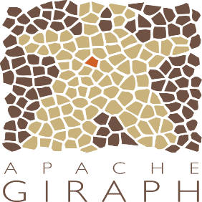




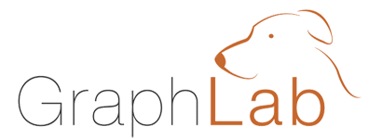
It is Difficult to Program and Use Graph Databases !!
Users must Learn, Deploy, and Manage multiple systems
Leads to brittle and often complex interfaces
It depends on the type of data, its size and properties to choose one of the above.

Slide 6
Thank you. 26-10-2015

